Slide 1
Phyre2
Dr. Lawrence Kelley
Structural Bioinformatics Group
Imperial College London

Slide 2
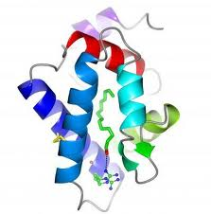
Phyre2
SVYDAAAQLTADVKKDLRDSW
KVIGSDKKGNGVALMTTLFAD
NQETIGYFKRLGNVSQGMAND
KLRGHSITLMYALQNFIDQLD
NPDSLDLVCS…….
Predict the 3D structure adopted by a user-supplied protein sequence

Slide 3
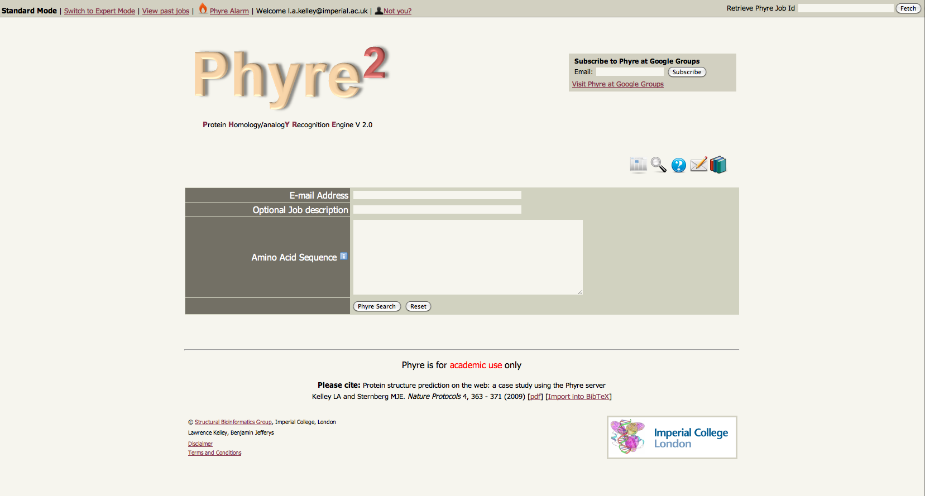

Slide 4
How does Phyre2 work?

Slide 5
Phyre2
ARDLVIPMIYCGHGY
Homologous sequences
User sequence
Search the 10 million known sequences for homologues using PSI-Blast.

Slide 6
Phyre2
HMM
ARDLVIPMIYCGHGY
User sequence
PSI-Blast
Hidden Markov model
Capture the mutational propensities at each position in the protein
An evolutionary fingerprint

Slide 7
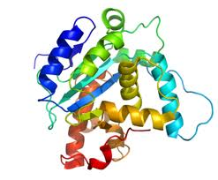
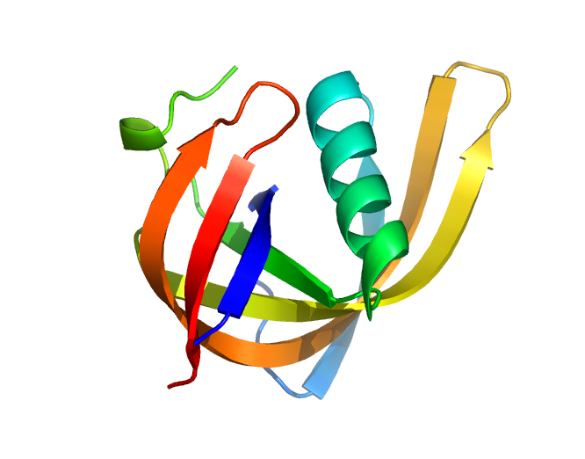
Phyre2
~ 65,000 known 3D structures

Slide 8
Phyre2
~ 65,000 known 3D structures

Slide 9
Phyre2
Extract sequence
HAPTLVRDC…….
~ 65,000 known 3D structures

Slide 10
Phyre2
Extract sequence
HAPTLVRDC…….
~ 65,000 known 3D structures
PSI-Blast

Slide 11
Phyre2
Extract sequence
HAPTLVRDC…….
~ 65,000 known 3D structures
PSI-Blast
HMM
Hidden Markov model
for sequence of KNOWN structure

Slide 12
Phyre2
HMM
HMM
HMM
~ 65,000 known 3D structures
~ 65,000 hidden Markov models

Slide 13
Phyre2
Hidden Markov Model Database of
KNOWN
STRUCTURES
~ 65,000 known 3D structures

Slide 14
Phyre2
HMM
ARDLVIPMIYCGHGY
PSI-Blast
Hidden Markov model
Capture the mutational propensities at each position in the protein
An evolutionary fingerprint

Slide 15
Phyre2
HMM
ARDLVIPMIYCGHGY
PSI-Blast
Hidden Markov Model DB of KNOWN
STRUCTURES
HMM-HMM
matching
Alignments of user sequence to known structures
ranked by confidence.
ARDL--VIPMIYCGHGY
AFDLCDLIPV--CGMAY
Sequence of known structure

Slide 16
Phyre2
HMM
ARDLVIPMIYCGHGY
PSI-Blast
Hidden Markov Model DB of KNOWN
STRUCTURES
HMM-HMM
matching
ARDL--VIPMIYCGHGY
3D-Model
AFDLCDLIPV--CGMAY
Sequence of known structure

Slide 17
Phyre2
HMM
ARDLVIPMIYCGHGY
PSI-Blast
Hidden Markov Model DB of KNOWN
STRUCTURES
Very powerful –
able to reliably detect extremely
remote homology
HMM-HMM
matching
Routinely creates accurate models even
when sequence identity is <15%
ARDL--VIPMIYCGHGY
3D-Model
AFDLCDLIPV--CGMAY
Sequence of known structure

