Slide 1
Poing
A dynamic model of protein folding
Simplified representation
Fast
Novel solvent model
Extensible
Notes:
For some years we have been developing a protein structure and folding model called poing.
The original intention was for this to be a tool for protein structure prediction.
It does this through modelling a folding pathway, using coarse-grained molecular dynamics.
It models synthesis of a protein by a large, heavy “ribosome”, as a computational shortcut to a compact conformation.
The method is very fast, and it is simple to add additional cellular effects to the model.

Slide 2
Poing
structure simplification
Small hydrophilic sidechain
Backbone
C-alpha
Protein backbone
Large hydrophobic sidechain
Notes:
The protein is reduced to a string of Calpha beads with sidechain centroid particles attached

Slide 3
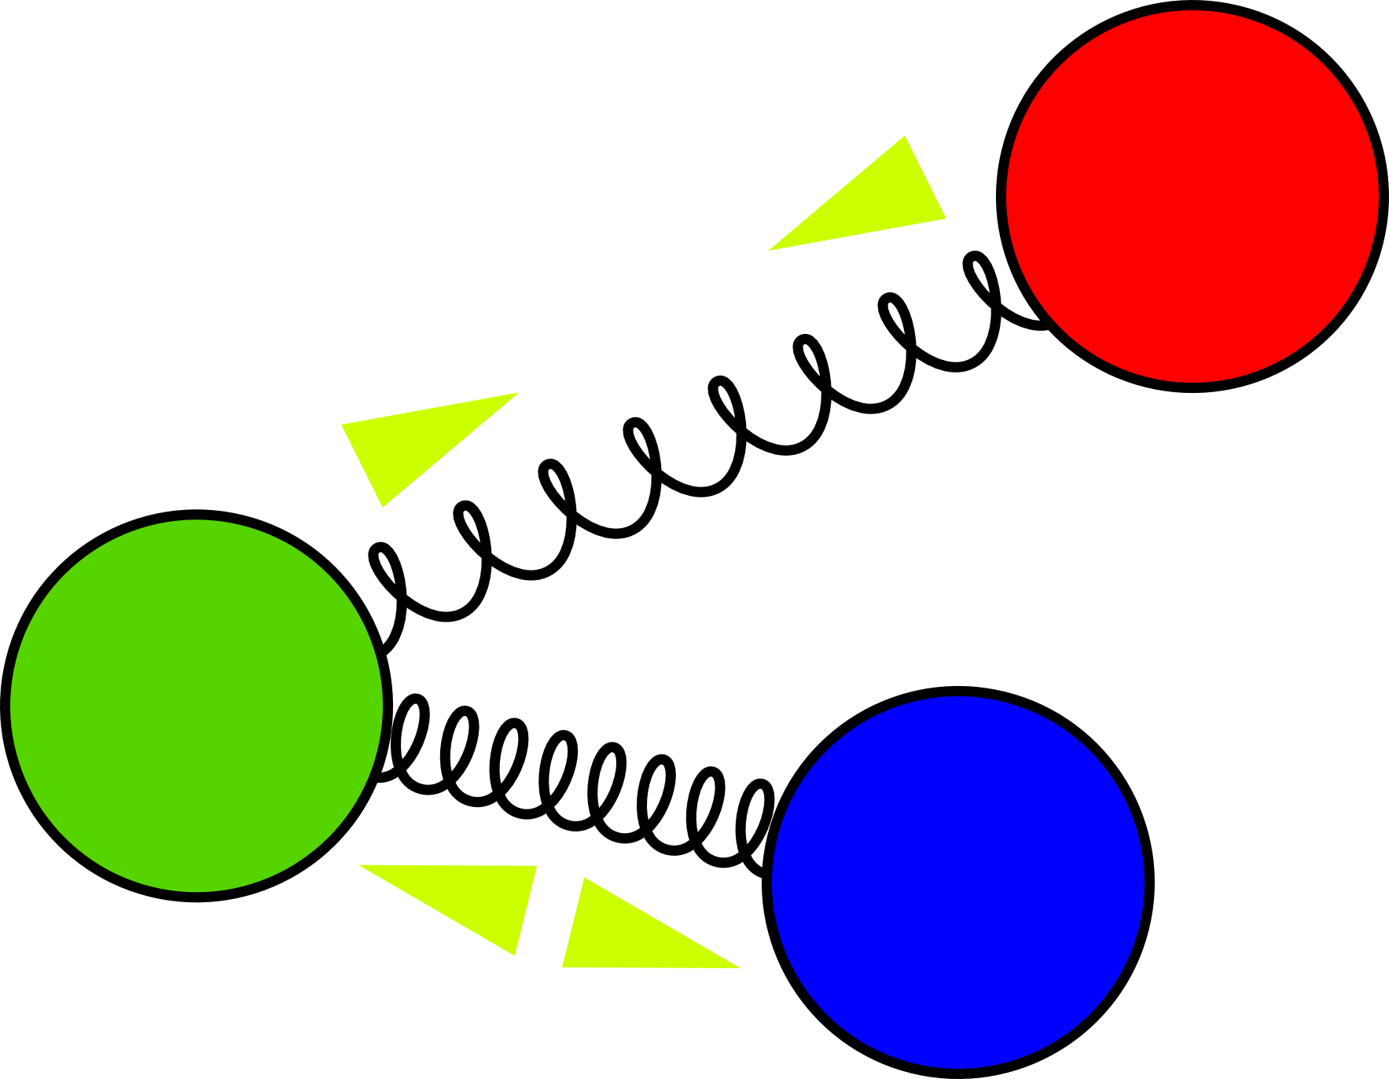
Poing
linear elastic springs
Notes:
Most forces in the model are simple linear elastic springs.
It two particles are too far apart, forces act to gradually bring them together.
If they are too close, forces act to push them apart.

Slide 4
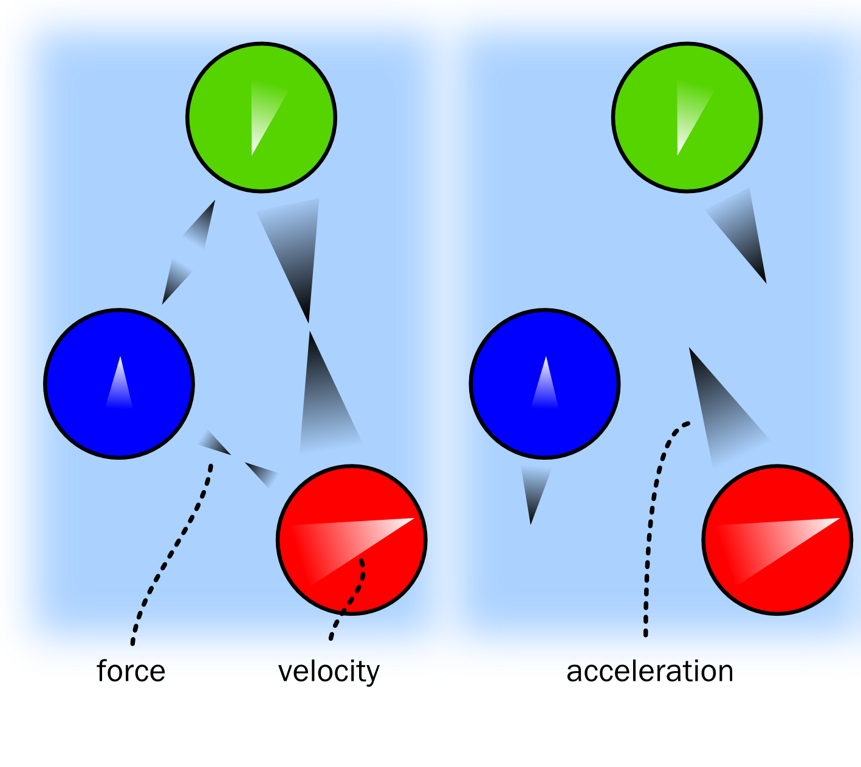
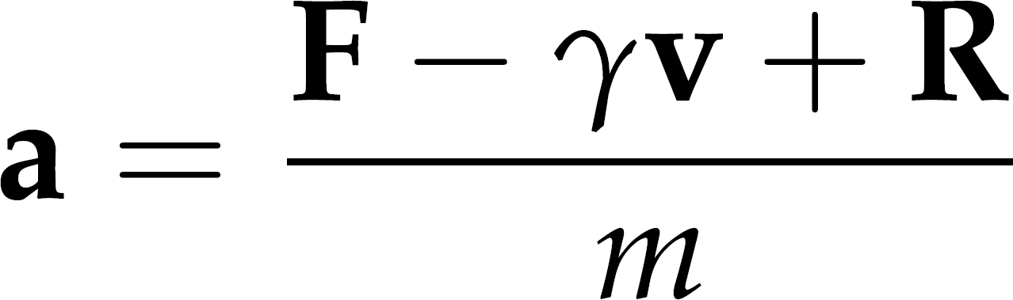
Poing
Langevin dynamics is F = ma ... PLUS a model for solvent
a: acceleration
F: net force (sum of many forces)
γ: drag factor
v: current particle velocity
R: randomly distributed vector
m: particle mass
Notes:
This is the formula for calculating the acceleration which is at the centre of Langevin modelling.
It is mostly just a rearrangement of F=ma
In addition to a force-field, this is a drag factor opposing the current motion of the particle, simulating the drag of solvent.
R is a randomly distributed vector which simulates the thermal input from the solvent
m is the mass of the particle, so larger particles have a lower acceleration than small ones, for a given set of forces.

Slide 5
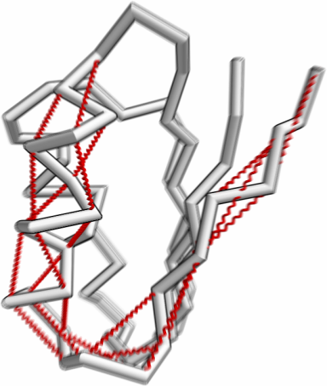
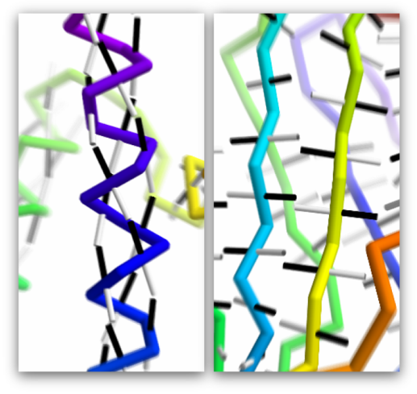
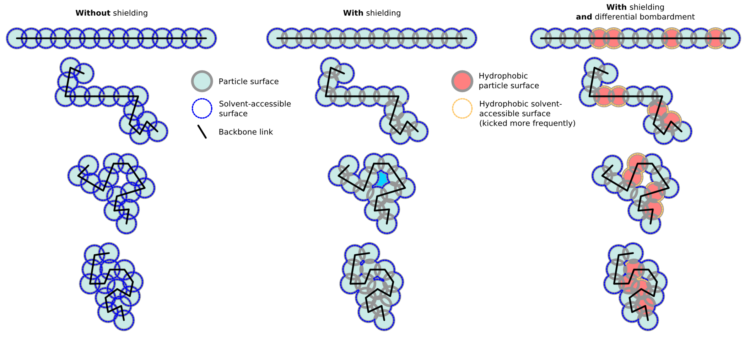
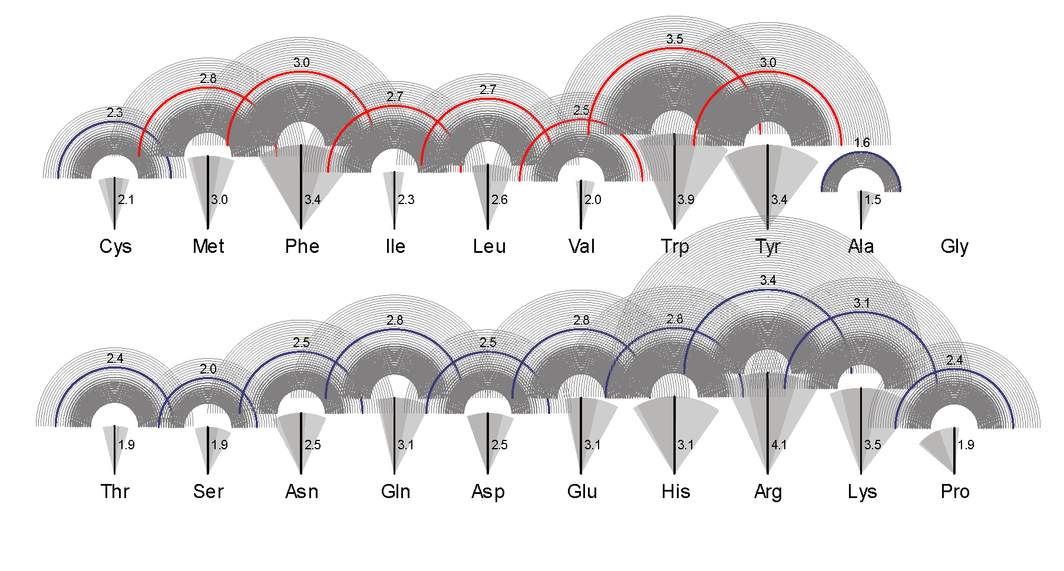
Poing
Secondary structure and hydrogen bonding
Solvent model leads to
hydrophobic collapse
Sidechain size and shape
Notes:
There is not enough time to give the other details of the model.
Suffice to say it has all the usual features you’d expect in a model for protein structure.
Springs keep the backbone together, and in a conformation which agrees with predicted or assigned secondary structure.
Sidechains are attached to the backbone, in the correct orientation, and kept away from each other by a steric force.
Our model for the water is somewhat novel, and may be the feature of a future publication.
The hydrophobic effect is part of the solvent model.

Slide 7
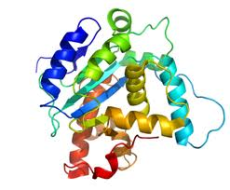
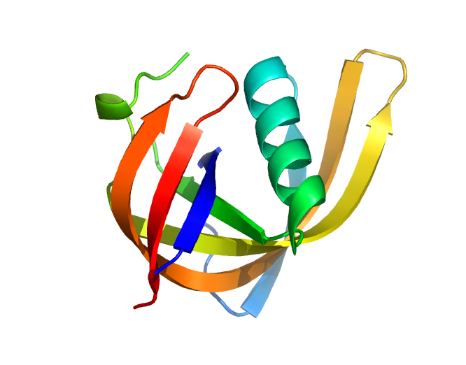
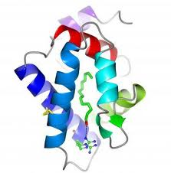
Phyre + Poing
HMM
ARNDLSLDLVCS…….
PSI-Blast
Hidden Markov Model DB of KNOWN STRUCTURES
HMM-HMM
matching
FINAL MODEL
POING: Synthesise from virtual ribosome.
Springs for constraints. Ab initio modelling
of missing regions.
Extract pairwise
distance constraints

Slide 8


Protein Folding Requires Crowd Control in a Simulated Cell.
Jefferys BR, Kelley LA and Sternberg MJE Journal of Molecular Biology (2010) Volume 397, Issue 5, 16 April 2010, Pages 1329-1338

