Slide 1
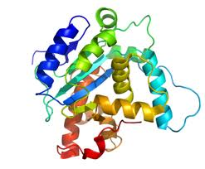
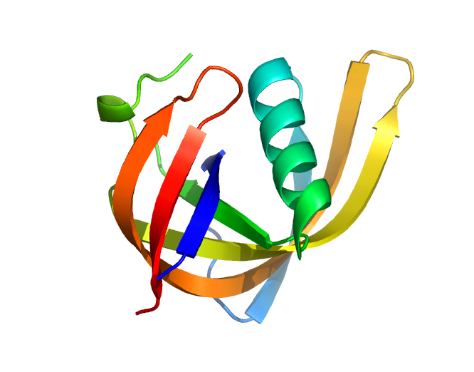
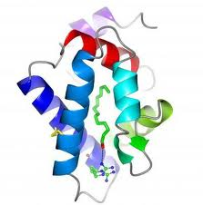
Phyre2: PhyreAlarm
PSI-Blast vs sequence database
User sequence
HMM
Hidden Markov model
of user sequence
SVYDAAAQLTADVKKD…….
Newly solved PDB
Structures added WEEKLY
Newly added structure HMMs
hmm-hmm matching
Yes
Confident hit?
Perform full Phyre modelling
No
Email results
New 3D model
Try again next week

