Slide 1
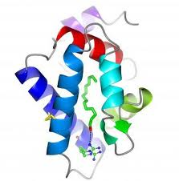
Phyre2: BackPhyre
User structure
Extract sequence and
Secondary structure information
SVYDAAAQLTADVKKDLRDSW
KVIGSDKKGNGVALMTTLFAD
NQETIGYFKRLGNVSQGMAND
KLRGHSITLMYALQNFIDQLD
NPDSLDLVCS…….
Rank | Hit | Confid-ence
1 | Gi…
2 | Gi..
3 | Gi..
. | .
. | .
PSI-Blast vs sequence database
Hidden Markov Model DB of Genomes
HMM
Hidden Markov model of user structure
hmm-hmm matching
Ranked list of genome hits

