Slide 1

PINALOG Protein Interaction Network Alignment and its implication in function prediction and complex detection
Hang Phan
Prof. Michael J.E. Sternberg
Division of Molecular Biosciences
Imperial College London
PhD Research Day April 1st 2011

Slide 2
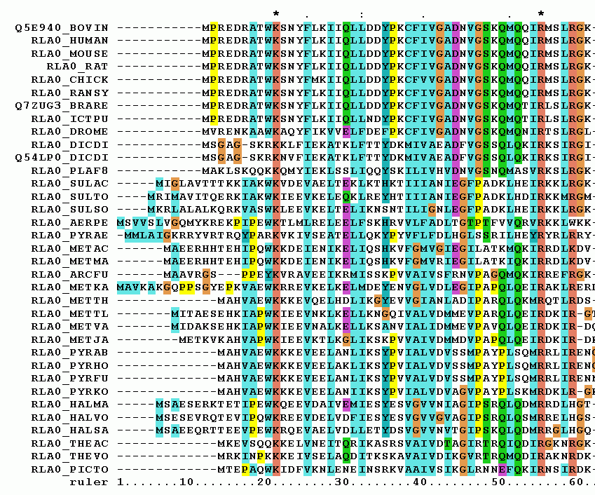
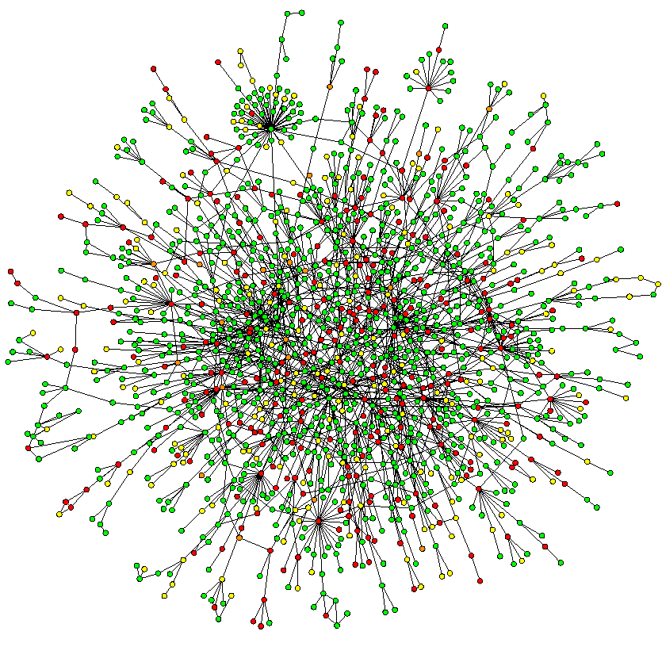
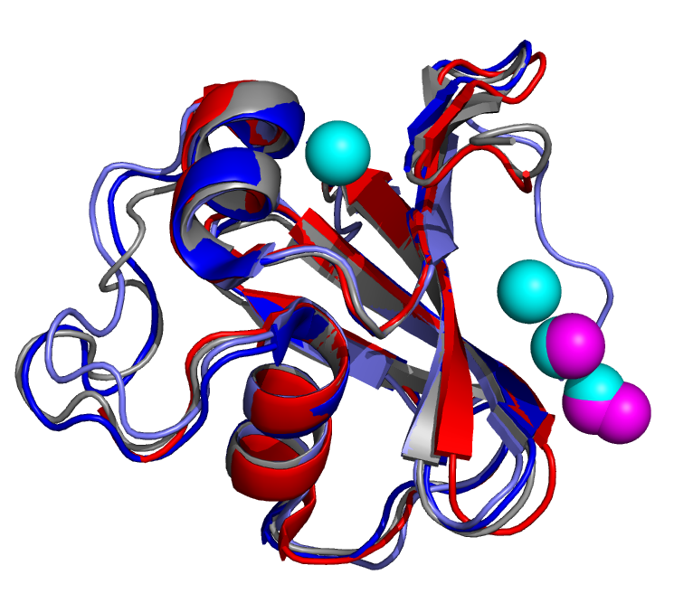
Comparison in biology
Protein interaction network
(PIN)
Notes:
Comparison of sequences and structures have had a central role in bioinformatics

Slide 3
Network alignment methods
Analogous to sequence alignment methods:
Global alignment methods: Greamlin, IsoRank
Local alignment methods: PathBLAST, MAwiSH
Pairwise alignment and multiple alignment

Slide 4
PINALOG
Principles
Global alignment
Large equivalenced subgraphs
Equivalence includes:
Network structure
Sequence similarity
Function similarity
Modules/ complexes in PIN are likely to be conserved across species
Detect possible modules in input networks and align these first, then expand.

Slide 5
PINALOG - Method
Community detection
Community mapping
Extension mapping
PIN A
PIN B
Core pairs
Mapped
core
A-N
B-P
C-M
D-Q
E-R
F-S
G-T
PIN A
Core’s first neighbour
PIN B
Core’s first neighbour
Map these

Slide 6
Protein similarity measures
Sequence similarity: BLAST score
Function similarity: estimated by similarity of GO terms associated with proteins
Combination of sequence and function similarity
Θ is automatically calculated by
Θ =1- C / ( M + N)
Where
C: number of reciprocal best BLAST hits of species A and B
A: number of proteins in species A
B: number of proteins in species B
Notes:
The closer the two species, the larger C gets, the smaller theta, -> less weight on sequence similarity

Slide 7
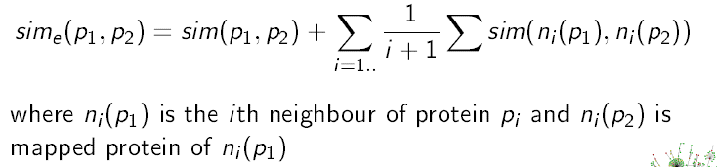
Protein similarity measures
Topological similarity: implicitly included in extension process by awarding protein pairs with similar equivalenced neighbourhood

Slide 8
PINALOG – Method details
PINA
Candidates for extension mapping, first neighbour of proteins in core
 | 2.1 | 1.3
 | 0.8 | 2.5
 | 0.9 | 2.3
PIN A | PIN B
I | X
H | Y
J | U
PINB
Communities
Score(I,X) = s(I,X) + ½ s(A,N)
Extension mapping of candidates, add to core and repeat

Slide 9
Alignment result assessment
No gold standard for alignment quality
Assessment method:
Conserved interactions: number, conserved ratio
Number of mapped protein pairs belonging to homologous clusters

Slide 10
Alignment results
HUMAN vs. YEAST PIN
 | N pairs | N conserved interaction | N Homologene pairs | N Inparanoid pairs
PINALOG_1 | 3,949 | 3,388 | 770 | 497
PINALOG auto | 5,223 | 3,319 | 697 | 454
IsoRank | 5,674 | 717 | 227 | 165
PINALOG_1: PINALOG using sequence and network topology
PINALOG auto: PINALOG also using function in alignment
IsoRank: Singh et al. Proc. Natl. Acad. Sci. USA, 105:12763-12768.
Automaticcally detected ortholog groups
Homologene : http://www.ncbi.nlm.nih.gov/homologene
Inparanoid:
http://inparanoid.sbc.su.se/cgi-bin/index.cgi

Slide 11
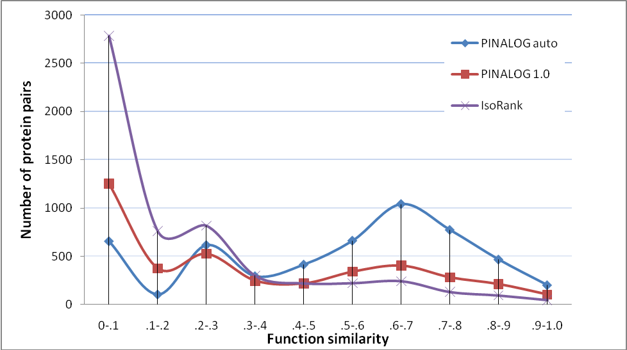
Function similarity of mapped protein pairs
Notes:
Please put only 2 graphs theta = auto theta = 1
Need to have larger text for axes. Maybe transfer to excel to do graphs

Slide 12
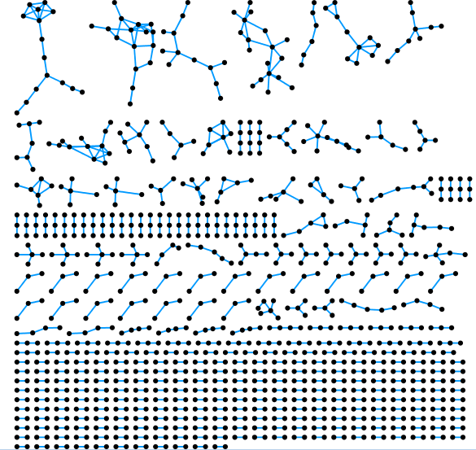
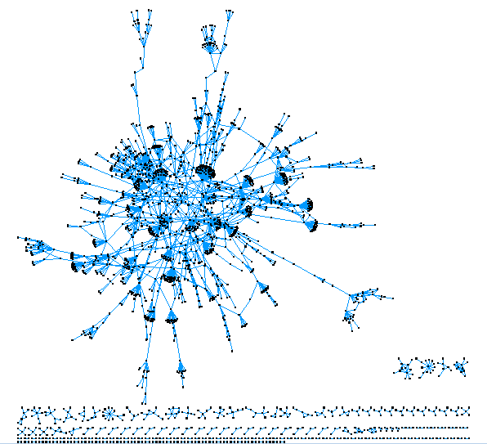
Conserved graphs
IsoRank conserved graph
PINALOG conserved graph
717 conserved interactions
3,388 conserved interactions
No large networks equivalenced

Slide 13


Function prediction by PINALOG
Comparison with PSI-BLAST prediction for GO Biological Process
PINALOG prediction from yeast interactome, PSI-BLAST prediction from entire UniprotKB
Better Recall at the similar level of Precision
 | PINALOG | PsiBlast
Recall | 0.14 | 0.07
Precision | 0.28 | 0.29

Slide 14
Conserved network analysis (1)
Cluster conserved network of human PIN by protein function
Assess overlap of clusters with known protein complexes in CORUM database
Human CORUM Core complexes | number of complexes | number of proteins in clusters | number of proteins in complexes | coverage rate
PINALOG auto all complexes | 251 | 1,179 | 1,471 | 0.80
PINALOG_1 all complexes | 223 | 914 | 1,131 | 0.81
Notes:
Clustering conserved network of human PIN by protein functions
Assess overlap of clusters with known protein complexes
Map clusters to yeast PIN, check overlap with known complexes
Assess functional correspondence of

Slide 15
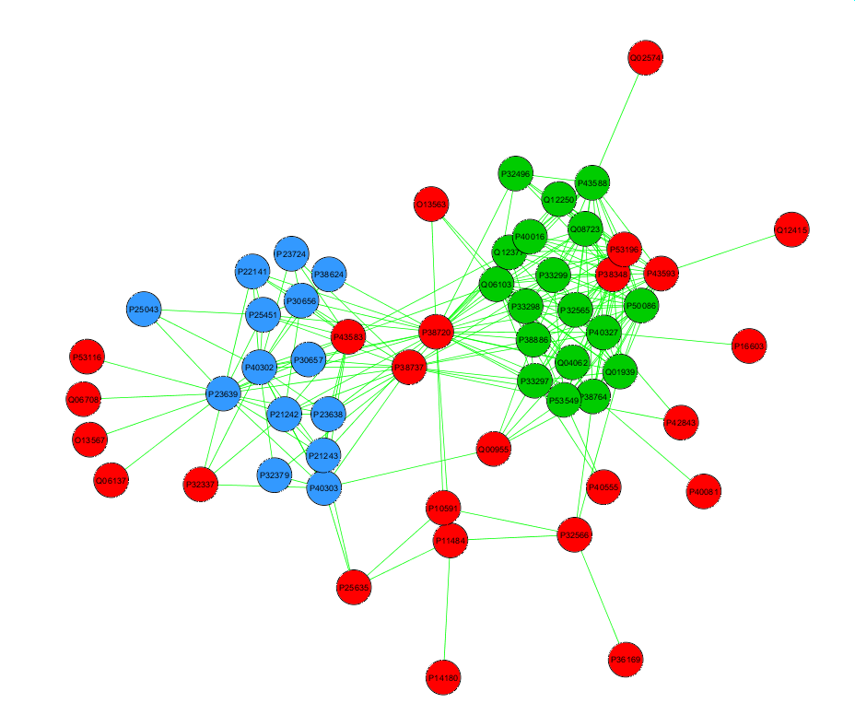
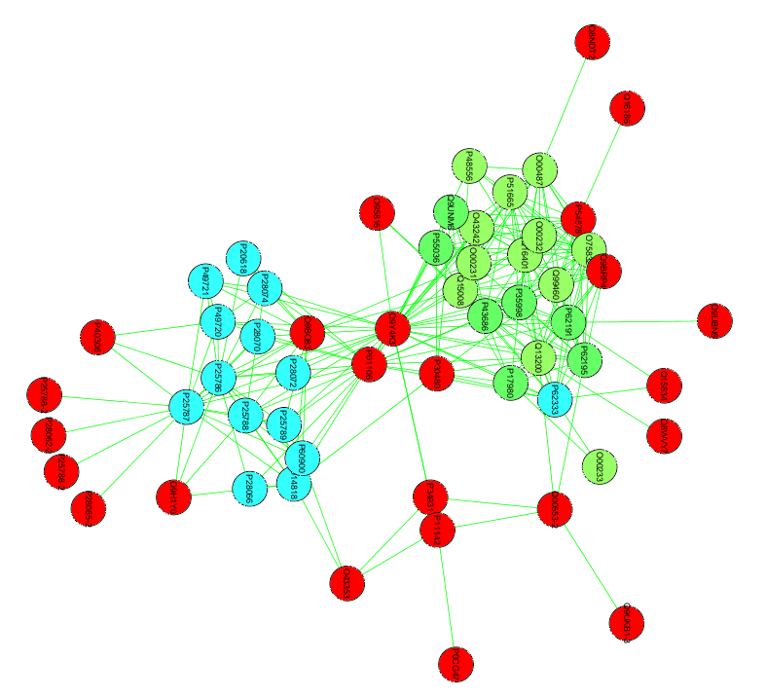
Conserved network analysis(2)
HUMAN – Cluster 12
YEAST – Map of cluster 12
19/22S Regulator
PA700
20S proteasome
20S proteasome

Slide 16
Conclusions
PINALOG is a novel network alignment focusing on functional equivalence.
Superior to IsoRank in quality of network alignment
Can predict components of protein complexes
Provide enhanced functional annotation in absence of homology
An alternative to network alignment methods for the bioinformatics community

Slide 17
Acknowledgement
I would like to thank the Wellcome Trust for generous funding

Slide 20
Function similarity by GO term semantic similarity
Semantic similarity(1): based on information content(IC) of terms
IC of term c: , p(c) is the freq. of c in the corpus
Similarity measures:
Relevance:
c_{A} is the most informative common ancestor

Slide 21
Semantic similarity examples
Total 500 proteins annotated
500
 | GO₃ - GO₄ | GO₃ - GO₃ | GO₁ - GO₄ | GO₁ - GO₂
c_{A} | GO₁ | GO₃ | GO₁ | GO₀
IC(c_{A}) | 1.009 | 2 | 1.009 | 0
sim_{Rel} | 0.503 | 0.990 | 0.692 | 0
GO₀
49
98
GO₁
GO₂
5
12
GO₃
GO₄
Notes:
Change graph and text

Slide 22
Function similarity
Schlicker’s *similarity of two proteins
Protein A: annotated with terms a₁, a₂, ... a_{n}
Protein B: annotated with terms b₁, b₂, ... b_{n}
Function similarity = max {rowScore, columnScore}
rowScore = 1/m ∑y_{i}
columnScore = 1/n ∑x_{i}
 | a₁ | a₂ | a₃ |  |  | a_{n} | _{Max Row}
b₁ |  |  |  |  |  |  | y₁
b₂ |  |  |  |  |  |  | y₂
b_{m} |  |  |  |  |  |  | y_{m}
_{Max column} | x₁ | x₂ |  |  |  | x_{n}
*Schlicker et al.2006
BMC Bioinformatics
doi: 1471-2105-7-302.

