Slide 1


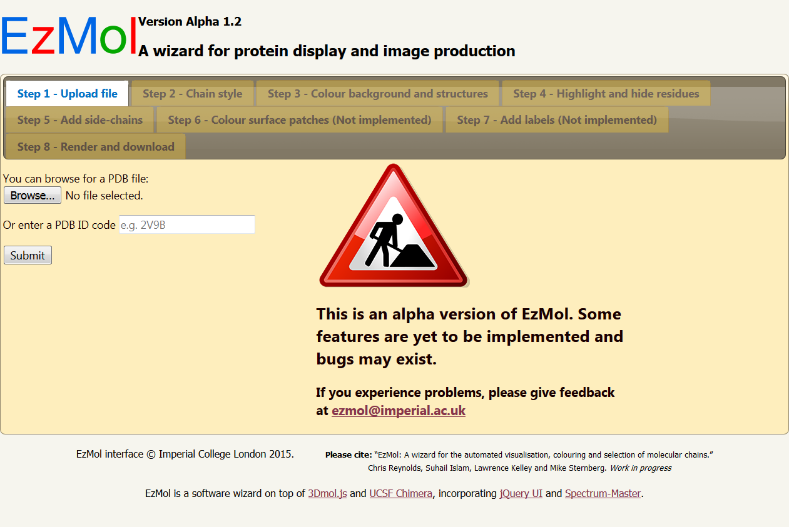
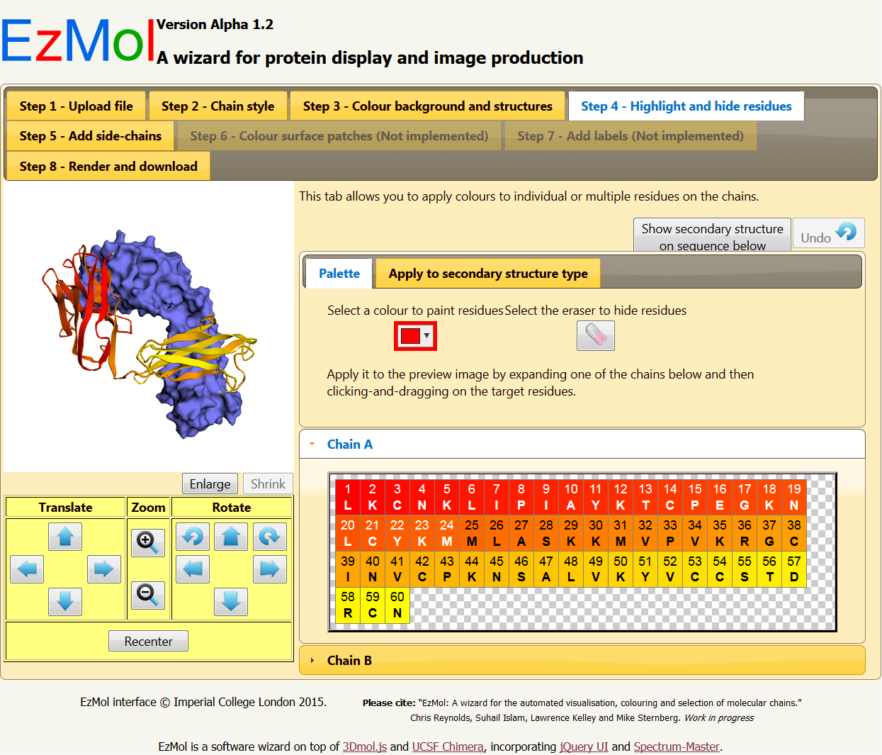
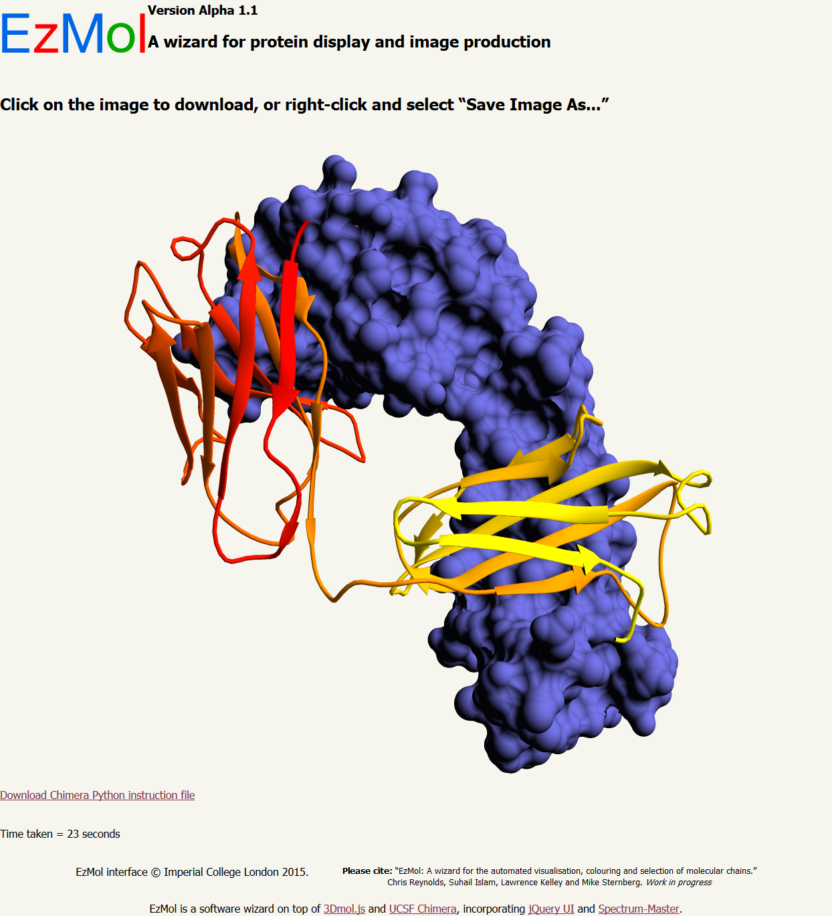
EzMol
A wizard for the automated visualisation, colouring and selection of molecular chains.
Centre for Integrative Systems Biology and Bioinformatics,
Department of Life Sciences.
Chris Reynolds, Suhail Islam, Lawrence Kelley and Mike Sternberg.
Specification
Client side
Server side
Why do we need another molecular visualisation tool? PyMol and Chimera alone have over 20,000 citations demonstrating the widespread use of protein graphics. However, our experience has convinced us that there is a major requirement for a graphics program that:
Is simple to use, with minimal confusing menus.
Requires no command line input.
Rapidly performs a carefully-identified limited set of tasks addressing the most common molecular visualisation requirements.
Acts as a software wizard, leading a user step-by-step through a very focussed set of options.
Requires no local software other than a web browser that is HTML5- and JavaScript-enabled.
Is cross-browser and multi-platform compatible.
Rapidly produces publication quality images.
Perl program
Figure 1. EzMol launch page.
3Dmol.js
JavaScript layer
Integrated technology
3Dmol.js generates a molecular viewer preview pane (top-left of Figure 2) which can be manipulated with the mouse.
Spectrum.js colorpicker allows selection of colours from a palette.
JQuery handles tabs and accordions in the layout.
UCSF Chimera models the final adjusted protein structure, and POV-RAY ray-traces it to give a high-resolution publication-quality image (Figure 3).
Design wizard
Figure 2. EzMol design wizard page.
An alpha-version of EzMol is available for inspection at http://sn.im/ezmol.
On the launch page (Figure 1), users can either upload a coordinate file in PDB format or retrieve a file from the PDB via its ID. A custom design wizard is generated (Figure 2), including a representation of the structure in 3Dmol.js.
EzMol provides intuitive options for chain display, adjusting the colour of entire chains and selected residues, adding side chains and generating solvent excluded surfaces for individual chains. EzMol provides stick, ribbon and surface representations.
Selection of display regions, toggling of side chains and colour selection are provided by windows similar to date selection on many internet booking sites (Figure 2).
The final render can be performed in resolutions suitable for slides or publications, and with a transparent background.
Perl program
UCSF Chimera
Figure 3. EzMol rendering page.

