Slide 1



Christopher Reynolds
Supervisor: Prof. Michael Sternberg
Bioinformatics Department
Division of Molecular Biosciences
Imperial College London

Slide 2
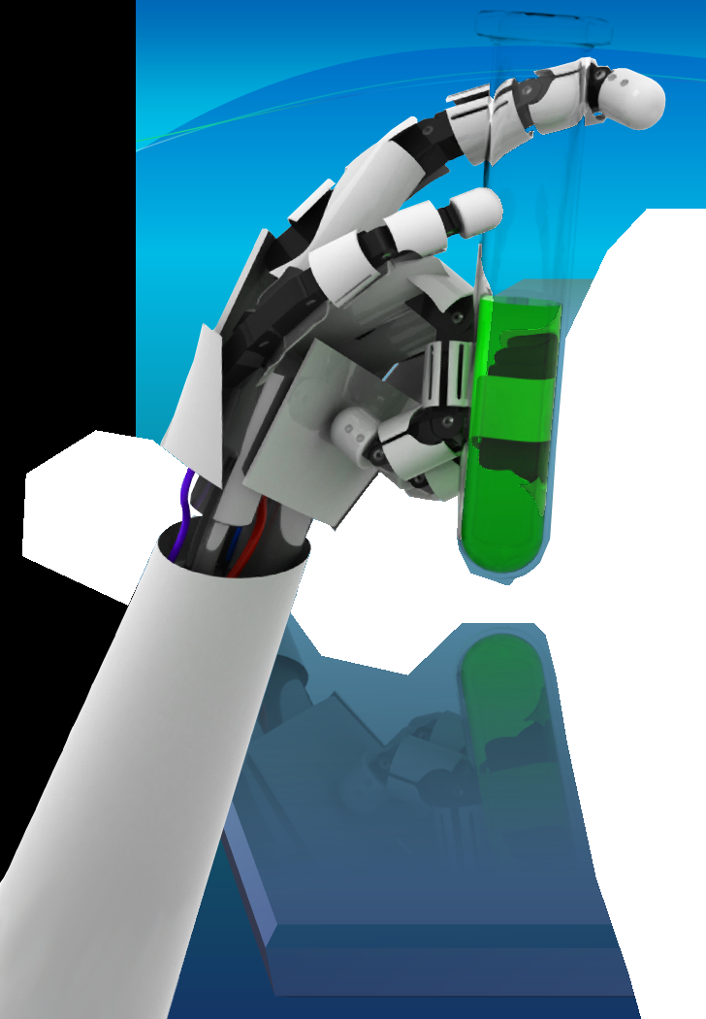
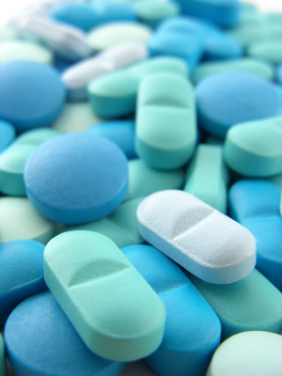

Integrating logic-based machine learning and virtual screening to discover new drugs.

Slide 3

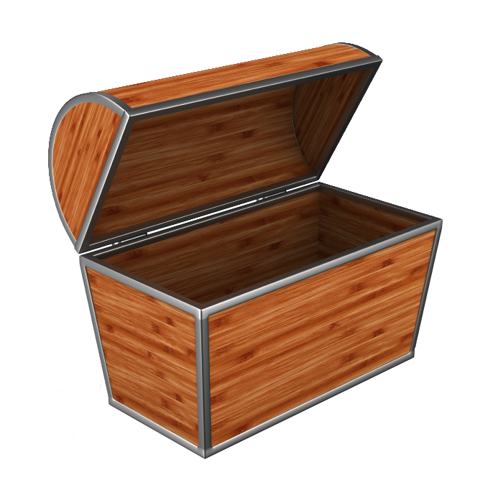
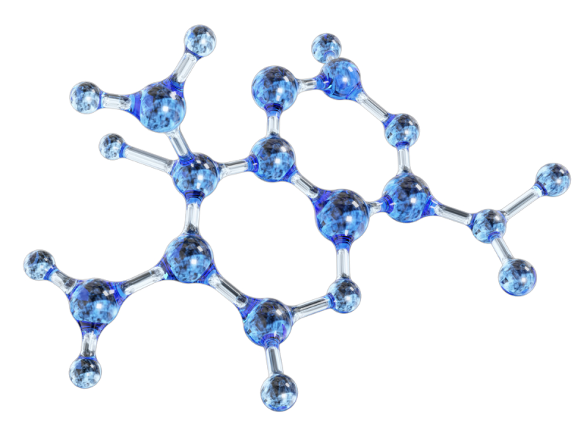

Slide 4

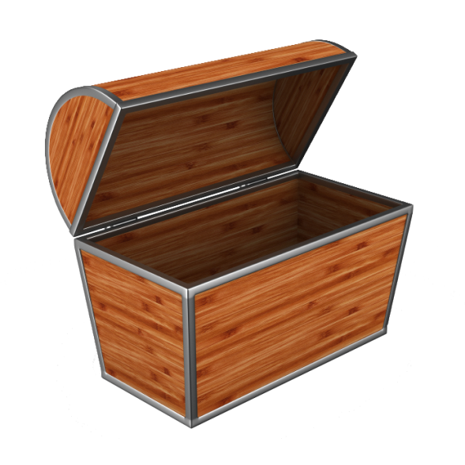
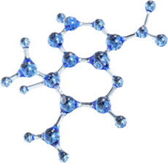

Slide 5
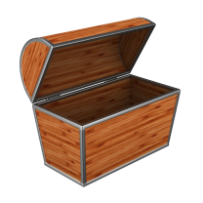

Slide 6
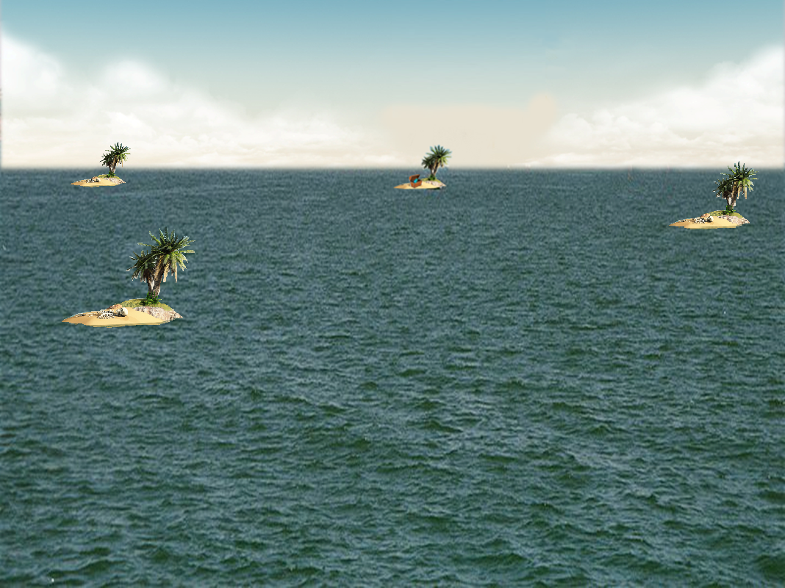

Slide 7
INDDEx™
Investigational Novel Drug Discovery by Example.
A proprietary technology developed by Equinox Pharma that uses a system developed from Inductive Logic Programming for drug discovery.
This approach generates human-comprehensible weighted rules which describe what makes the molecules active.
In a blind test, INDDEx™ had a hit rate of 30%, predicting around 30 active molecules, each capable of being the start of a new drug series.

Slide 8
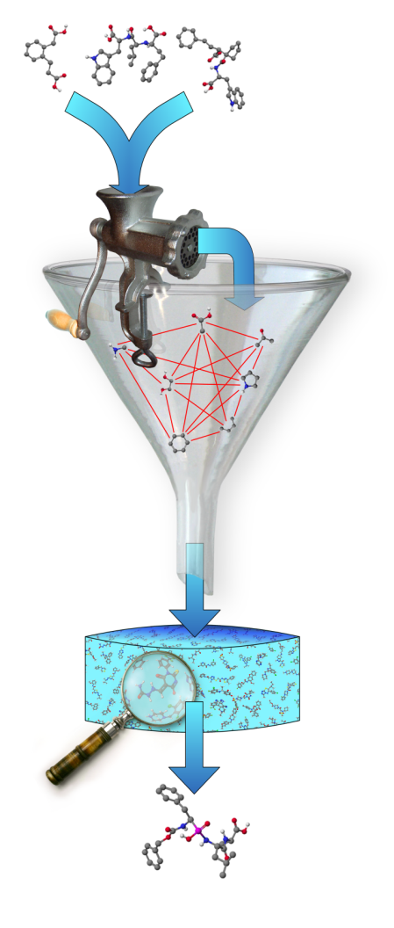
Observed activity
Fragmentation of molecules into chemically relevant substructure
Inductive Logic Programming generates QSAR rules
Screens model against molecular database
Novel hits

Slide 9
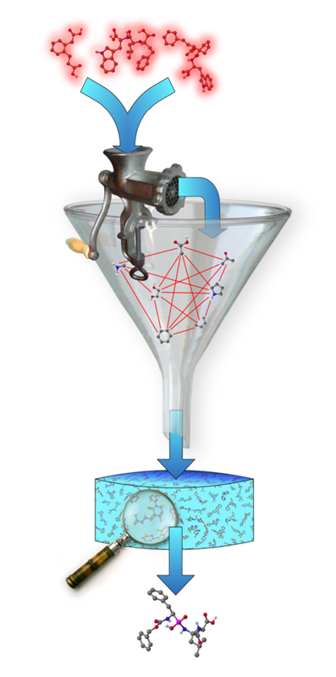

Slide 11
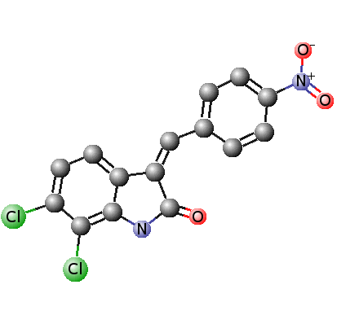
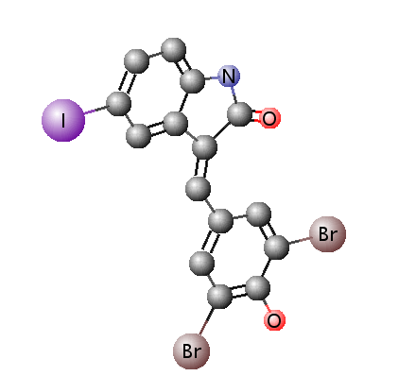
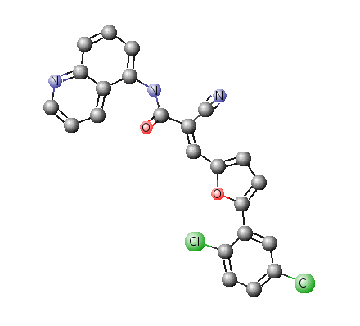
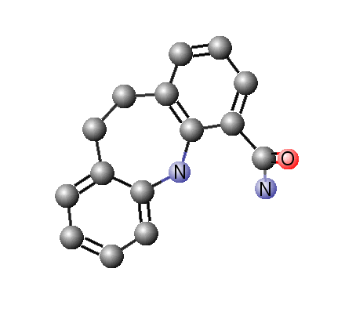
Dataset

Slide 12
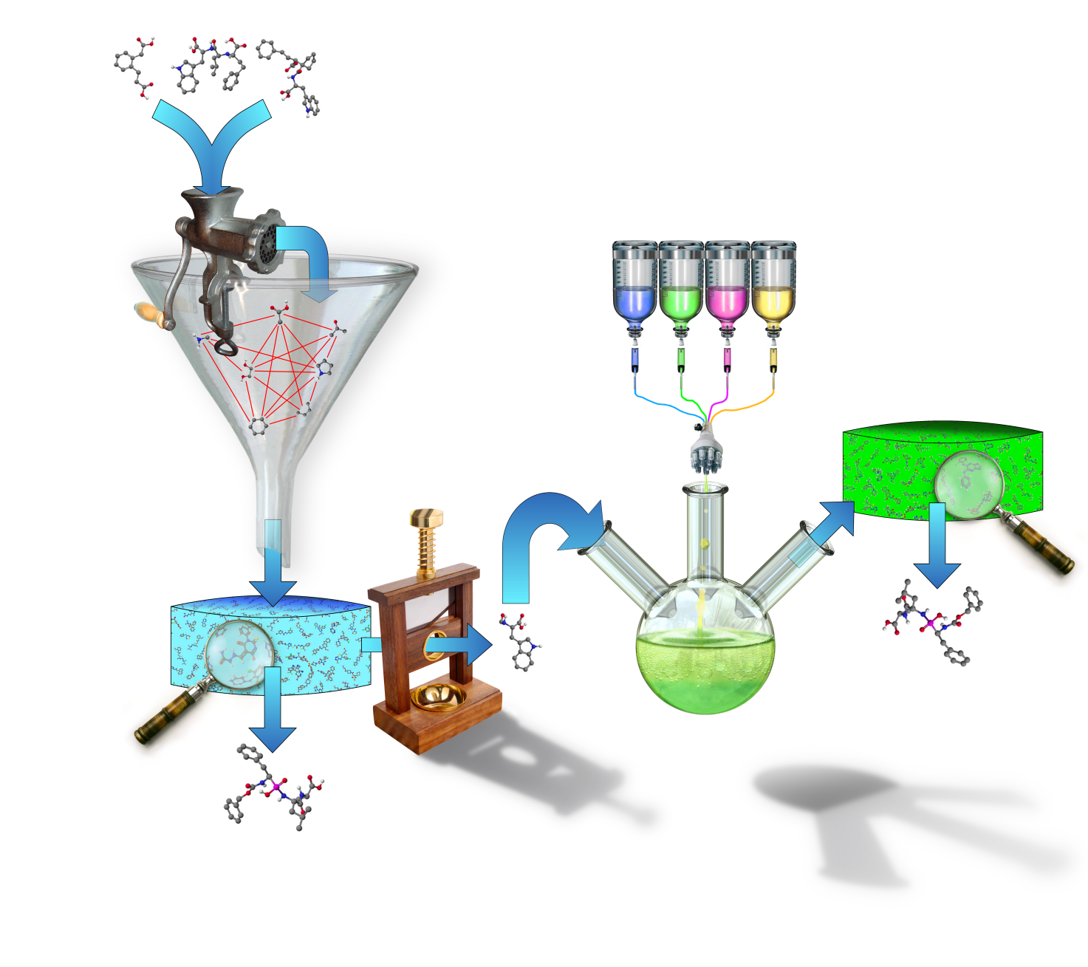

Slide 13
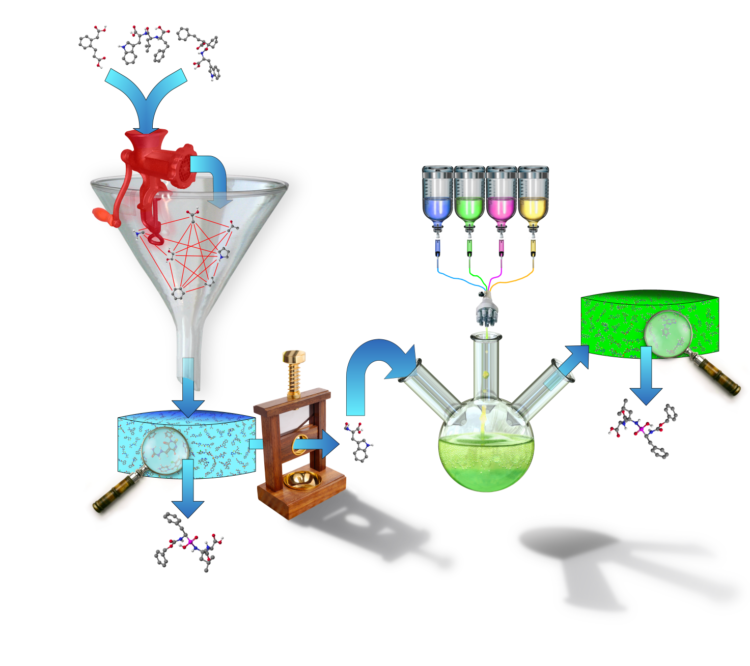

Slide 15
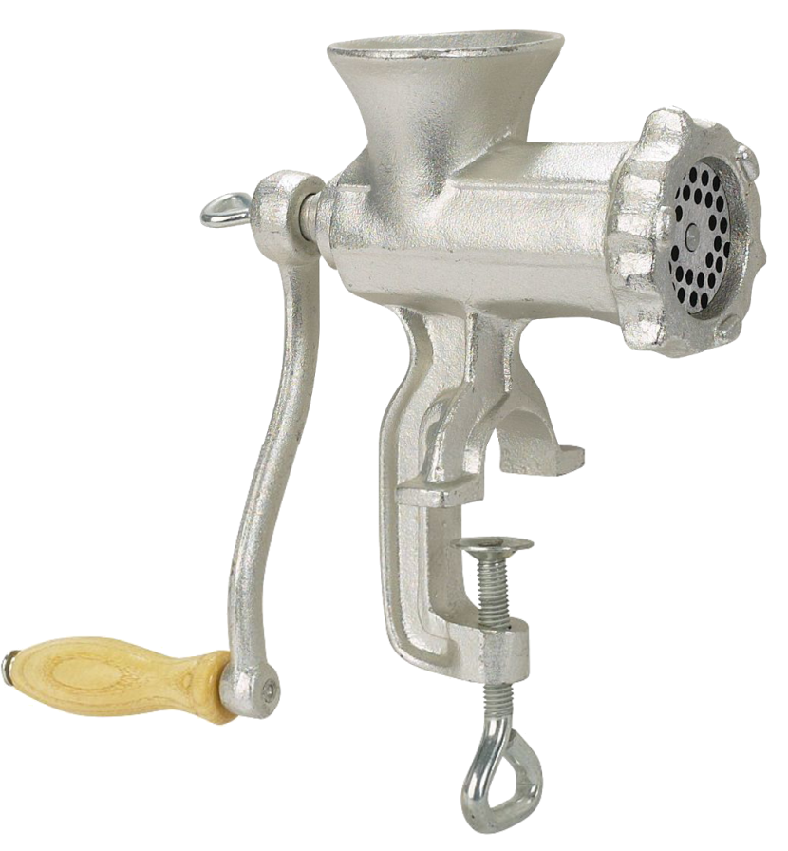
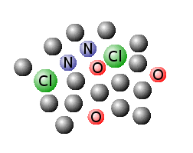
Fragmentation
Molecules broken into chemically relevant fragments.
Simplest fragmentation is to break the molecule into its component atoms.
More complex fragmentations break the molecule into fragments relating to hydrophobicity and charge.

Slide 17
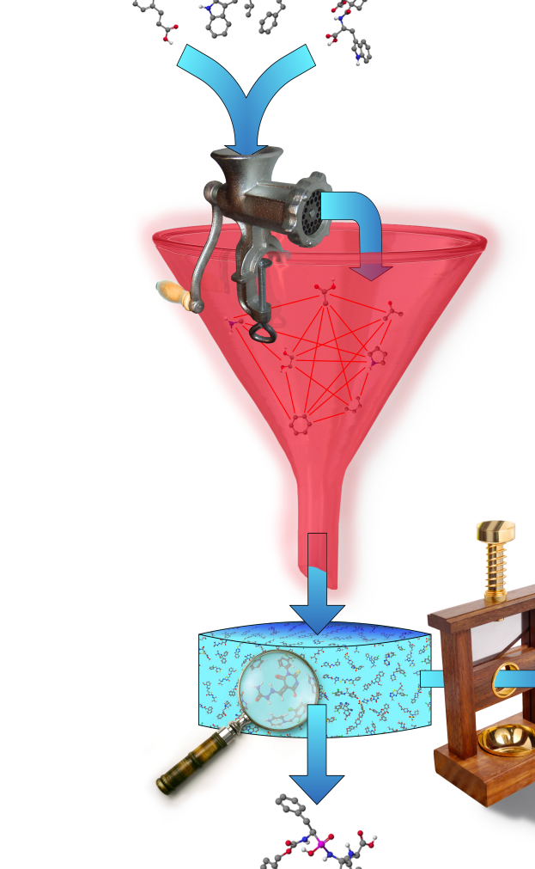

Slide 19
Deriving logical rules
Create a series of hypotheses linking the distances of different structure fragments.
For each hypothesis, find how good an indicator of activity it is.
Hypotheses above a certain compression can be classed as rules.

Slide 20
Example ILP rules
active(A):- positive(A, B), Nsp2(A, C),
distance(A, B, C, 5.2, 0.5).
Molecule is active if there is a positive charge centre and an sp₂ orbital nitrogen atom 5.2 ± 0.5 Å apart.
active(A):- phenyl(A, B), phenyl(A, C),
distance(A, B, C, 0.0, 0.5).
Molecule is active if a phenyl ring is present.

Slide 21
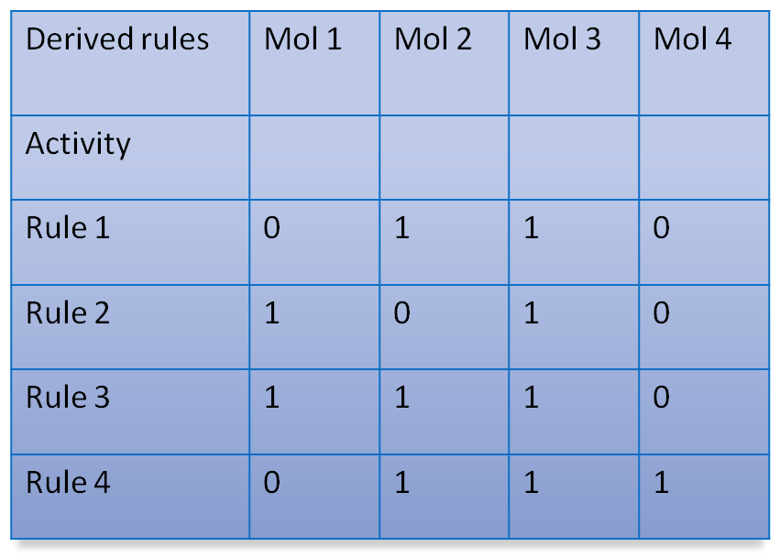
Deriving and quantifying the rules
Hypothesis matrix
Rules matrix: Machine Learning Kernel
Derived hypotheses | Mol 1 | Mol 2 | Mol 3 | Mol 4
Activity
Hypothesis 1 | 0 | 1 | 1 | 0
Hypothesis 2 | 1 | 0 | 1 | 0
Hypothesis 3 | 1 | 1 | 1 | 0
Hypothesis 4 | 0 | 1 | 1 | 1
Derived hypotheses | Correlation
Hypothesis 1 | 0
Hypothesis 2 | 0
Hypothesis 3 | 0.7
Hypothesis 4 | -0.7
Support
Vector
Machine
+
+
−
−
Calculate
correlation
Inductive
Logic
Hypotheses

Slide 23
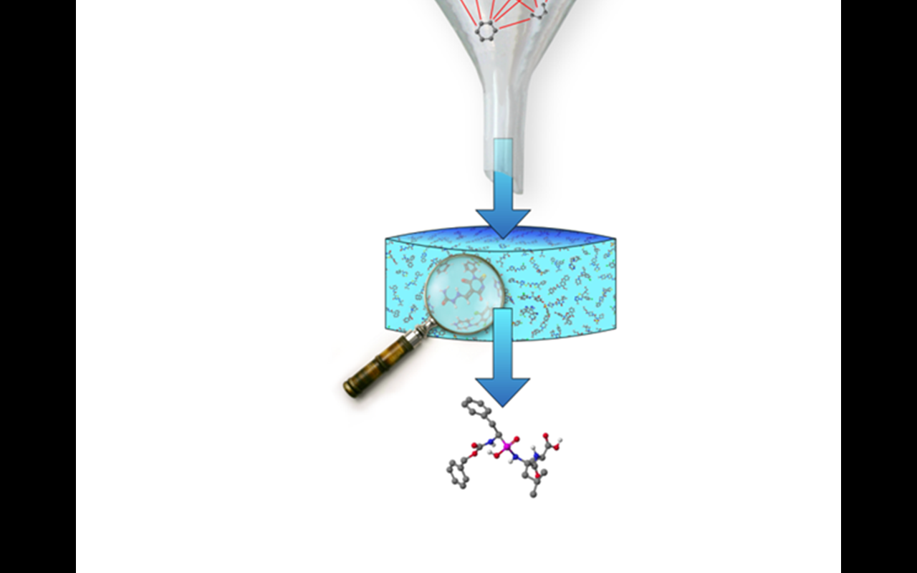
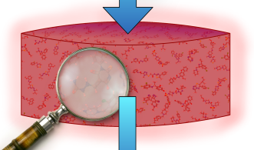

Slide 25
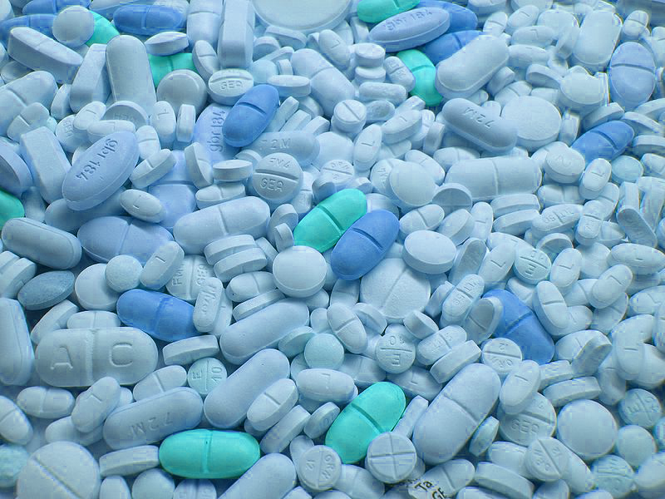
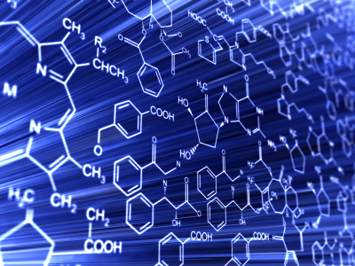
Screening
Apply model to a database of molecules. (ZINC)
Contains 11,274,443 molecules available to buy “off-the-shelf”.
INDDEx™ pre-calculates
descriptors to save time.

Slide 26
Testing
Tested on publically available data
  Directory of Useful Decoys (DUD)
Case study
  Finding molecules to inhibit the SIRT2 protein.

Slide 27
Testing methodology
Actives
Decoys
All Decoys
95,171 Decoys
40 protein targets

Slide 28
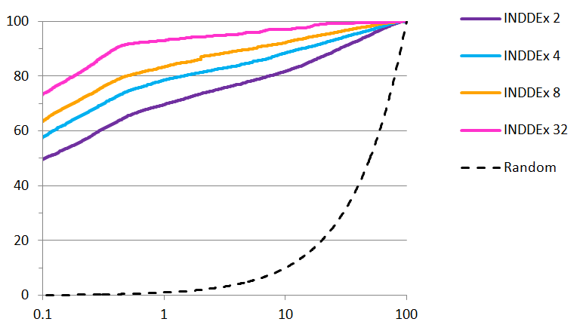
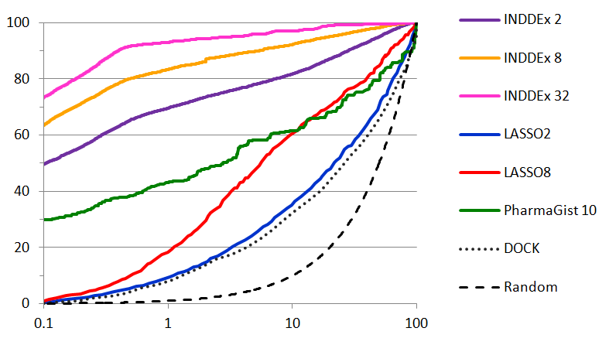
Enrichment curves
% of known ligands retrieved
% of ranked database
Results for LASSO and DOCK from (Reid et al. 2008), and results for PharmaGist from (Dror et al. 2009)

Slide 29
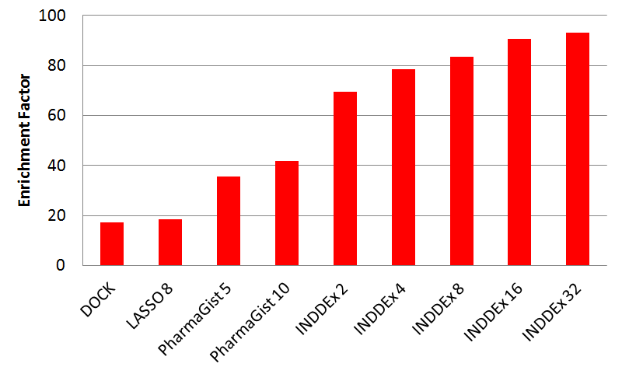
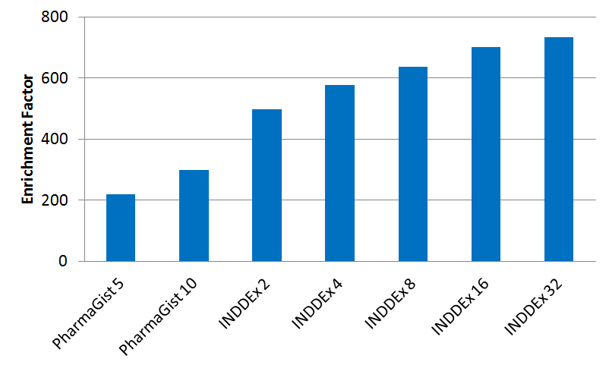
Enrichment Factors
Enrichment factor
EF_{1%}
EF_{0.1%}

Slide 30
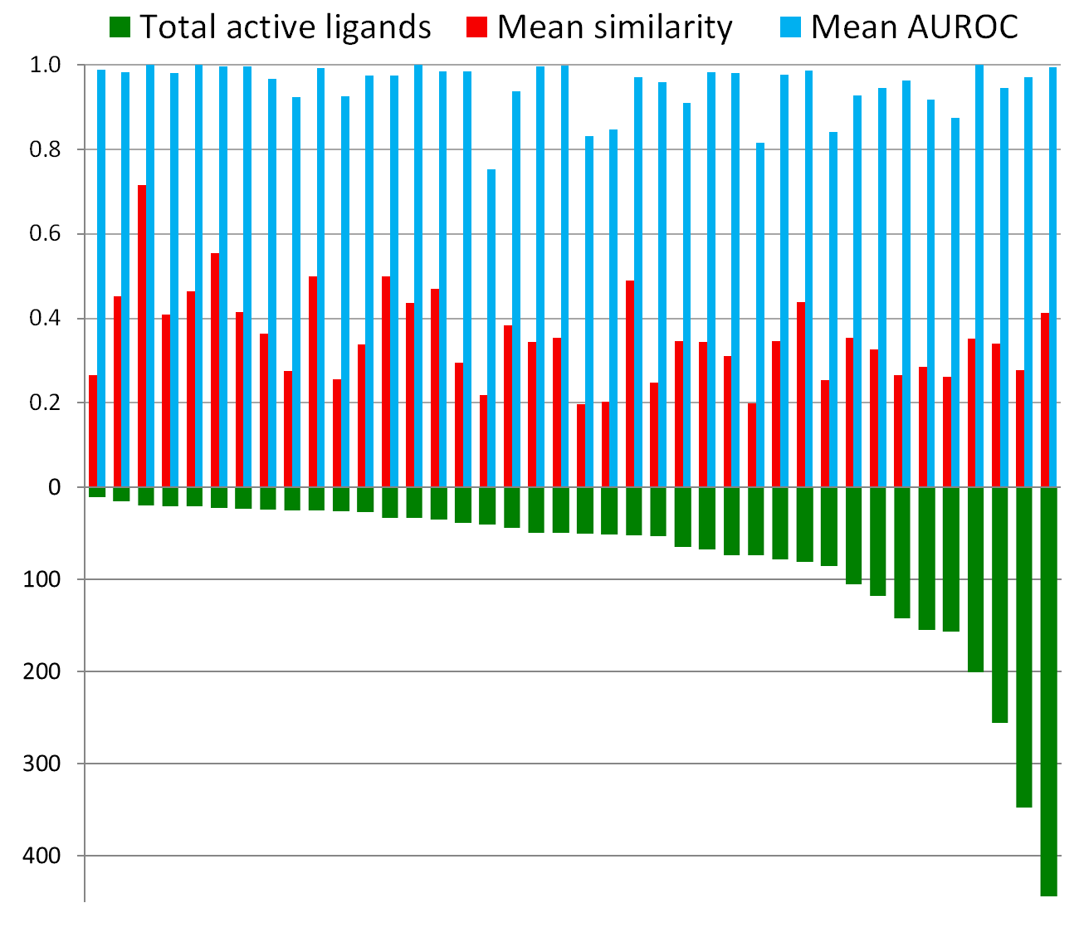
Performance, similarity, and target set size
Mean similarity of dataset / Average of ROC area
Number of active ligands
Notes:
This is a note

Slide 31
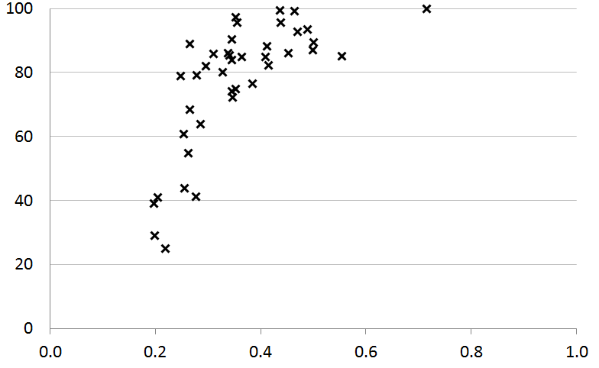
Similarity versus performance
Pearson’s R = 0.71
Enrichment Factor at 1%
Drug-Like Molecules
Dataset mean similarity

Slide 32
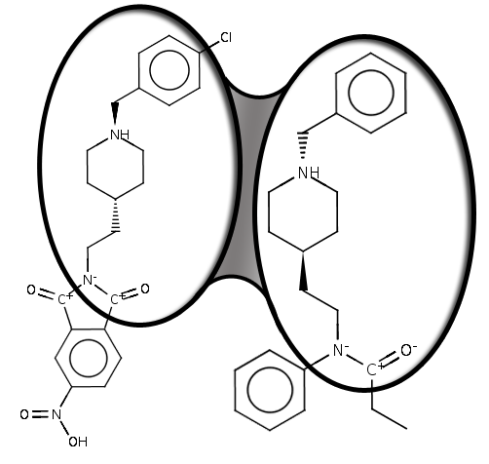
Testing scaffold hopping
 | Atoms | Bonds | Total
N_{A} | 30 | 33 | 63
N_{B} | 26 | 28 | 54
N_{AB} | 18 | 21 | 39
N_{AB} N_{A} + N_{B} - N_{AB} | 0.47 | 0.53 | 0.50

Slide 33
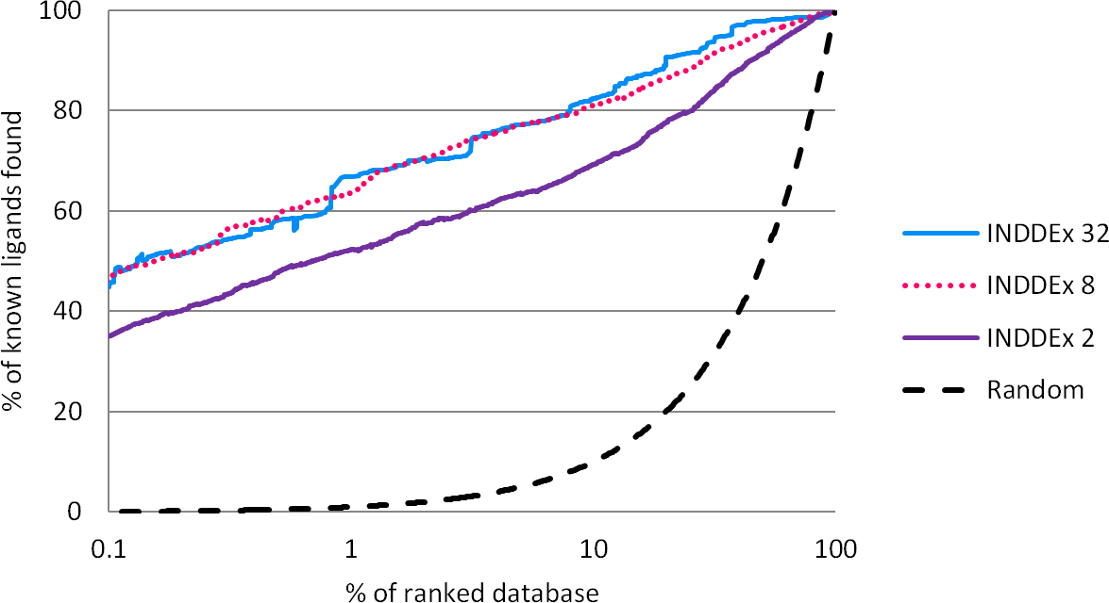
Testing scaffold hopping
% of known ligands retrieved
% of ranked database

Slide 34


Rule examples for PDGFrb
Rule (all distances have a tolerance of 1 Ångström) | Fit to training data
 | 0.574
 | -0.441

Slide 35
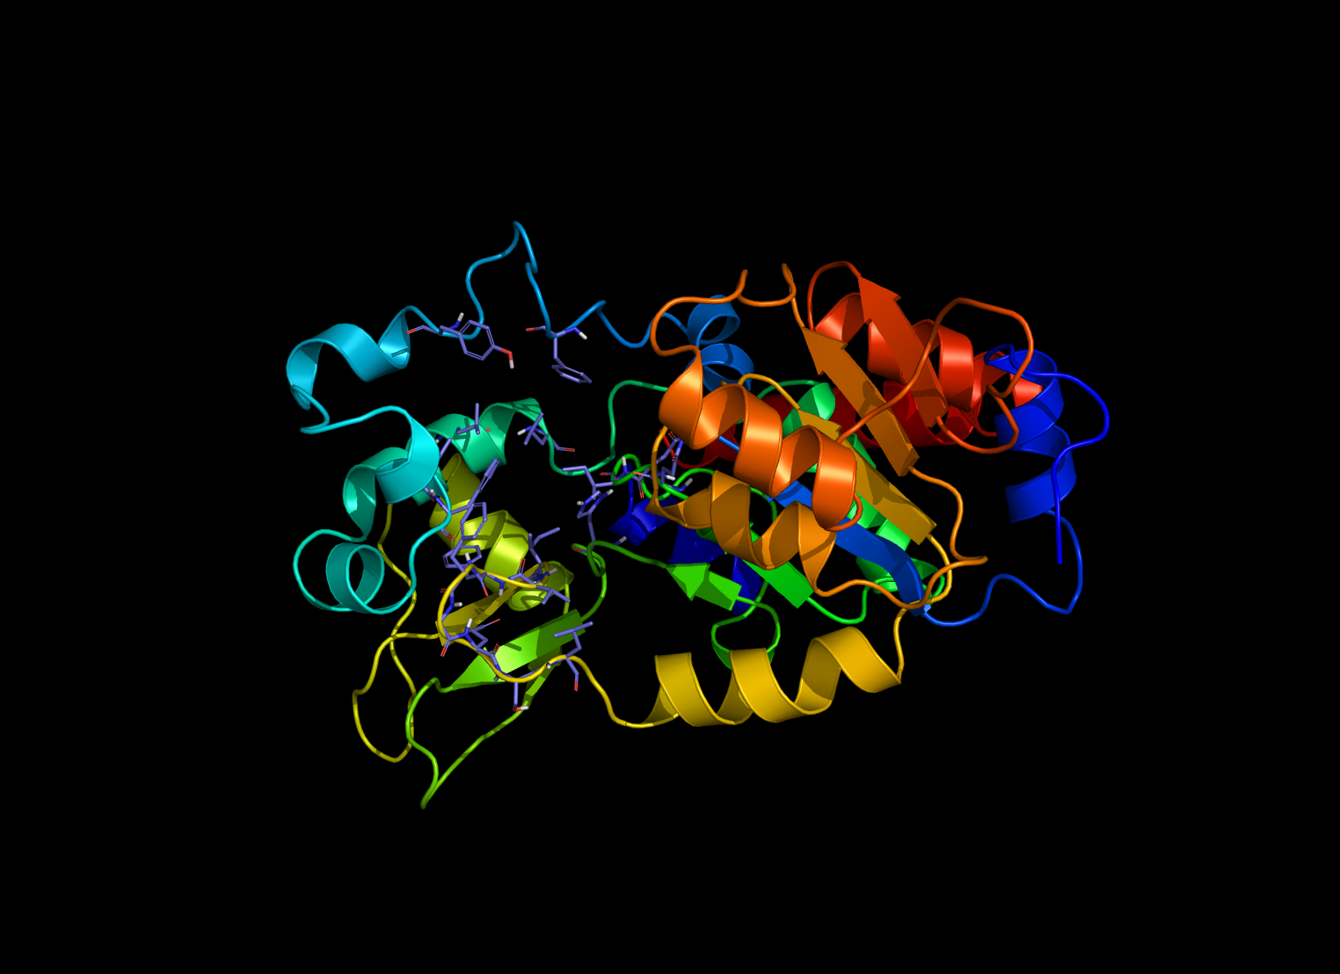
Case study: SIRT2 inhibition
SIRT2 is NAD-dependent deacetylase sirtuin-2.
3 chains, each a domain.
Inhibition can cause apoptosis in cancer cell lines (Li, Genes Cells, 2011).

Slide 36
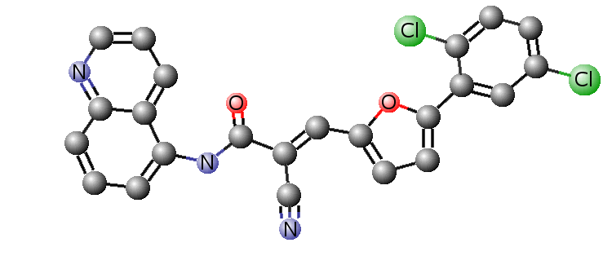
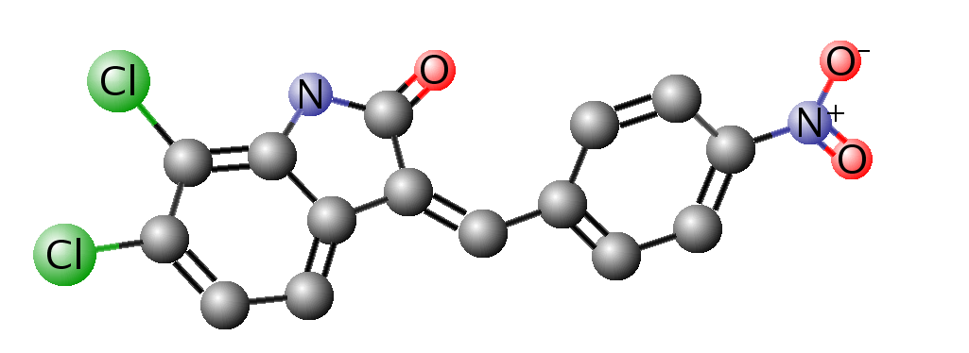
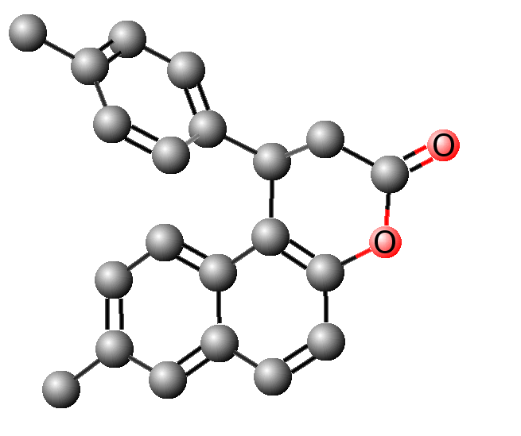
Molecules found by in vitro tests to have some low activity against SIRT2

Slide 37
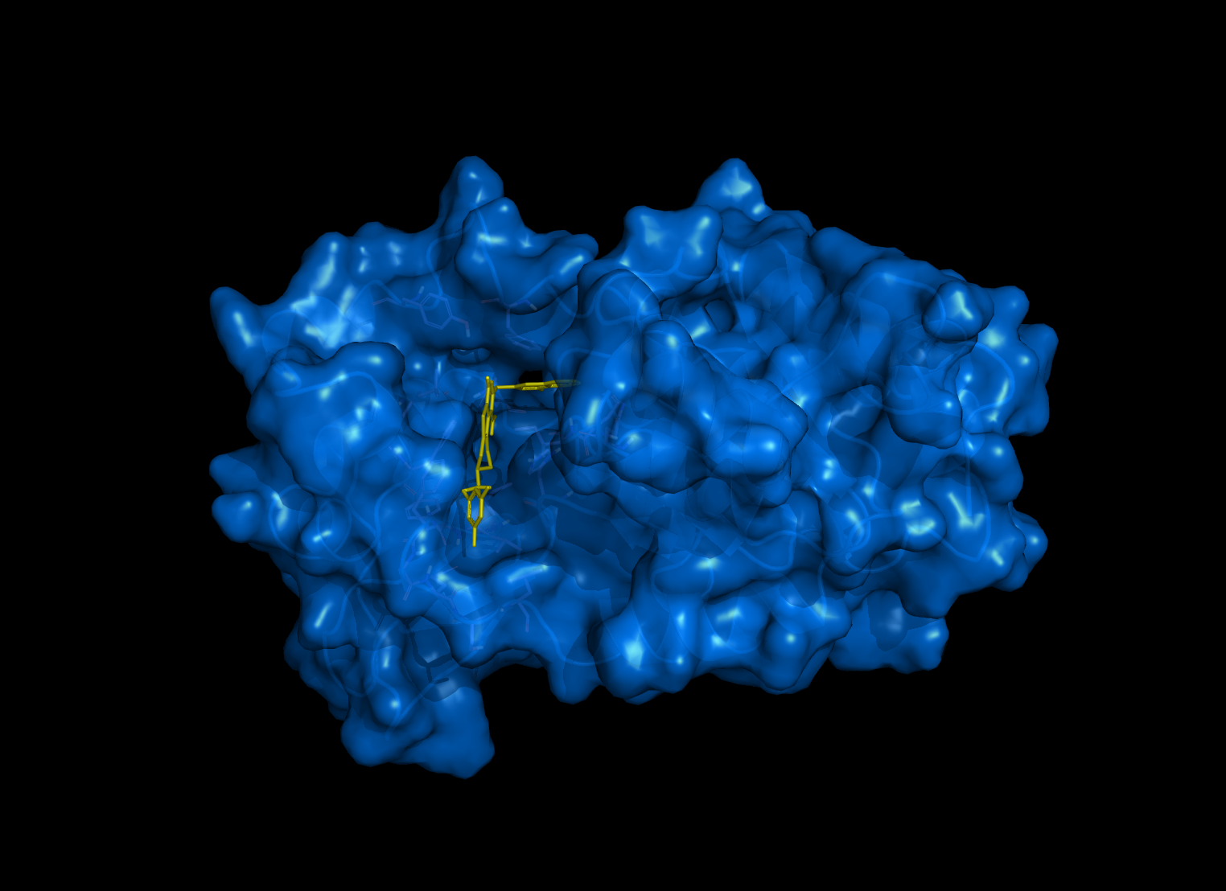

Predicted molecules docked against modelled SIRT2 protein structure using GOLD™

Slide 38
SIRT2 results
Training data
  8 molecules
  IC₅₀ activities between 1.5 µM and 78 µM
8 molecules with best consensus INDDEx and docking scores purchased and tested.
  All molecules were structurally distinct from training molecules.
Two molecules had activity. One had IC₅₀ of 3.4 μM. Better than all but one of the training data molecules.

Slide 39
Summary
INDDEx has been shown to be a powerful screening method whose strength lies in learning topological descriptors of multiple active compounds.
INDDEx can achieve a good rate of scaffold hopping even when there are low numbers of active compounds to learn from.
Potential new drug leads found for SIRT2 protein. Testing is continuing.

Slide 40



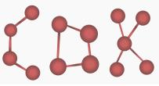
Acknowledgments
  Mike Sternberg
  Stephen Muggleton
  Ata Amini
  Suhail Islam
SIRT2 drug design
Paolo Di Fruscia
Matt Fuchter
Eric Lam
Chemistry Development Kit
Imagery
Wikimedia Commons
iStockPhoto®
  Funding
  BBSRC
  Equinox Pharma
  All of you for listening.

Slide 41

Questions?

