Slide 1



Christopher Reynolds,
Stephen Muggleton and Michael Sternberg
Bioinformatics and Computing Departments
Imperial College London

Slide 2
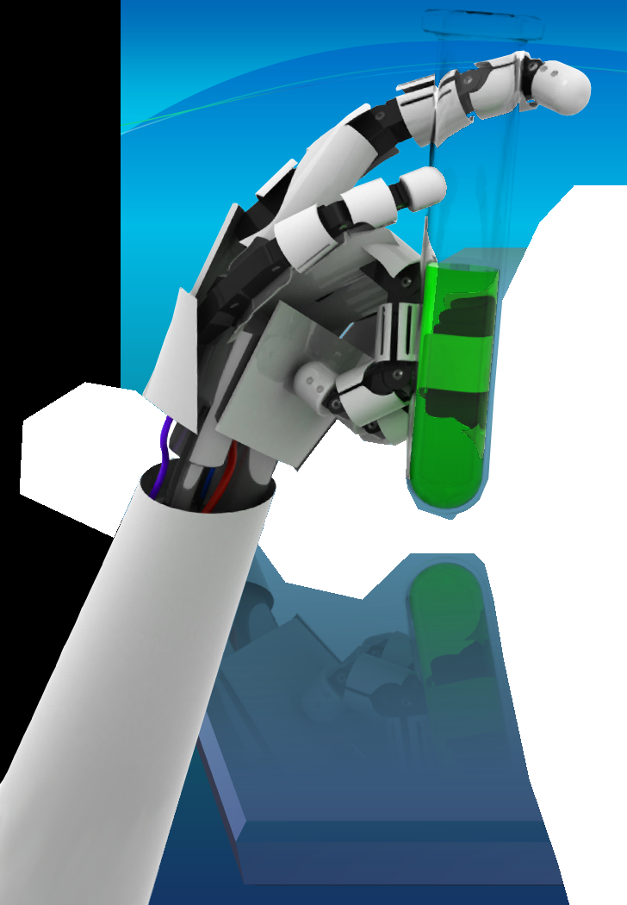
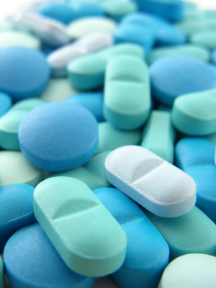

In silico lead discovery by integrating ligand screening and chemical synthesis rules

Slide 3

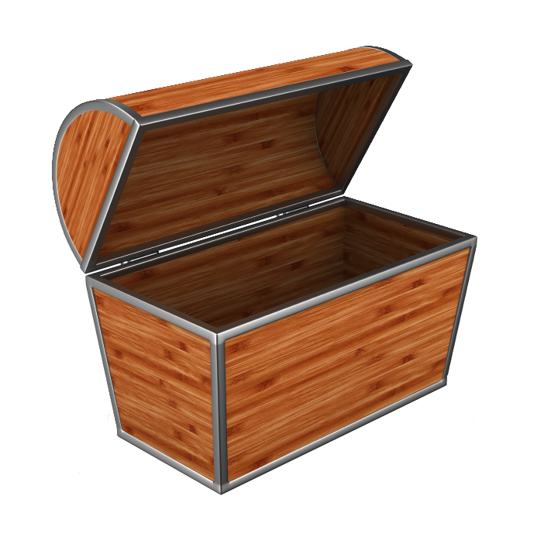
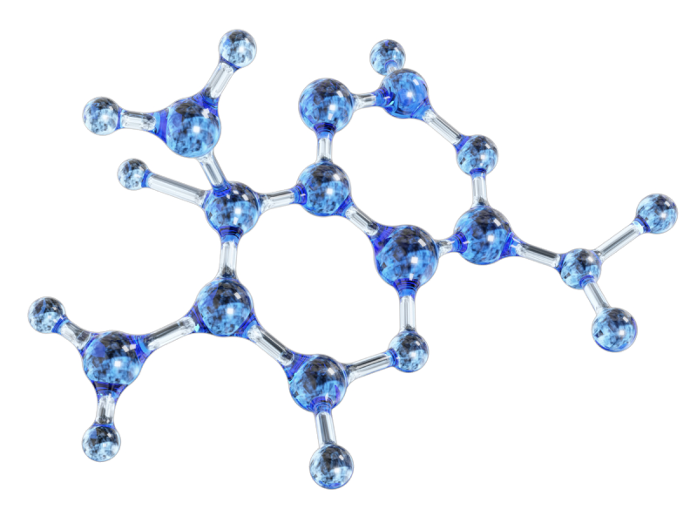

Slide 4

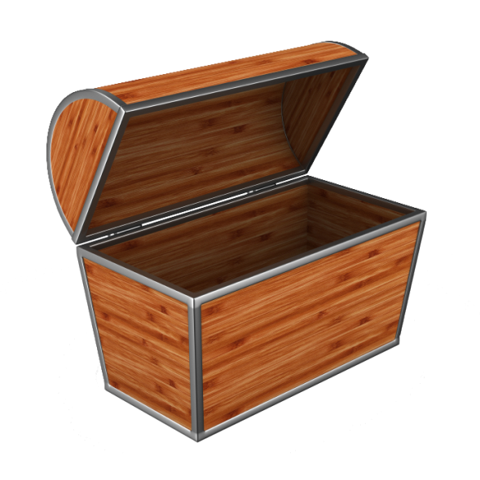
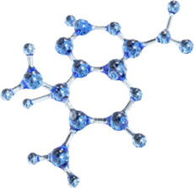

Slide 5
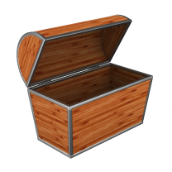

Slide 6
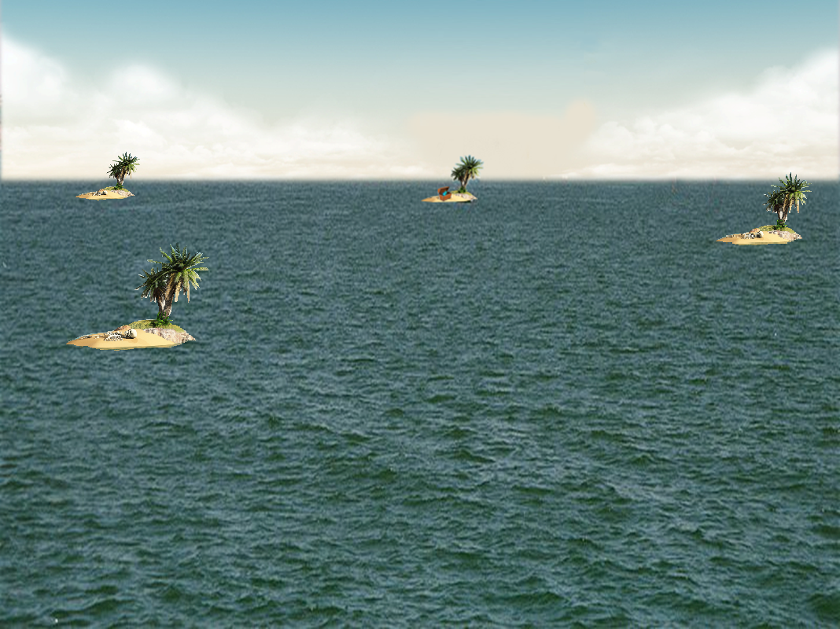

Slide 7
Summary
Synthetic space is intractable
INDDEx – a logic-based drug-discovery tool
Virtual reactions
Estimating the size of searchable synthetic space
Filtering search space
Estimating the power of the virtual reaction search
Case study of application to drug discovery
Conclusion

Slide 8
The size of small molecule space
Most frequently given estimate for all possible small-molecules is around 10⁶⁰
  Drug-like molecules estimated between 10¹⁴ and 10³⁰
  Synthetically accessible estimated at 10¹³
Several publications and presentations have given estimates between 10¹⁸ and 10²⁰⁰

Slide 9
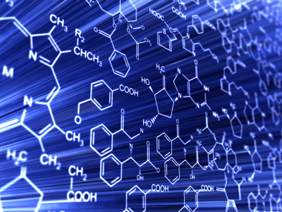
ZINC database
ZINC = Zinc Is Not Commercial
Publically available, free-to-use
ZINC 12 contains the 3D structures of > 35 million “purchasable” molecules.
Divided into subsets of
fragment-like molecules,
purchasable molecules,
etc.

Slide 10
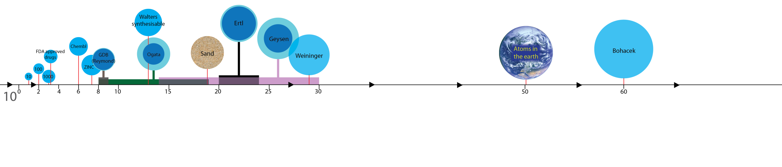

Slide 11
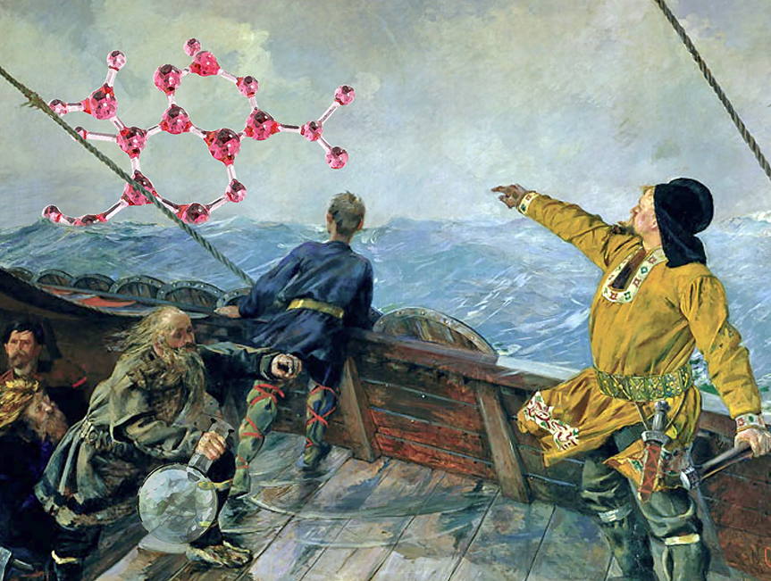

Slide 12
Summary
Synthetic space is intractable
INDDEx – a logic-based drug-discovery tool
Virtual reactions
Estimating the size of searchable synthetic space
Filtering search space
Estimating the power of the virtual reaction search
Case study of application to drug discovery
Conclusion

Slide 13
INDDEx™
Investigational Novel Drug Discovery by Example.
A proprietary technology that uses an algorithm developed from Inductive Logic Programming for drug discovery.
SVILP
  Support Vector Inductive Logic Programming
  Applies SV weighting to ILP rules
This approach generates human-comprehensible weighted logical rules which describe what makes the molecules active.

Slide 14


Understandable rules
?
Standard programs:
Activity = 0.45 LogP + 0.5667 LUMO + 1.65 V
Logic-based rules:
In an active molecule
Fragment A is 7Å from fragment B which is bonded
to fragment C which is bonded to fragment D
7Å
C
D
B
A

Slide 15
Deriving logical rules
Create a series of hypotheses linking the distances of different structure fragments.
For each hypothesis, find how good an indicator of activity it is.
Hypotheses above a certain compression can be classed as rules.

Slide 16
Example ILP rules
active(A):- positive(A, B), Nsp2(A, C),
distance(A, B, C, 5.2, 0.5).
Molecule is active if there is a positive charge centre and an sp₂ orbital nitrogen atom 5.2 ± 0.5 Å apart.
active(A):- phenyl(A, B), phenyl(A, C),
distance(A, B, C, 0.0, 0.5).
Molecule is active if a phenyl ring is present.

Slide 17
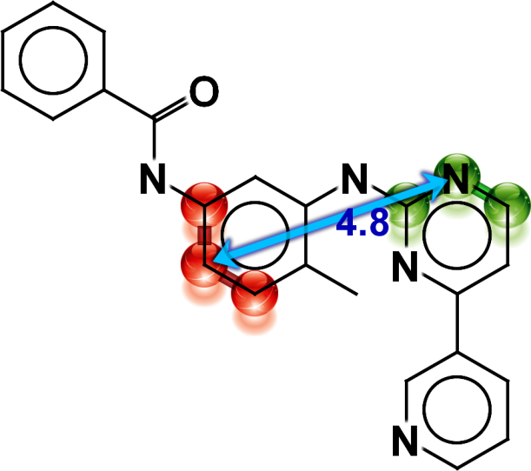
Example rules
Rules derived for the PDGfrb target from the Dataset of Useful Decoys (DUD).
Correlation of coverage to training data = 0.586
Fragment one (shown in green) consists of a nitrogen atom connected to a carbon via an aromatic bond and a carbon via an aromatic bond; these atoms are connected to a total of one hydrogen. Fragment two (shown in red) consists of a carbon atom connected to a carbon via an aromatic bond and a carbon via an aromatic bond; these atoms are connected to a total of two hydrogens. The distance between the nitrogen in fragment one and the initial carbon in fragment two is 4.80 ± 1.0 Å.
ZINC00600761 (active)

Slide 18
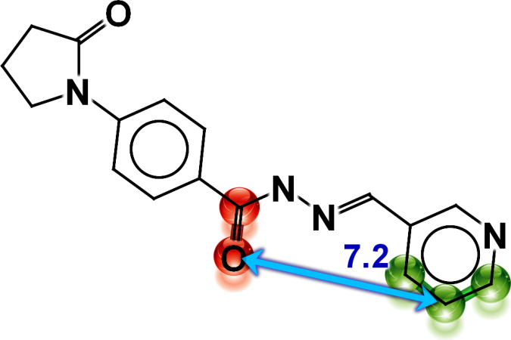
Example of a negative rule
Correlation of coverage to training data = -0.383
Fragment one (shown in green) consists of a carbon atom connected to a carbon via an aromatic bond and a carbon via an aromatic bond; these atoms are connected to a total of three hydrogens. Fragment two (shown in red) consists of a oxygen atom connected to a carbon via a double bond; none of these atoms are connected to any hydrogens. The distance between the initial carbon in fragment one and the oxygen in fragment two is 7.25 ± 1.0 Å.
ZINC00290973 (inactive)

Slide 19
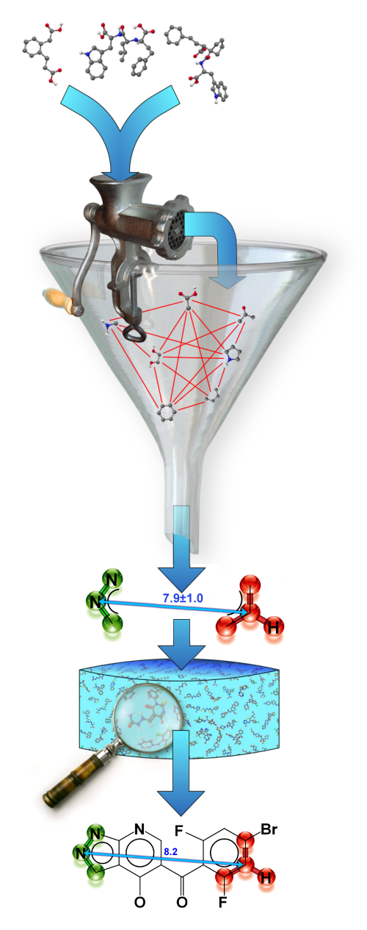
INDDEx process
Observed activity
Fragmentation of molecules into substructure
Inductive Logic Programming generates QSAR rules
Support Vector Machines turn qualitative rules into quantitative model
Screen model against molecular database
Novel hits

Slide 20
Directory of Useful Decoys
Benchmarking dataset
40 protein targets
Decoys:Actives = 30:1
Decoys selected to be physicochemically close to the actives, but different in structure.

Slide 21
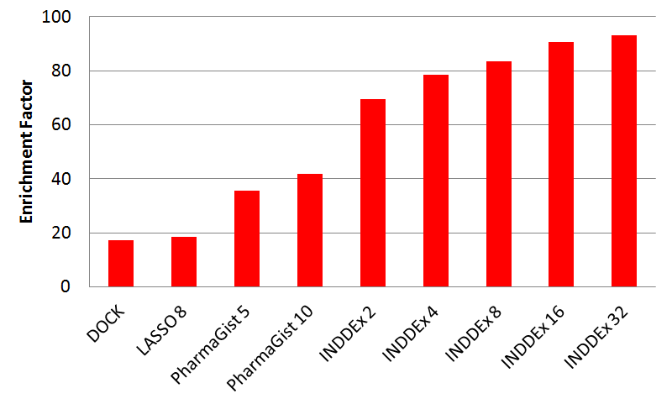
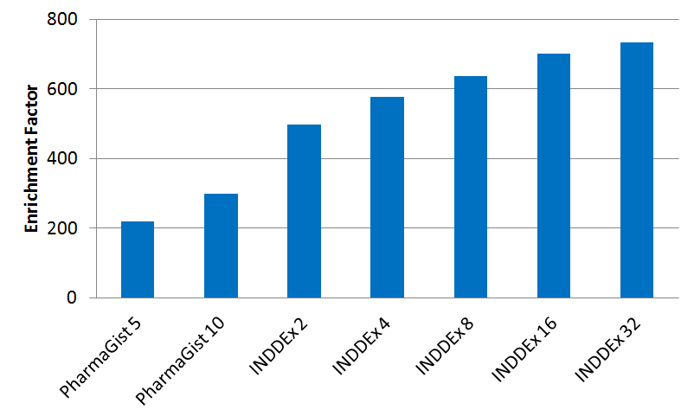
Enrichment Factors on screening the Directory of Useful Decoys
Enrichment factor
EF_{1%}
EF_{0.1%}

Slide 22
Summary
Synthetic space is intractable
INDDEx – a logic-based drug-discovery tool
Virtual reactions
Estimating the size of searchable synthetic space
Filtering search space
Estimating the power of the virtual reaction search
Case study of application to drug discovery
Conclusion

Slide 23
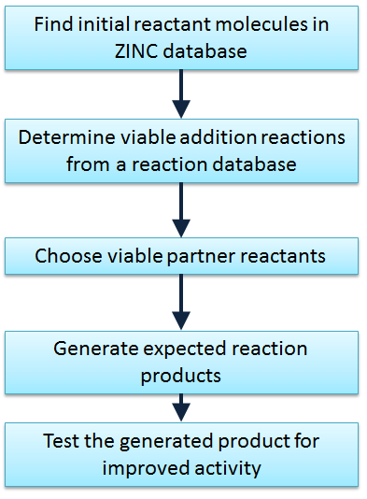
Overview of modification process

Slide 24
Carrying out a virtual reaction
Simple Molecular Input Reaction Kinetic String (SMIRKS).
ChemAxon’s Reactor tool contains a library of SMIRKS along with rules about what a molecule must be like to participate in the reaction (Pirok et al, J Chem Inf Model, 2006).

Slide 25
SMIRKS reaction
C=[N,O] + C(H)(=C)[C,N,P,S] + >>
[C:3]=[N,O:4] + [C:1]([H:2])(=[C:6])[C,N,P,S:5] + >>
[C:1]([C:3][N,O:4][H:2])(=[C:6])[C,N,P,S:5]
C(C[N,O]H)(=C)[C,N,P,S]
4
4
OH
O
1
5
5
EWG
+
EWG
1
6
R
3
R
3
H
6
Bayliss-Hillman Alkylation reaction

Slide 26
ChemAxon rules
Can exclude reactants, and give requirements for reactivity.
  match(reactant(0), “C=[N,O,S]”)
  match(ratom(3), “O=C[C:1]=O”)
  matchcount(reactant(0), “[F,Cl,Br,I]”)==1
  charge(ratom(3), “aromaticsystem”) > 0.3
Also give data for yield which can be used to guide choice of reactions.
Easy to add new rules and data.

Slide 27
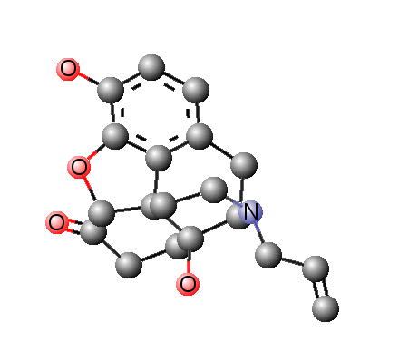
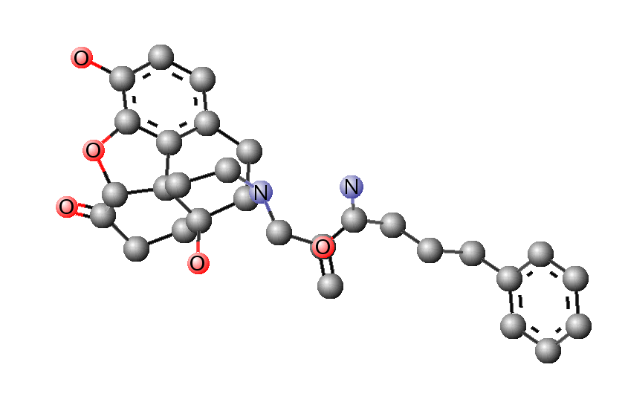
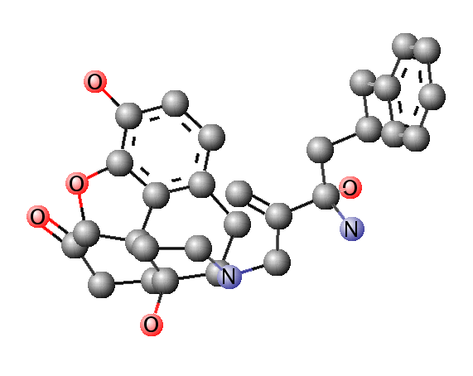
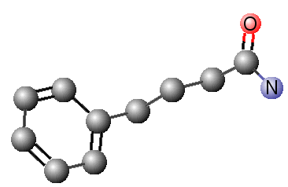
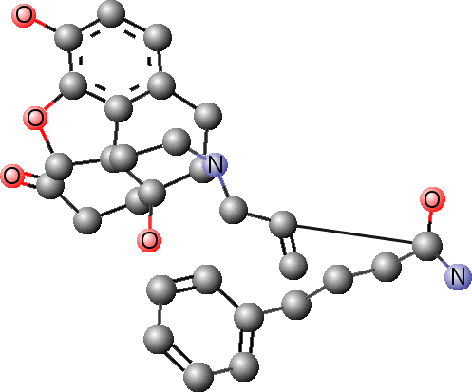
Predicted molecule
Minimised product
Reactants
Product
Initial reactant
Partner reactant
+

Slide 28
Summary
Synthetic space is intractable
INDDEx – a logic-based drug-discovery tool
Virtual reactions
Estimating the size of searchable synthetic space
Filtering search space
Estimating the power of the virtual reaction search
Case study of application to drug discovery
Conclusion

Slide 29
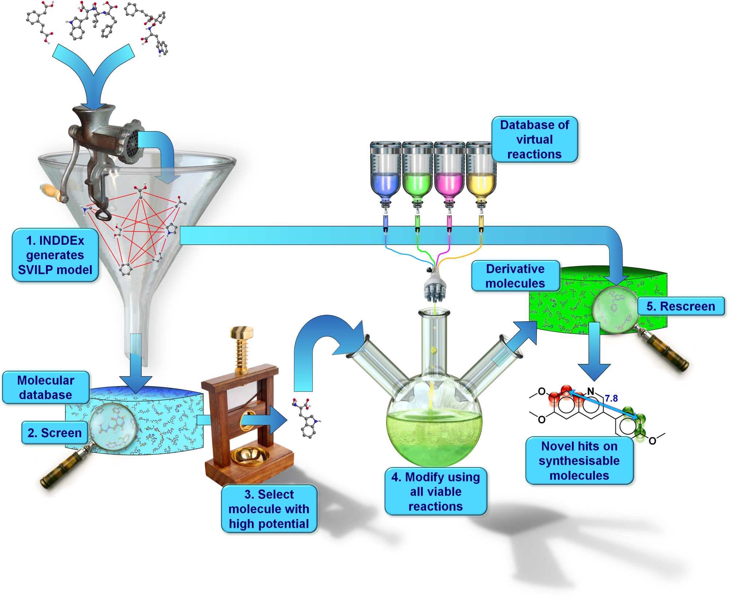
INDDEx with virtual reactions

Slide 30
Virtual reactions open up search space
~ 100 commonly used organic reactions.
482,606 fragment-like molecules in ZINC database.
54 reactions incorporated so far into INDDEx

Slide 31
Virtual reactions open up search space
Random ZINC molecules tested:
  100 randomly selected ZINC molecules
Random test
molecules
Average reactions
per molecule
Reactant
partners
Total products
per molecule
2.28
27,227
53,450
All ZINC
100
35 million purchasable molecules in ZINC
Therefore potential space
= 35,000,000 × 53,450 products per molecule
= 1.9 × 10¹² molecules

Slide 32
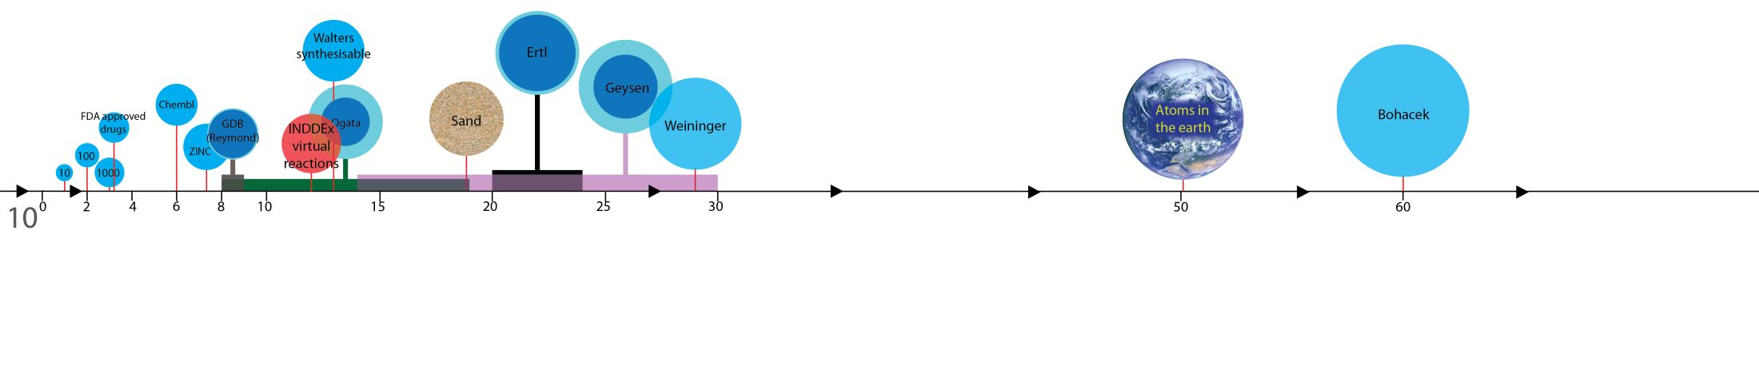

Slide 33
Summary
Synthetic space is intractable
INDDEx – a logic-based drug-discovery tool
Virtual reactions
Estimating the size of searchable synthetic space
Filtering search space
Estimating the power of the virtual reaction search
Case study of application to drug discovery
Conclusion

Slide 34
Filtering search space
Need to cut down search space.
Partial Logical Rule Reactant Selection (PLoRRS) uses the INDDEx logical rules without support vector weighting to give a score of the potential of a molecule to form active compounds one synthetic step away.
INDDEx takes the top 100 positive rules, and gives one point for any rule only half-filled.
Identifies molecules that might potentially have their logic-based rules fulfilled after undergoing a reaction.

Slide 35
Matching unfulfilled fragments
Rule: Fragment A must be x ångströms from Fragment B
A rule is counted as half-fulfilled if only one of the fragments match and x > 2
 |  | Fragment A match | Fragment B match
 |  | FALSE | TRUE
Fragment A match | FALSE | FALSE | TRUE
Fragment B match | TRUE | TRUE | FALSE

Slide 36
Summary
Synthetic space is intractable
INDDEx – a logic-based drug-discovery tool
Virtual reactions
Estimating the size of searchable synthetic space
Filtering search space
Estimating the power of the virtual reaction search
Case study of application to drug discovery
Conclusion

Slide 37
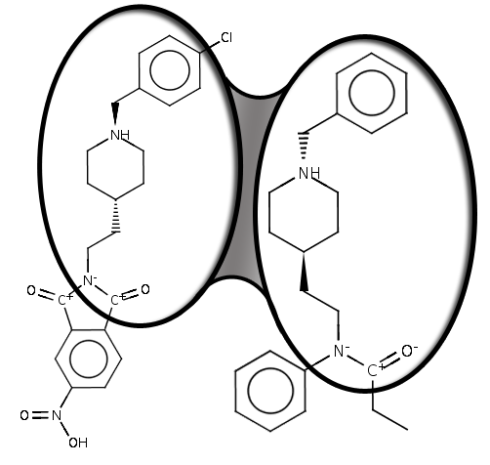
Similarity – Tanimoto Coefficient
 | Atoms | Bonds | Total
N_{A} | 30 | 33 | 63
N_{B} | 26 | 28 | 54
N_{AB} | 18 | 21 | 39
N_{AB} N_{A} + N_{B} - N_{AB} | 0.47 | 0.53 | 0.50

Slide 38
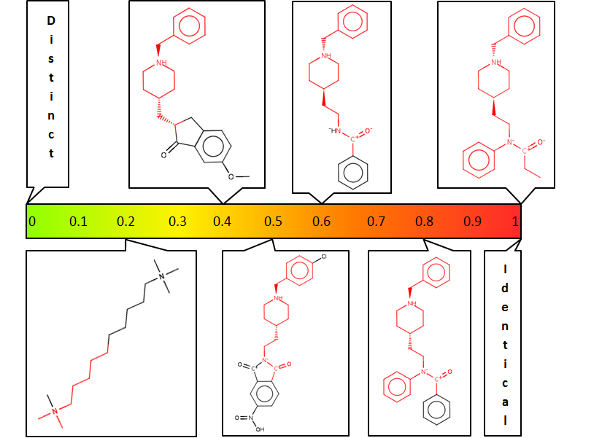

Slide 39
Benchmarking
Aim is to quantify how well virtual reactions and PLoRRS filtering can explore synthetic space by identifying molecules that are active but would not be found by a search of an existing database.

Slide 40
DUD target set of active ligands
Training set of 8
randomly‑chosen molecules
Test set of remaining active compounds
INDDEx SVILP model
ZINC fragment database filtered to remove structures similar to the test set
PLoRRS matches
SVILP matches
Virtual synthetic products
Virtual synthetic products
Check for similarity to held‑back test set
Pooled consensus virtual synthetic products
Evaluation

Slide 41
Benchmarking
The method was tested on all 40 target sets in the DUD dataset.
Virtual reactions, with PLoRRS filtering and used to search virtual synthetic space of each target
Tests also done using SVILP as selection method for initial and partner reactants
Success judged by similarity of generated molecules to known actives

Slide 42
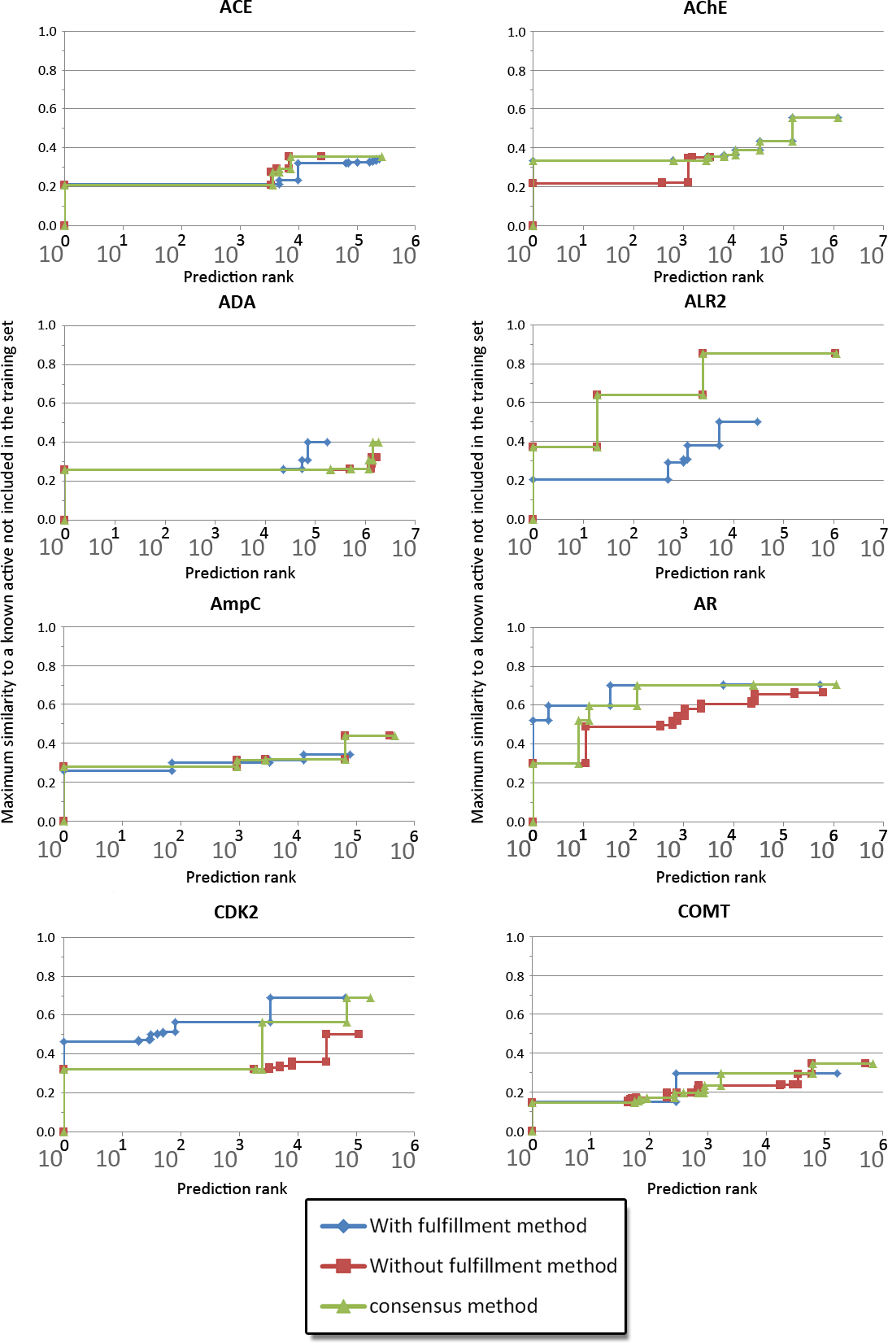
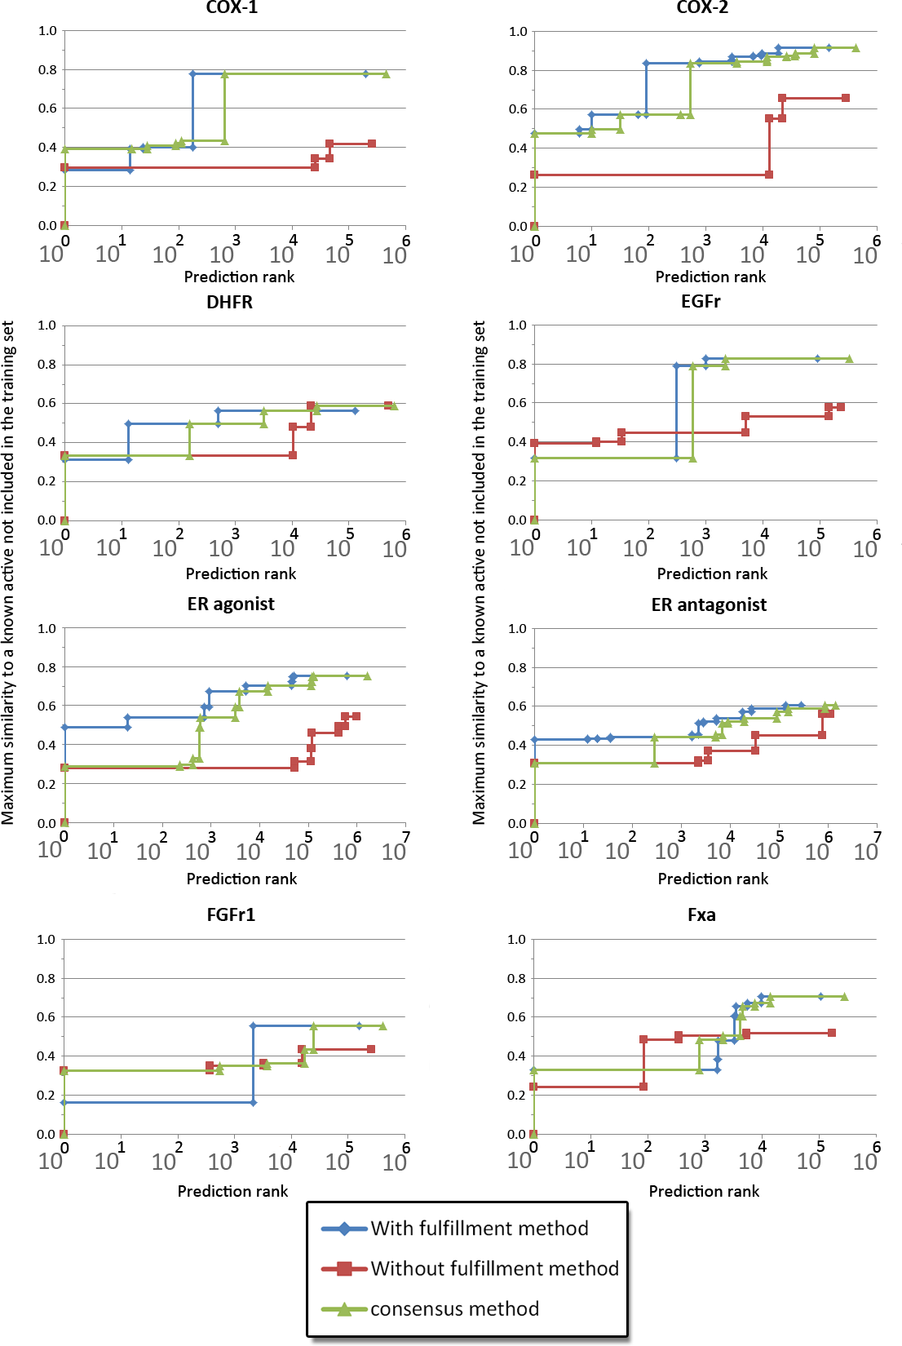

Slide 43
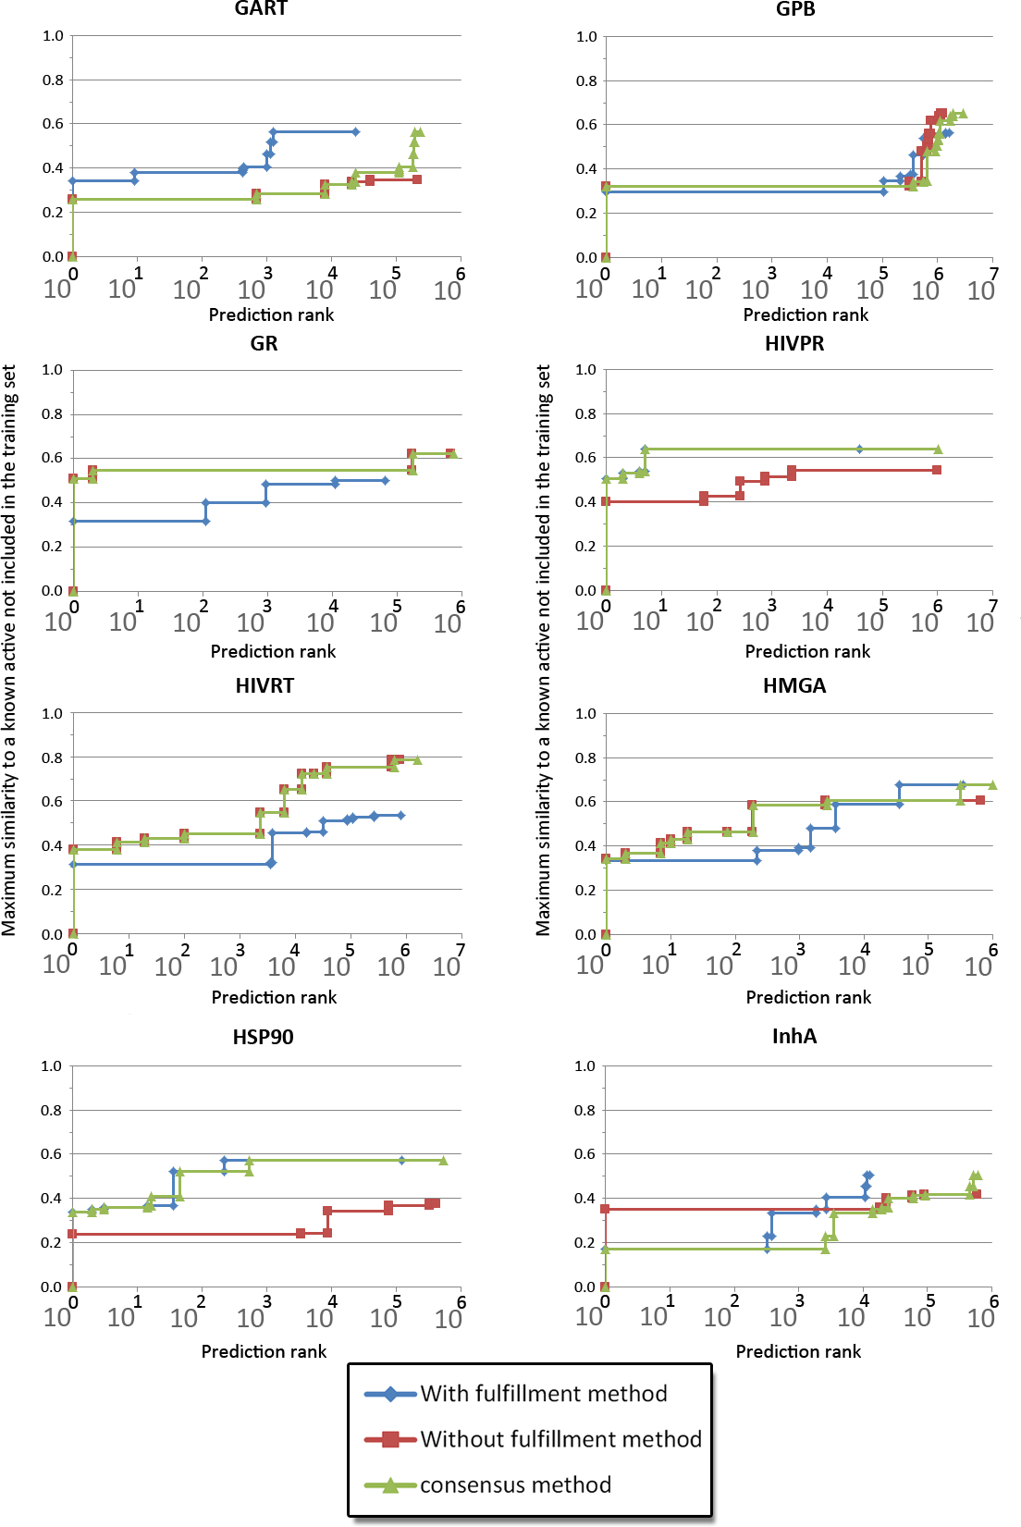
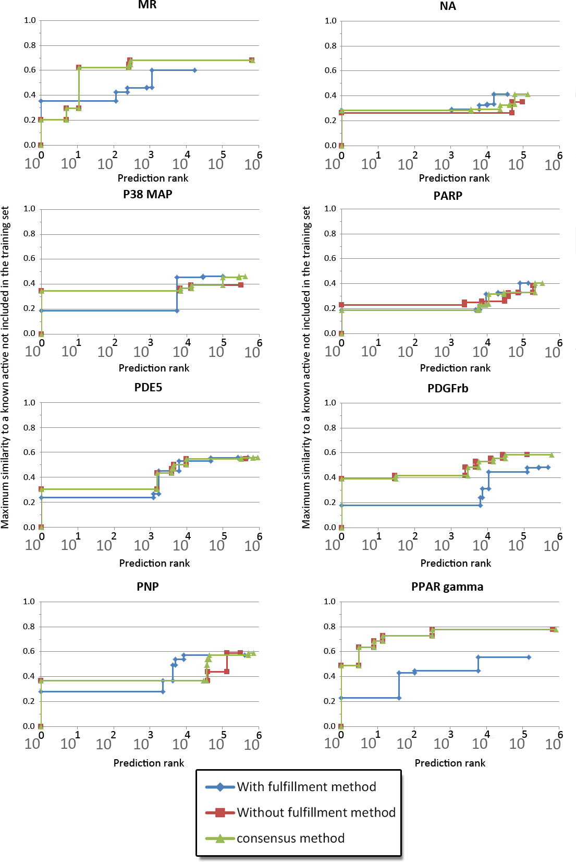

Slide 44
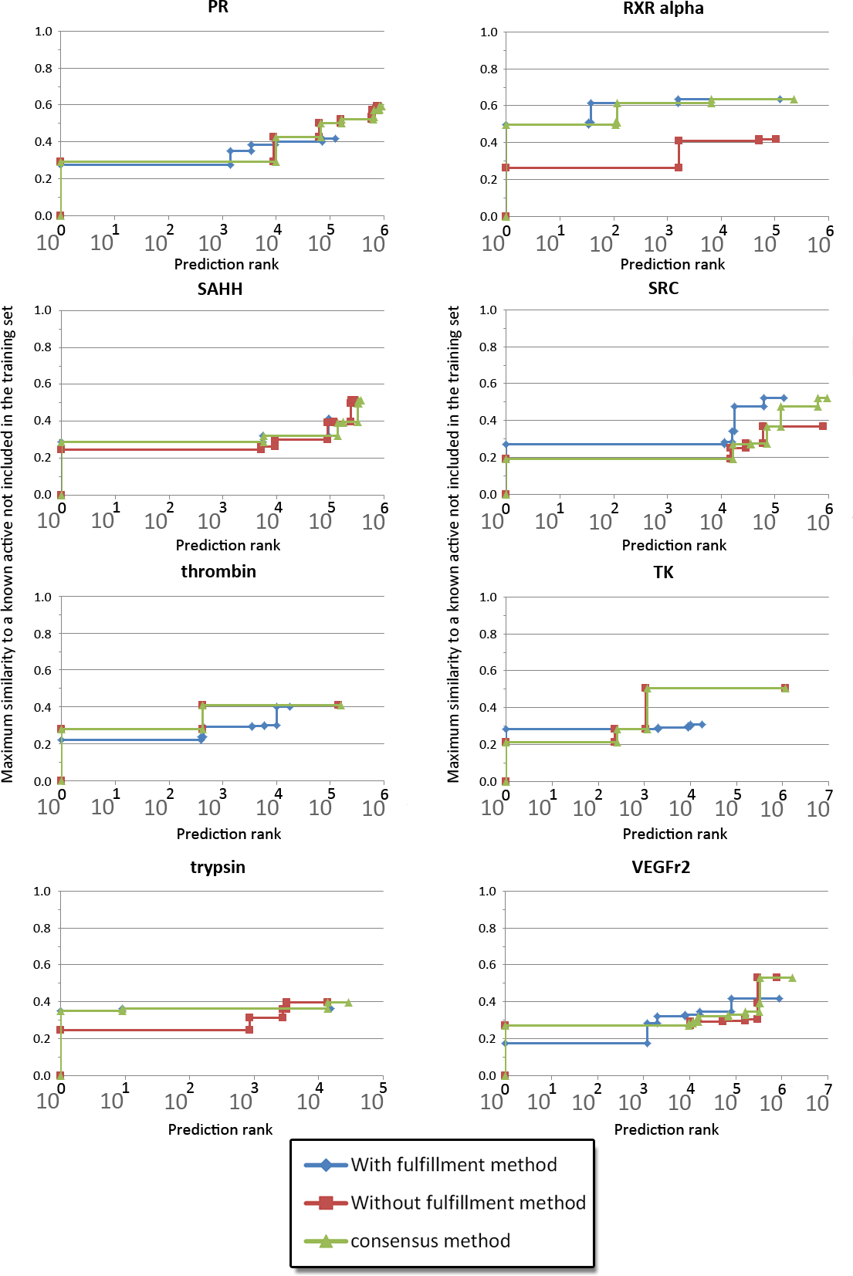

Slide 45
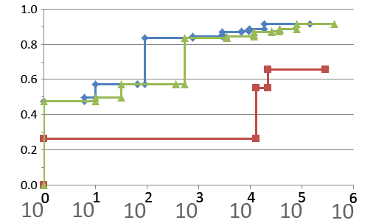

Virtual compounds similar to known actives for the COX-2 target
Maximum similarity to a known active not included in the training set
With PLoRRS method
Without PLoRRS method
Consensus method
Figure 2.

Slide 46
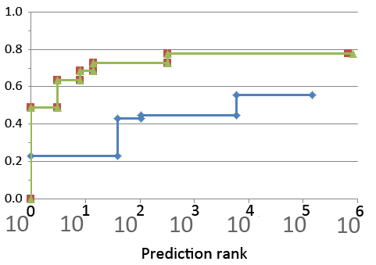
Virtual compounds similar to known actives for the PPAR γ target
Maximum similarity to a known active not included in the training set
With PLoRRS method
Without PLoRRS method
Consensus method
Figure 2.

Slide 47
Summary of results
 |  | Maximum similarity achieved by rank using:
 |  | PLoRRS |  |  | SVILP |  |  | A consensus of PLoRRS and SVILP
 |  | 10 | 100 | 1000 | 10 | 100 | 1000 | 10 | 100 | 1000
Number of targets with a similarity value greater than | 0.6 | 1 | 4 | 7 | 1 | 3 | 3 | 2 | 4 | 9
 | 0.7 | 0 | 2 | 4 | 0 | 1 | 1 | 0 | 1 | 5
 | 0.8 | 0 | 1 | 2 | 0 | 0 | 0 | 0 | 0 | 1
Table 2. Summary table of the results of the virtual screening power assessment.
Table 3 applies McNemar’s test^{[37]} to the data. These figures result in a p‑value of 0.0156 with a one-tailed test (using an exact binomial distribution) expecting the PLoRRS method to add additional power, or of 0.0313 with a two-tailed test.

Slide 48
McNemar’s Test
McNemar’s test comparing the successes of Naïve SVILP against the consensus method incorporating PLoRRS, defining success as greater than 0.6 similarity within the top 1000.
 | SVILP with PLoRRS success | SVILP with PLoRRS fail
Naïve SVILP success | 3 | 0
Naïve SVILP fail | 6 | 31

Slide 49
Mann–Whitney U test
The one-tailed p‑values when comparing the performances of the methods using the Mann–Whitney U statistical test
These results indicate that using the consensus method is preferential to using either method individually, as it results in either an increased number of retrievals or the same amount
 | SVILP rank 100 | Consensus rank 100 | SVILP rank 1000 | Consensus rank 1000
PLoRRS rank 100 | 0.464 | 0.214
SVILP rank 100 |  | 0.203
PLoRRS rank 1000 |  |  | 0.283 | 0.152
SVILP rank 1000 |  |  |  | 0.039

Slide 50
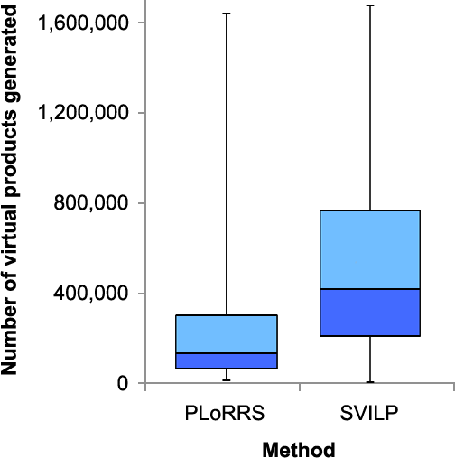
Amount of synthetic space explored

Slide 51
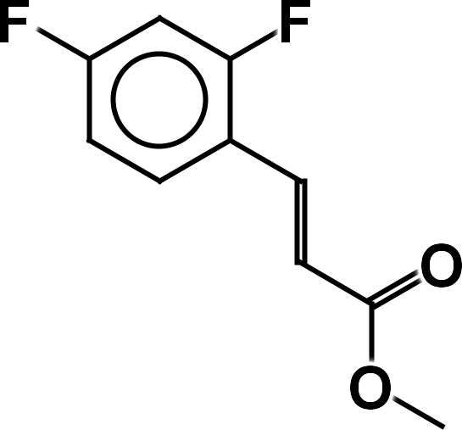
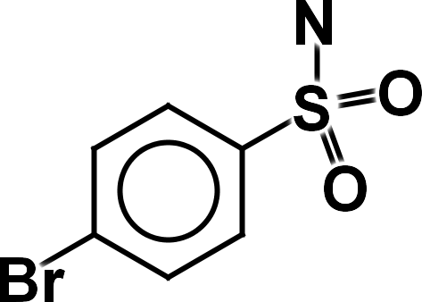
    Case studies of the virtual products
COX-2 target
Ranked 90th
ZINC04369096
ZINC21985593

Slide 52
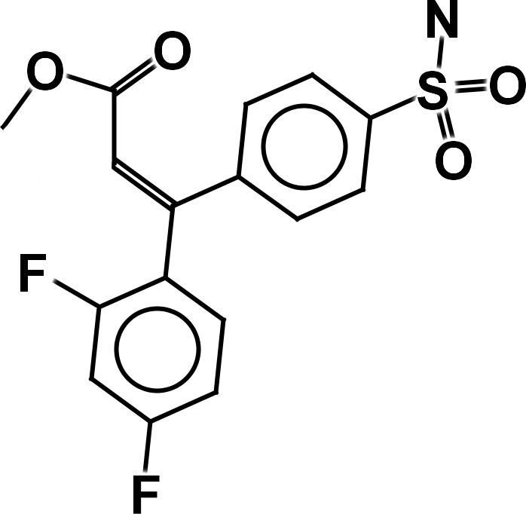
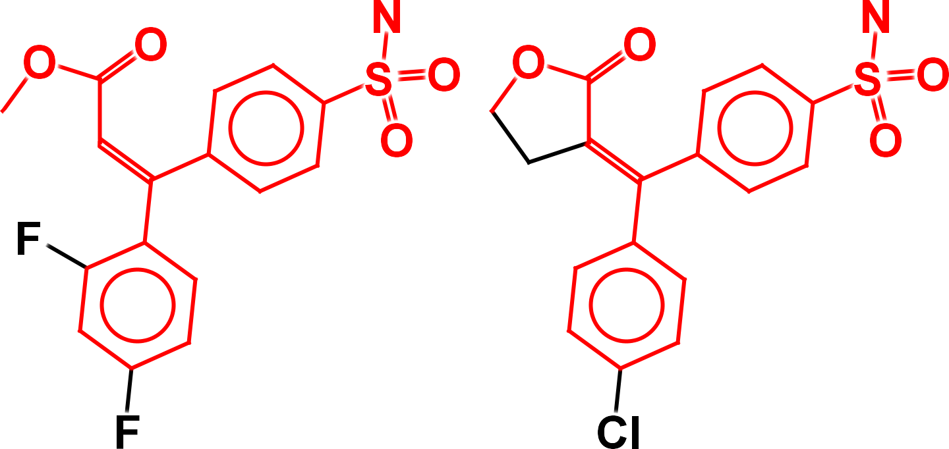
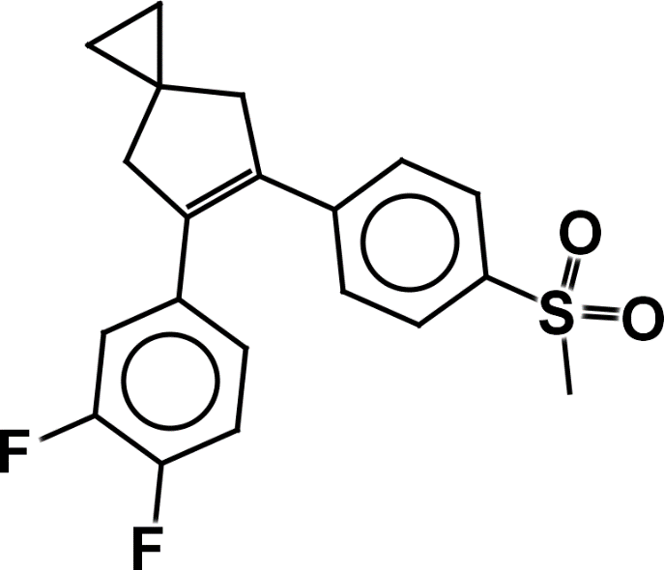
Virtual product formed
Heck reaction
Virtual product
Closest match in the held-back actives, ZINC03959950
Most similar molecule in training data, ZINC03814740.

Slide 53
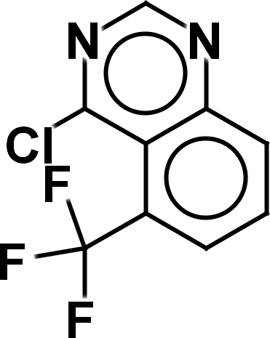
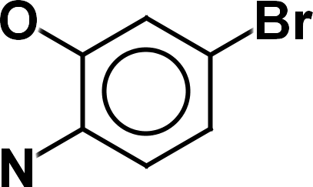
    Case studies of the virtual products
EGFr target
Ranked 308th
ZINC26894451
ZINC20357555

Slide 54
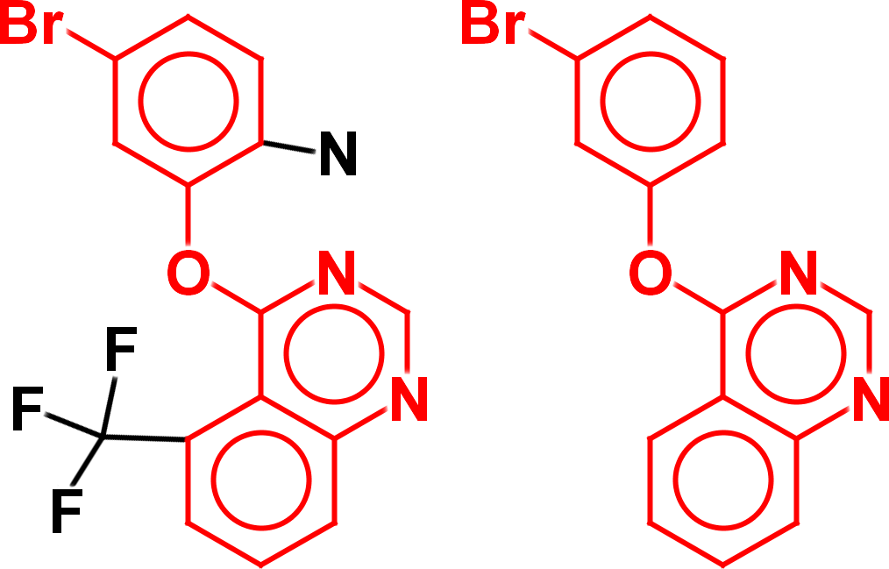
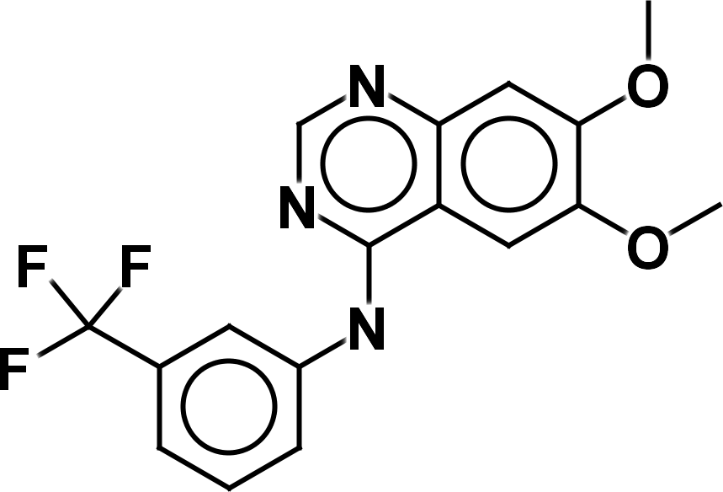
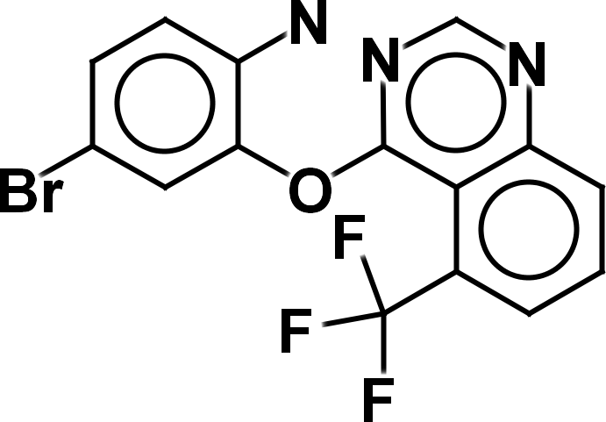
Virtual product formed
Ullmann condensation reaction
Virtual product
Closest match in the held-back actives, ZINC03815386
Most similar molecule in training data, ZINC03815044

Slide 55
Speed and timing testing
To produce a derivative, and calculate a predicted score for it, takes 107ms.
Assuming an average number of 53,450 products per molecules, this gives a time of 5,727 seconds to explore a single molecule (95 minutes).
Tests were performed on an Intel i7-3820 CPU @ 3.60GHz, running on a single core, with all data reading/writing from a Samsung PM83 Solid state drive.

Slide 56
Summary
Synthetic space is intractable
INDDEx – a logic-based drug-discovery tool
Virtual reactions
Estimating the size of searchable synthetic space
Filtering search space
Estimating the power of the virtual reaction search
Case study of application to drug discovery
Conclusion

Slide 57
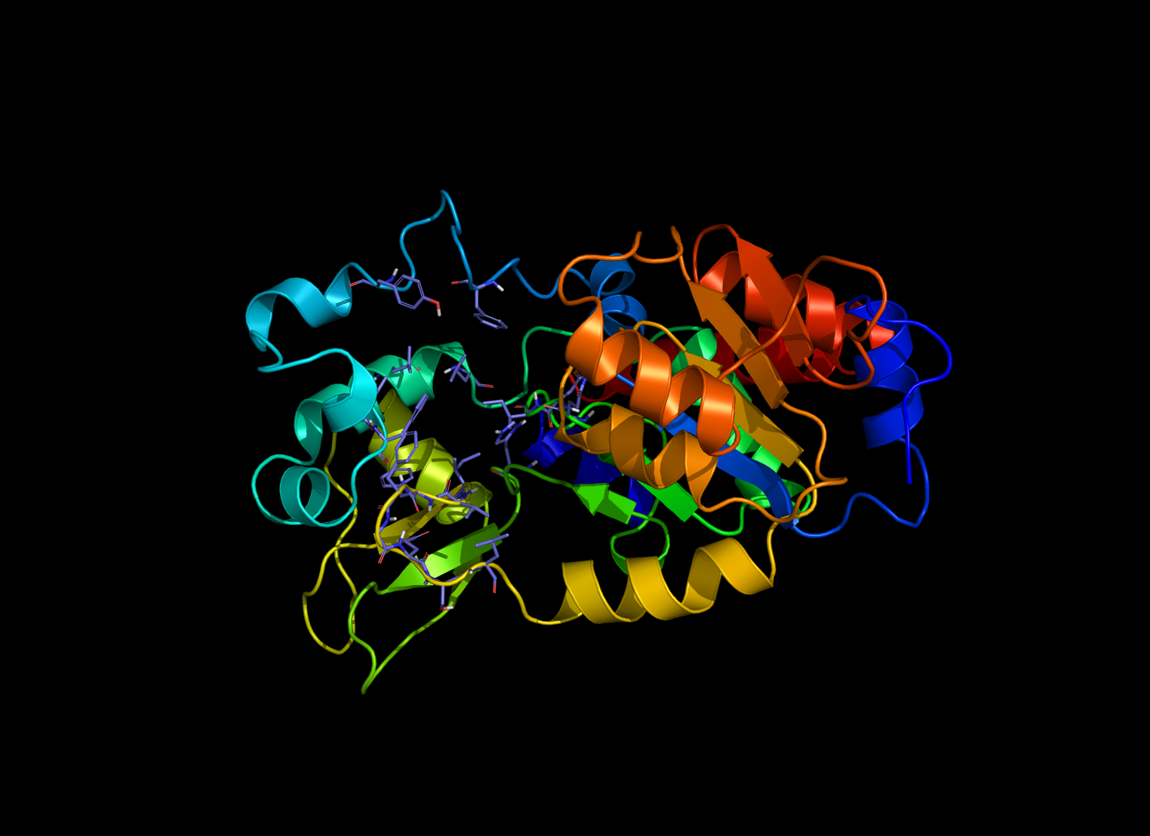
Case study: SIRT2 inhibition
SIRT2 is NAD-dependent deacetylase sirtuin-2.
3 chains, each a domain.
Linked to Parkinson’s disease.

Slide 58
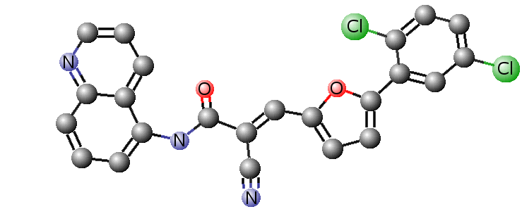
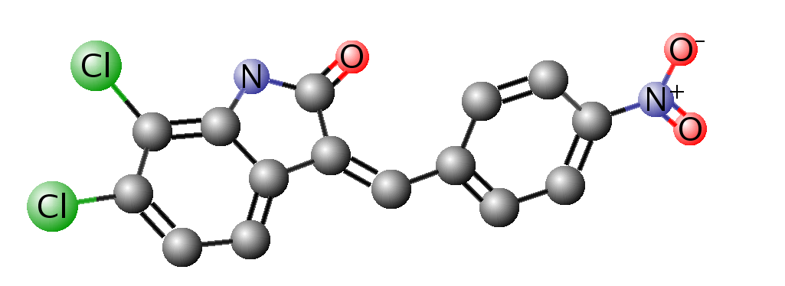
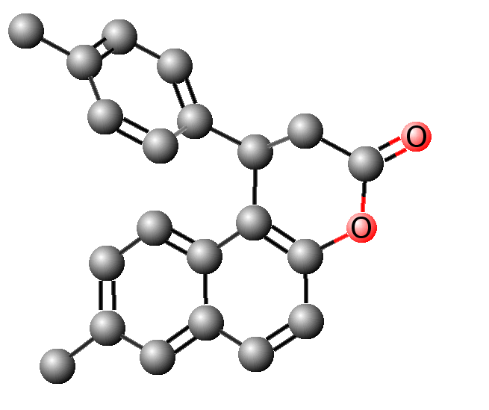
Molecules found by in vitro tests to have some low activity against SIRT2

Slide 59
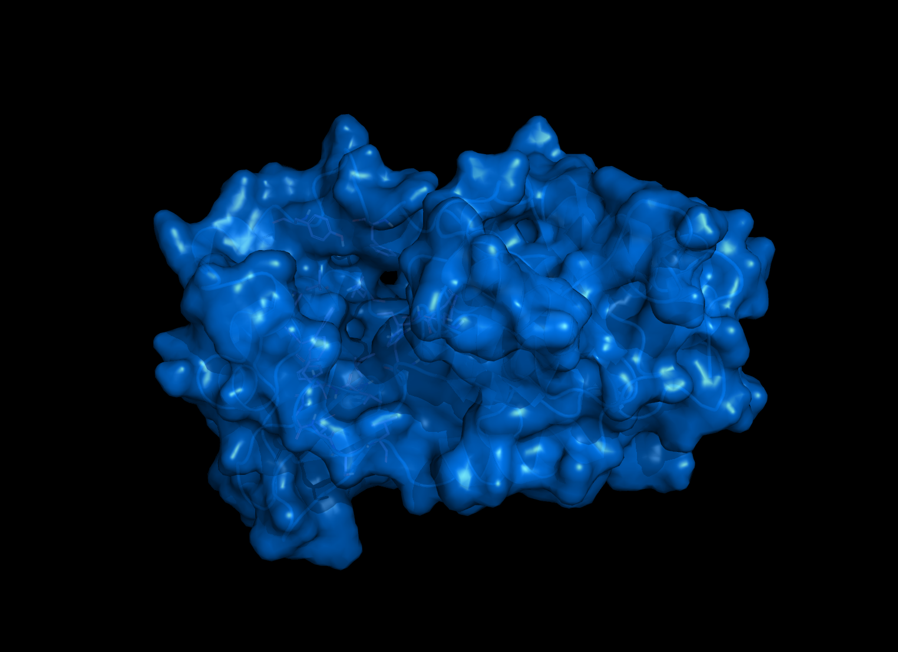
Predicted molecules docked against modelled SIRT2 protein structure using GOLD™

Slide 60
SIRT2 results – Screening
Training data
  8 active molecules
  IC₅₀ activities between 1.5 µM and 78 µM, but the best were unselective
8 molecules with best consensus INDDEx and docking scores purchased and tested.
  All molecules were structurally distinct from training molecules.
Two molecules had activity. One had IC₅₀ of 1.45 μM. As good as one of the training data molecules, selective for SIRT2 and chemically distinct.

Slide 61
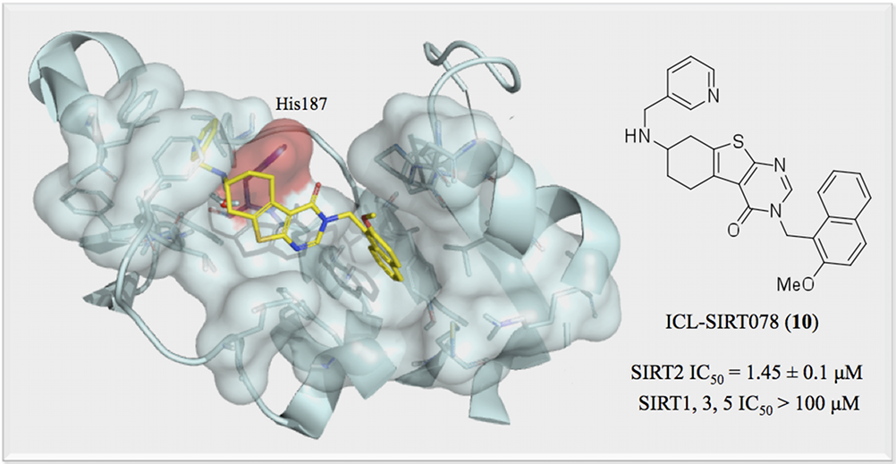
SIRT2 results – Screening

Slide 62

SIRT2 results – Virtual reactions
Scaled-down virtual reactions method
  Two reactions
  ~ 30 library side-chains
  ~ 1000 possible products
Made 171 derivatives
  9 had an IC₅₀ less than 1.5 µM
  The best had an IC₅₀ of 0.39 µM

Slide 63
Summary
Synthetic space is intractable
INDDEx – a logic-based drug-discovery tool
Virtual reactions
Estimating the size of searchable synthetic space
Filtering search space
Estimating the power of the virtual reaction search
Case study of application to drug discovery
Conclusion

Slide 64
Conclusion
INDDEx is powerful screening method whose strength lies in learning topological descriptors of multiple active compounds.
Applying virtual reactions allows the efficient search of synthetic space and can generate compounds similar to known actives.
Promising drug leads found for SIRT2 protein.

Slide 65




Acknowledgments
  Mike Sternberg
  Stephen Muggleton
  Ata Amini
  Suhail Islam
SIRT2 drug design
Paolo Di Fruscia
Matt Fuchter
Eric Lam
Chemistry Development Kit
Imagery
Wikimedia Commons
iStockPhoto®
  Funding
  BBSRC
  Equinox Pharma
  The 3DSIG organisers
  All of you for listening

Slide 66

Questions?

Slide 67

Testing scaffold hopping
% of known ligands retrieved
% of ranked database

Slide 68


Enrichment curves
% of known ligands retrieved
% of ranked database
Results for LASSO and DOCK from (Reid et al. 2008), and results for PharmaGist from (Dror et al. 2009)

Slide 69

Overview of the INDDEx process

