Slide 1
Overview
Edinburgh users – log in as normal
Non-Edinburgh users, grab a guest account from me.
Google Chrome recommended for Phyre2 (anything but Internet Explorer really!)
Go to main Phyre2 page, click on ‘fully booked’ then on ‘Workshop tutorial for attendees’ for schedule, feedback form and these slides to follow along with.

Slide 2
Overview
Theory
12:30-13:30 Protein structure prediction and Phyre2
Lawrence Kelley, Imperial
13:30-14:00 Investigating protein function with 3DLigandSite
Mark Wass, University of Kent
14:00-14:30 Using SuSPect to predict phenotypic effects of missense variants
Chris Yates, UCL
14:30-14:50 Coffee/Tea
Practical
14:50-15:20 Hands on tour of Phyre2
15:20-16:30 Worked examples and help with your own proteins

Slide 3




Using Phyre2 to predict protein structure on the web.
April 2015
Dr. Lawrence Kelley
Mr. Stefans Mezulis
Prof. Michael Sternberg

Slide 4
Overview
Questions welcome throughout
Methods, interpretation of results
Extended functionality
Future of Phyre2

Slide 5
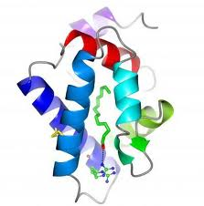
Phyre2
SVYDAAAQLTADVKKDLRDSW
KVIGSDKKGNGVALMTTLFAD
NQETIGYFKRLGNVSQGMAND
KLRGHSITLMYALQNFIDQLD
NPDSLDLVCS…….
Predict the 3D structure adopted by a user-supplied protein sequence

Slide 6
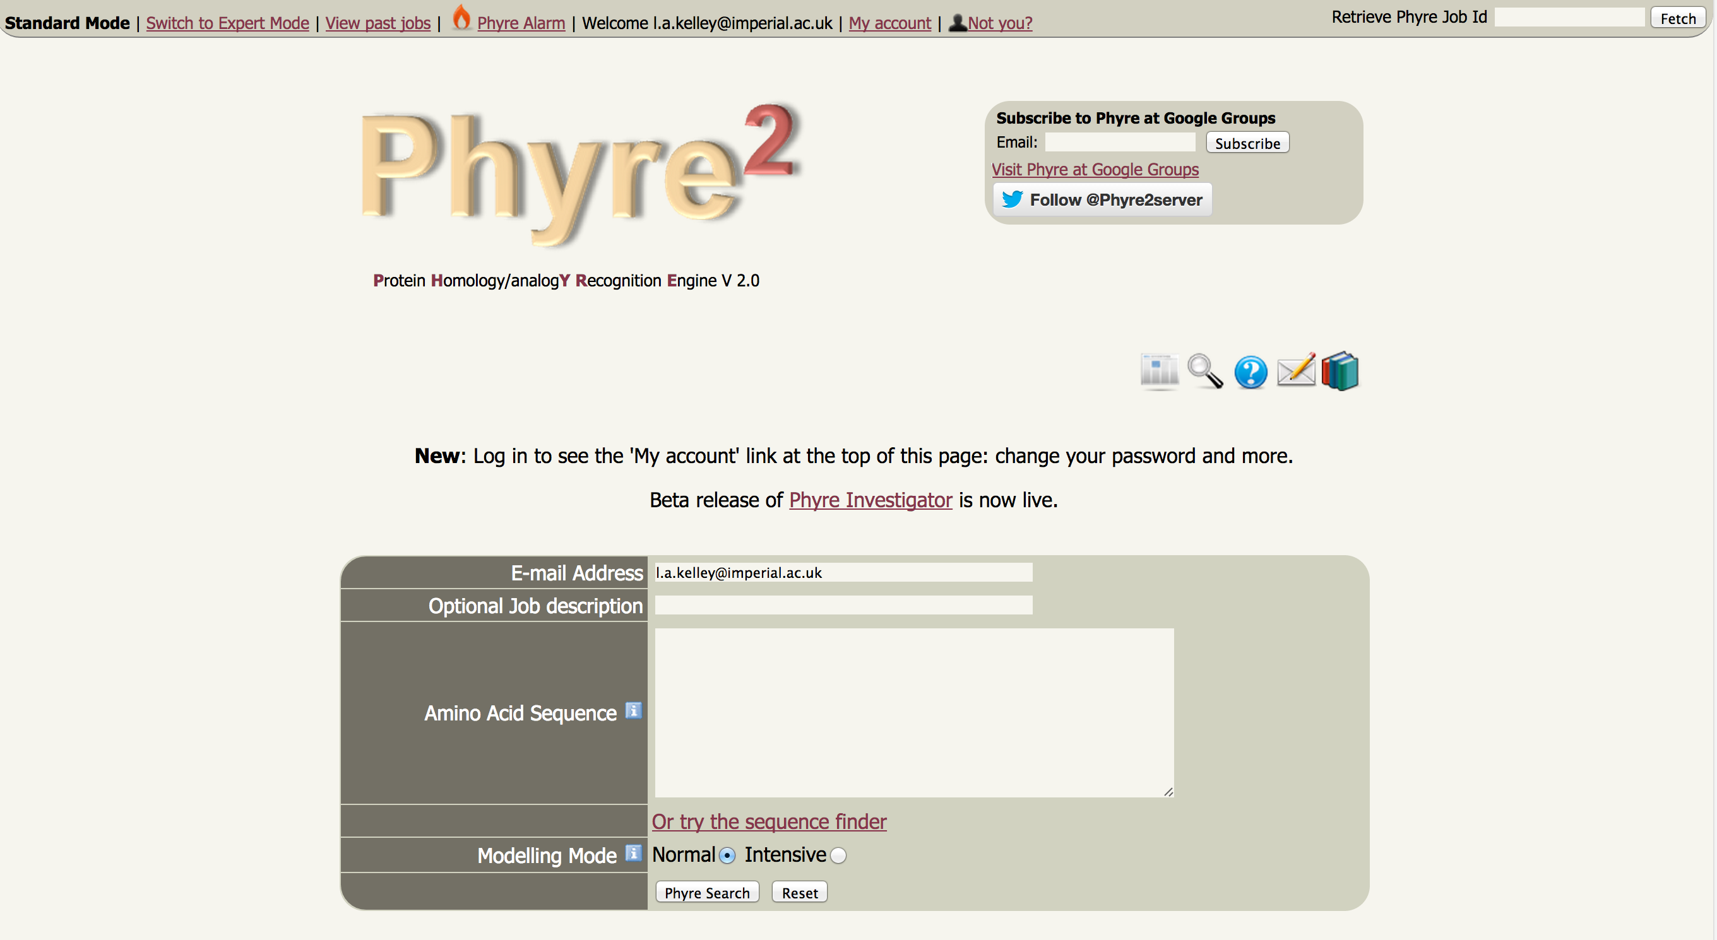
http://www.sbg.bio.ic.ac.uk/phyre2

Slide 7
How does Phyre2 work?

Slide 8
How does Phyre2 work?
“Normal” Mode
“Intensive” Mode
Advanced functions

Slide 9
How does Phyre2 work?
“Normal” Mode
“Intensive” Mode
Advanced functions

Slide 10
Phyre2
ARDLVIPMIYCGHGY
Homologous sequences
User sequence
Search the 30 million known sequences for homologues using PSI-Blast.

Slide 11
Phyre2
HMM
ARDLVIPMIYCGHGY
User sequence
PSI-Blast
Hidden Markov model
Capture the mutational propensities at each position in the protein
An evolutionary fingerprint

Slide 12
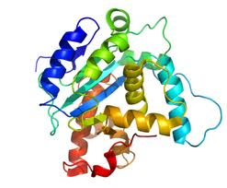
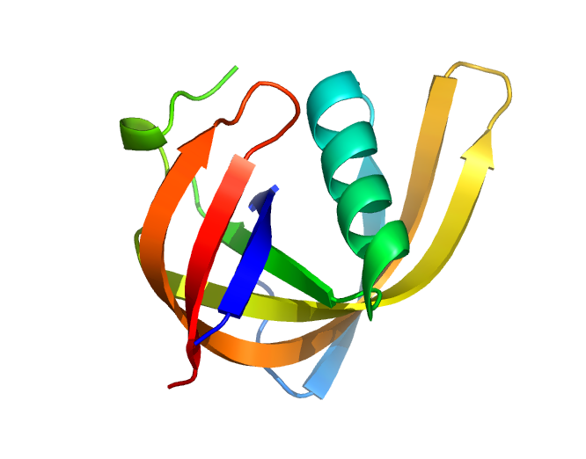
Phyre2
~ 100,000 known 3D structures

Slide 13
Phyre2
~ 100,000 known 3D structures

Slide 14
Phyre2
Extract sequence
HAPTLVRDC…….
~ 100,000 known 3D structures

Slide 15
Phyre2
Extract sequence
HAPTLVRDC…….
~ 100,000 known 3D structures
PSI-Blast

Slide 16
Phyre2
Extract sequence
HAPTLVRDC…….
~ 100,000 known 3D structures
PSI-Blast
HMM
Hidden Markov model
for sequence of KNOWN structure

Slide 17
Phyre2
HMM
HMM
HMM
~ 100,000 known 3D structures
~ 100,000 hidden Markov models

Slide 18
Phyre2
Hidden Markov Model Database of
KNOWN
STRUCTURES
~ 100,000 known 3D structures

Slide 19
Phyre2
HMM
ARDLVIPMIYCGHGY
PSI-Blast
Hidden Markov model
Capture the mutational propensities at each position in the protein
An evolutionary fingerprint

Slide 20
Phyre2
HMM
ARDLVIPMIYCGHGY
PSI-Blast
Hidden Markov Model DB of KNOWN
STRUCTURES
HMM-HMM
Matching
(HHsearch, Soeding)
Alignments of user sequence to known structures
ranked by confidence.
ARDL--VIPMIYCGHGY
AFDLCDLIPV--CGMAY
Sequence of known structure

Slide 21
Phyre2
HMM
ARDLVIPMIYCGHGY
PSI-Blast
Hidden Markov Model DB of KNOWN
STRUCTURES
HMM-HMM
Matching
(HHsearch, Soeding)
ARDL--VIPMIYCGHGY
3D-Model
AFDLCDLIPV--CGMAY
Sequence of known structure

Slide 22
Phyre2
HMM
ARDLVIPMIYCGHGY
PSI-Blast
Hidden Markov Model DB of KNOWN
STRUCTURES
Very powerful –
able to reliably detect extremely
remote homology
HMM-HMM
Matching
(HHsearch, Soeding)
Routinely creates accurate models even
when sequence identity is <15%
ARDL--VIPMIYCGHGY
3D-Model
AFDLCDLIPV--CGMAY
Sequence of known structure

Slide 23
From alignment to crude model
ARDL--VIPMIYCGHGY
Query (your sequence)
AFDLCDLIPV--CGMAY
Known
Structure
L
C
V
D
C
P
F
D
Y
G
Known 3D
Structure coordinates
A
I
A
L
M

Slide 24
From alignment to crude model
ARDL--VIPMIYCGHGY
Query
Re-label the known structure
according to the mapping from
the alignment.
AFDLCDLIPV--CGMAY
Known
Structure
I
Insertion (handled by loop modelling)
L
M
Y
D
Del
C
P
R
Y
G
A
I
A
Homology model
V
M

Slide 25
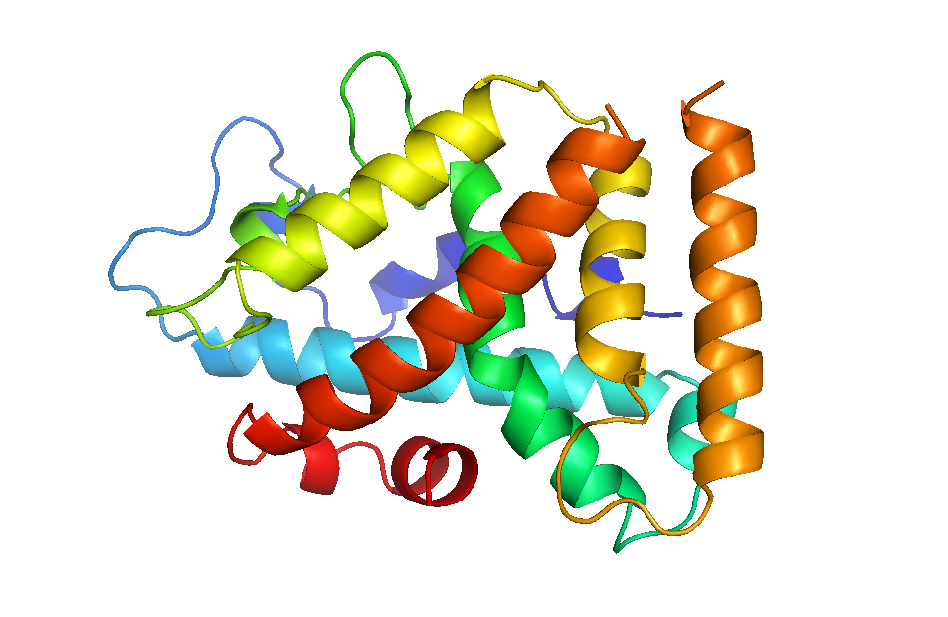
Loop modelling
ARDAKQH
d

Slide 26
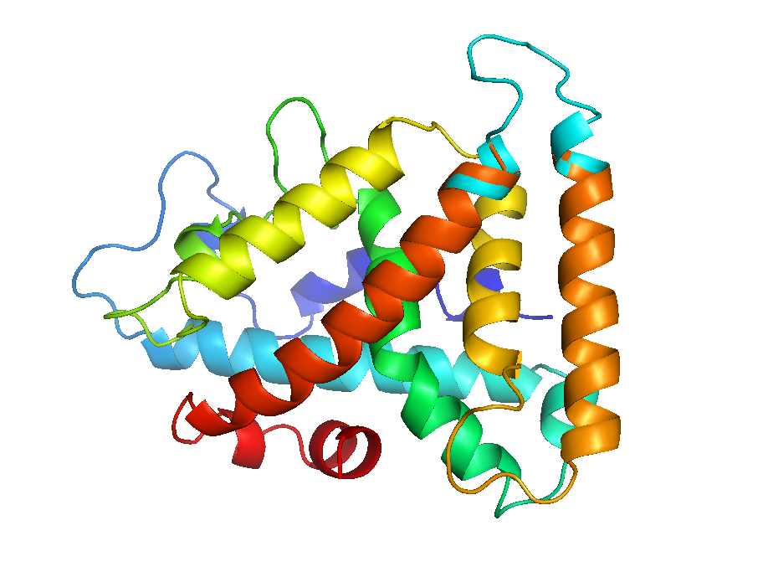
Loop modelling

Slide 27
Loop modelling
Insertions and deletions relative to template modelled by a loop library up to 15 aa’s in length
Short loops (<=5) good. Longer loops less trustworthy
Be wary of basing any interpretation of the structural effects of point mutations

Slide 28
Sidechain modelling

Slide 29
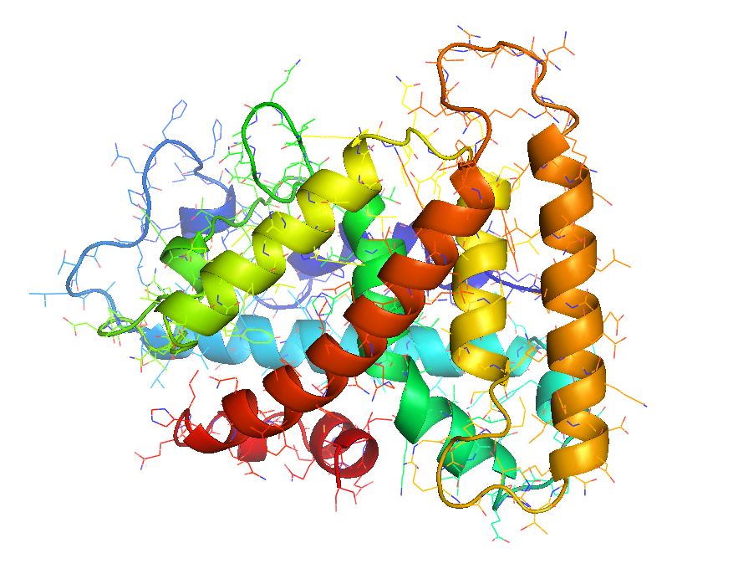
Sidechain modelling

Slide 30
Sidechain modelling
Optimisation problem
Fit most probable
rotamer at each position
According to given
backbone angles
Whilst avoiding clashes

Slide 31
Sidechain modelling
Sidechains will be modelled with ~80% accuracy IF……the backbone is correct.
Clashes *will* sometimes occur and if frequent, indicate probably a wrong alignment or poor template
Analyse with Phyre Investigator

Slide 32
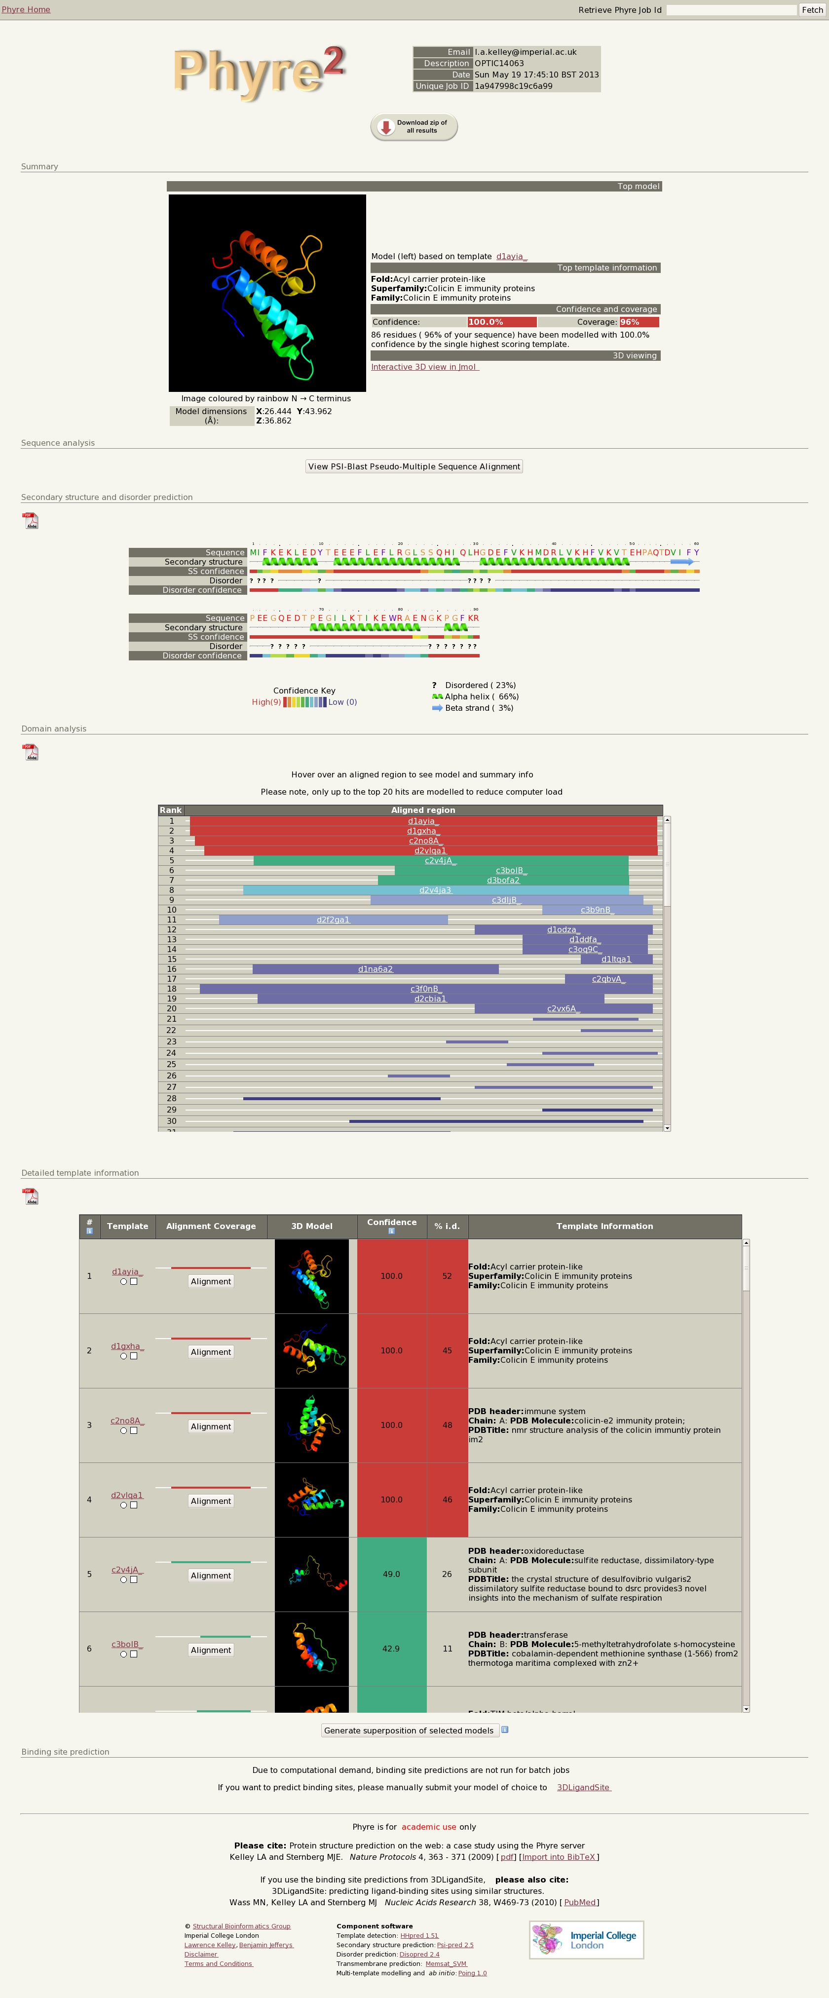
Example results
Top model info
Secondary structure/disorder
Domain analysis
Detailed template information

Slide 33
Example results
Top model info
Secondary structure/disorder
Domain analysis
Detailed template information

Slide 34
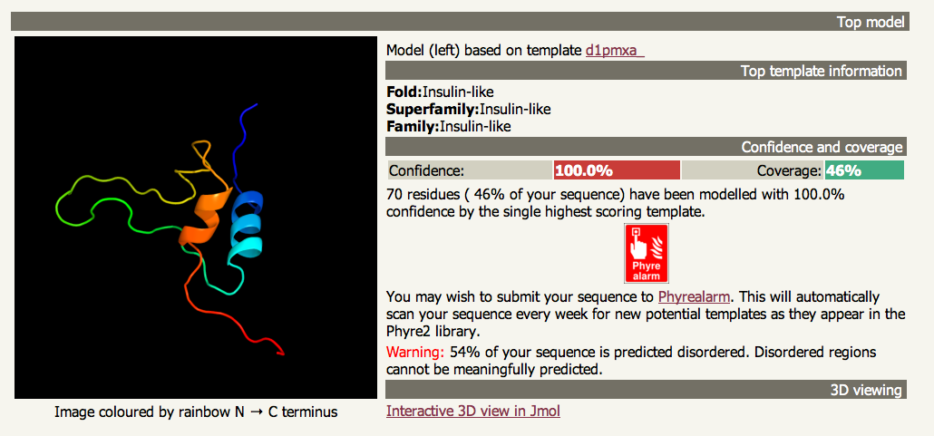
Example results

Slide 35
Example results
Top model info
Secondary structure/disorder
Domain analysis
Detailed template information

Slide 36
Example results
Top model info
Secondary structure/disorder
Domain analysis
Detailed template information

Slide 37
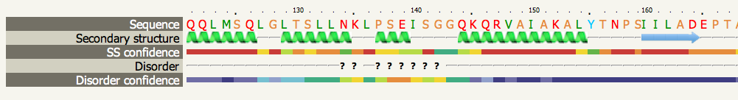
Example SS/disorder prediction

Slide 38
Secondary structure and disorder
Based on neural networks trained on known structures.
Given a diverse set of homologous sequences, expect ~75-80% accuracy.
Few or no homologous sequences? Only 60-62% accuracy

Slide 39
Example results
Top model info
Secondary structure/disorder
Domain analysis
Detailed template information

Slide 40
Example results
Top model info
Secondary structure/disorder
Domain analysis
Detailed template information

Slide 41
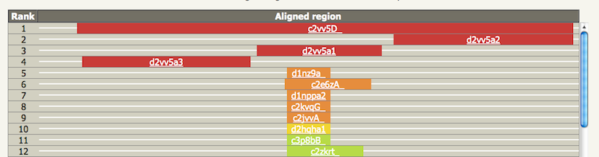
Example domain analysis

Slide 42
Domain analysis
Local hits to different templates indicate domain structure of your protein
Multiple domains can be linked using ‘Intensive mode’

Slide 43
Example results
Top model info
Secondary structure/disorder
Domain analysis
Detailed template information

Slide 44
Example results
Top model info
Secondary structure/disorder
Domain analysis
Detailed template information

Slide 45
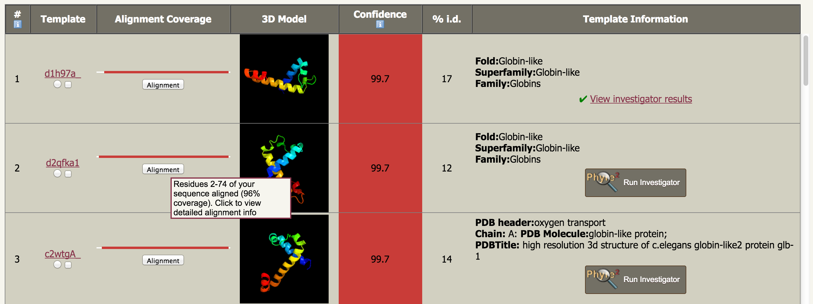
Main results table
Actual Model!
Not just a picture of the template –
click to download model

Slide 46
Interpreting results
How accurate is my model?
Simple question with a complicated answer!
RMSD very commonly used, but often misleading
Modelling community uses TM score for benchmarking: essentially the percentage of alpha carbons superposable on the answer within 3.5Å. Prediction of TM-score coming soon.
Focused on the protein core, rather than loops and sidechains.

Slide 47
Interpreting results
MAIN POINT: The confidence estimate provided by Phyre2 is NOT a direct indication of model quality – though it is related…
It is a measure of the likelihood of homology
Model quality can now be assessed using the new Phyre Investigator (more later)
New measure of model quality coming soon..

Slide 48
Interpreting results
Sequence identity and model accuracy
High confidence (>90%) and High seq. id. (>35%): almost always very accurate: TM score>0.7, RMSD 1-3Å
High confidence (>90%) and low seq. id. (<30%) almost certainly the correct fold, accurate in the core (2-4Å) but may show substantial deviations in loops and non-core regions.

Slide 49
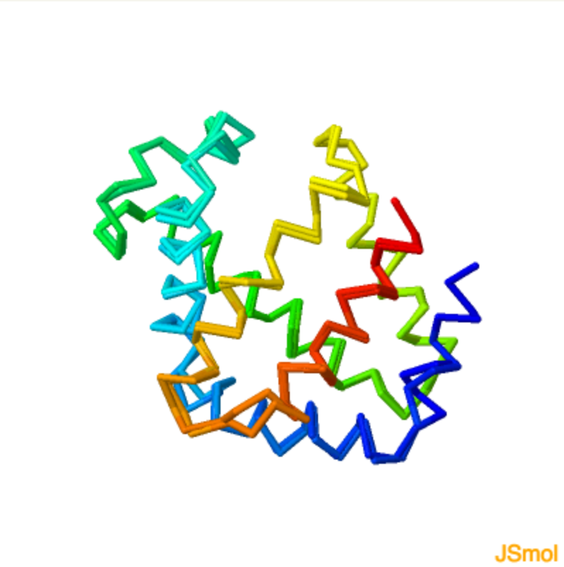
Interpreting results
100% confidence,
56% sequence identity, TM-score 0.9

Slide 50
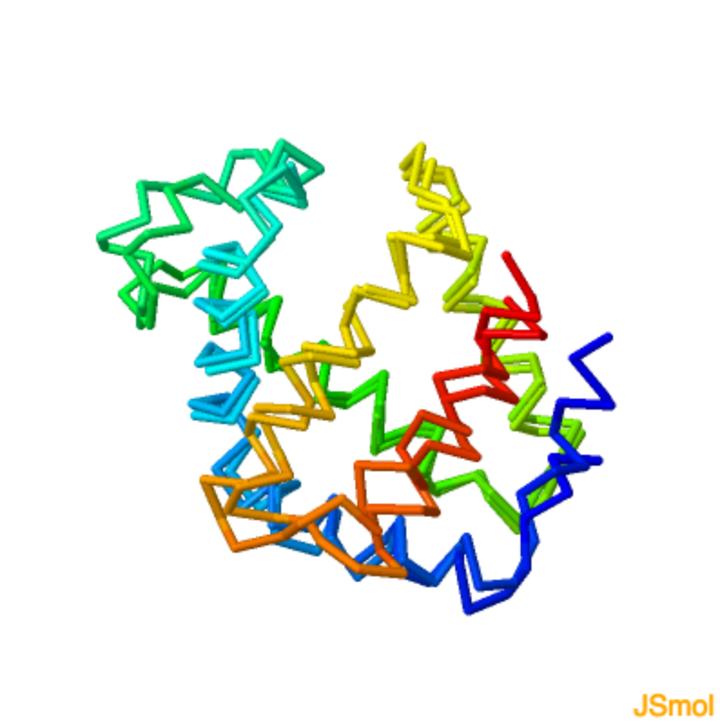
Interpreting results
100% confidence,
24% sequence identity, TM-score 0.8

Slide 51
Interpreting results
Checklist
Look at confidence
Given multiple high confidence hits, look at % sequence identity
Biological knowledge relating function of template to sequence of interest
Structural superpositions to compare models – many similar models increase confidence
Examine sequence alignment

Slide 52
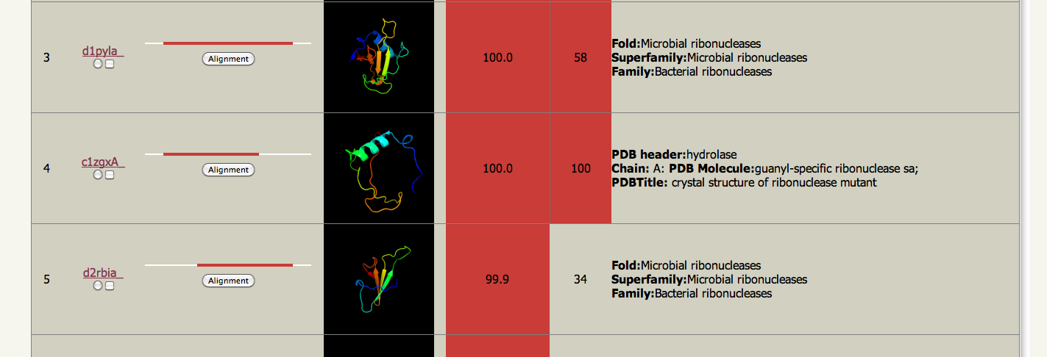
Main results table

Slide 53
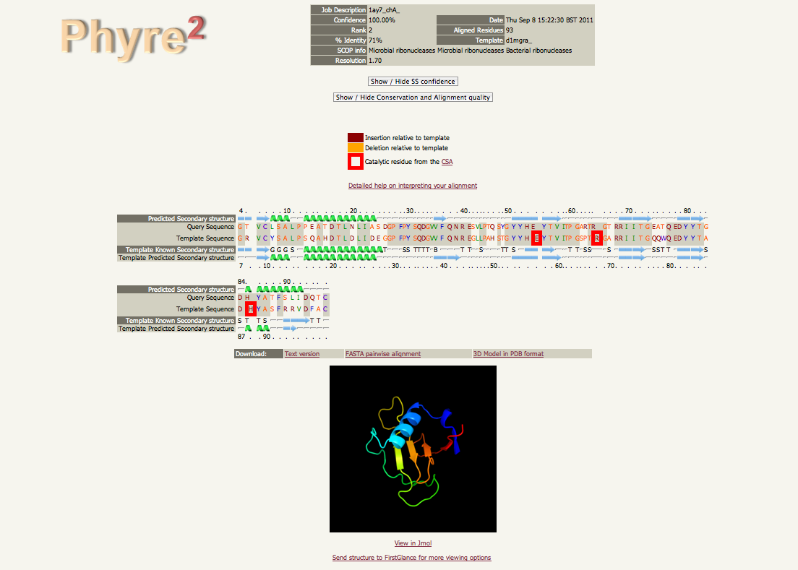
Alignment view

Slide 54
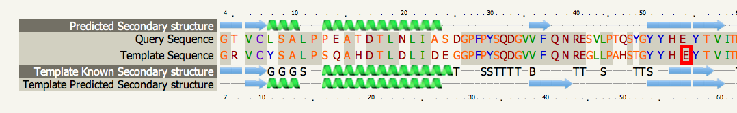
Alignment view

Slide 55
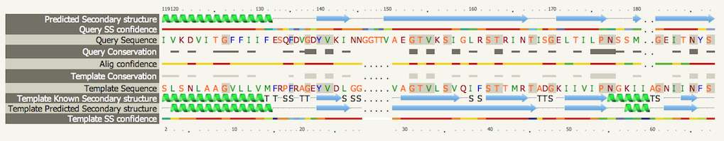
Alignment view

Slide 56
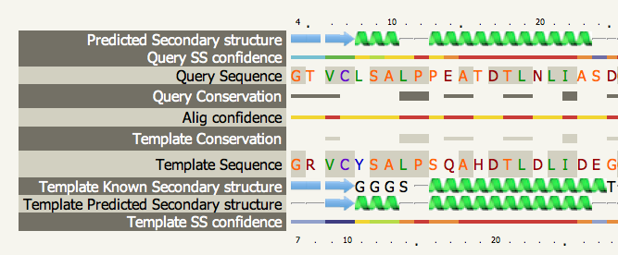
Alignment view

Slide 57
Alignment interpretation
Checklist
Secondary structure matches
Gaps in SS elements indicate potentially wrong alignment
Active sites present in the Catalytic Site Atlas (CSA) for the template highlighted – look for identity or conservative mutations when transferring function
Alignment confidence per residue

Slide 58
Mutations
The STRUCTURAL effects of point mutations on structure will NOT be modelled accurately
Checklist
Is it near the active site?
Is it a change in the hydrophobic core?
Is it near a known binding site? (can predict with e.g. 3DLigandSite)
Phyre Investigator can help (see later)

Slide 59
Is my model good enough?
All depends on your purpose.
Good enough for drug design? – probably if the sequence identity is very high (>50%)
Sometimes good enough if far lower seq id but accurate around site of interest.
High confidence but low seq i.d. still very likely correct fold, useful for a range of tasks.

Slide 60
How does Phyre2 work?
“Normal” Mode
“Intensive” Mode
Advanced functions

Slide 61
How does Phyre2 work?
“Normal” Mode
“Intensive” Mode
Advanced functions

Slide 62
Shortcomings of ‘normal’ Mode
Individual domains in multi-dom proteins often modelled separately
Regions with no detectable homology to known structure unmodelled
Does not use multiple templates which, when combined could result in better coverage
Thus need a system to fold a protein without templates
and combine templates when we have them

Slide 63
Poing – simplified folding model
structure simplification
Small hydrophilic sidechain
Backbone
C-alpha
Protein backbone
Large hydrophobic sidechain
Notes:
The protein is reduced to a string of Calpha beads with sidechain centroid particles attached

Slide 64
VIDEO

Slide 65
Phyre + Poing
HMM
ARNDLSLDLVCS…….
PSI-Blast
Hidden Markov Model DB of KNOWN STRUCTURES
HMM-HMM
matching
FINAL MODEL
POING: Synthesise from virtual ribosome.
Springs for constraints. Ab initio modelling
of missing regions.
Extract pairwise
distance constraints

Slide 66
Phyre + Poing + Modeller
Key
Modeller
High accuracy
Ab initio
region
junk
Crude, Calpha only
Ab initio
region
Poing
Maintains detail in confident regions whilst creating ‘reasonable’ ab initio regions
Reasonable
Guess. Compact
with SS elements
Modeller
Poing + Modeller

Slide 67
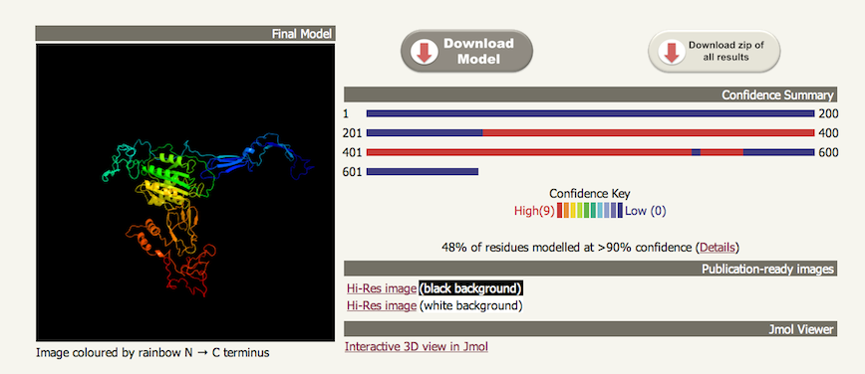
Intensive mode

Slide 68
Intensive mode
Designed to handle mutliple domains or proteins with substantial stretches of sequence without detectable homologous structures.
POOR at ab initio regions
GOOD at combining multiple templates covering different regions

Slide 69
Intensive mode
Relative domain orientation will NOT generally be correct if those domains come from different PDB’s with little structural overlap.
Query
✔
Template 1
Template 2

Slide 70
Intensive mode
Relative domain orientation will NOT generally be correct if those domains come from different PDB’s with little structural overlap.
Query
✖
Template 1
Template 2
?

Slide 71
Intensive mode
B-factors in final model indicate ab initio vs. template-based modelled regions
Can be slow on large proteins and limited to 1,000 residues.
Under active development – improved version available in a few months.

Slide 72
Intensive mode
“Intensive” does not always equal “Better”!
Checklist
Always use normal mode first to understand what regions can be well modelled
Multiple overlapping high confidence domains? Good, try intensive. Otherwise skip it.
Danger of “spaghettification”
Active development, new version ‘soon’

Slide 73
How does Phyre2 work?
“Normal” Mode
“Intensive” Mode
Advanced functions

Slide 74
How does Phyre2 work?
“Normal” Mode
“Intensive” Mode
Advanced functions

Slide 75
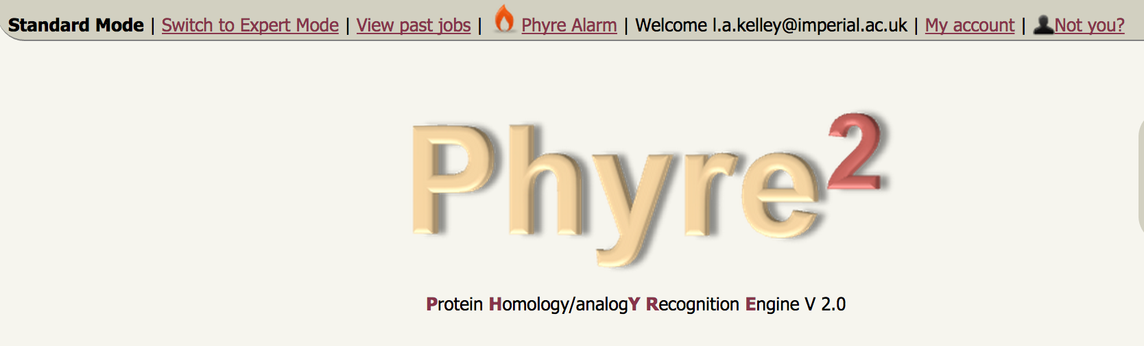
Advanced functions
Register and Log in to access Expert Mode

Slide 76
Advanced functions
PhyreAlarm – automatically re-run tricky sequences every week
BackPhyre – compare a structure to up to 30 genomes
One-To-One Threading – use specfic PDB for model building
Batch Jobs – run many sequences at once
Job Manager – keep track of your jobs and history

Slide 77
Advanced functions
PhyreAlarm – automatically re-run tricky sequences every week
BackPhyre – compare a structure to up to 30 genomes
One-To-One Threading – use specfic PDB for model building
Batch Jobs – run many sequences at once
Job Manager – keep track of your jobs and history

Slide 78
PhyreAlarm
Sometimes no confident homology detected
Automatically try every week as new structures are deposited in the PDB
Receive an email if hit found
PhyreAlarm auto-suggested in cases where sequence has low coverage by confident hits
Two clicks adds your sequence to the alarm queue

Slide 79
PhyreAlarm
User sequence
HMM
SVYDAAAQLTADVKKD…….
Newly solved PDB
Structures added WEEKLY
HMM-HMM matching
Newly added structure HMMs
Yes
Confident hit?
Perform full Phyre modelling
No
Email results
New 3D model
Try again next week

Slide 80
Advanced functions
PhyreAlarm – automatically re-run tricky sequences every week
BackPhyre – compare a structure to up to 30 genomes
One-To-One Threading – use specfic PDB for model building
Batch Jobs – run many sequences at once
Job Manager – keep track of your jobs and history

Slide 81
Advanced functions
PhyreAlarm – automatically re-run tricky sequences every week
BackPhyre – compare a structure to up to 30 genomes
One-To-One Threading – use specfic PDB for model building
Batch Jobs – run many sequences at once
Job Manager – keep track of your jobs and history

Slide 82
BackPhyre
Does a structure I’m interested in exist in an organism?
30 searchable genomes to-date.
Scan multiple genomes at a time. Quite fast.
New version will allow users to upload their own genomes of interest.

Slide 83
BackPhyre
User structure
SVYDAAAQLTADVKKDLRDSW
KVIGSDKKGNGVALMTTLFAD
NQETIGYFKRLGNVSQGMAND
KLRGHSITLMYALQNFIDQLD
NPDSLDLVCS…….
Rank | Hit | Confid-ence
1 | Gi…
2 | Gi..
3 | Gi..
. | .
. | .
Hidden Markov Model DB of Genomes
HMM
HMM-HMM matching
Ranked list of genome hits

Slide 84
Advanced functions
PhyreAlarm – automatically re-run tricky sequences every week
BackPhyre – compare a structure to up to 30 genomes
One-To-One Threading – use specfic PDB for model building
Batch Jobs – run many sequences at once
Job Manager – keep track of your jobs and history

Slide 85
Advanced functions
PhyreAlarm – automatically re-run tricky sequences every week
BackPhyre – compare a structure to up to 30 genomes
One-To-One Threading – use specfic PDB for model building
Batch Jobs – run many sequences at once
Job Manager – keep track of your jobs and history

Slide 86
One-to-One Threading
Useful if you:
a) Know a better template than found by Phyre2
b) Have your own structure not yet in the PDB
c) Model a a lower-ranked (>20) template
d) Want more expert control over alignment options: local/global, secondary structure weight etc.

Slide 87
One to one threading
User structure
HMM of
User structure
SVYDAAAQLTADVKKDLRDSWDLVCS…….
HMM-HMM matching
User sequence
HMM of
user
sequence
KLRGHSITLMYALQN
NPDSLDLVCS…….
Final model

Slide 88
Advanced functions
PhyreAlarm – automatically re-run tricky sequences every week
BackPhyre – compare a structure to up to 30 genomes
One-To-One Threading – use specfic PDB for model building
Batch Jobs – run many sequences at once
Job Manager – keep track of your jobs and history

Slide 89
Advanced functions
PhyreAlarm – automatically re-run tricky sequences every week
BackPhyre – compare a structure to up to 30 genomes
One-To-One Threading – use specfic PDB for model building
Batch Jobs – run many sequences at once
Job Manager – keep track of your jobs and history

Slide 90
Batch Jobs
Only Normal mode for speed considerations
Sequences are processed more slowly than individual submissions to maintain user experience
Batch job progress can be monitored, view intermediate results
100 Sequences by default. Use the My Account page to request an increase (up to 1-2k)

Slide 91
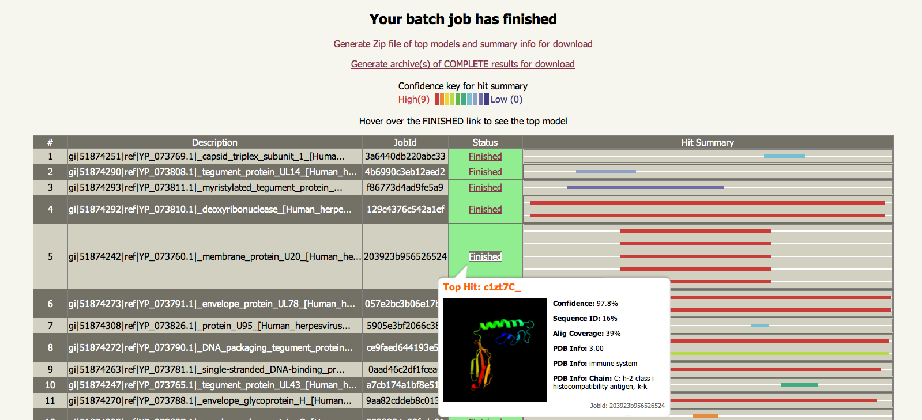
Batch Jobs

Slide 92
Advanced functions
PhyreAlarm – automatically re-run tricky sequences every week
BackPhyre – compare a structure to up to 30 genomes
One-To-One Threading – use specfic PDB for model building
Batch Jobs – run many sequences at once
Job Manager – keep track of your jobs and history

Slide 93
Advanced functions
PhyreAlarm – automatically re-run tricky sequences every week
BackPhyre – compare a structure to up to 30 genomes
One-To-One Threading – use specfic PDB for model building
Batch Jobs – run many sequences at once
Job Manager – keep track of your jobs and history

Slide 94
Job manager
Only available if logged in
Shows complete job history, sequence, top hit summary
Allows deletion and renewal of jobs (they expire after 30 days)

Slide 95
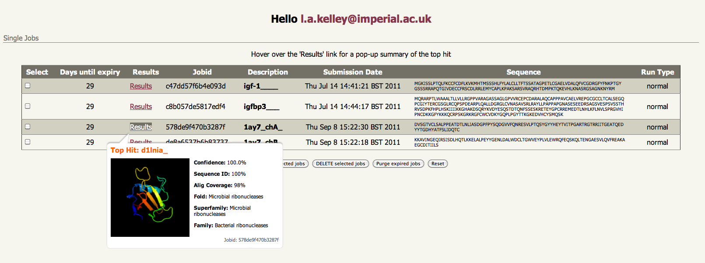
Job manager

Slide 96
3DLigandSite
Predict ligand and binding sites from structure
If a Phyre2 hit is sufficiently confident….
Top model sent automatically to 3DLigandSite for ligand binding site prediction
Sequences submitted to 3DLigandSite automatically sent to Phyre2 for modelling

Slide 97
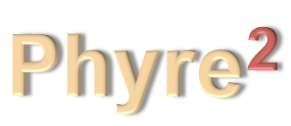
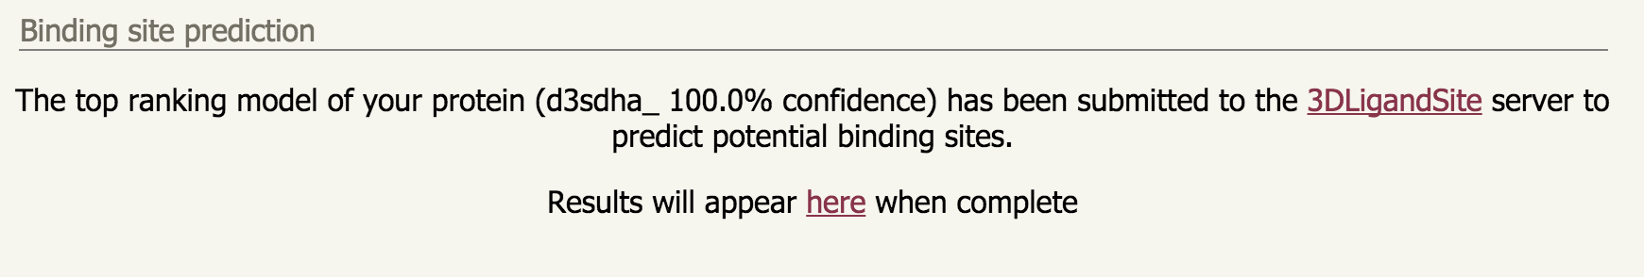
3DLigandSite
Confident hit?
3DLigandSite
Sequence only?
Currently a link near bottom of Phyre2 Results
New version will have an embedded JSMol viewer,
summary table of results within Phyre2 web page

Slide 98
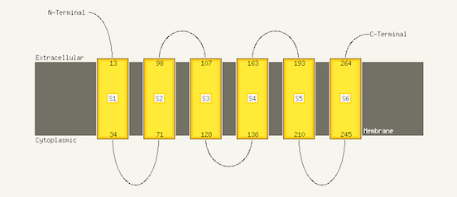
Transmembrane helices
If confidently predicted to contain membrane helices, topology prediction run. (Machine learning approach estimated to be 85% accurate)
Memsat-SVM, Nugent & Jones, 2009

Slide 99

Phyre Investigator

Slide 100
Phyre Investigator
What parts of a model are reliable?
What parts may be functionally important? (guide mutagenesis, understand mutants/SNPs)
What residues are involved in interactions with other proteins?

Slide 101
Phyre Investigator
Clashes
Rotamer outliers
Ramachandran outliers
ProQ2 model quality assessment
Alignment confidence (HHsearch)
Conservation/evolutionary trace (Jenson-Shannon divergence –far faster and just as accurate as ET)
Catalytic Site Atlas
Disorder
Pocket detection (Fpocket)
Protein interface residues (PI-Site, ProtinDB)
Conserved Domain Database ‘conserved features’ for NCBI-curated domains

Slide 102
Phyre Investigator
Effect of Mutations?
Will a SNP effect my protein’s function?
New method: SuSPect by Chris Yates
Integrated into Phyre Investigator
Also standalone server

Slide 103
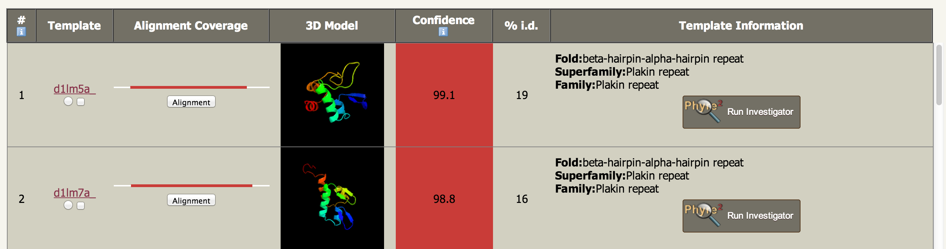
Phyre Investigator

Slide 104
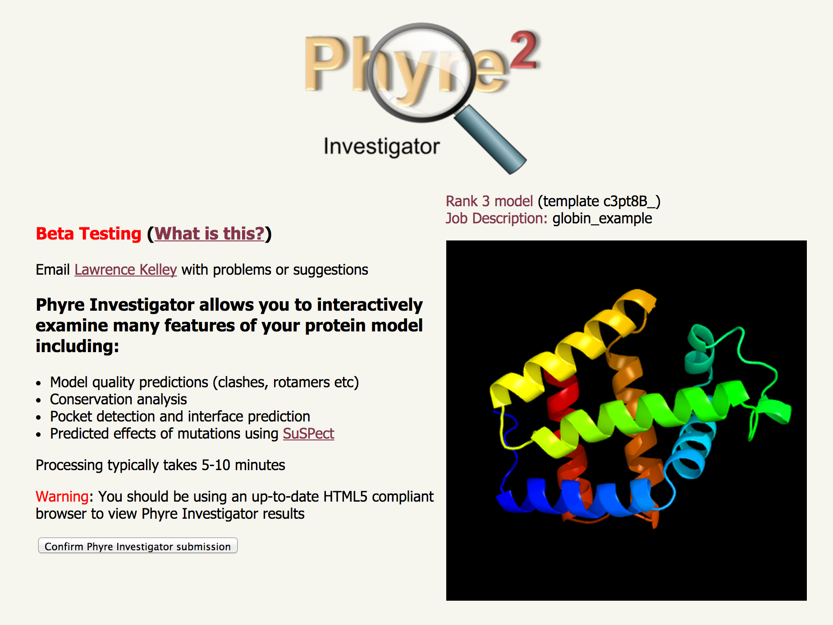
Phyre Investigator

Slide 105
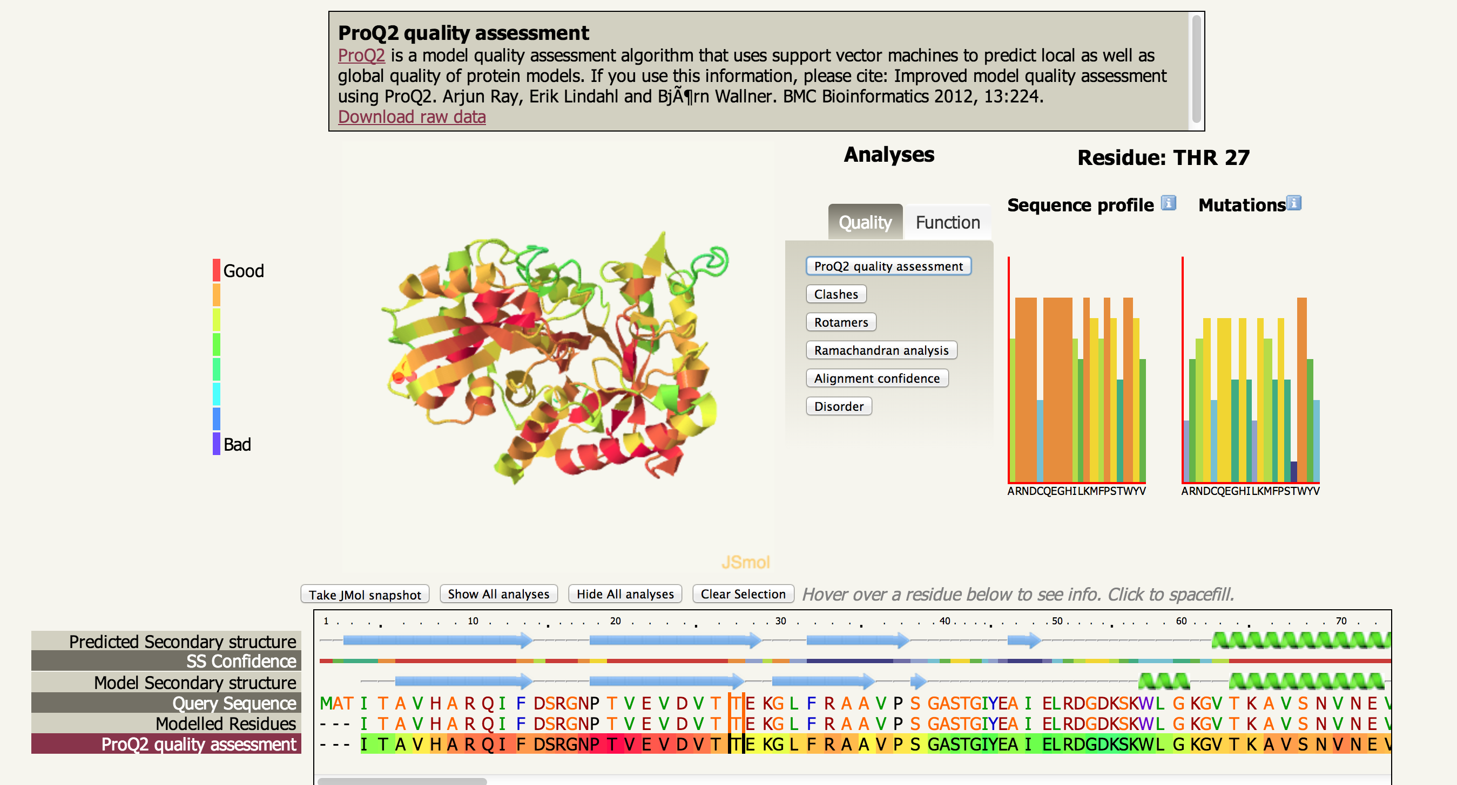
Phyre Investigator

Slide 106
Future
New paper in Nature Protocols:
The Phyre2 web portal for protein modelling, prediction
and analysis (Kelley, Mezulis, Wass, Yates & Sternberg)
Awaiting proofs, should be out in a few weeks at most

Slide 107
2015: Complex building

Slide 108
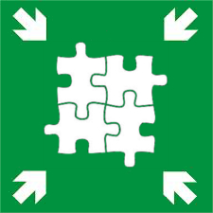
2015: Complex building
Phyre Assembly Point

Slide 109
Complex building
Scan via sequence or structure
Database of known complexes
(homo and hetero)
against database of complexes
User model/
Crystal structure
Matches between your structure
And complexes containing a
homologous
structure

Slide 110
Complex building
User chooses which complex
Is desired and which chains
to substitute

Slide 111
Complex building
Rotate user model onto
Structural homologue
Remove
Structural
homologue
Refinement, clash check
Interface quality check
Final complex and
Quality assessment
Crude
Predicted complex

Slide 112
Complex building
Include Rosetta relax protocol for the complex
Report clashes
Report quality of interface – investigate existing scoring schemes
Generalise to permit users to upload multiple structures
Scan and find existing complexes that contain structural homologues of the input models in different combinations

Slide 113
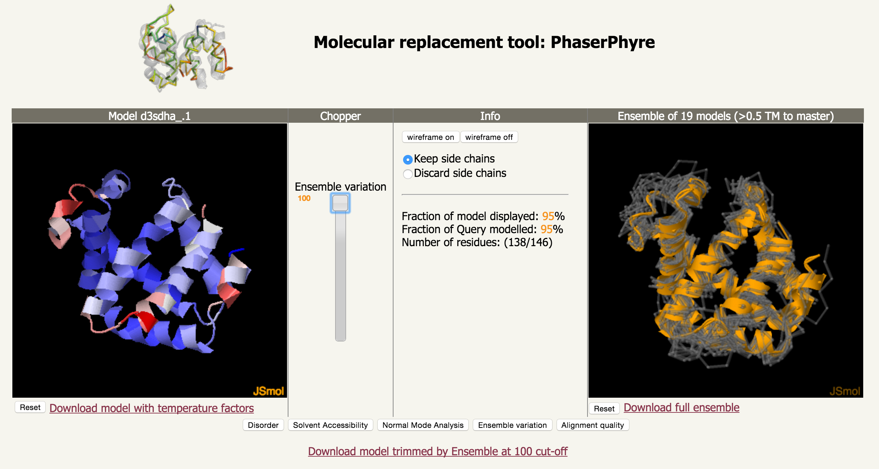
PhaserPhyre

Slide 114
PhyreStorm
Searching Topology with Rapid Matching
Structural search and alignment of the entire PDB in under 1 minute.
Go directly from a Phyre2 model and find all other similar structures rapidly.
Beta release in 1-2 months. Interface under developement

Slide 115
Jalview Integration
Jalview users can submit their sequence to Phyre2 directly within the Jalview desktop app or web applet
Should be in place in 1-2 months
Later, allow Phyre2 users to directly load their model and alignments into Jalview
Work with Geoff Barton and Jim Procter, Dundee

Slide 116
Feedback welcome
Ease of use – what’s clear/unclear on the site?
Functionality – is there something you wish it could do that it doesn’t?
Contact:
  Anonymous feedback on Phyre2 Workshop page
  Twitter (@phyre2server)
  Google Groups (groups.google.com/group/phyre)
  Email (l.a.kelley@imperial.ac.uk)

Slide 117
Thank You!

Slide 118
Complex building
Main challenge is designing an intuitive user interface.
Each complex displayed in browser, chains colour coded.
Select chains to replace and with what input model via tick boxes.

Slide 119
PhyreRisk
Wellcome Trust 5 year grant
PhyreRisk – integrate disease networks, SNPs, GWAS, protein structure and complexes

Slide 120
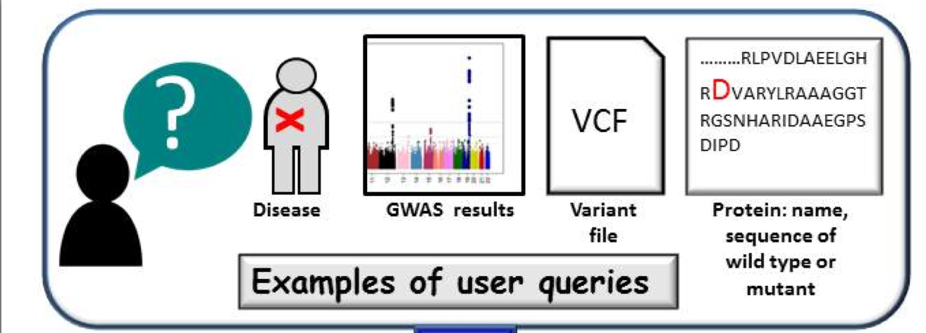
PhyreRisk
Integrate disease networks, SNPs, GWAS,
protein structure and complexes

Slide 121
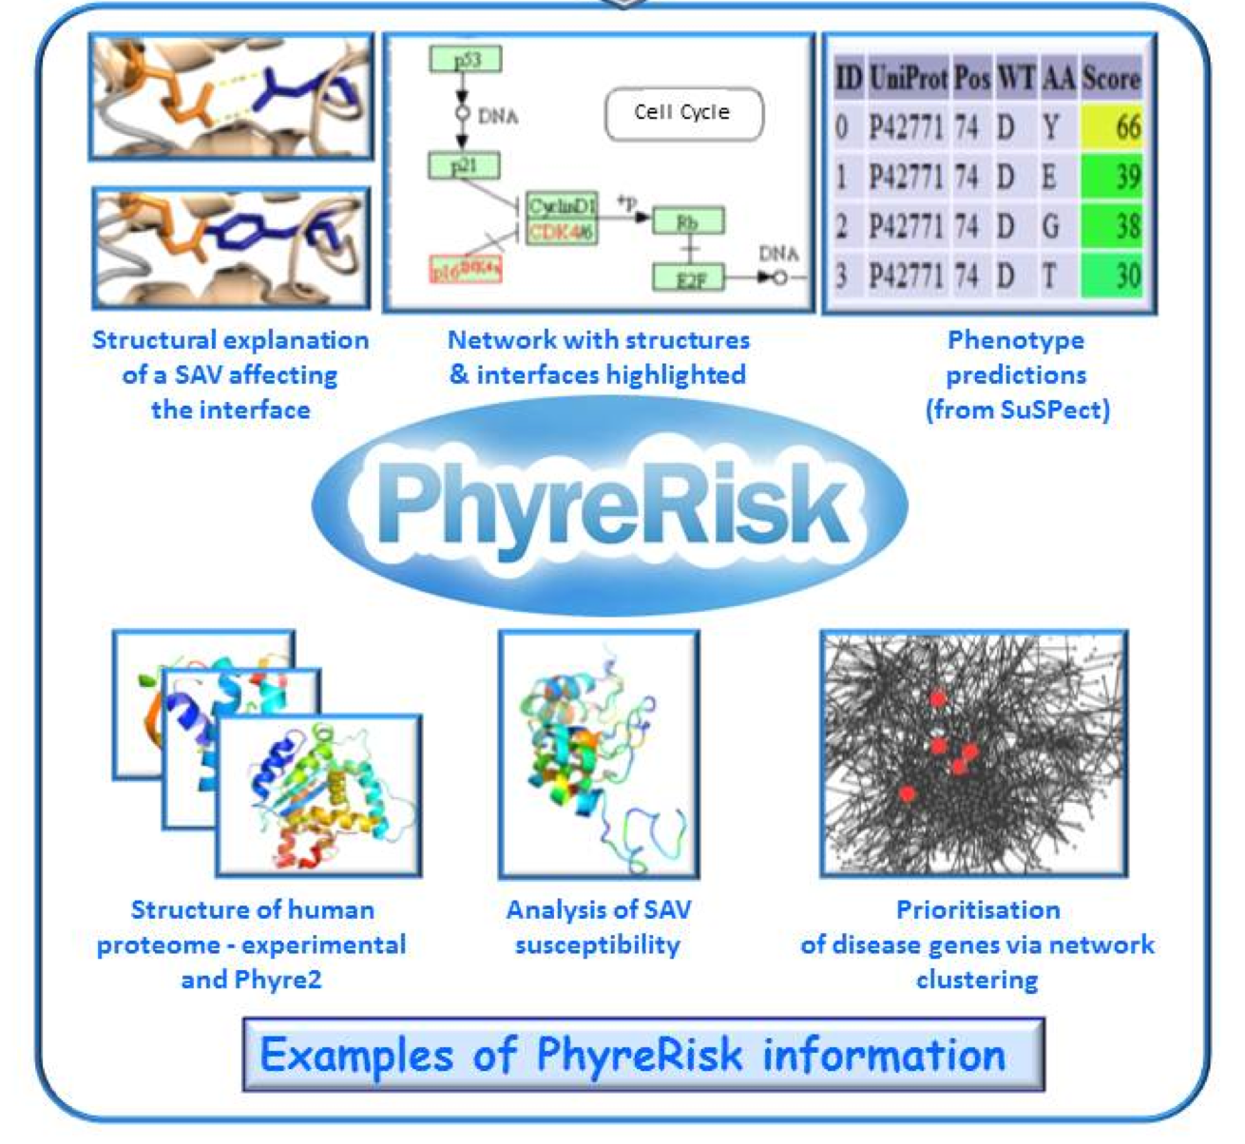
PhyreRisk

Slide 122
Enhancing and maintaining Phyre2
User selection of templates for multiple template modelling
Integration with Jalview
Video tutorials for all aspects of the server
Interactive tool to cluster and compare models
Rosetta refinement
Cn3D compatibility
Cloud, faster version of Phyre2
Fast structural search against the PDB
User-uploadable genomes for processing for Backphyre
Building PTM’s using SidePRO

Slide 123
Enhancing and maintaining Phyre2
Stefans Mezulis : Core homology detection and modelling
Hongjiang Miao : Investigating contact prediction for structure prediction

Slide 124
Interface Enhancements

Slide 125
Interface Enhancements
Use of Ajax and Google’s jQuery for more dynamic content in pages
Job renewal without leaving the page
Dynamic rendering of analysis history with Phyre Investigator (allows downloadable static pages but also with dynamic content)
Improved help and FAQ
Sequence finder
Improved model comparison
Shifting all pages from Jmol to Jsmol
Collapsible content for easier viewing
Account page for password changes and batch limit increase requests

Slide 126
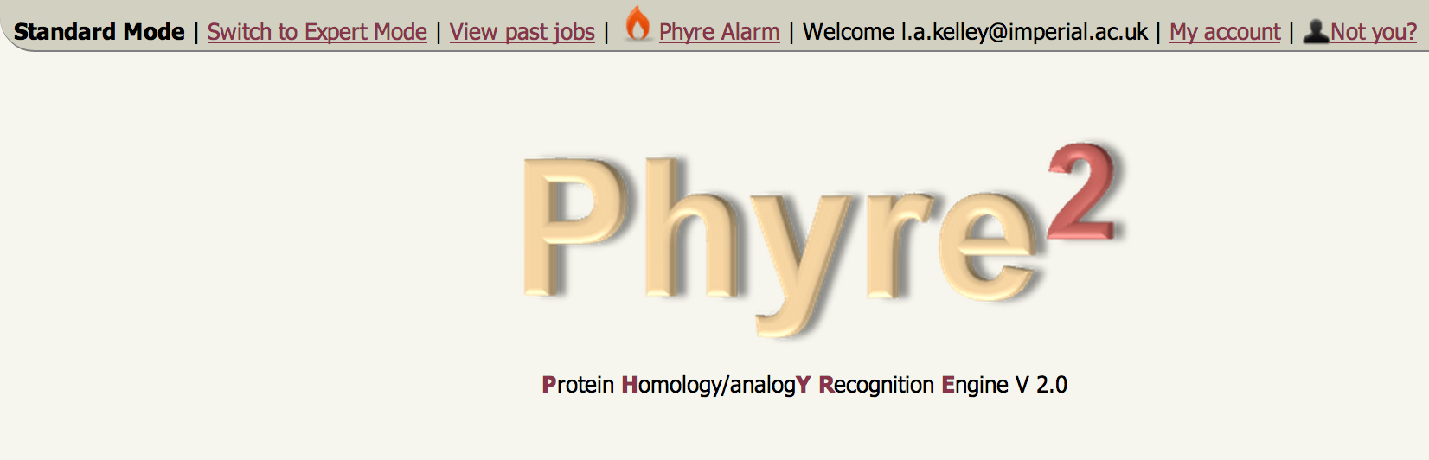
Interface Enhancements
Account manager

Slide 127
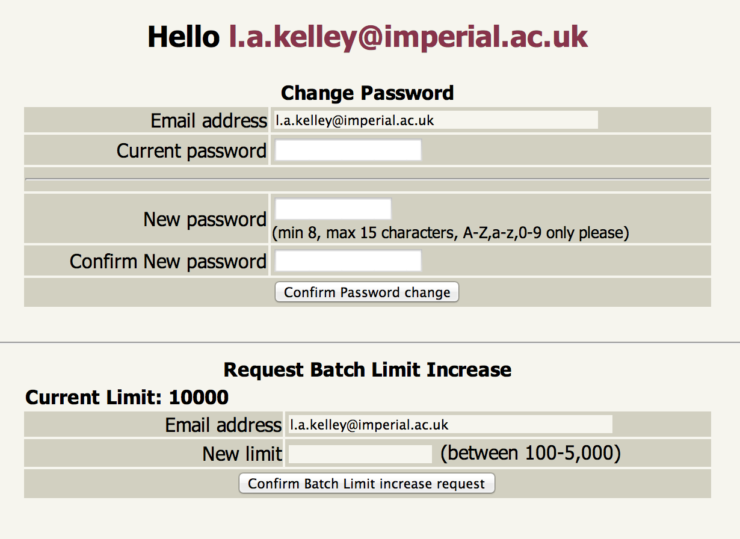

Slide 128
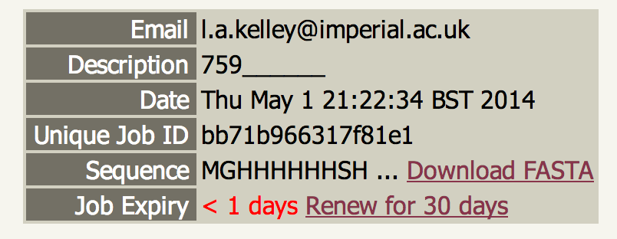
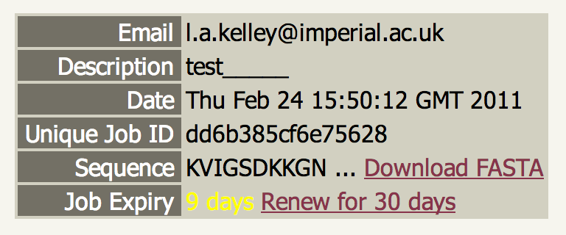
One-click job renewal

Slide 129
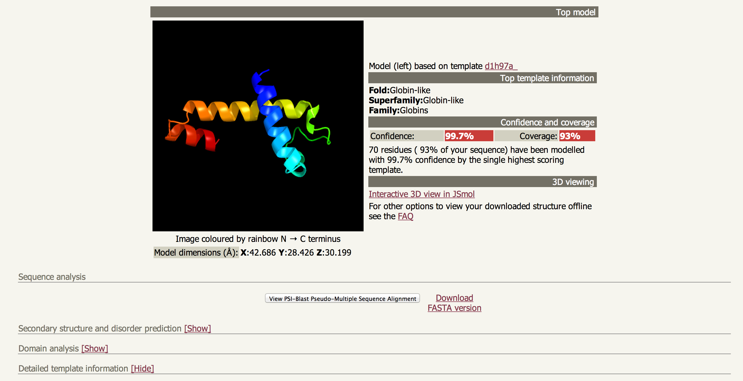
FAQ and Collapsible analyses

Slide 130
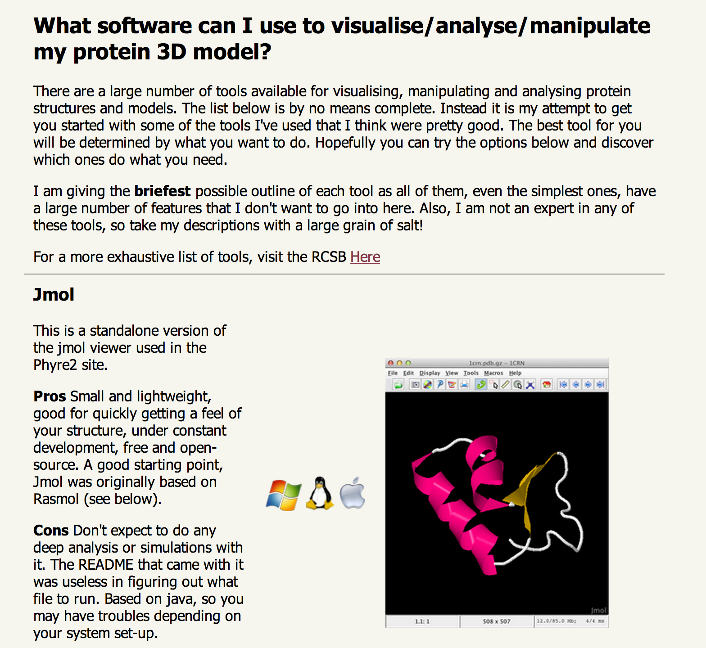
Molecular visualisation software FAQ

Slide 131
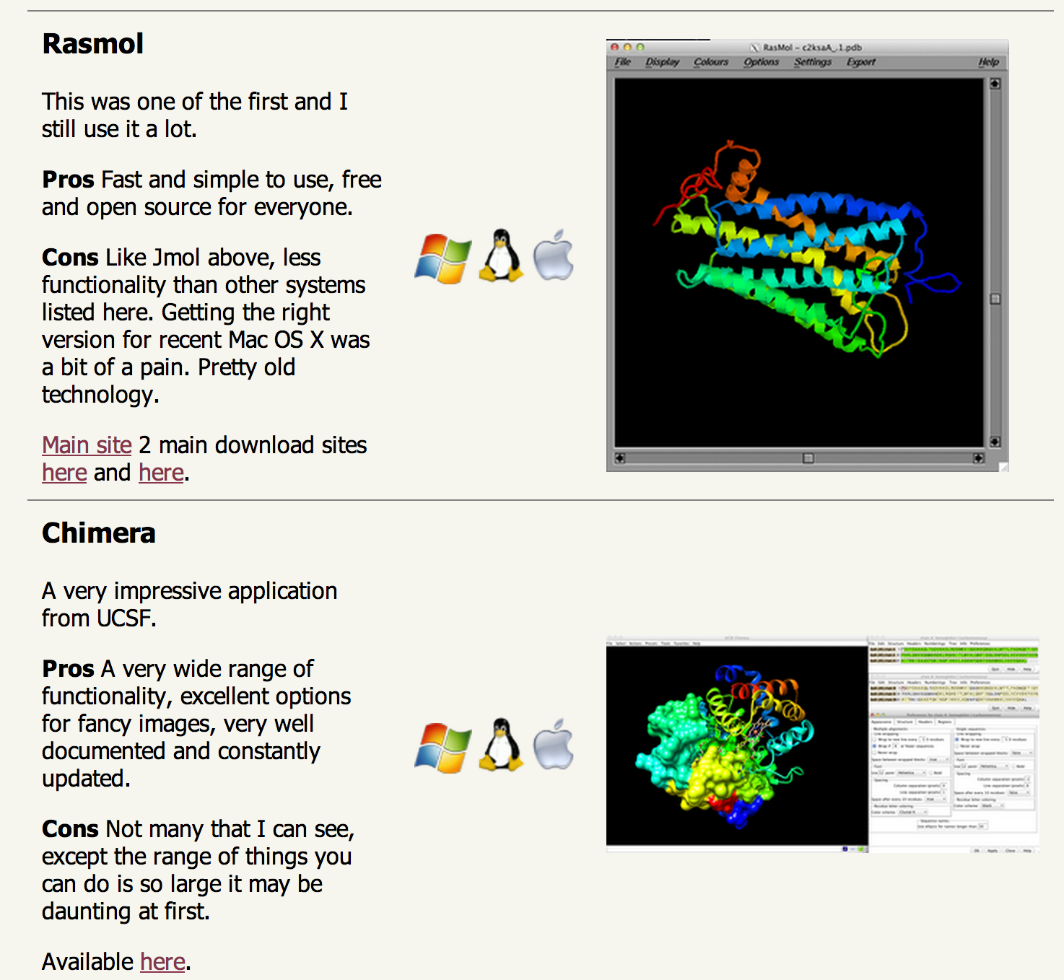
Molecular visualisation software FAQ

Slide 132
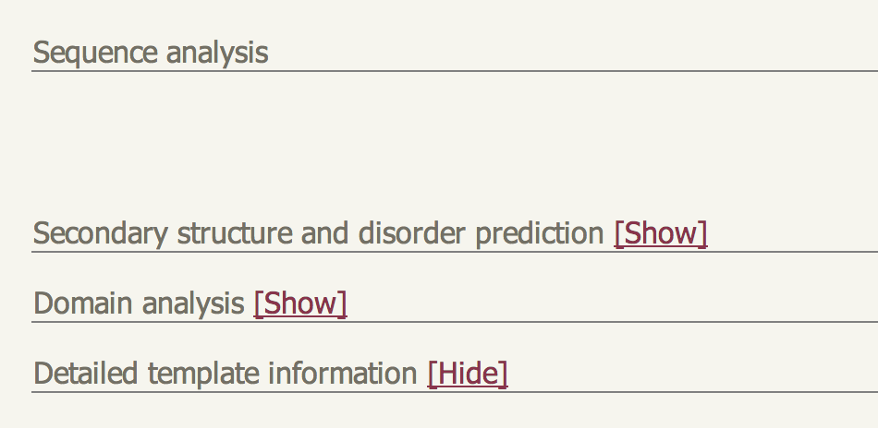
Collapsible analyses to reduce clutter

Slide 133
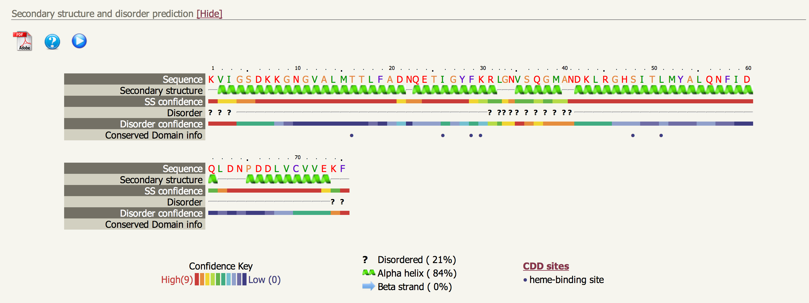
CDD sites and Context-specific help
Pop-up video help coming soon

Slide 134
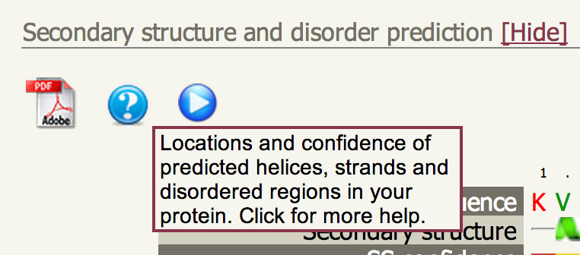
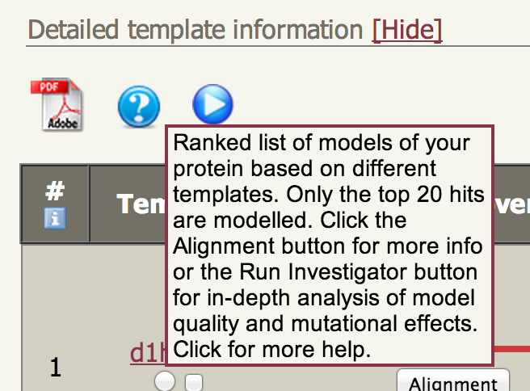
Context help – links to full help

Slide 135
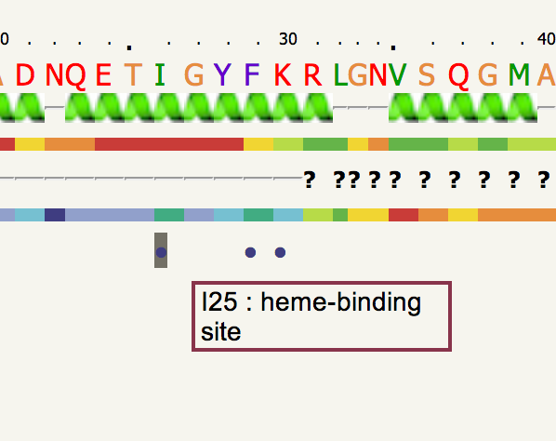
Conserved Domain Database scan

Slide 136
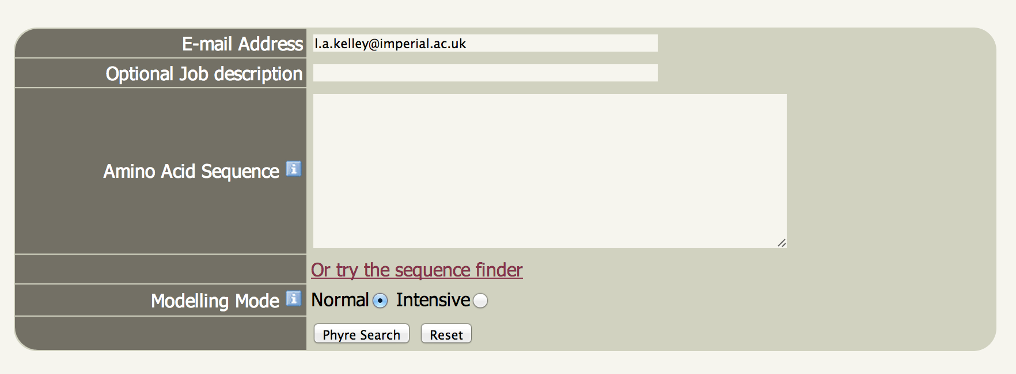
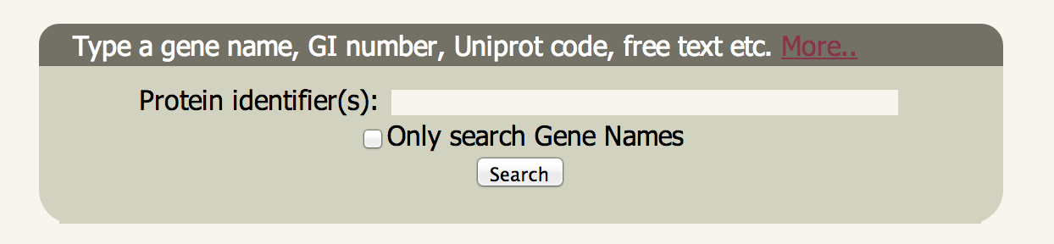
The Sequence Finder

Slide 137
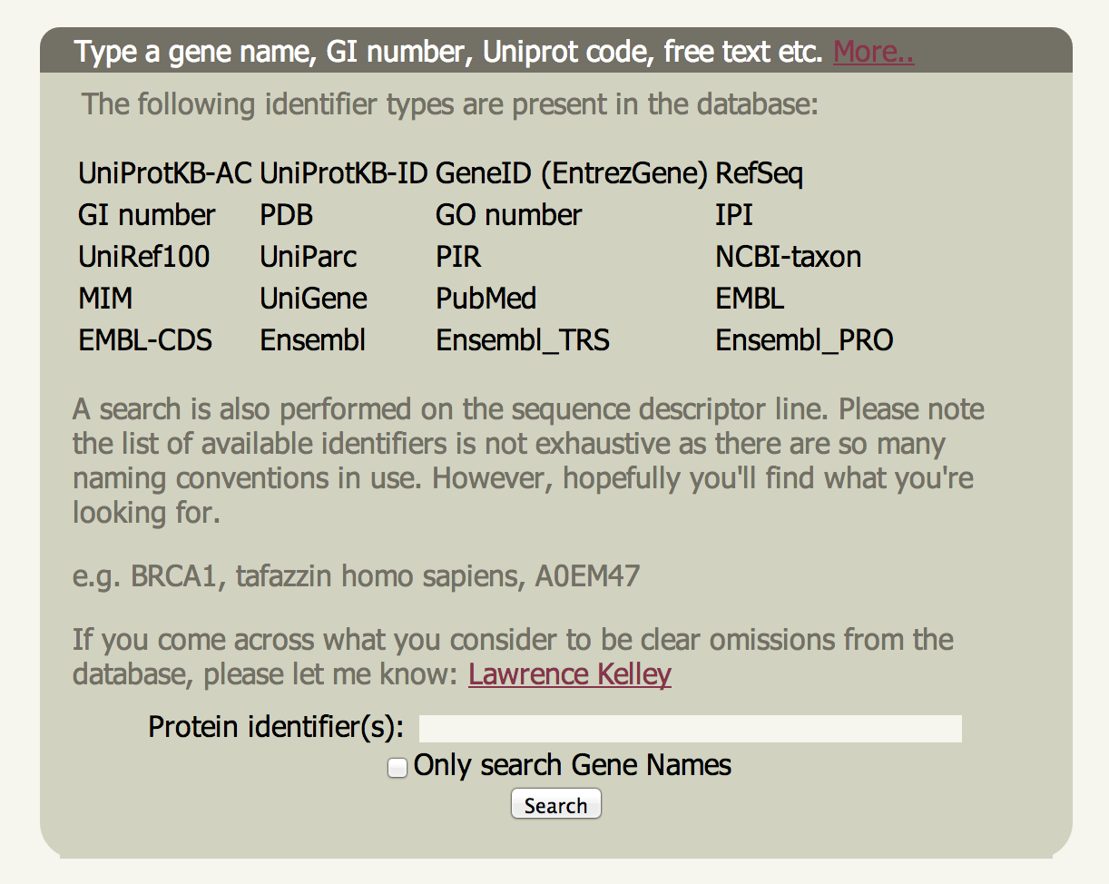
The Sequence Finder

Slide 138
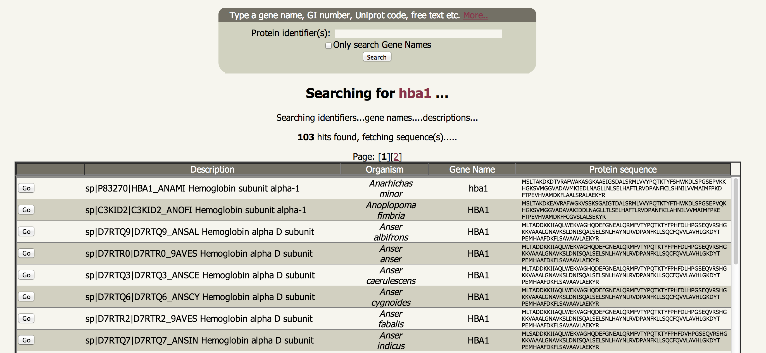
The Sequence Finder

Slide 139
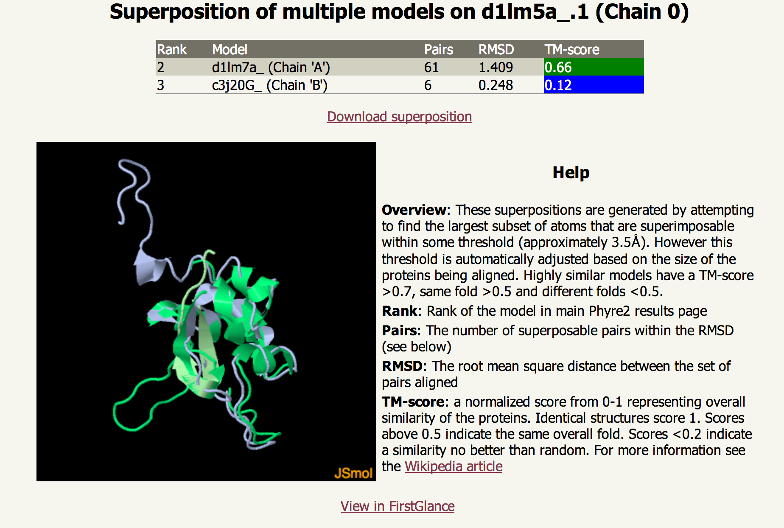
Improved Model Comparison

Slide 140

Fold Library

Slide 141

Fold Library

Slide 142
Fold Library
NOT entire PDB (speed reasons)
80% identity and 80% coverage threshold
Updated every week by scanning sequences of new PDB structures against existing library
If you need a particular template, use One-to-One Threading
Can view any entry or search for PDB codes
Auto-fetch and BLAST against library to find nearest homologues

Slide 143
Fold Library
Naming conventions – may change…
Library built from Structural Classification of Proteins (SCOP) and supplemented by the PDB
SCOP updates lag behind the PDB
“d1abcA1” – (d)omain from SCOP, PDB code 1abc chain A and it is domain 1 from that chain.
“c1xyzD_” – (c)hain from PDB code 1xyz, chain D.

Slide 146
Fold Library
Can be a huge variation in resolution of structures for a given protein.
In the past we have chosen randomly – MISTAKE
To detect homology, sometimes you need a ‘remote’ profile and sometimes a ‘close’ profile – i.e. more/less iterative searches and more/less filtering for effective number of sequences:
Turns out different regimes are good or bad depending on the difficulty/remoteness of the target from a known structure

Slide 147
Fold Library
Cluster PDB at 100% sequence i.d.
threshold with Blastclust
9 fold libraries (2,3,4 iterations x Neff 7,9,11)
Filter alignments based on
effective number of sequences (Neff)
Choose highest resolution structure from each cluster
Gather sequence homologues using HHblits for 2, 3 and 4 iterations
Re-cluster with CD-Hit down to
95% sequence i.d. threshold

Slide 148
Sliding Window searching
Multi-domain proteins can sometimes generate profiles biased towards particular domains
This means a domain that is easily found when by itself can sometimes be missed when connected to other domains
To avoid this, use a sliding window of the sequence and merge hits

Slide 149
Sliding Window searching
Query
200
Query
fragments
50
Merge hits, re-rank, renumber and
model build for input to Poing

Slide 150

Sliding window helps for hard targets

Slide 151
Backend Improvements

Slide 152
Issues facing multiple template modelling
Loss of information/detail by reducing representation to Calpha only
How to pick templates?
Maximise coverage
Minimise distortion caused by combining inconsistent templates
Weighing contribution of different templates
Can Rosetta relax help?
High accuracy problems in the past – clashes etc.

Slide 153
Picking templates
Tested and testing multiple methods for maximising coverage whilst avoiding degradation of good templates
Most of the improvement comes from coverage (as initially said by Torsten)
Only include multiple templates if you haven’t already got a confident one for a region
Complex heuristic – I won’t bore you…

Slide 154
Combining Poing and Modeller
Stefans currently working on new Poing that includes the full backbone
Expect improvements especially in beta-sheets – a current shortcoming of Poing
Now have template springs weighted according to our confidence in them – some promising results

Slide 155
Future Additions
This summer: Phyre Investigator
Allow interactive analysis of model quality and prediction of effect of single nucleotide polymorphisms
Winter 2013 – prediction of complexes:
First homodimers, homomultimers and then hetero-

Slide 156


Slide 157

Poing
linear elastic springs
Notes:
Most forces in the model are simple linear elastic springs.
It two particles are too far apart, forces act to gradually bring them together.
If they are too close, forces act to push them apart.

Slide 158


Poing
Langevin dynamics is F = ma ... PLUS a model for solvent
a: acceleration
F: net force (sum of many forces)
γ: drag factor
v: current particle velocity
R: randomly distributed vector
m: particle mass
Notes:
This is the formula for calculating the acceleration which is at the centre of Langevin modelling.
It is mostly just a rearrangement of F=ma
In addition to a force-field, this is a drag factor opposing the current motion of the particle, simulating the drag of solvent.
R is a randomly distributed vector which simulates the thermal input from the solvent
m is the mass of the particle, so larger particles have a lower acceleration than small ones, for a given set of forces.

Slide 159




Poing
Secondary structure and hydrogen bonding
Solvent model leads to
hydrophobic collapse
Sidechain size and shape
Notes:
There is not enough time to give the other details of the model.
Suffice to say it has all the usual features you’d expect in a model for protein structure.
Springs keep the backbone together, and in a conformation which agrees with predicted or assigned secondary structure.
Sidechains are attached to the backbone, in the correct orientation, and kept away from each other by a steric force.
Our model for the water is somewhat novel, and may be the feature of a future publication.
The hydrophobic effect is part of the solvent model.

Slide 161
Poing
Secondary structure and hydrogen bonding
Solvent model leads to
hydrophobic collapse
Sidechain size and shape
Notes:
There is not enough time to give the other details of the model.
Suffice to say it has all the usual features you’d expect in a model for protein structure.
Springs keep the backbone together, and in a conformation which agrees with predicted or assigned secondary structure.
Sidechains are attached to the backbone, in the correct orientation, and kept away from each other by a steric force.
Our model for the water is somewhat novel, and may be the feature of a future publication.
The hydrophobic effect is part of the solvent model.

Slide 162
Intensive mode
Motivation: Modeller is good at combining multiple templates in cases of close homology.
Cannot handle ab initio folding or cases where there is substantial disagreement between input models
Poing can handle any case, but loses atomic detail in cases of close homology
Thus combine Poing and Modeller for best of both worlds

Slide 163

Performance

Slide 164
Shortcomings of ‘normal’ Mode
Because of local alignment or novel domain combinations, domains often modelled separately
Regions with no detectable homology to known structure unmodelled
Does not use multiple templates which, when combined could result in better coverage
Thus need a system to fold a protein without templates
and combine templates when we have them

Slide 165

SuSPect: Disease-Susceptibility and Structure for nsSNP Phenotype Prediction
Secondary structure
Support Vector Machine
SuSPect Score: 0.93
Intrinsic
disorder
Solvent accessibility
Conservation
Notes:
VCF, large batch snp data
pre-computed predictions all of human
extra interpretation - english language
and lots more options - currently under active devlopment

Slide 166
SuSPect: Benchmarking against other systems (Varibench)
Benchmark consists of 20k SNPs
(15k Neutral, 5k pathogenic)
Notes:
varibench set submitted to condel which submitted to polyphony and sift
varibench submitted to mutassessor and fathom
these systems chosen because they can accept batch
other popular ones: snap snps&go
in published work these perform comparably to mutassessor
varibench filtered to remove any training data leaving: 13k neutral and 5k pathogenic
whole varibench is about 30k, ended up testing on 20k

Slide 167

SuSPect – Phenotypic effect of amino acid variants
Sequence conservation
PSSM
Pfam domain
Jensen-Shannon entropy
Structural features
Predicted solvent accessibility
Network features
Protein-protein interaction (PPI) as domain centrality
Interactome

Slide 168
SuSPect – Results on non-training data (VariBench)
SuSPect
Mutation
Assessor
SIFT
Sensitivity
PolyPhen2
Benchmark consists of 20k SNPs
(15k Neutral, 5k pathogenic)
1 - Specificity

Slide 169

Neonatal diabetes
Arg 201 His in ATP-sensitive inward rectifier potassium channel 11 (Kir6.6)
SuSPect gives score of 87/100 – high probability of disease associated

Slide 170



Phyre2 yields model which suggest structural basis for disease
Most variants predict to be disease associated
Arg 201 forms H-bond with main chain O
His in variant could not form
similar interaction

Slide 171
VIDEO

Slide 172
SuSPect: Disease-Susceptibility and Structure for nsSNP Phenotype Prediction
Secondary structure
Support Vector Machine
SuSPect Score: 0.93
Intrinsic
disorder
Solvent accessibility
Conservation

Slide 173
Batch Jobs
Default 100 jobs maximum (early adopters got 10)
Simply let me know if you want an upgrade
Only FASTA formatted sequences in a single file accepted currently
Only Normal mode for speed considerations
Sequences are processed more slowly than individual submissions to maintain user experience
Batch job progress can be monitored, view intermediate results

Slide 174
Transmembrane helices
Memsat-SVM (Jones, UCL)
Machine-learning system (Support Vector Machine – SVM) trained on known TM helix containing proteins
Accuracy on topology benchmark: 89%
Not integral to Phyre2, added for convenience

Slide 175

Job manager

Slide 176
Phyre Investigator

Slide 177
Phyre Investigator

Slide 178
Other upcoming work
Currently writing a Nature Protocols paper for Phyre2
3DLigandSite – dynamic jQuery-based integration of 3DLigandsite predictions and downloadable models with chosen ligand and pose.

Slide 179
Core algorithm
Currently participating in CASP as PhyreX – independent server from Phyre2 to prevent disruption for normal users
New fold library construction pipeline
New homology detection pipeline
New scheme for multiple template modelling
New backbone resconstruction algorithm and replacement of previous sidechain modelling software (R3 -> SCWRL4)

Slide 180
VIDEO

Slide 181
Workflow
Gather sequences with PSI-BLAST
Predict secondary structure and disorder
Build HMM
Scan HMM vs. library
Build crude backbone model
Model inserts and deletes with loop modelling
Add sidechains

Slide 182
Performance
All major systems blind-tested by Critical Assessment of Structure Prediction (CASP) every two years.
Always a “winner”, but usually no statistically significant difference amongst the top 5 or 10 servers.
Phyre2 consistently amongst top performers

Slide 183
New: Phyre Investigator
Model quality assessment
Location of functional sites
Effect of mutations on structure and function
Protein-protein Interface(s)

Slide 184
Build a tool that helps researchers explore these questions by integrating a range of analysis tools in a user-friendly interface that people will actually use.
Avoid drowning in data.
Allow user to target their analysis based on what they want to know.

Slide 185
Sequence/Structure Interface
Key is integrating user interaction at sequence and structure level simultaneously.
Use javascript to communicate between dynamic HTML for the sequence and Jsmol– wasn’t easy!
Is now stable and highly flexible

Slide 186
Phyre Investigator
Clashes
Rotamer outliers
Ramachandran outliers
ProQ2 model quality assessment (Qmeans probably needs retraining as Torsten once said)
Alignment confidence (HHsearch)
Conservation/evolutionary trace (Jenson-Shannon divergence –far faster and just as accurate as ET)
Catalytic Site Atlas
Disorder
Pocket detection (Fpocket)
Protein interface residues (PI-Site, ProtinDB)
Conserved Domain Database ‘conserved features’ for NCBI-curated domains

Slide 187
Phyre Investigator
Effect of Mutations?
Will a SNP effect my protein’s function?
New method: SuSPect
Recently developed by Chris Yates in our lab
Integrated into Phyre Investigator
Also standalone server

Slide 188
Growth and the community

Slide 189
Phyre2 Community
Process ~600 single user submissions per day
In 2013, 200k single submissions, +80k in batch submissions
Phyre Google Group: 2012: 300 members, 2014: 1,000 members
Received >1,000 letters of support for recent grant proposal
Twitter starting to grow (60 followers) – useful to warn of server downtime and new features
Two Phyre papers now cited >2,100 times

Slide 190

Phyre2 Usage Growth
(not cumulative)
The new Phyre Investigator tool has been used ~ 4,000 times
since its launch on Jan 22, 2014

Slide 191
Grant progress

Slide 192
Key grant proposals and where we are
Interface enhancements
Modelling enhancements
Model quality assessment
Location of functional sites
Effect of mutations on structure and function
Protein-protein Interface(s)
Interacting partners
Three-dimensional model of the protein complexed with its partners

Slide 193
Key grant proposals and where we are
Interface enhancements
Modelling enhancements
Model quality assessment
Location of functional sites
Effect of mutations on structure and function
Protein-protein Interface(s)
Phyre
Investigator

Slide 194
Key grant proposals and where we are
Interacting partners
Three-dimensional model of the protein complexed with its partners
Preliminary work using 3DID database
Primarily work for the final year

Slide 196


