Slide 1
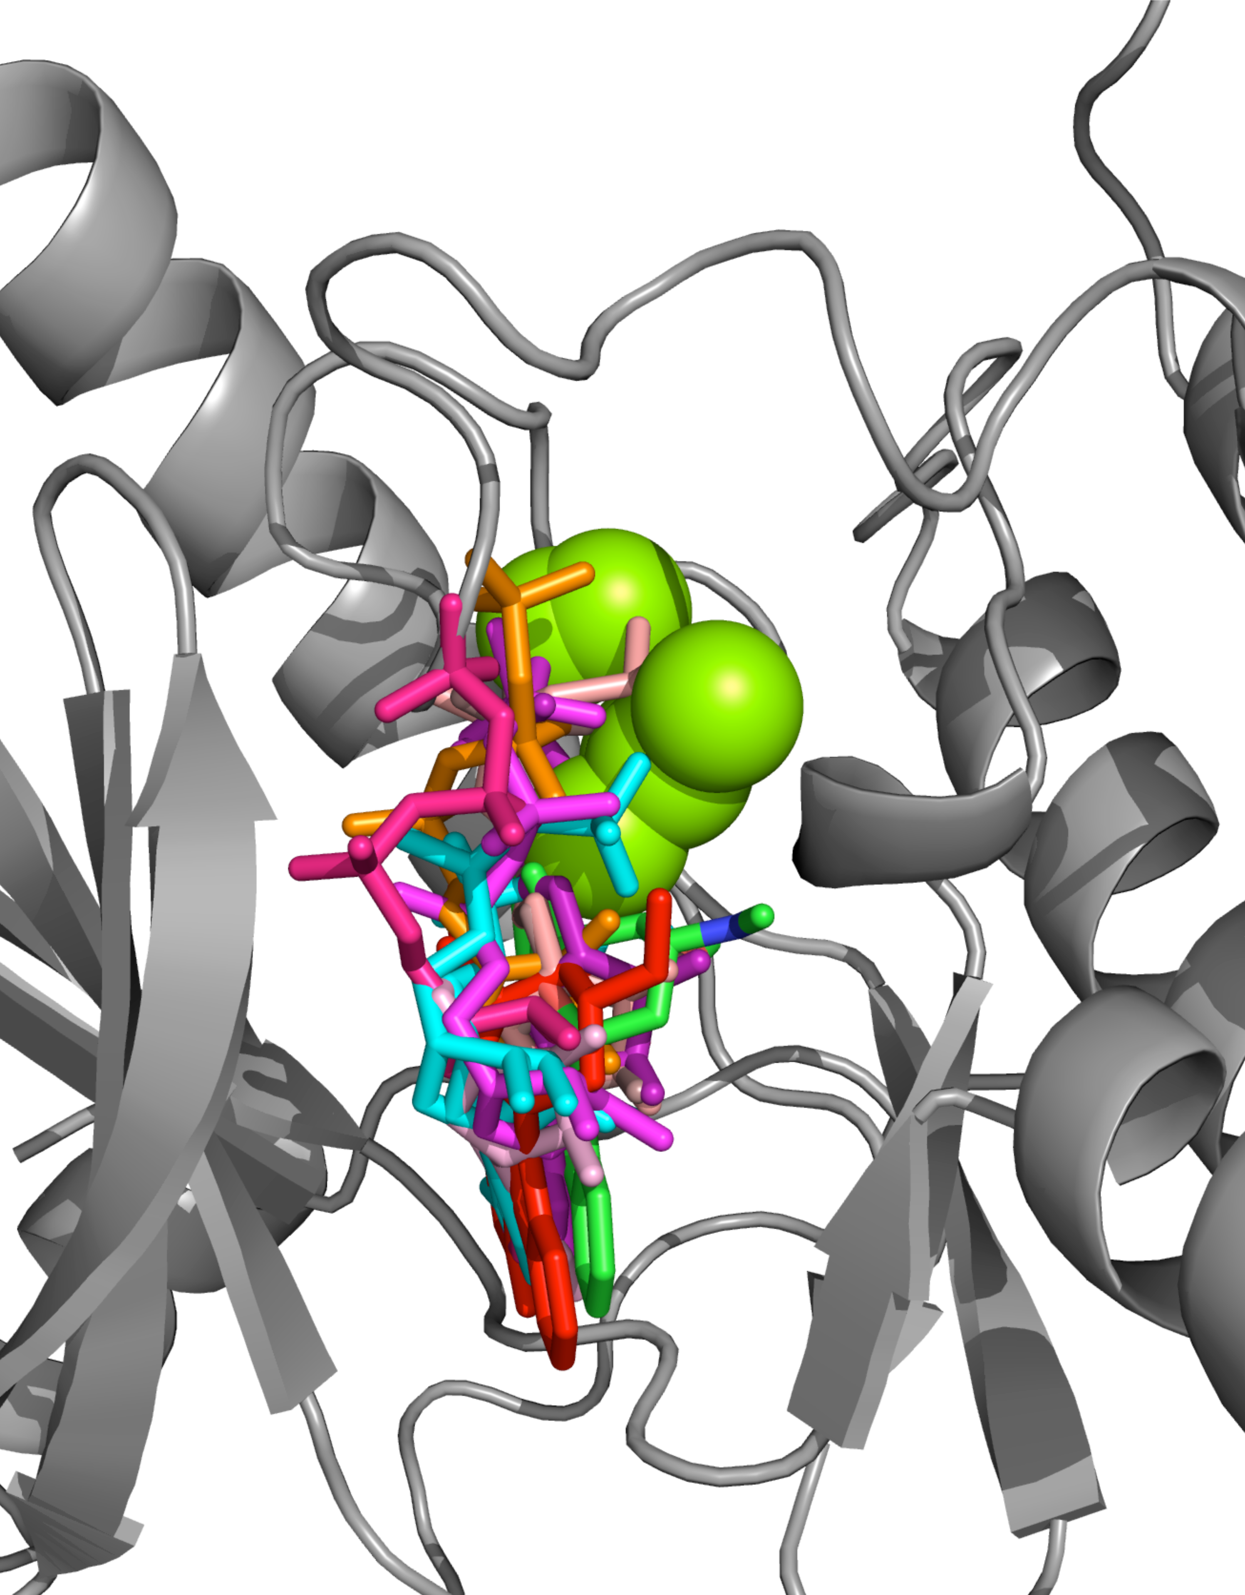
Modelling binding site with 3DLigandSite
Mark Wass
m.n.wass@kent.ac.uk

Slide 2


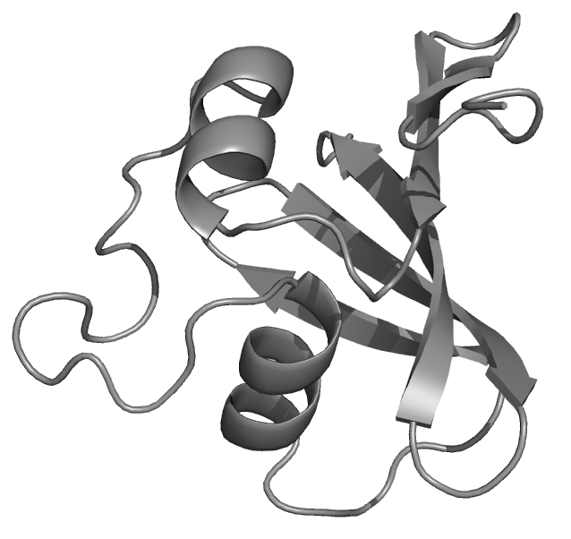
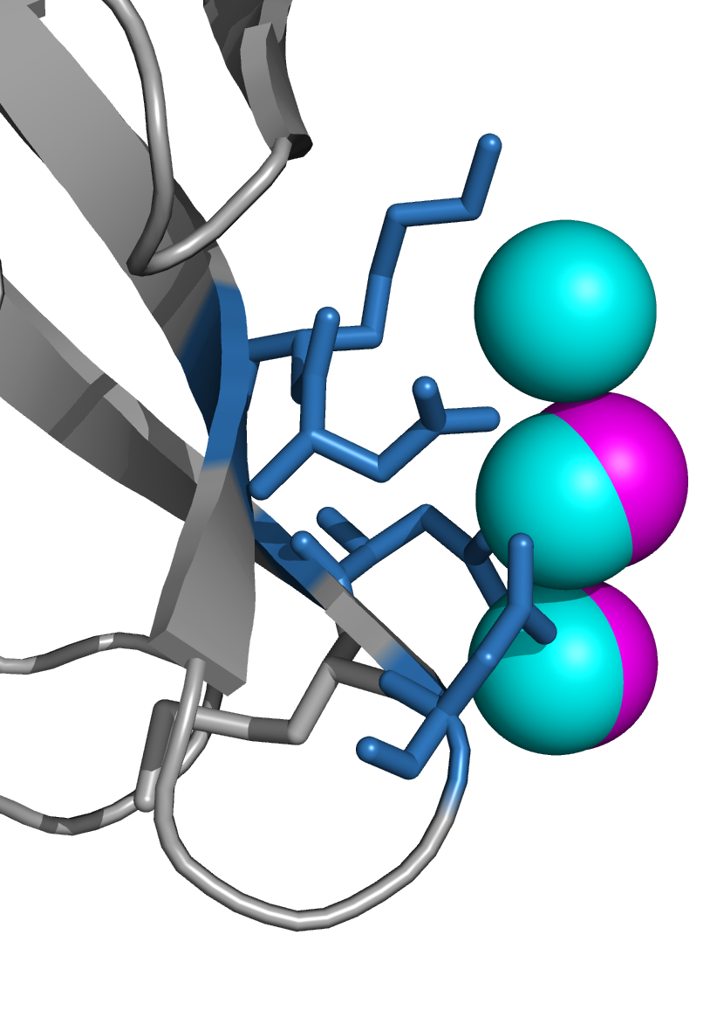
CASP
MEEYKVVVCGSGPVALGCF
Target sequence
(2 per day)
Human predictors
Server predictors
3 days
3 weeks
Predicted
Binding site
Predicted
structure
Results
Performance
Compared to other groups
Assessment

Slide 3
3DLigandSite
Developed as a result of participation in CASP
MTEYKLVVVGAGGVGKSALTIQLIQ

Slide 4
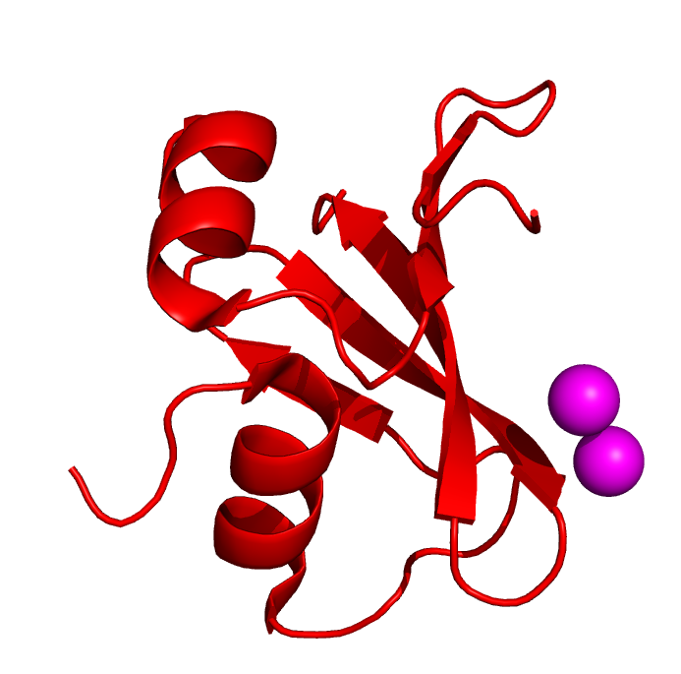
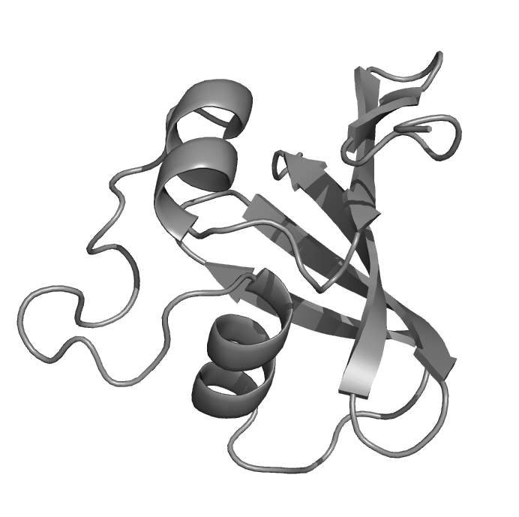
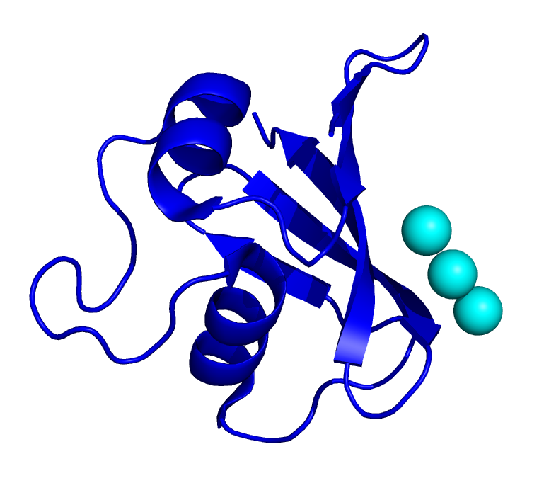
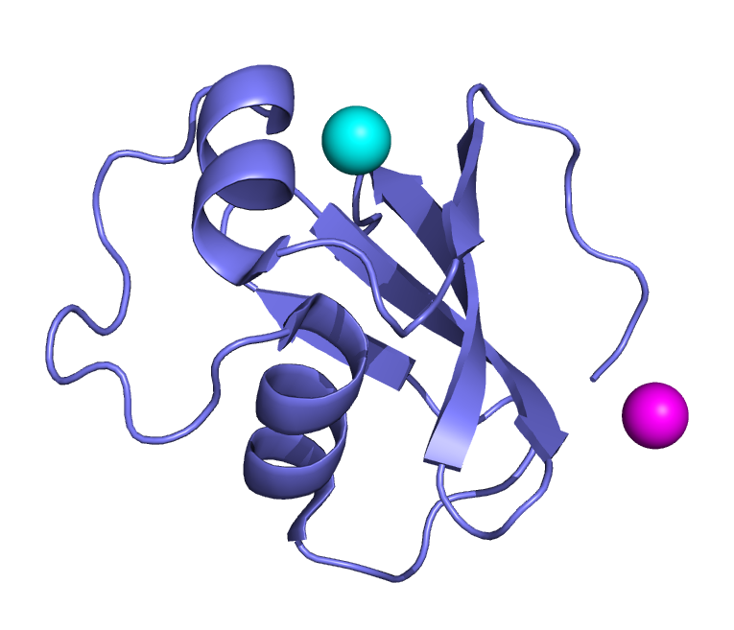


3DLigandSite
Homologous structures
2oai
2pls
2p4p
Magnesium
Calcium
Wass & Sternberg Proteins 2009

Slide 5
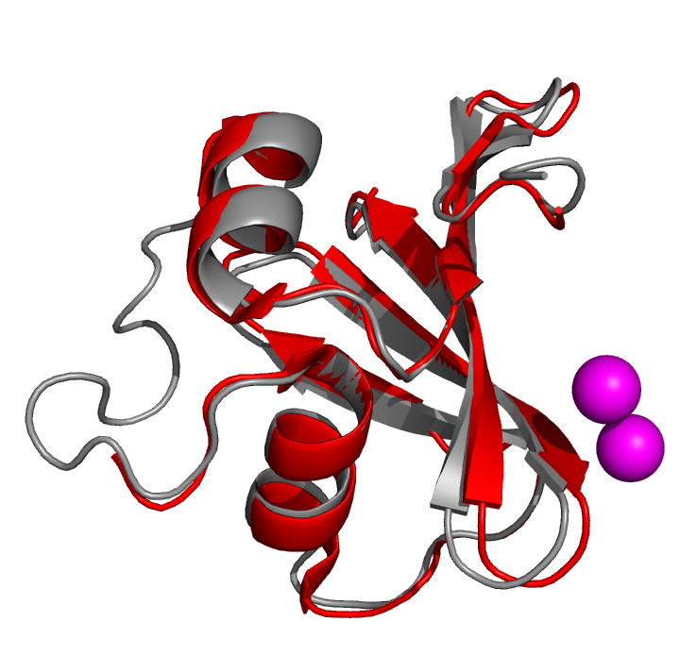
3DLigandSite
Homologous structures
2oai
2pls
2p4p
Magnesium
Calcium
Wass & Sternberg Proteins 2009

Slide 6
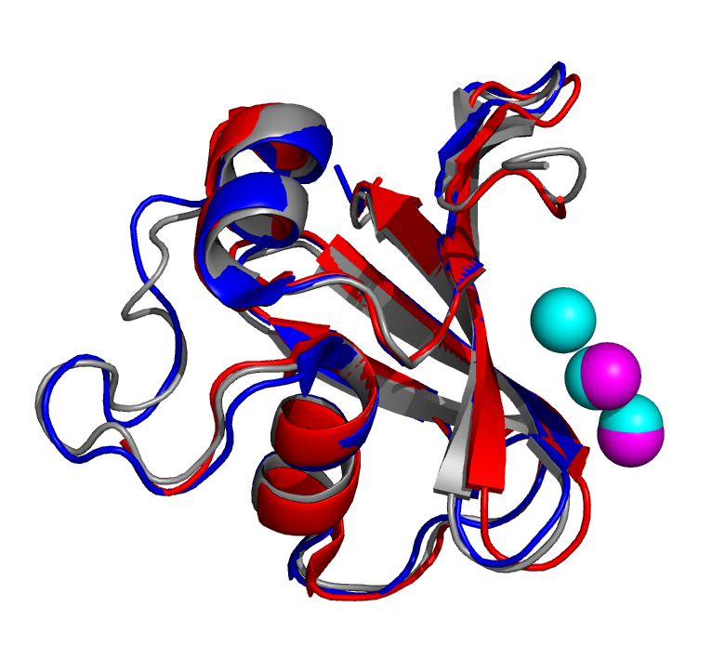
3DLigandSite
Homologous structures
2oai
2pls
2p4p
Magnesium
Calcium
Wass & Sternberg Proteins 2009

Slide 7
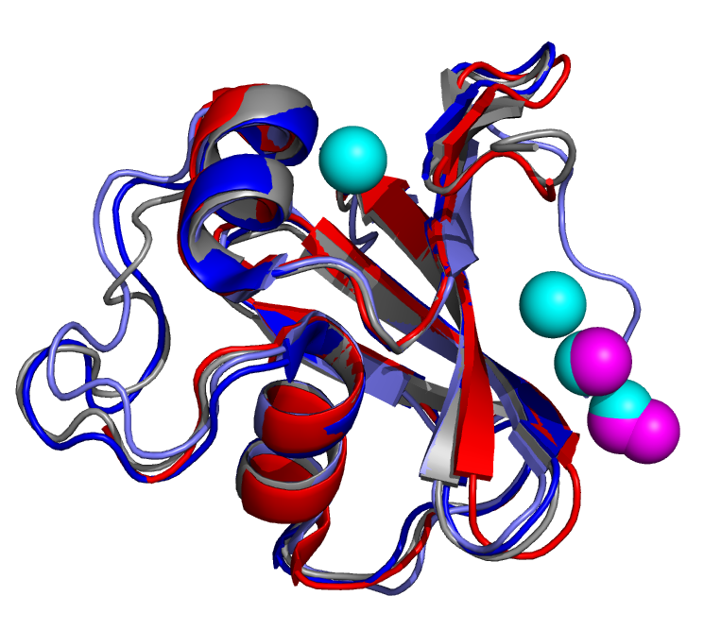
3DLigandSite
Homologous structures
2oai
2pls
2p4p
Magnesium
Calcium
Wass & Sternberg Proteins 2009

Slide 8
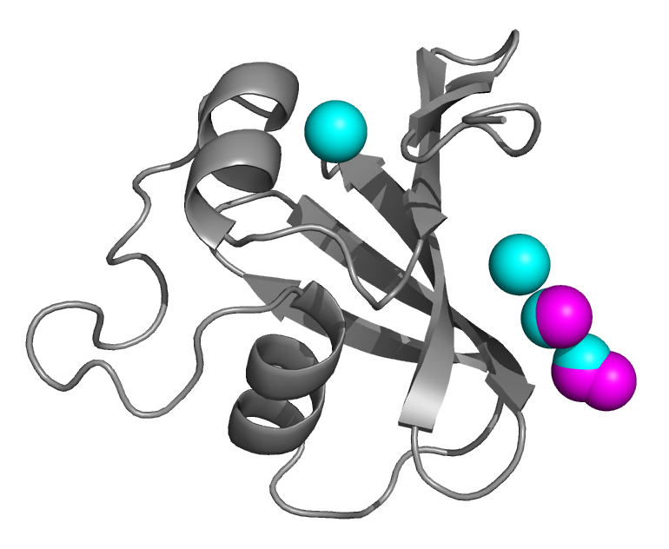
3DLigandSite
Homologous structures
Calcium
Magnesium
Wass & Sternberg Proteins 2009

Slide 9
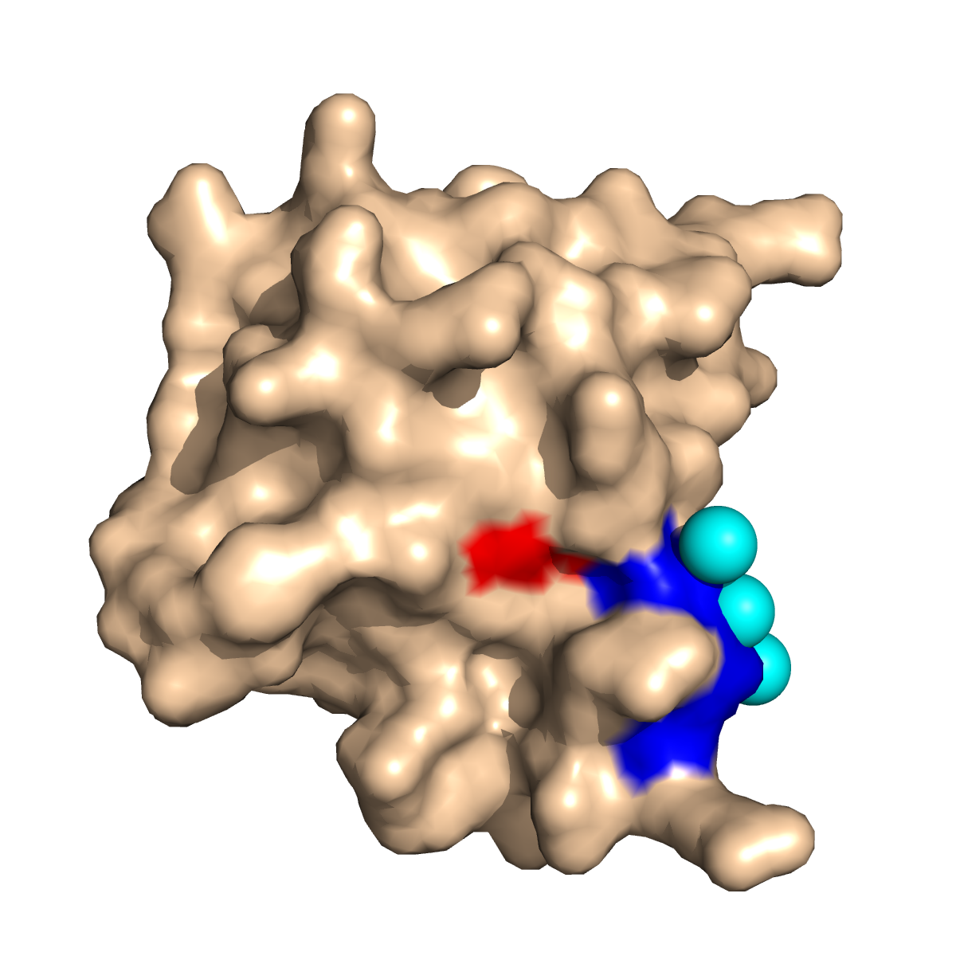
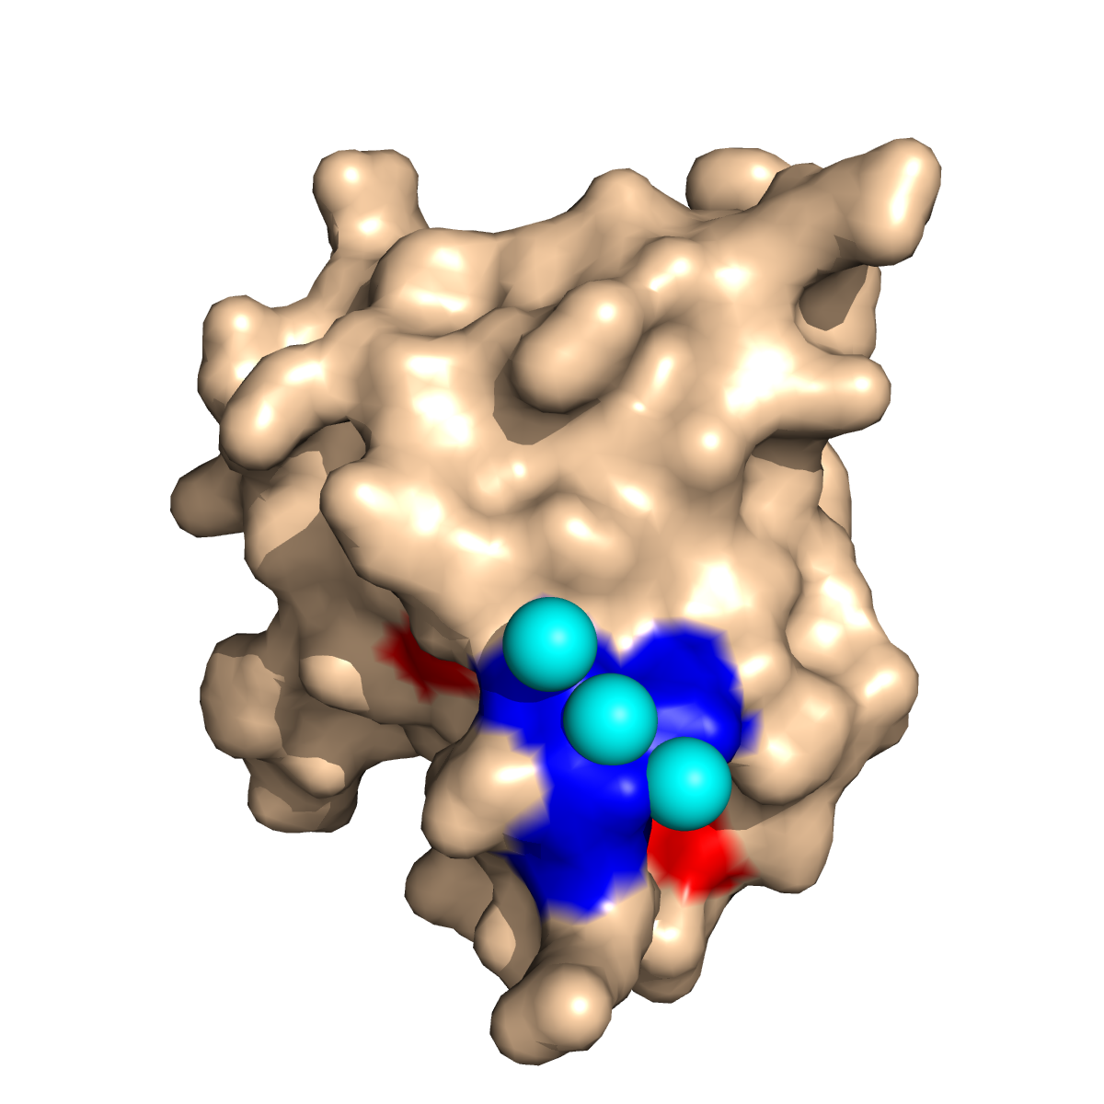
3DLigandSite
Calcium
True positive
False Positive
Wass & Sternberg Proteins 2009

Slide 10
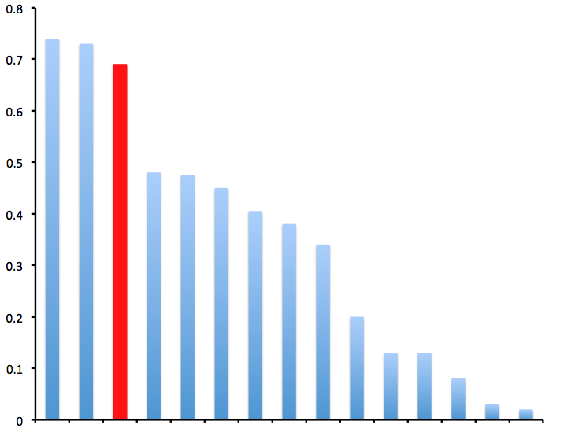
Performance at CASP8
LEE group
Assessed using Matthews’ Correlation coefficient –
-range -1 – +1
LEE & Sternberg not statistically different.
LEE & Sternberg are statistically different to all other predictors (p <0.01).
Sternberg group
MCC
Groups
Adapted from Lopez et al., 2009

Slide 11
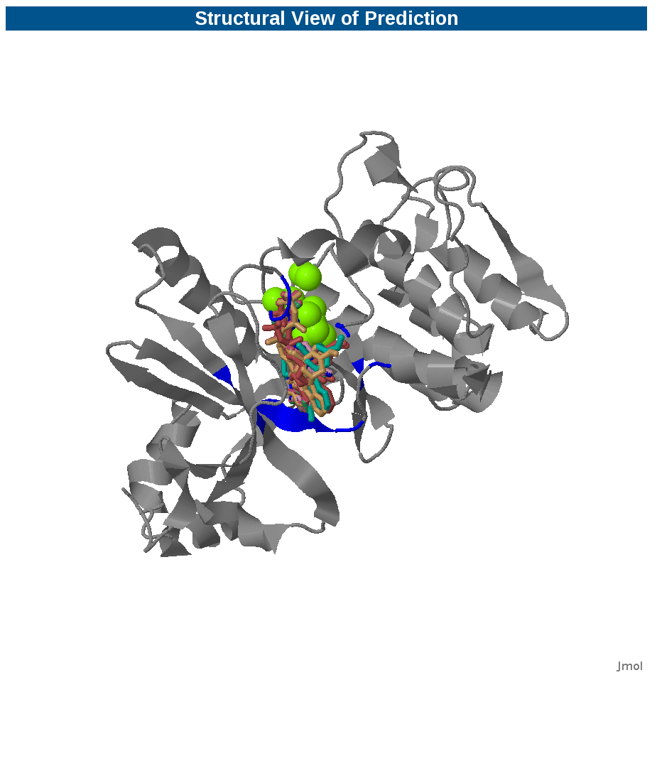
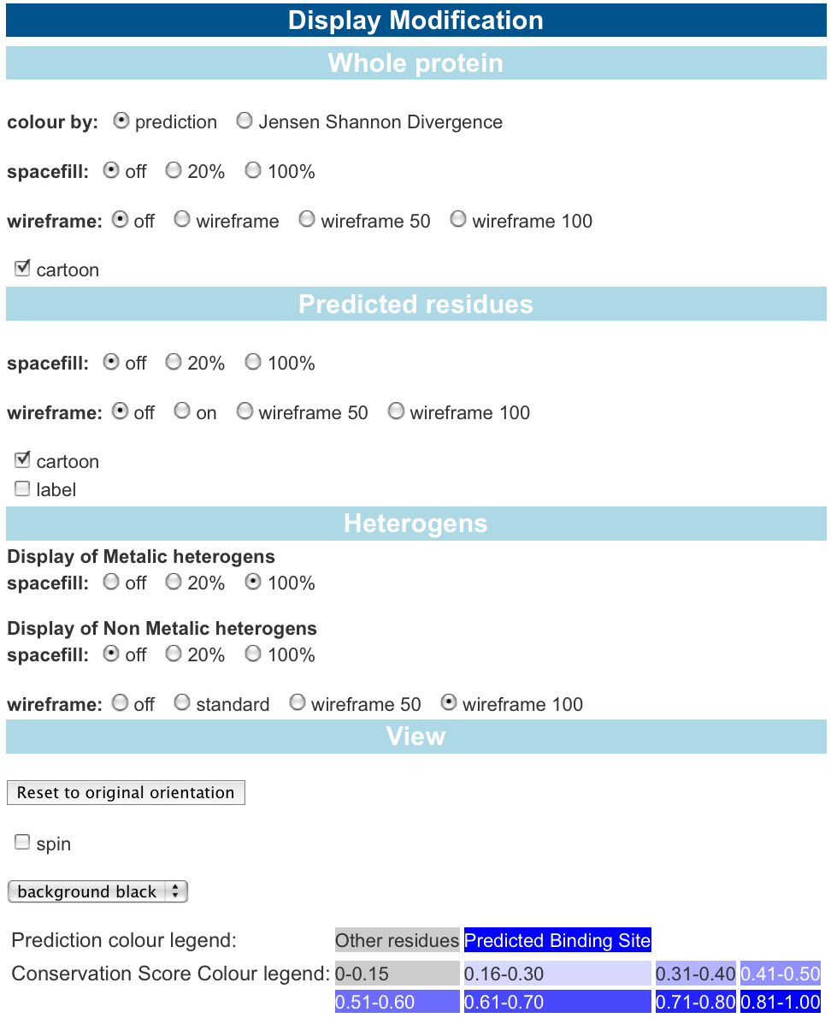

3DLigandSite
Automating our CASP8 approach
Wass et al., NAR 2010

Slide 12
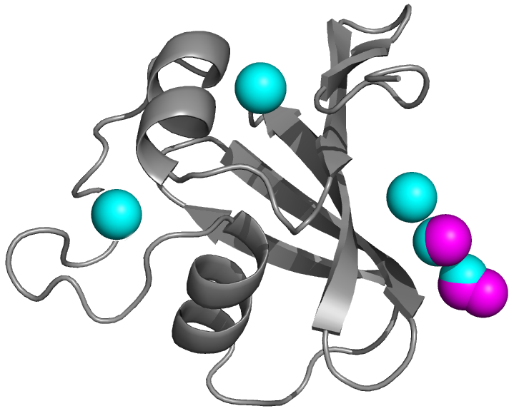
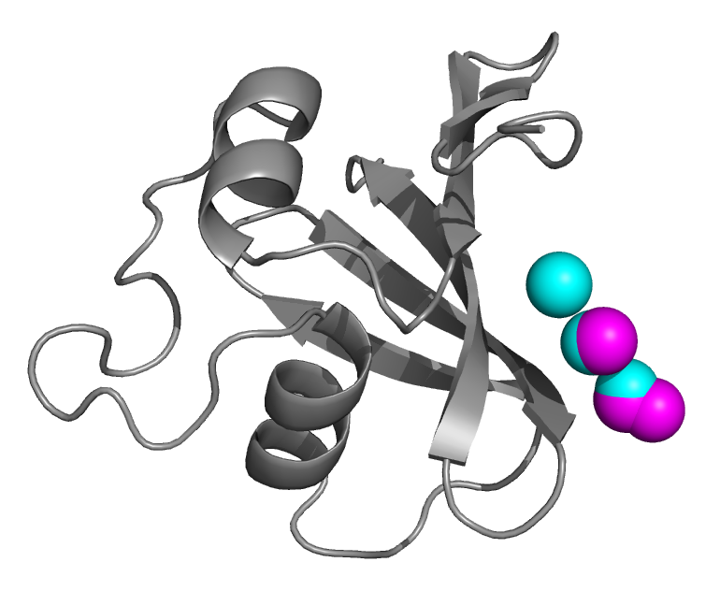
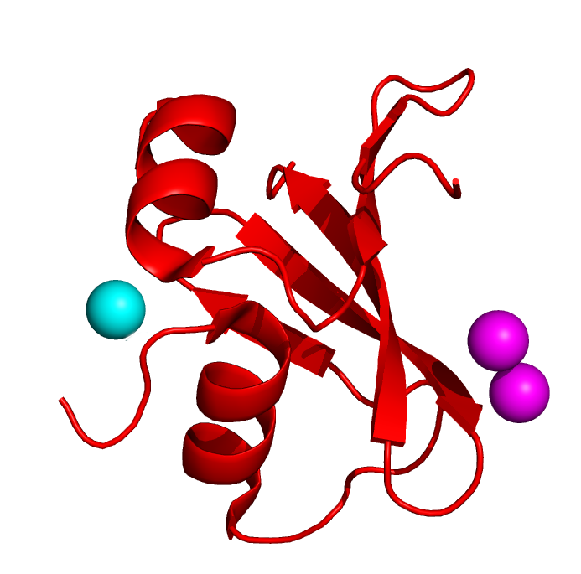
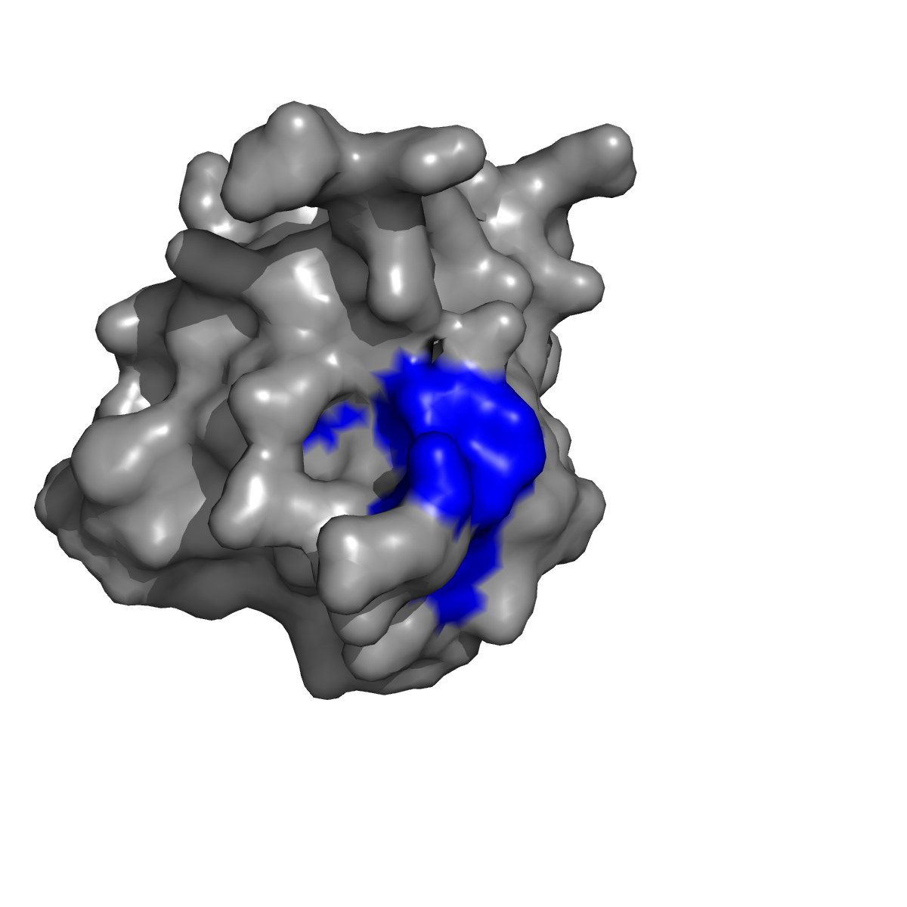

3DLigandSite
3DLigandSite
MAMMOTH search against
Structural library
MTEYKLVVVGAGG
Phyre2
Cluster
ligands
Select clusters
Structural
model
Align
homologous
structures
User provided
strcuture
Make prediction
Using selected
Clusters
Wass et al., NAR 2010

Slide 13
3DLigandSite
3DLigandSite
MAMMOTH search against
Structural library
MTEYKLVVVGAGG
Phyre2
Cluster
ligands
Select clusters
Structural
model
Align
homologous
structures
User provided
strcuture
Make prediction
Using selected
Clusters
Wass et al., NAR 2010

Slide 14
3DLigandSite
3DLigandSite
MAMMOTH search against
Structural library
MTEYKLVVVGAGG
Phyre2
Cluster
ligands
Select clusters
Structural
model
Align
homologous
structures
User provided
strcuture
Make prediction
Using selected
Clusters
Wass et al., NAR 2010

Slide 15
3DLigandSite
3DLigandSite
MAMMOTH search against
Structural library
MTEYKLVVVGAGG
Phyre2
Cluster
ligands
Select clusters
Structural
model
Align
homologous
structures
User provided
strcuture
Make prediction
Using selected
Clusters
Wass et al., NAR 2010

Slide 16
3DLigandSite
3DLigandSite
MAMMOTH search against
Structural library
MTEYKLVVVGAGG
Phyre2
Cluster
ligands
Select clusters
Structural
model
Align
homologous
structures
User provided
strcuture
Make prediction
Using selected
Clusters
Predictions
Wass et al., NAR 2010

Slide 17
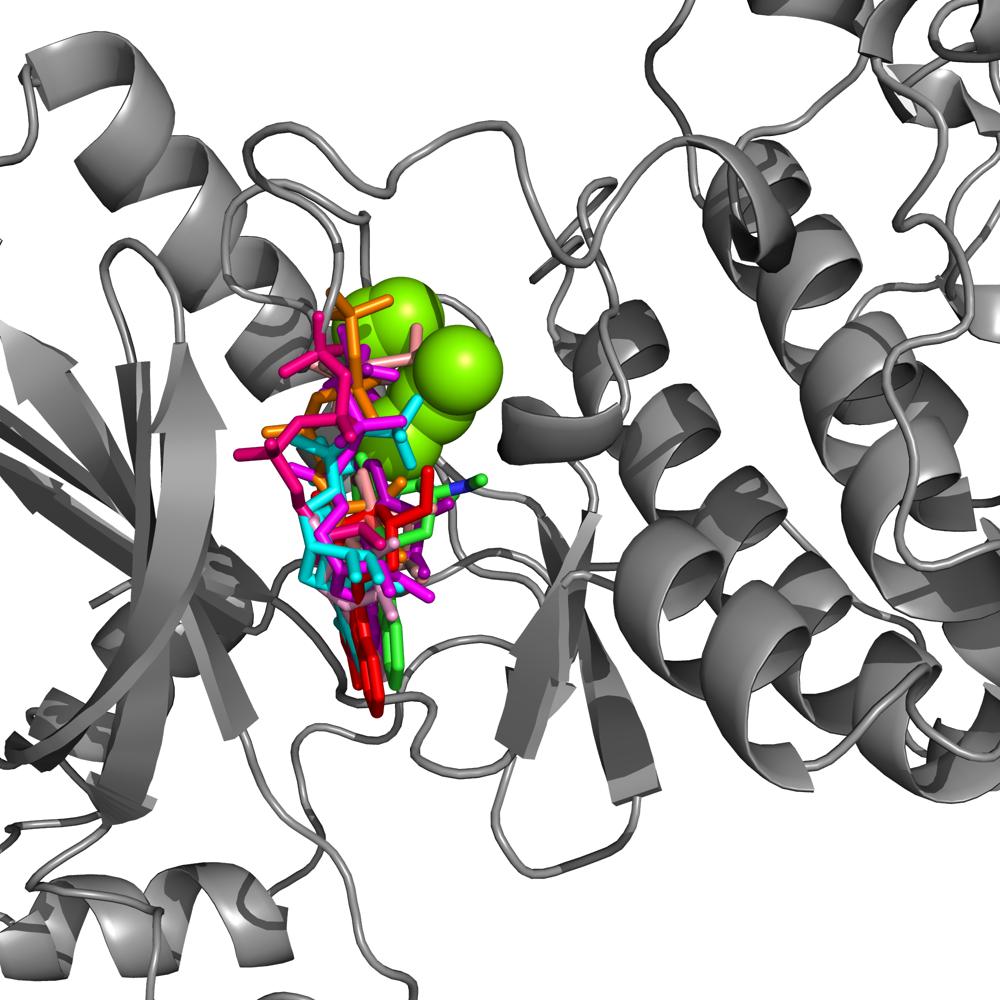
Predicting contacting residues
Predicting the residues contacting the ligand
Multiple molecules in cluster but where is the actual binding site?
Threshold for prediction = Contact 25% ligands

Slide 18
CASP8 targets (28)
3DLigandSite Benchmarking
3DLigandSite Benchmarking
FINDSITE set (617)
Measure | 3DLigandSite
MCC | 0.68
Recall | 70%
Precision | 70%
Measure | 3DLigandSite | Human CASP8
MCC | 0.64 | 0.63
Recall | 71% | 83%
Precision | 60% | 56%
MCC – Matthews Correlation Coefficient
Recall– percentage of binding sites that are predicted (TP/(TP+FN))
Precision– percentage of predicted residues that are correct (TP/(TP+FP))

Slide 19
Using 3DLigandSite

Slide 20
3DLigandSite
MAMMOTH search against
Structural library
MTEYKLVVVGAGG
Phyre2
Cluster
ligands
Select clusters
Structural
model
Align
homologous
structures
User provided
strcuture
Make prediction
Using selected
Clusters
Wass et al., NAR 2010

Slide 21
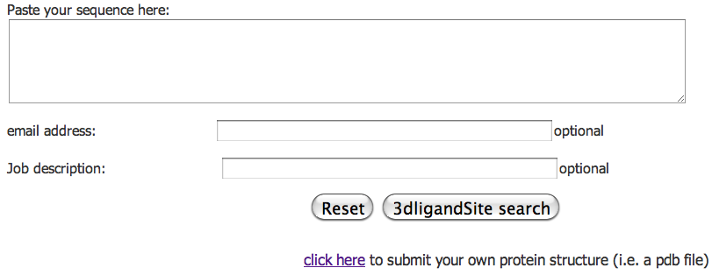
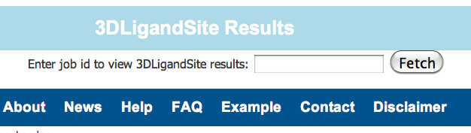
Homepage - submission
Paste sequence and Run
Or submit your own structure
Retrieve results

Slide 22
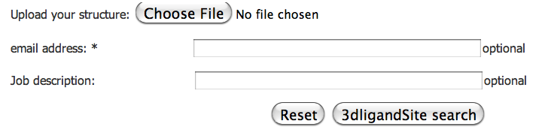
Homepage - submission
Upload structure

Slide 23
Results page

Slide 24
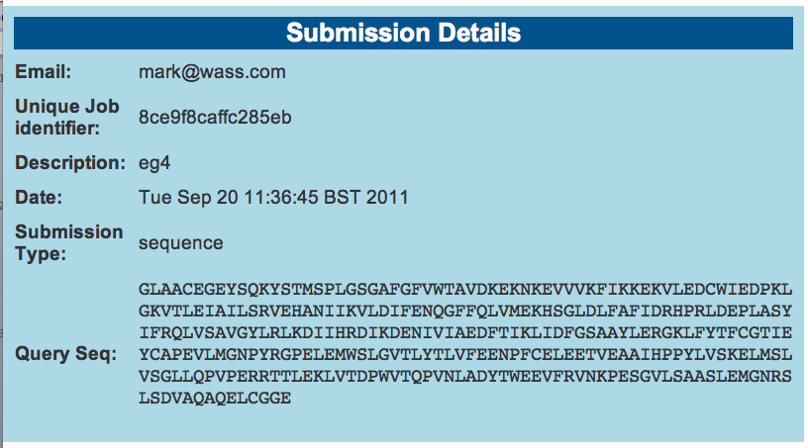
Submission details
JOB ID
Submission type – sequence/structure

Slide 25
3DLigandSite
MAMMOTH search against
Structural library
MTEYKLVVVGAGG
Phyre2
Cluster
ligands
Select clusters
Structural
model
Align
homologous
structures
User provided
strcuture
Make prediction
Using selected
Clusters
Wass et al., NAR 2010

Slide 26
3DLigandSite
MAMMOTH search against
Structural library
MTEYKLVVVGAGG
Phyre2
Cluster
ligands
Select clusters
Structural
model
Align
homologous
structures
User provided
strcuture
Make prediction
Using selected
Clusters
Wass et al., NAR 2010

Slide 27
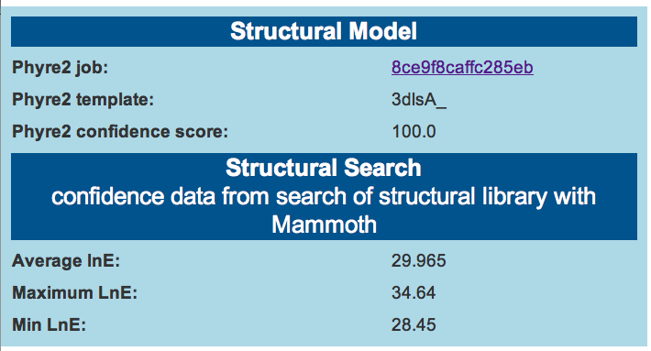
Structural model
JOB ID –same as 3DLig job id
Model confidence 0 (low) -100 (high)
Similarity of structural hits
(higher value = structures more similar)
Min lnE value used = 7
Predictions using low LnE values e.g. < ~12-15 should be treated with caution

Slide 28
3DLigandSite
MAMMOTH search against
Structural library
MTEYKLVVVGAGG
Phyre2
Cluster
ligands
Select clusters
Structural
model
Align
homologous
structures
User provided
strcuture
Make prediction
Using selected
Clusters
Wass et al., NAR 2010

Slide 29
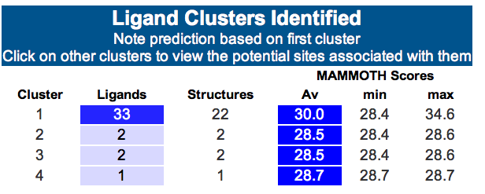
Ligand Clusters
Model confidence 0 (low) -100 (high)
Clusters ranked by number of ligands.
Mammoth scores for cluster displayed to indicate how similar the structures are that contributed the ligands in the cluster.
Top cluster displayed as main prediction. Click on rows to view predictions for the other clusters.

Slide 30
3DLigandSite
MAMMOTH search against
Structural library
MTEYKLVVVGAGG
Phyre2
Cluster
ligands
Select clusters
Structural
model
Align
homologous
structures
User provided
strcuture
Make prediction
Using selected
Clusters
Predictions
Wass et al., NAR 2010

Slide 31
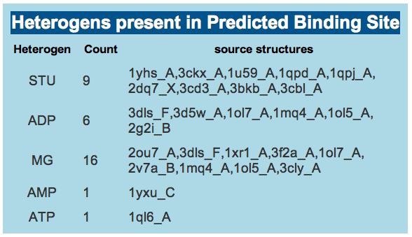
Interpreting predictions – what ligands?
Lists the ligands that are present in the cluster and the structures that they are from

Slide 32
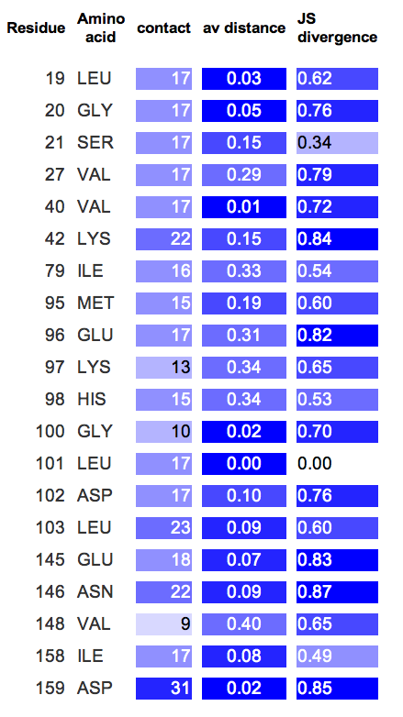
Interpreting predictions
Predicted residue table
Residues in cluster that are < 0.5A +vdw of 25% of cluster predicted
Number of ligand contact
Av distance between residue and these ligands
JS Divergence – conservation score (range 0 – 1).
These values can be used to refine the prediction – e.g.
  residues that contact few of the ligands
  are further from the ligands
  Have low conservation scores

Slide 33
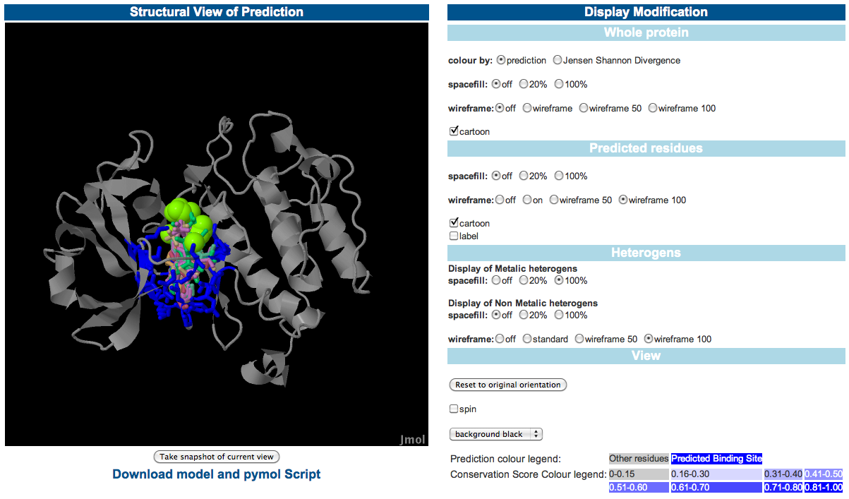
Interpreting predictions

Slide 34
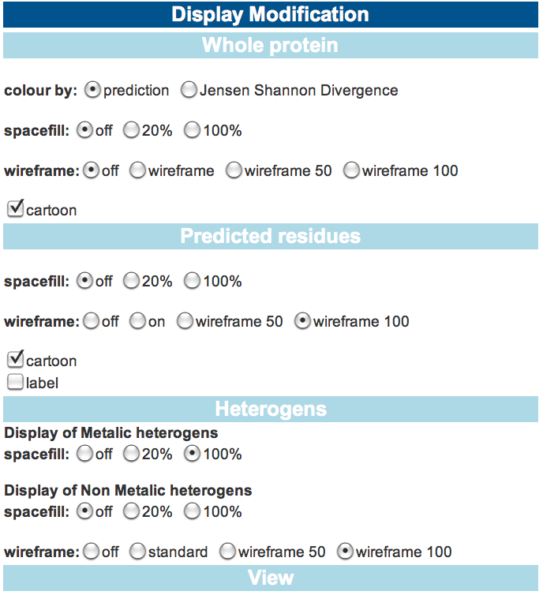
Interpreting predictions
Control:
Colouring of protein – by prediction or conservation
Display of protein:
Spacefill/wireframe/cartoon
Label predicted residues so they can be identified in the graphical view.
Separate controls for display of predicted residues
Modify display of ligands:
Spacefill/wireframe
Overall:
Make protein rotate
Change background colour

Slide 35
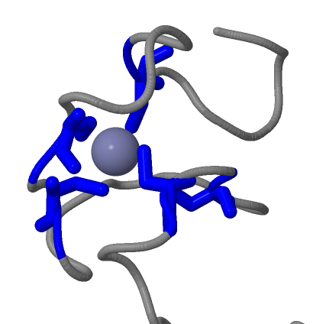
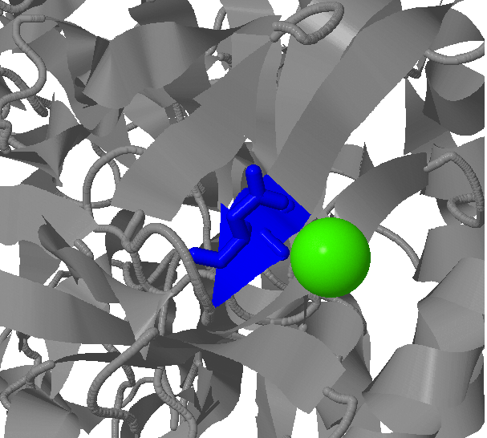
Interpreting predictions - Metals
Metals found bound like this – with 3-6 residues
Often the residues aren’t sequential
Binding sites with a single residue contacting the ligand are likely to be wrong

Slide 36
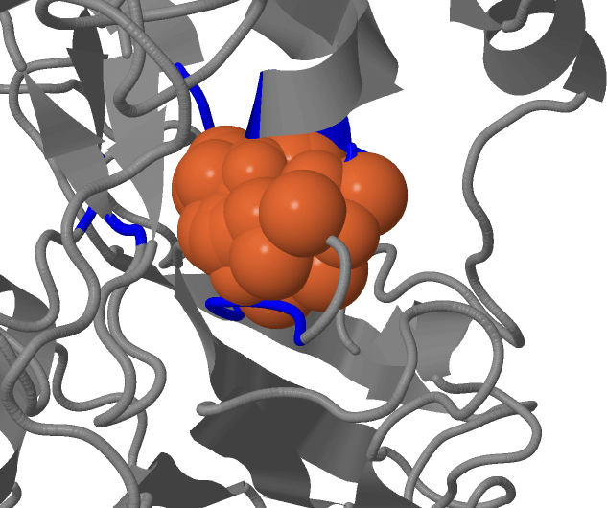
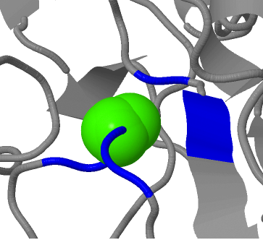
Interpreting predictions - Metals
Sometimes the cluster of residues might overlap with the protein structure as in the examples above. This is more likely where the cluster is close to a loop. The prediction may be good but it might also be slightly affected by the overlap of the cluster and the structure

Slide 37
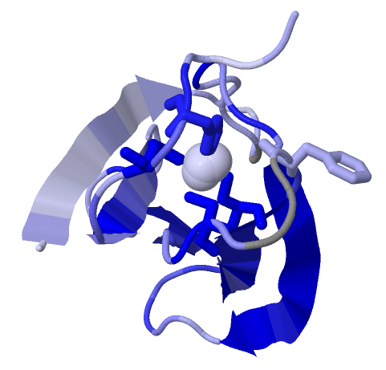
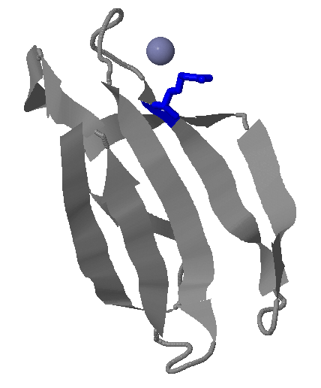
Interpreting predictions - Metals
2 clusters for the same protein.
Multiple ligands in cluster
Multiple residues contacting ligand
Looks like it could be a ligand binding site
Divergence colouring help suggest residue that might not be part of the binding site.
Single ligand in cluster
Single residue binds the ligand
Unlikely to be a ligand binding site

Slide 38
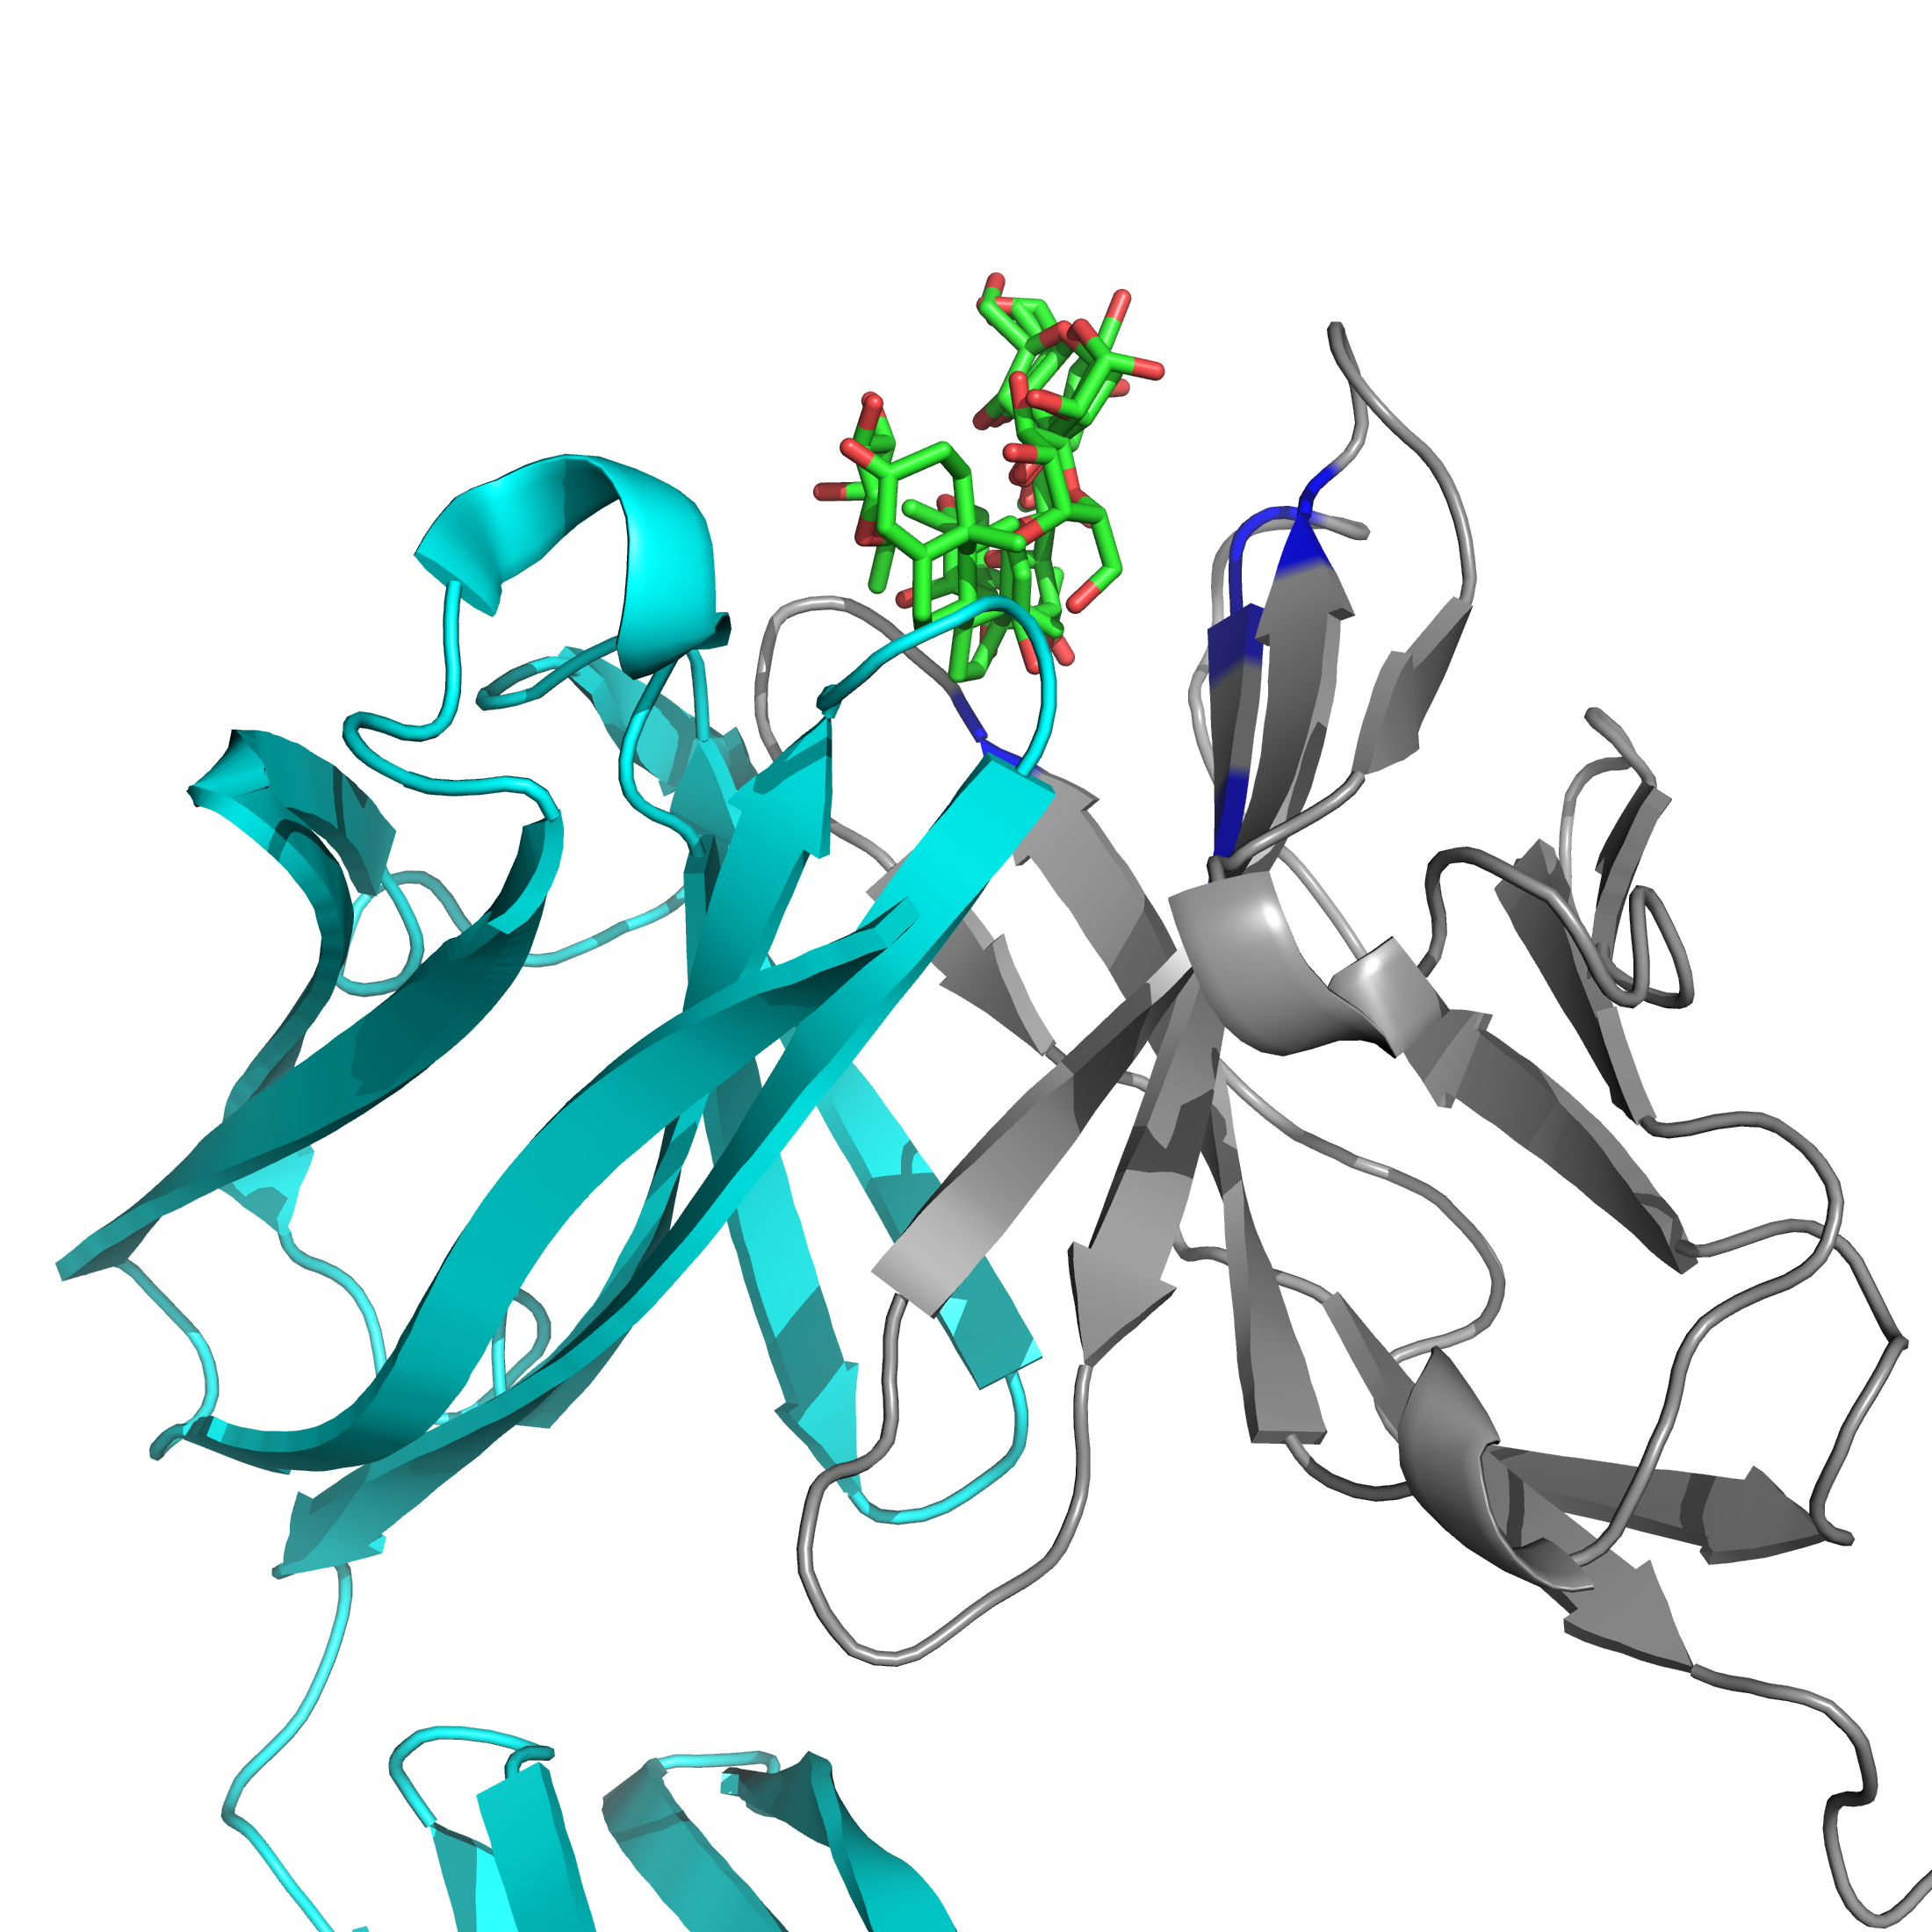
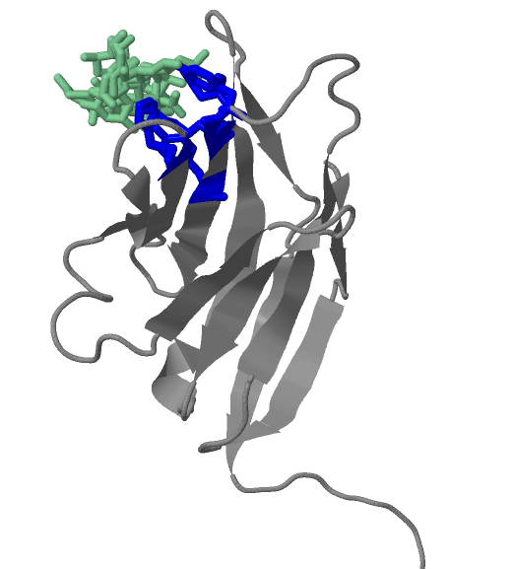
Interpreting predictions - Oligomers
Site only binds part of cluster
Prediction viewed with other chain of dimer from one of the templates
When predictions only seem to contact part of the ligand in some example this is because the ligand is bound between chains in an oligomer. Therefore part of the binding site might be missed. Different clusters predicted for the binding site may predict different residues that when combined contain the full binding site

Slide 39
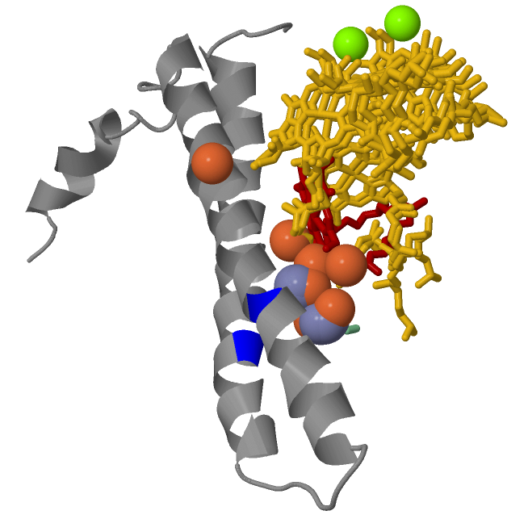
Interpreting predictions – large Clusters
Large cluster of many different ligands.
This is unlikely to be a binding site

Slide 40
Interpreting predictions
Suggestions for interpreting results:
Consider the similarity between the structure and the hits
The number of ligands in a cluster may be indicative of how likely it is for the region to be a binding site
Use of the JS Divergence score may help refine predictions
Metal binding site predictions can have high levels of false positive.
  Especially if there are many clusters and the clusters only contain a single metal ion
  Metal ions a generally contact multiple residues
  Checking the conservation score may be helpful here to remove false predictions
Clusters can occasionally become very large – with many ligands covering a large are of the protein. Such a large site is likely to be incorrect, although part of it may be ligand binding.

Slide 41
Modelling binding site with 3DLigandSite
Mark Wass
m.n.wass@kent.ac.uk

