Slide 1





Protein structure prediction: Theory and examples with Phyre2
Oct 2017
Dr. Lawrence Kelley
Dr. Stefans Mezulis
Prof. Michael Sternberg

Slide 2
Overview
Tip: Submit your sequence(s) to Phyre2 now – results might be ready by end of the talk.
Search for ‘Phyre2’ on Google
www.sbg.imperial.ac.uk/phyre2

Slide 3
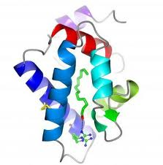
Overview
Protein Folding Problem
SVYDAAAQLTADVKKDLRDSW
KVIGSDKKGNGVALMTTLFAD
NQETIGYFKRLGNVSQGMAND
KLRGHSITLMYALQNFIDQLD
NPDSLDLVCS…….
Space of possibilities vast: # conformations > # atoms in the universe
Energetics not understood: even if we picked the right one we wouldn’t know it

Slide 4
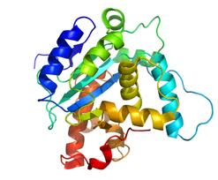
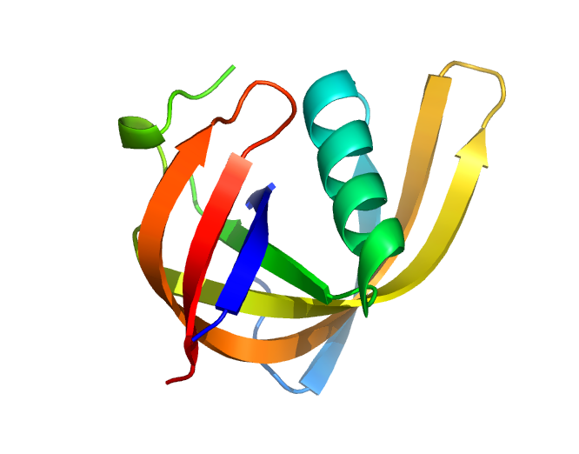
Overview
Three major approaches
  Template-based
  Template-free
  Hybrid
………..
ARDLVIPMIYCGHGY
ARDLVIPMIYCGHGY

Slide 5
Overview
Three major approaches
  Template-based - Reliable
    Protein fold space is limited
    50% of typical proteome covered
  Template-free - Unreliable
    Protein folding problem is unsolved
    Even if answer is good, don’t know when its good
  Hybrid - Useful in special cases

Slide 6
This talk
1. Template-based, Hybrid – principles, Phyre2 examples and interpretation
2. Advanced Phyre2 tools – genome searching, model quality analysis etc.
3. Alternative resources - SwissModel, GenThreader etc.
4. [Future of Phyre2]
5. Worked examples – hands-on web tutorial

Slide 7
Template-based modelling
Overview of core methods
  Template detection
  Alignment
  Loops
  Sidechains
Common core to majority of available methods:
  Phyre2
  SwissModel
  GenThreader
  HHpred
  others

Slide 8
Template-based modelling
Why does it work?
Phyre2 ‘Normal’ mode

Slide 9
Fold Discovery VS Structure Determination over the years
Fold space is limited and we know most of it.. probably
Data from RCSB website, based on folds in CATH 4.0

Slide 10
Fold recognition by scanning
For compatibility with known structures
SVYDAAAQLTADVKKDLRDSW
KVIGSDKKGNGVALMTTLFAD
NQETIGYFKRLGNVSQGMAND
KLRGHSITLMYALQNFIDQLD
NPDSLDLVCS…….
But often the sequence signal is weak
100K structures

Slide 11
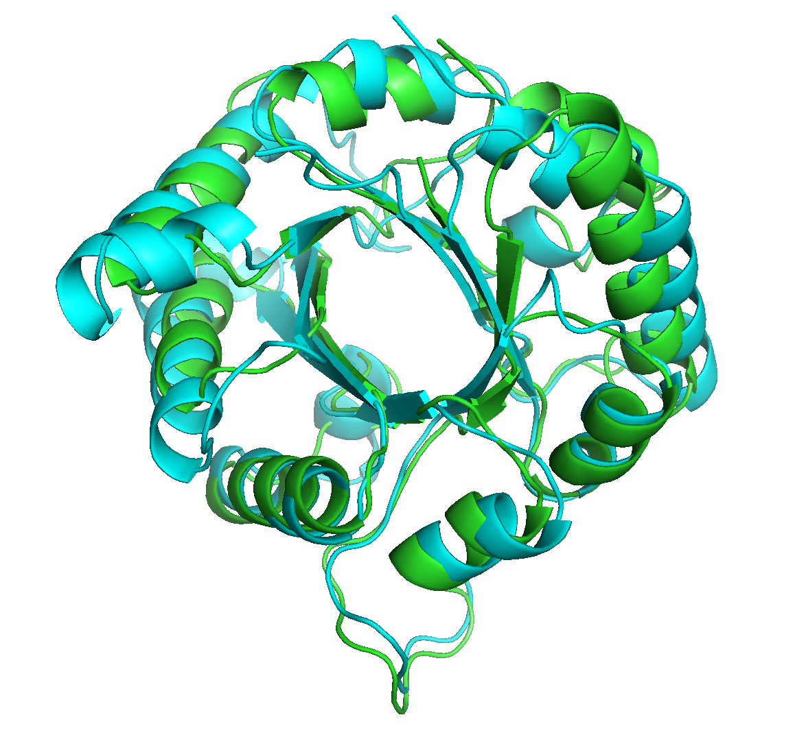
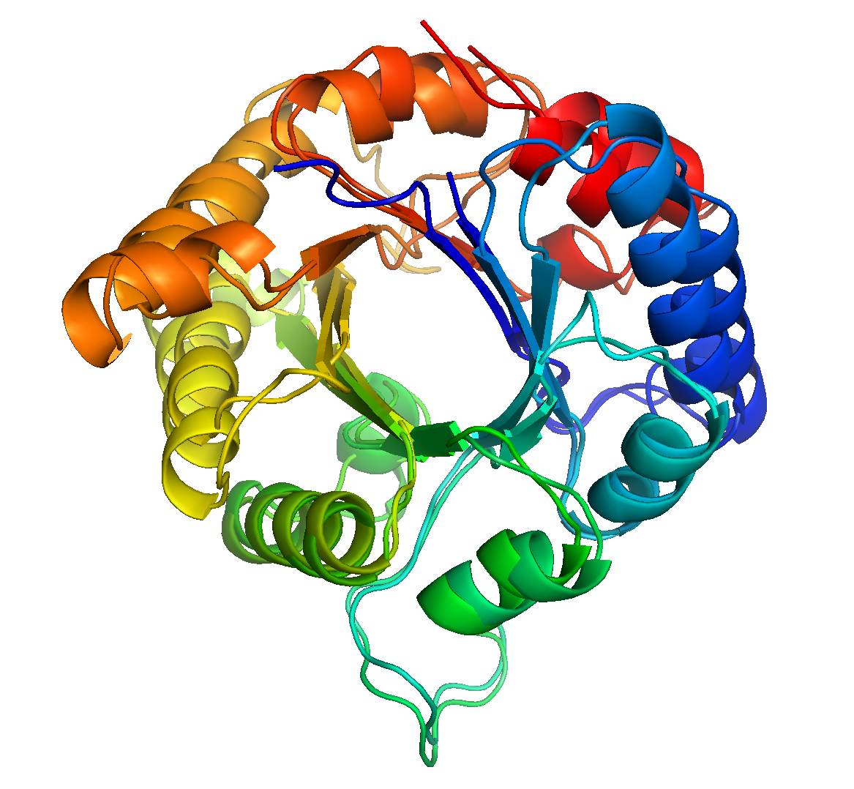
How to detect remote sequence similarity?
72% residues superposable <4A
18% sequence identity
Triose Phosphate Isomerase from
Chicken and Methanocaldococcus

Slide 12
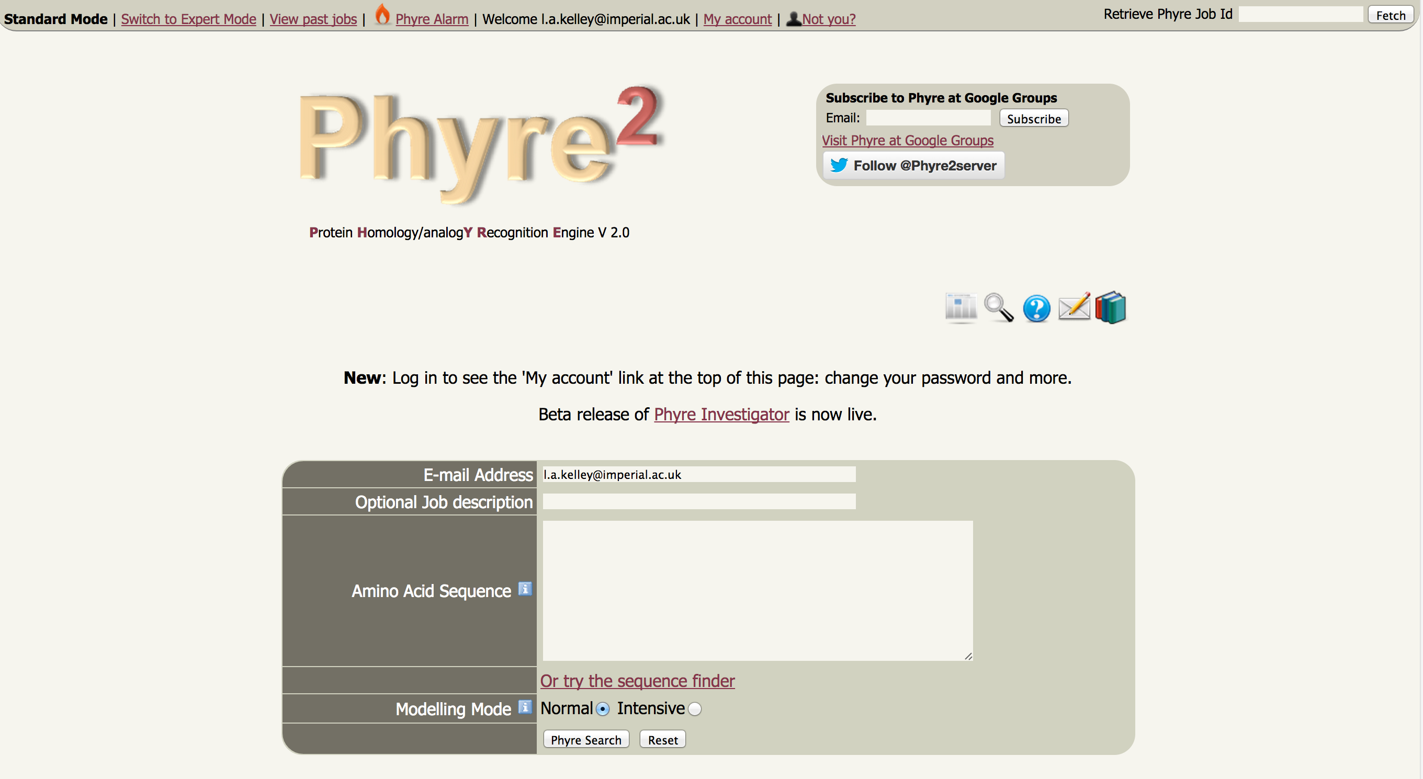
~1,000 user submissions per day
~50,000 users worldwide
http://www.imperial.ac.uk/phyre2

Slide 13
Phyre2
SVYDAAAQLTADV…
Homologous sequences
User sequence
Search the 100 million known sequences for homologues using PSI-Blast.

Slide 14
Phyre2
SVYDAAAQLTADV…
Homologous sequences
User sequence
SVYDAAAQLTADVKKDLRDSW-KVIGSDKKGNGVALMTTLFADNQETIGYFKRLGNVSQG
SVYDAAAQLTADVK---LRDSYKVIGSDKKGNGVALMTTLFADNQETIGYFKRLGNVSQG
SVYDAAVQLTADVKKDLRDSWKVIGSDKKGNGVA---TTLFADNQETIGYFKRLGNVSQG
SVYDAAAQLTADV------DSLKVIGSDKKGNGVALMTTLFADNQETIGYFKRLGNVSQG
SVYDAAAQLTADVKKDLRDSWKVIGS----GNGVALMTTLFADNQETIGYFKRLGNVSQG
Hidden Markov Model
(HMM)

Slide 15
Phyre2
ARDLVIPMIYCGHGY
HMM
User sequence
PSI-Blast
Hidden Markov model
Capture the mutational propensities at each position in the protein
An evolutionary fingerprint

Slide 16
Phyre2
Extract sequence
HAPTLVRDC…….
~ 100,000 known 3D structures
PSI-Blast
HMM
Hidden Markov model
for sequence of KNOWN structure

Slide 17
Phyre2
HMM
HMM
HMM
~ 100,000 known 3D structures
~ 100,000 hidden Markov models

Slide 18
Phyre2
Hidden Markov Model Database of
KNOWN
STRUCTURES
~ 100,000 known 3D structures

Slide 19
Phyre2
ARDLVIPMIYCGHGY
HMM
User sequence
PSI-Blast
Hidden Markov Model DB of KNOWN
STRUCTURES
Core method of all major servers
Very powerful
Can confidently detect and align proteins
when sequence similarity as low as 15%
HMM-HMM
Matching
(HHsearch, Soeding)
ARDL--VIPMIYCGHGY
3D-Model
AFDLCDLIPV--CGMAY
Sequence of known structure

Slide 20
From alignment to crude model
ARDL--VIPMIYCGHGY
Query (your sequence)
AFDLCDLIPV--CGMAY
Known
Structure
L
C
V
D
C
P
F
D
Y
G
Known 3D
Structure coordinates
A
I
A
L
M

Slide 21
From alignment to crude model
ARDL--VIPMIYCGHGY
Query
Re-label the known structure
according to the mapping from
the alignment.
AFDLCDLIPV--CGMAY
Known
Structure
I
Insertion (handled by loop modelling)
L
M
Y
D
Del
C
P
R
Y
G
A
I
A
Homology model
V
M

Slide 22
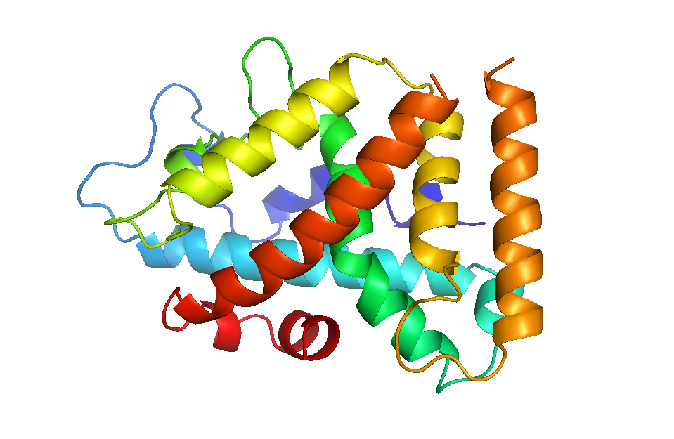
Loop modelling
ARDAKQH
d

Slide 23
Loop modelling
Fragment the entire PDB
Find sequences similar to indel
Check end-point distances
Check backbone geometry
Fit using robot arm algorithm
Sort by pseudo-energy

Slide 24
A quick note on energy functions
Physics
Statistical
e.g. CHARMM, AMBER, etc.
a.k.a.: Pair potentials
Empirical energy functions

Slide 25
A quick note on energy functions
Physics
Statistical
GOOD: Detailed refinement
Small scale changes
True?
BAD: Tends to destroy
Homology models
(either functions wrong
(e.g. lack of water) or decades
compute time req’d
GOOD: well-behaved with
course models
BAD: unreliable, due to lack of
data

Slide 26
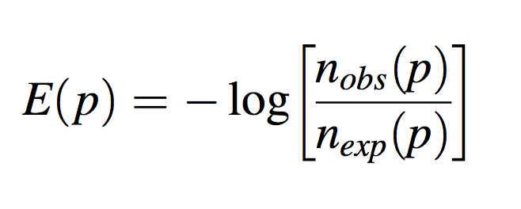
Statistical potentials – How?
What should the ‘energy’ be for a Valine in contact with a Leucine?
Go through all PDB structures, counting how often we see a property p vs what we expect by chance (e.g. x and y in contact, or z exposed to solvent…etc.)
Courtesy of Ludwig Boltzmann

Slide 27
Loop modelling
Fragment the entire PDB
Find sequences similar to indel
Check end-point distances
Check backbone geometry
Fit using robot arm algorithm
Sort by pseudo-energy

Slide 28
Loop modelling
ARDAKQH
d

Slide 29
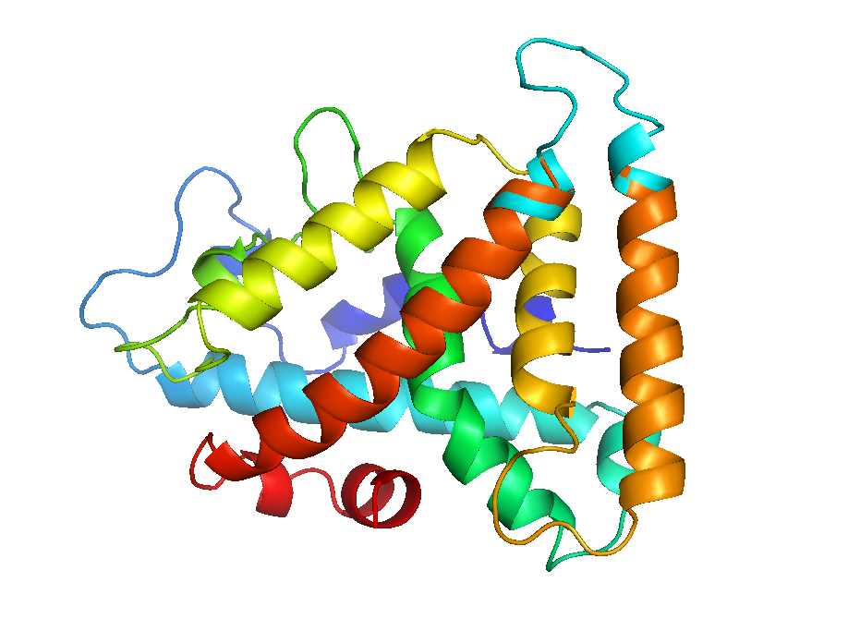
Loop modelling

Slide 30
Loop modelling - accuracy
Insertions and deletions relative to template modelled by a loop library up to 15 aa’s in length
Short loops (<=5) good. Longer loops less trustworthy
Be wary of basing any interpretation of the structural effects of point mutations

Slide 31
Sidechain modelling

Slide 32
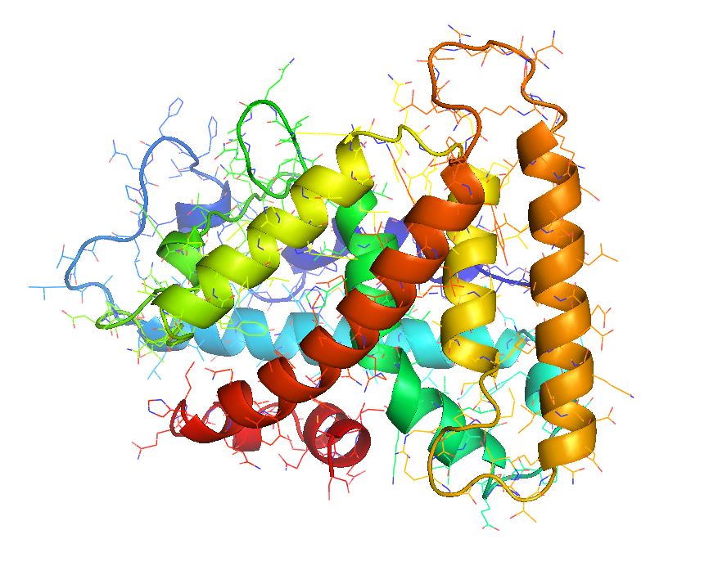
Sidechain modelling

Slide 33
Sidechain modelling
Optimisation problem
Fit most probable
rotamer at each position
According to given
backbone angles
Whilst avoiding clashes

Slide 34
Sidechain modelling - accuracy
Sidechains will be modelled with ~80% accuracy (chi 1) IF……the backbone is correct.
Clashes *will* sometimes occur and if frequent, indicate probably a wrong alignment or poor template
Analyse with Phyre Investigator

Slide 35
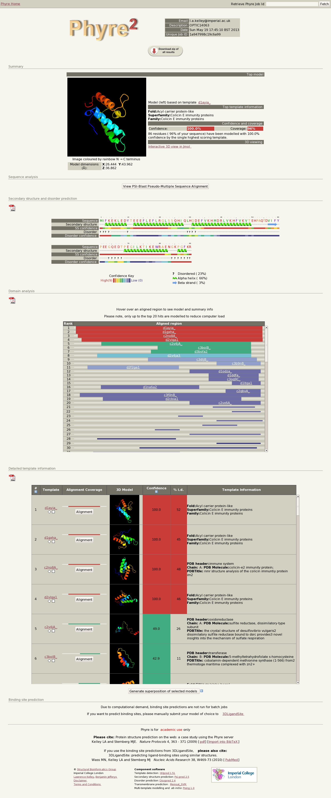
Example results
Top model info
Secondary structure/disorder
Domain analysis
Detailed template information

Slide 36
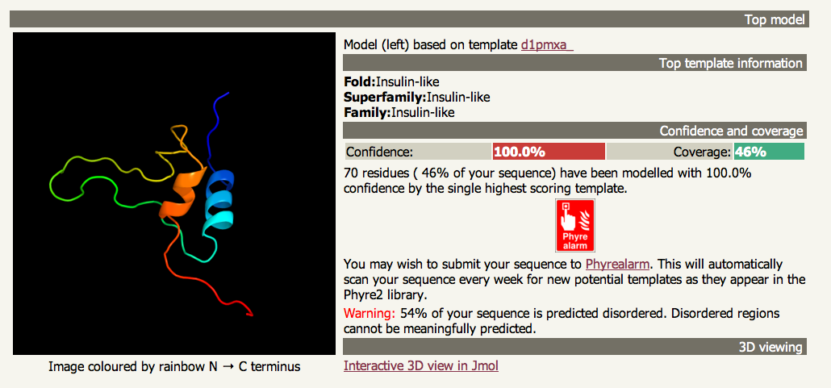
Example results

Slide 37
Example results
Top model info
Secondary structure/disorder
Domain analysis
Detailed template information

Slide 38
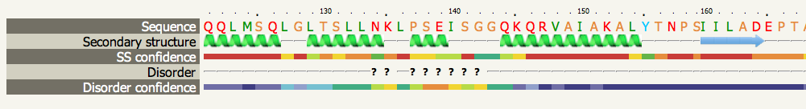
Example SS/disorder prediction

Slide 39
Secondary structure and disorder
Based on neural networks trained on known structures.
Given a diverse set of homologous sequences, expect ~75-80% accuracy.
Few or no homologous sequences? Only 60-62% accuracy
PSI-Pred and Diso-Pred by Jones, UCL

Slide 40
Example results
Top model info
Secondary structure/disorder
Domain analysis
Detailed template information

Slide 41
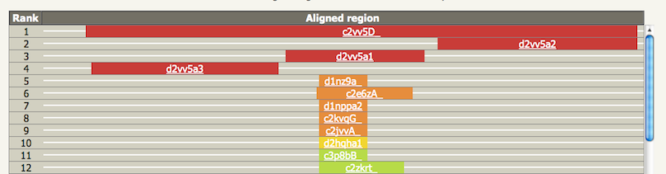
Example domain analysis

Slide 42
Domain analysis
Local hits to different templates indicate domain structure of your protein
Multiple domains can be linked using ‘Intensive mode’ (a Hybrid method)

Slide 43
Example results
Top model info
Secondary structure/disorder
Domain analysis
Detailed template information

Slide 44
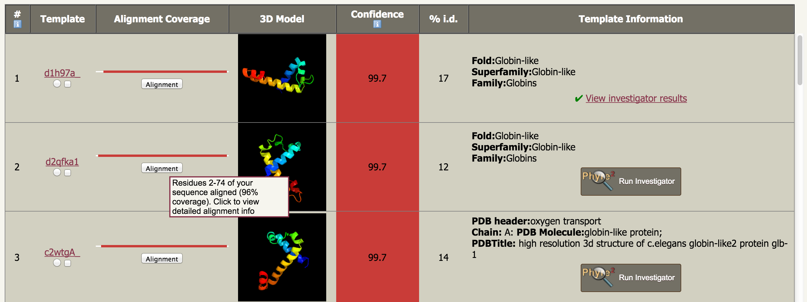
Main results table
Actual Model!
Not just a picture of the template –
click to download model

Slide 45
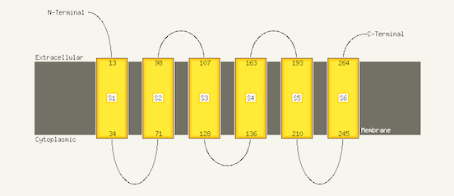
Transmembrane helices
If confidently predicted to contain membrane helices, topology prediction run. (Machine learning approach estimated to be 85% accurate)
Memsat-SVM, Nugent & Jones, 2009

Slide 46
Interpreting results
Need measure of similarity of structures when we know the answer
To discuss accuracy of a model, we need a way to quantify similarity of a model to the right answer
RMSD very commonly used, but often misleading
Modelling community uses TM score for benchmarking: essentially the percentage of alpha carbons superposable on the answer within 3.5Å.
Focused on the protein core, rather than loops and sidechains.

Slide 47
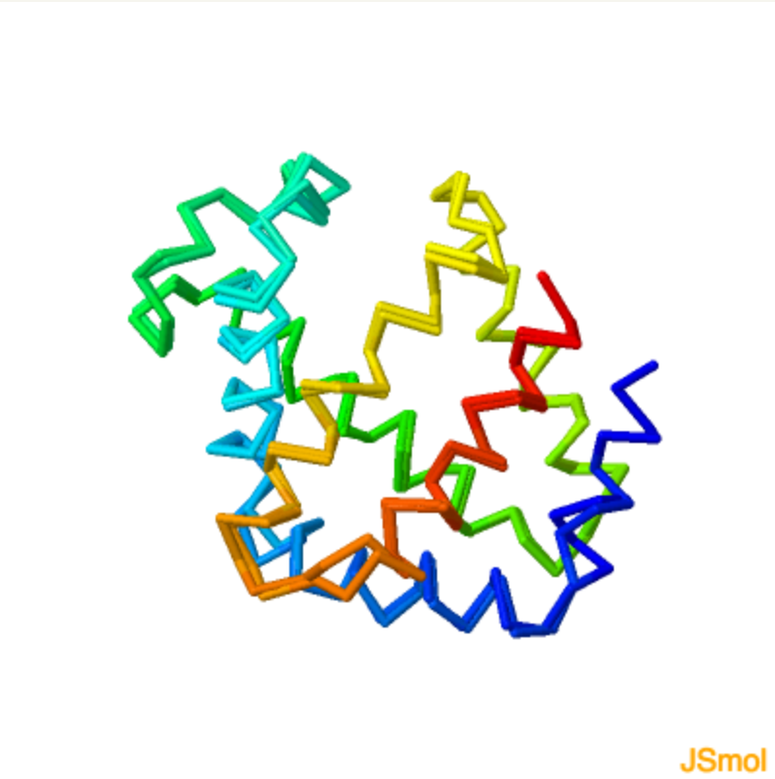
Interpreting results
Comparing two known structures
TM-score 0.9

Slide 48
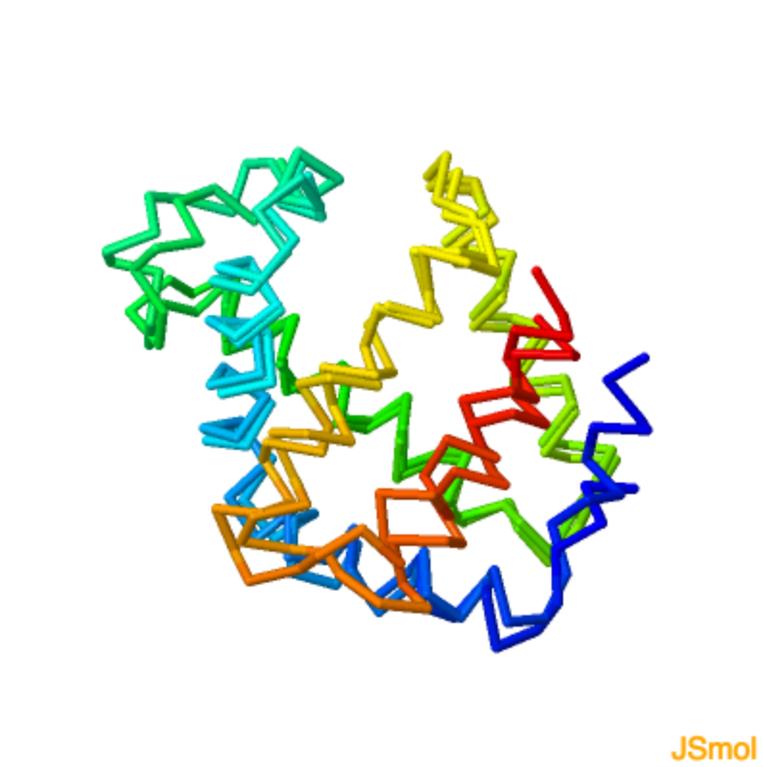
Interpreting results
Comparing two known structures
TM-score 0.8

Slide 49
Interpreting results
In Phyre we don’t know the answer
But we do have a confidence measure and sequence identity to guide us
How do these quantities relate to accuracy?

Slide 50
Interpreting results
Comparing model with native (the answer)
TM-score 0.9
Phyre output
100% confidence,
56% sequence identity

Slide 51
Interpreting results
Comparing model with native (the answer)
TM-score 0.8
Phyre output
100% confidence,
24% sequence identity

Slide 52
Interpreting results
How accurate is my model?
Simple question with a complicated answer!
Phyre2 returns a confidence (0-100)
  This is the confidence that your protein and the template are homologous
Next version will have a predicted TM-score

Slide 53
Interpreting results
Sequence identity and model accuracy
High confidence (>90%) and High seq. id. (>35%): almost always very accurate: TM score>0.7, RMSD 1-3Å.
High confidence (>90%) and low seq. id. (<30%) almost certainly the correct fold, accurate in the core (2-4Å) but may show substantial deviations in loops and non-core regions.

Slide 54
Interpreting results
Checklist
Look at confidence – be VERY wary if <90%
Given multiple high confidence hits, look at % sequence identity
Biological knowledge relating function of template to sequence of interest
Structural superpositions to compare models – many similar models increase confidence
Examine sequence alignment

Slide 55
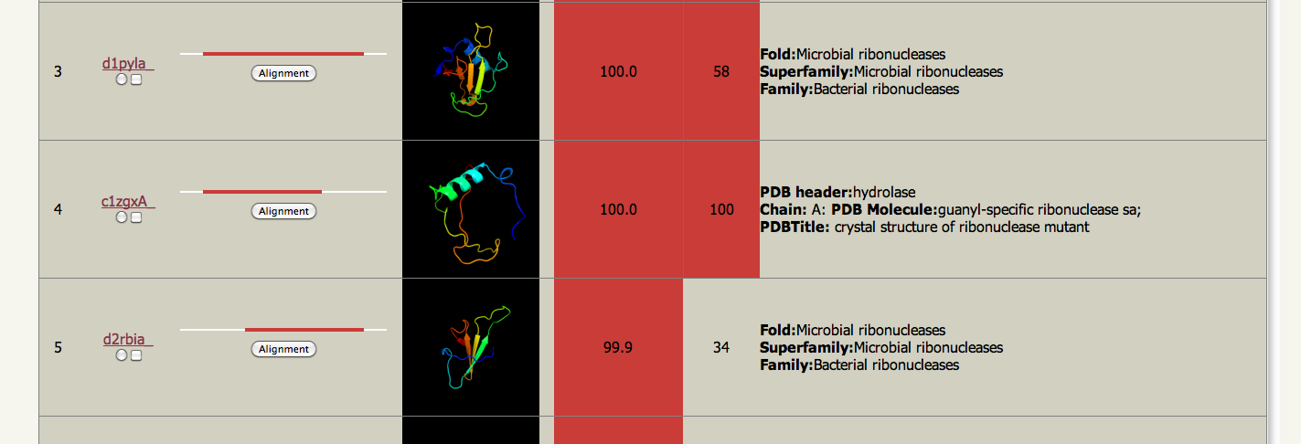
Main results table

Slide 56
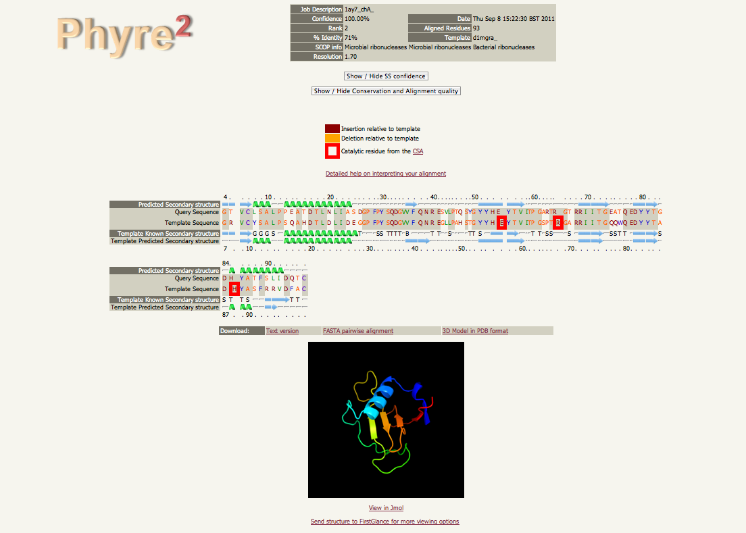
Alignment view

Slide 57
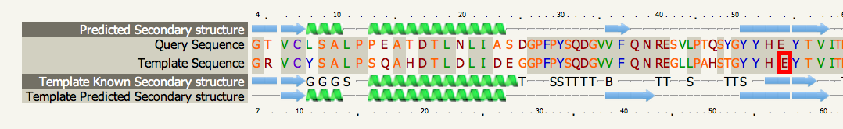
Alignment view

Slide 58
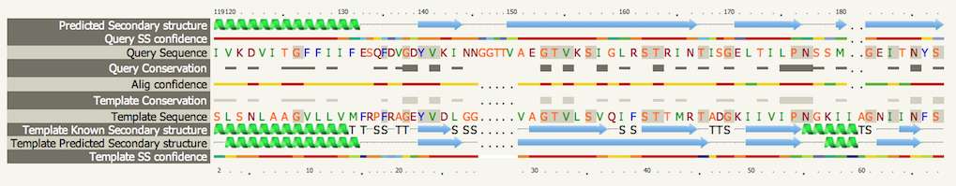
Alignment view

Slide 59
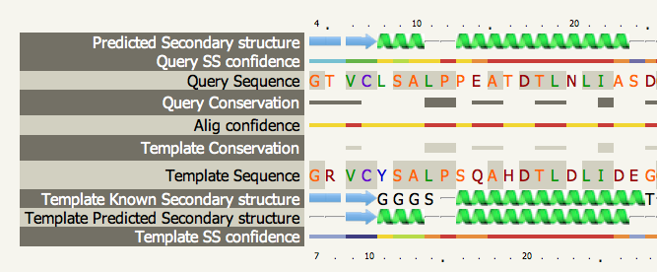
Alignment view

Slide 60
Alignment interpretation
Checklist
Secondary structure matches
Gaps in SS elements indicate potentially wrong alignment
Active sites present in the Catalytic Site Atlas (CSA) for the template highlighted – look for identity or conservative mutations when transferring function
Alignment confidence per residue

Slide 61
Mutations
The STRUCTURAL effects of point mutations on structure will NOT be modelled accurately
Checklist
Is it near the active site?
Is it a change in the hydrophobic core?
Is it near a known binding site? (can predict with e.g. 3DLigandSite)
Phyre Investigator can help (see later)

Slide 62
Is my model good enough?
All depends on your purpose.
Good enough for drug design? – probably if the sequence identity is very high (>50%)
Sometimes good enough if far lower seq id but accurate around site of interest.
High confidence but low seq i.d. still very likely correct fold, useful for a range of tasks.
E.g. pockets, proximal residues, variants, interfaces…

Slide 63
Hybrid approach– mixing template-based and template-free methods
Phyre2 ‘Intensive’ mode

Slide 64
Shortcomings of ‘normal’ Mode
Individual domains in multi-dom proteins often modelled separately
Query
Template 1
Template 2
???

Slide 65
Shortcomings of ‘normal’ Mode
Regions with no detectable homology to known structure unmodelled
Query
Template 1
Template 2
???

Slide 66
Shortcomings of ‘normal’ Mode
Does not use multiple templates which, when combined could result in better coverage
Query
Template 1
Template 2
Template 3
Template 4
???

Slide 67
Shortcomings of ‘normal’ Mode
Thus need a system to fold a protein without templates and combine templates when we have them.

Slide 68
Shortcomings of ‘normal’ Mode
Thus need a system to fold a protein without templates and combine templates when we have them.
Fragment approach (i-Tasser, Robetta)
Constraints + simulated synthesis (Phyre2)

Slide 69
Poing – simplified folding model
structure simplification
Small hydrophilic sidechain
Backbone
C-alpha
Protein backbone
Large hydrophobic sidechain
Notes:
The protein is reduced to a string of Calpha beads with sidechain centroid particles attached

Slide 70
Phyre + Poing
ARNDLSLDLVCS…….
HMM
PSI-Blast
Hidden Markov Model DB of KNOWN STRUCTURES
HMM-HMM
matching
FINAL MODEL
POING: Synthesise from virtual ribosome.
Springs for constraints. Ab initio modelling
of missing regions (bury hydrophobics, avoid clash
Maintain secondary structure).
Extract pairwise
distance constraints

Slide 71
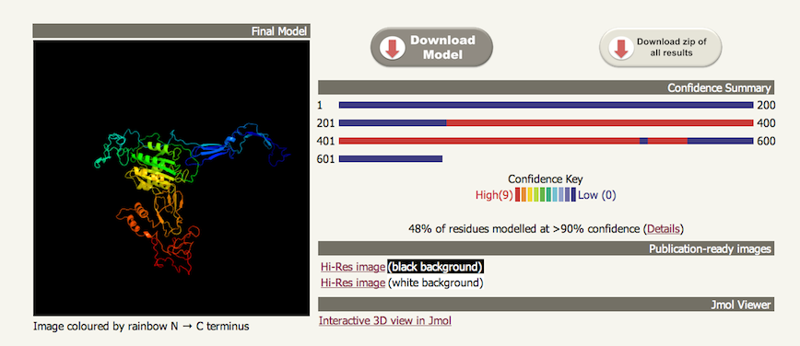
Intensive mode

Slide 72
Intensive mode
Designed to handle mutliple domains or proteins with substantial stretches of sequence without detectable homologous structures.
POOR at ab initio regions
GOOD at combining multiple templates covering different regions

Slide 73
Intensive mode
Relative domain orientation will NOT generally be correct if those domains come from different PDB’s with little structural overlap.
Query
✔
Template 1
Template 2

Slide 74
Intensive mode
Relative domain orientation will NOT generally be correct if those domains come from different PDB’s with little structural overlap.
Query
✖
Template 1
Template 2
?

Slide 75
Intensive mode
B-factors in final model indicate ab initio vs. template-based modelled regions
Can be slow (or break!) on large proteins and limited to 1,000 residues.
Under active development – improved version available in a few months.

Slide 76
Intensive mode
“Intensive” does not always equal “Better”!
Checklist
Always use normal mode first to understand what regions can be well modelled
Multiple overlapping high confidence domains? Good, try intensive (it will auto-recommend it). Otherwise skip it.
Danger of “spaghettification”

Slide 77
Advanced tools
Phyre2 Expert mode

Slide 78
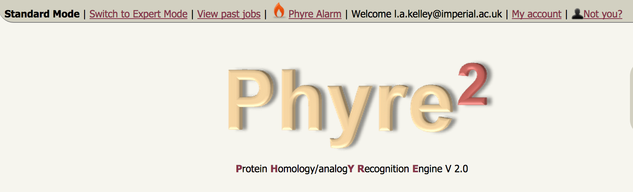
Advanced functions
Register and Log in to access Expert Mode

Slide 79
Advanced functions
PhyreAlarm – automatically re-run tricky sequences every week
BackPhyre – compare a structure to up to 30 genomes
One-To-One Threading – use specfic PDB for model building
Batch Jobs – run many sequences at once
Job Manager – keep track of your jobs and history

Slide 80
PhyreAlarm
Sometimes no confident homology detected
If at first you don’t succeed….
Wait a week
Automatically try every week as new structures are deposited in the PDB

Slide 81
PhyreAlarm
User sequence
HMM
SVYDAAAQLTADVKKD…….
Newly solved PDB
Structures added WEEKLY
HMM-HMM matching
Newly added structure HMMs
Yes
Confident hit?
Perform full Phyre modelling
No
Email results
New 3D model
Try again next week

Slide 82
PhyreAlarm
PhyreAlarm auto-suggested in cases where sequence has low coverage by confident hits
Two clicks adds your sequence to the alarm queue

Slide 83
Advanced functions
PhyreAlarm – automatically re-run tricky sequences every week
BackPhyre – compare a structure to up to 30 genomes
One-To-One Threading – use specfic PDB for model building
Batch Jobs – run many sequences at once
Job Manager – keep track of your jobs and history

Slide 84
BackPhyre
Does a protein I’m interested in exist in a particular organism?

Slide 85
BackPhyre
User structure
OR User sequence
SVYDAAAQLTADVKKDLRDSW
KVIGSDKKGNGVALMTTLFAD
NQETIGYFKRLGNVSQGMAND
KLRGHSITLMYALQNFIDQLD
NPDSLDLVCS…….
Rank | Hit | Confid-ence
1 | Gi…
2 | Gi..
3 | Gi..
. | .
. | .
Hidden Markov Model DB of Genomes
HMM
HMM-HMM matching
Ranked list of genome hits

Slide 86
BackPhyre
33 searchable genomes to-date.
Scan multiple genomes at a time. Quite fast.
New version will allow users to upload their own genomes of interest (maybe).
Agrobacterium_tumefaciens
Arabidopsis_thaliana
Archaeon
Autotransporters
Bacillus_subtilis
Bartonella_henselae
Bdellovibrio_bacteriovorus
Bodo_saltans
C elegans
Clostridium_difficile
Corynebacterium_diphtheriae
Desulfitobacterium_hafniense
Drosophila_melanogaster
Enterobacteria_phage_T4
Escherichia_coli_K12
Homo_sapiens
Lactobacillus_casei
Leishmania
Mus_musculus
Mycobacterium_tuberculosis
Nanoarchaeota
Neisseria_meningitidis
Plasmodium_falciparum
Pseudomonas_aeruginosa
Saccharomyces_cerevisiae
Schistosoma_mansoni
Staphylococcus_aureus
Streptococcus_pneumoniae
Streptomyces_coelicolor
Sulfolobus_solfataricus
Synechococcus
Thermoplasma_acidophilum
Yersinia_pestis

Slide 87
Advanced functions
PhyreAlarm – automatically re-run tricky sequences every week
BackPhyre – compare a structure to up to 30 genomes
One-To-One Threading – use specfic PDB for model building
Batch Jobs – run many sequences at once
Job Manager – keep track of your jobs and history

Slide 88
One-to-One Threading
Useful if you:
a) Know a better template than found by Phyre2
b) Have your own structure not yet in the PDB
c) Model a lower-ranked (>20) template
d) Want more expert control over alignment options: local/global, secondary structure weight etc.

Slide 89
One to one threading
User structure
HMM of
User structure
SVYDAAAQLTADVKKDLRDSWDLVCS…….
HMM-HMM matching
User sequence
HMM of
user
sequence
KLRGHSITLMYALQN
NPDSLDLVCS…….
Final model

Slide 90
Advanced functions
PhyreAlarm – automatically re-run tricky sequences every week
BackPhyre – compare a structure to up to 30 genomes
One-To-One Threading – use specfic PDB for model building
Batch Jobs – run many sequences at once
Job Manager – keep track of your jobs and history

Slide 91
Batch Jobs
Only Normal mode for speed considerations
Sequences are processed more slowly than individual submissions to maintain user experience
Batch job progress can be monitored, view intermediate results
100 Sequences by default. Use the My Account page to request an increase (up to 1-2k)

Slide 92
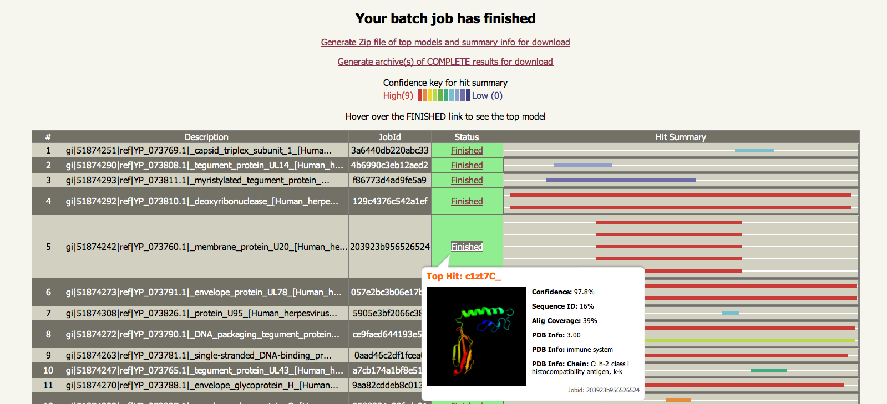
Batch Jobs

Slide 93
Advanced functions
PhyreAlarm – automatically re-run tricky sequences every week
BackPhyre – compare a structure to up to 30 genomes
One-To-One Threading – use specfic PDB for model building
Batch Jobs – run many sequences at once
Job Manager – keep track of your jobs and history

Slide 94
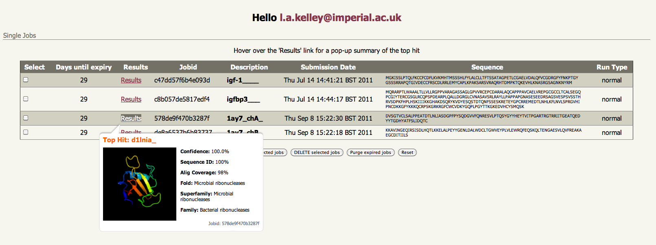
Job manager

Slide 95

Phyre Investigator

Slide 96
Phyre Investigator
What parts of a model are reliable?
What parts may be functionally important? (guide mutagenesis, understand mutants/SNPs)
What residues are involved in interactions with other proteins?

Slide 97
Phyre Investigator
Clashes
Rotamer outliers
Ramachandran outliers
ProQ2 model quality assessment
Alignment confidence (HHsearch)
Conservation/evolutionary trace (Jenson-Shannon divergence –far faster and just as accurate as ET)
Catalytic Site Atlas
Disorder
Pocket detection (Fpocket)
Protein interface residues (PI-Site, ProtinDB)
Conserved Domain Database ‘conserved features’ for NCBI-curated domains

Slide 98
Phyre Investigator
Effect of Mutations?
Will a SNP effect my protein’s function?
New method: SuSPect by Dr. Chris Yates
Integrated into Phyre Investigator
Also standalone server
http://www.sbg.bio.ic.ac.uk/suspect/
Yates et al, 2014 J Mol Biol.

Slide 99
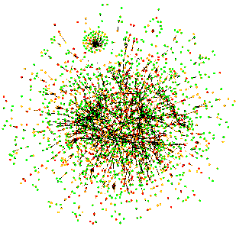
SuSPect – Phenotypic effect of amino acid variants
Sequence conservation
Sequence profile (PSSM)
Pfam domain
Jensen-Shannon entropy
Structural features
Predicted solvent accessibility
Network features
Protein-protein interaction (PPI) as domain centrality
Interactome
Notes:
varibench set submitted to condel which submitted to polyphony and sift
varibench submitted to mutassessor and fathom
these systems chosen because they can accept batch
other popular ones: snap snps&go
in published work these perform comparably to mutassessor
varibench filtered to remove any training data leaving: 13k neutral and 5k pathogenic
whole varibench is about 30k, ended up testing on 20k

Slide 100
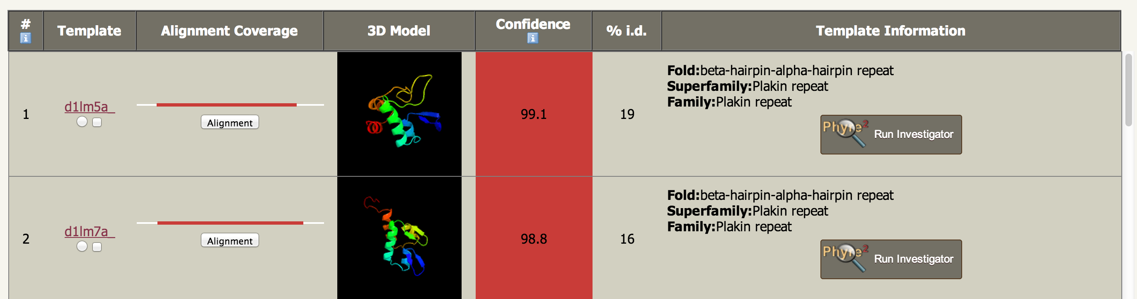
Phyre Investigator

Slide 101
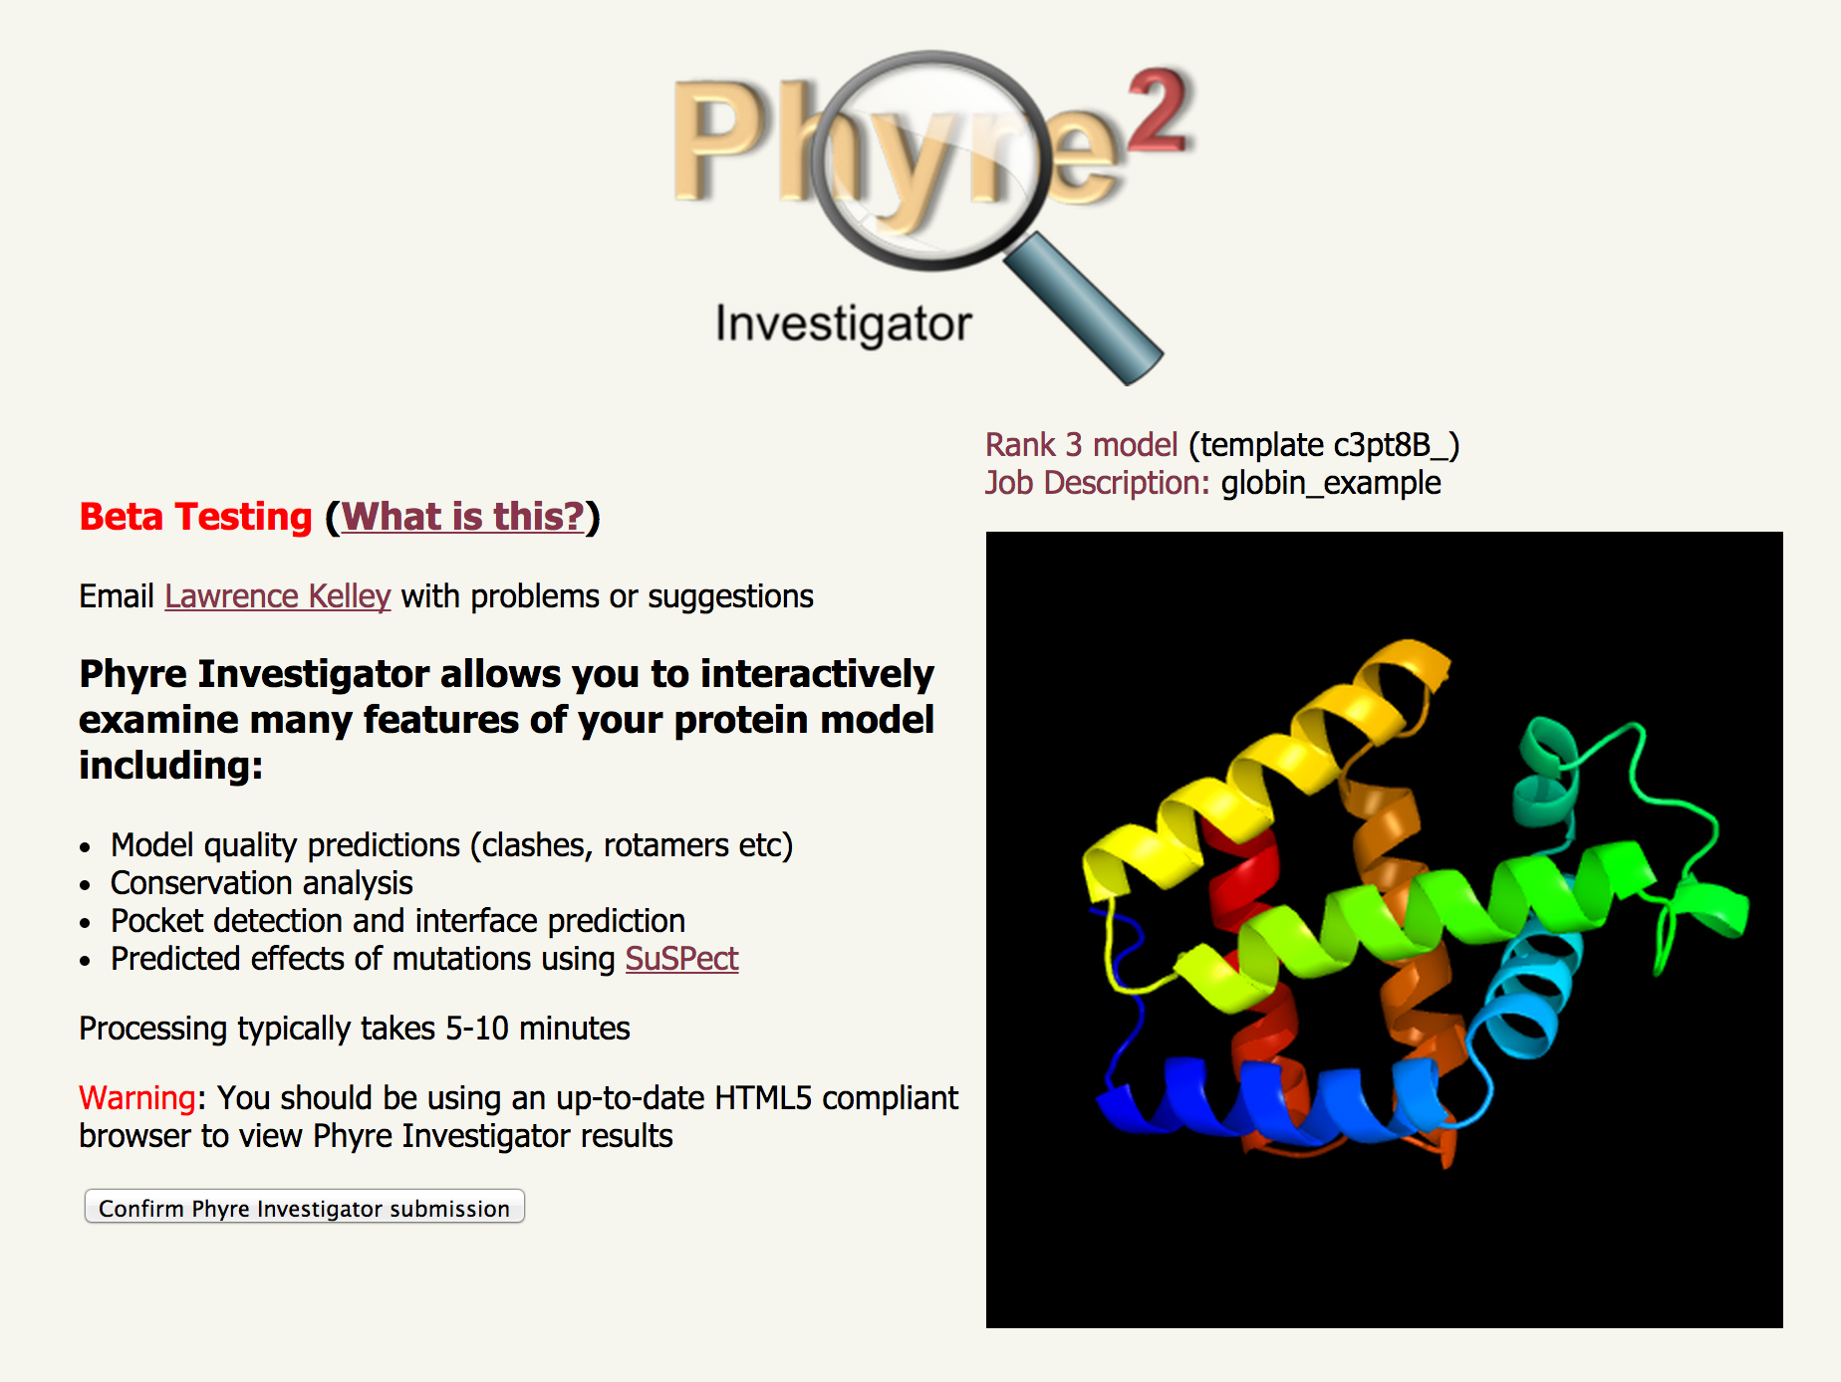
Phyre Investigator

Slide 102
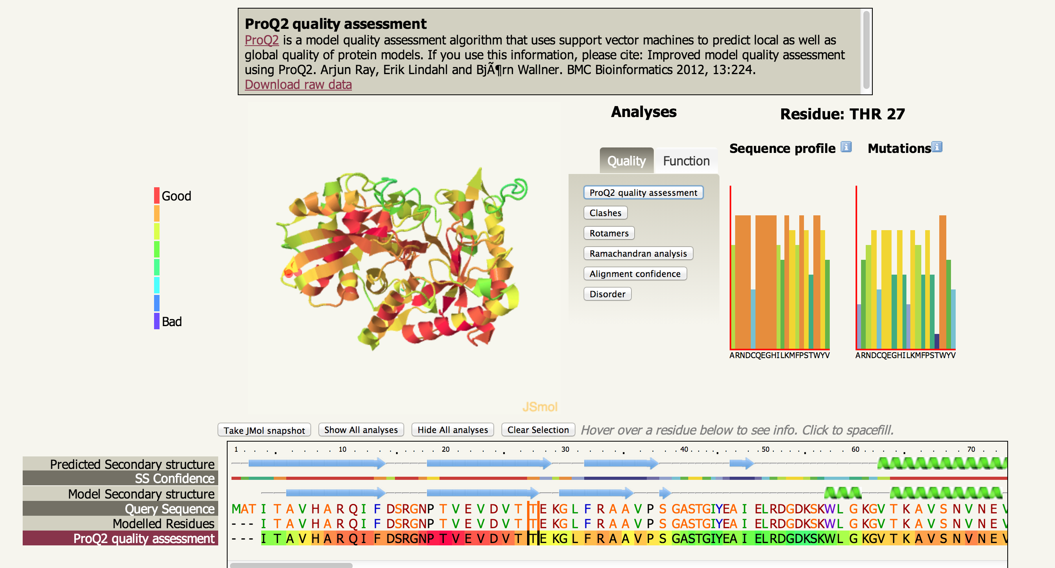
Phyre Investigator
Notes:
DEMO
http://www.sbg.bio.ic.ac.uk/phyre2/phyre2_output/ca8acc6688d7f918/investigator/c3pt8B_.3/summary.html

Slide 103
Alternative resources to Phyre2

Slide 104
Alternative Resources
Template-based
  HHpred - hmm + Modeller
  SwissModel- hmm + loops + sidechains like Phyre
  (p)(m)(pDom)GenThreader - profile-profile + Modeller
  And others….
Hybrid
  Robetta (Robot Rosetta)
  i-TASSER

Slide 105
Template-based alternatives
HHpred, SwissModel, GenThreader

Slide 106
Alternative Resources
Template-based
 | Registration required? | Speed | Single-step modelling | Multi- template? | Batch processing
HHpred | No | Fast | No | Yes | No
SwissModel | No | Fast | No | No | No
GenThreader | No | Fast | No | No | No
Phyre2 | No | Fast | Yes | Yes | Yes
Fast= minutes to hours

Slide 107
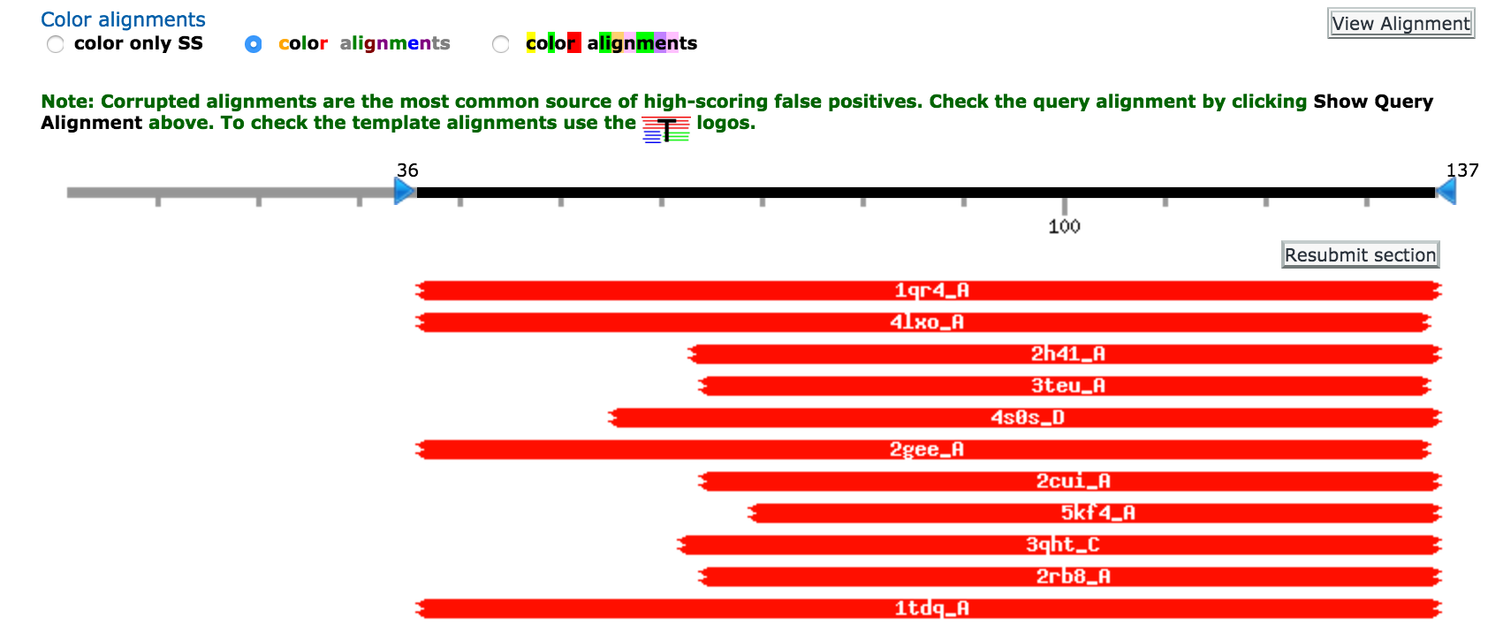
HHpred

Slide 108
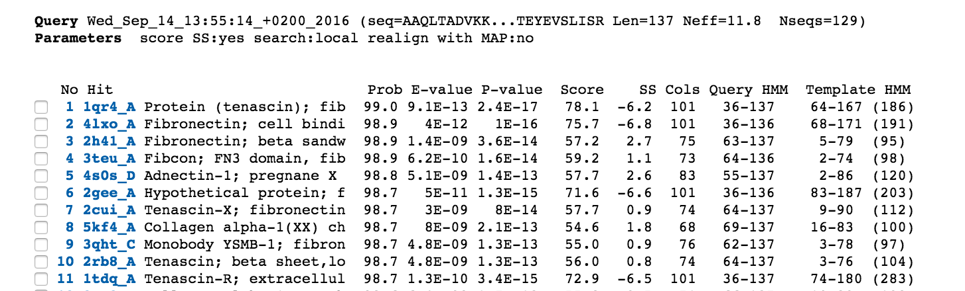
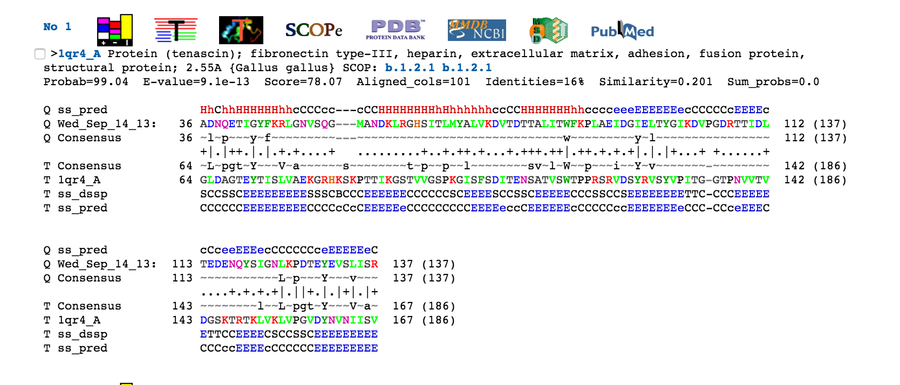
HHpred

Slide 109
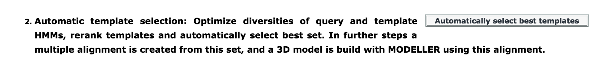
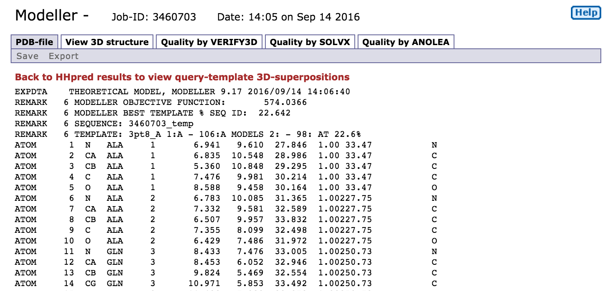
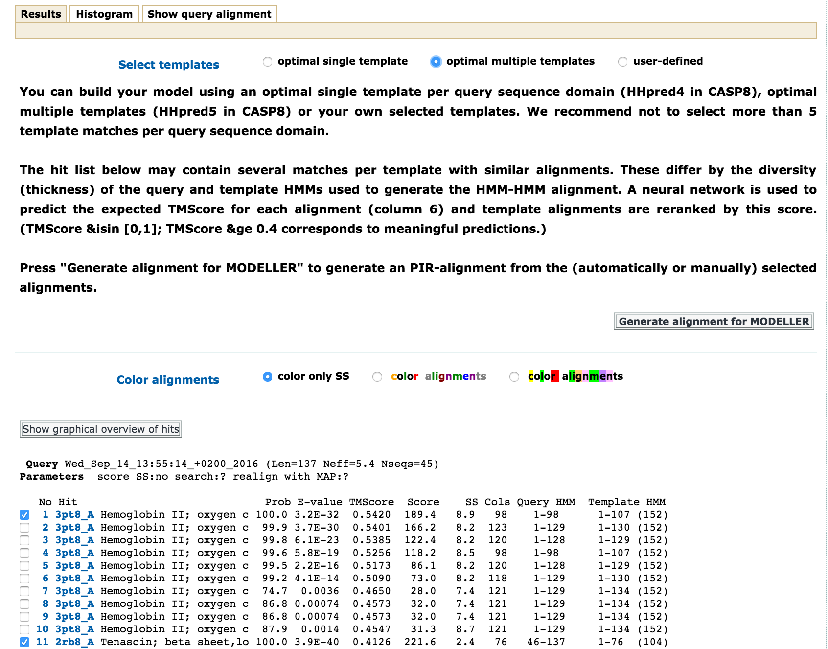
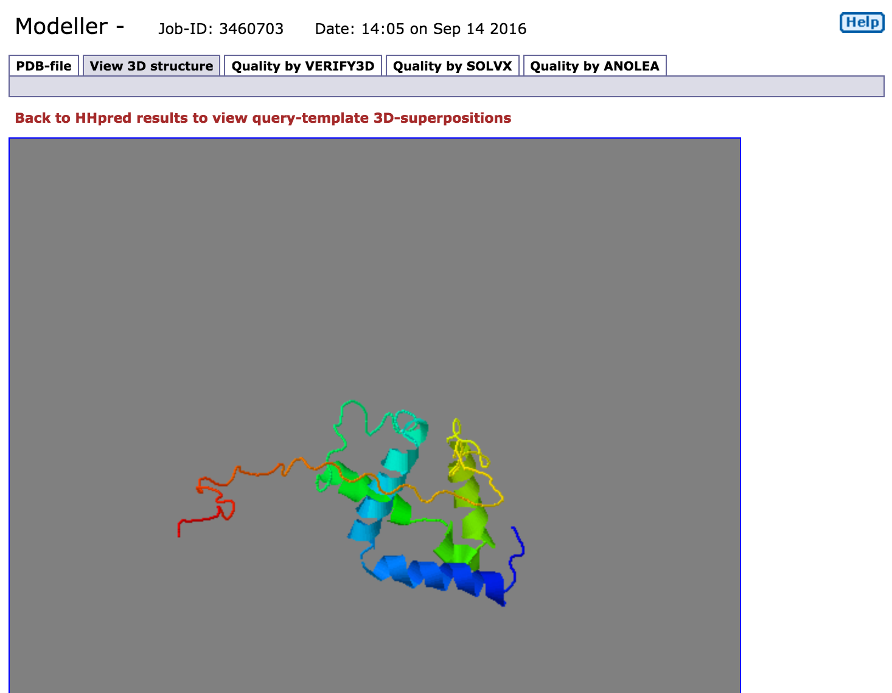
HHpred
Automatic or manual template selection
(requires Modeller license Key)

Slide 110
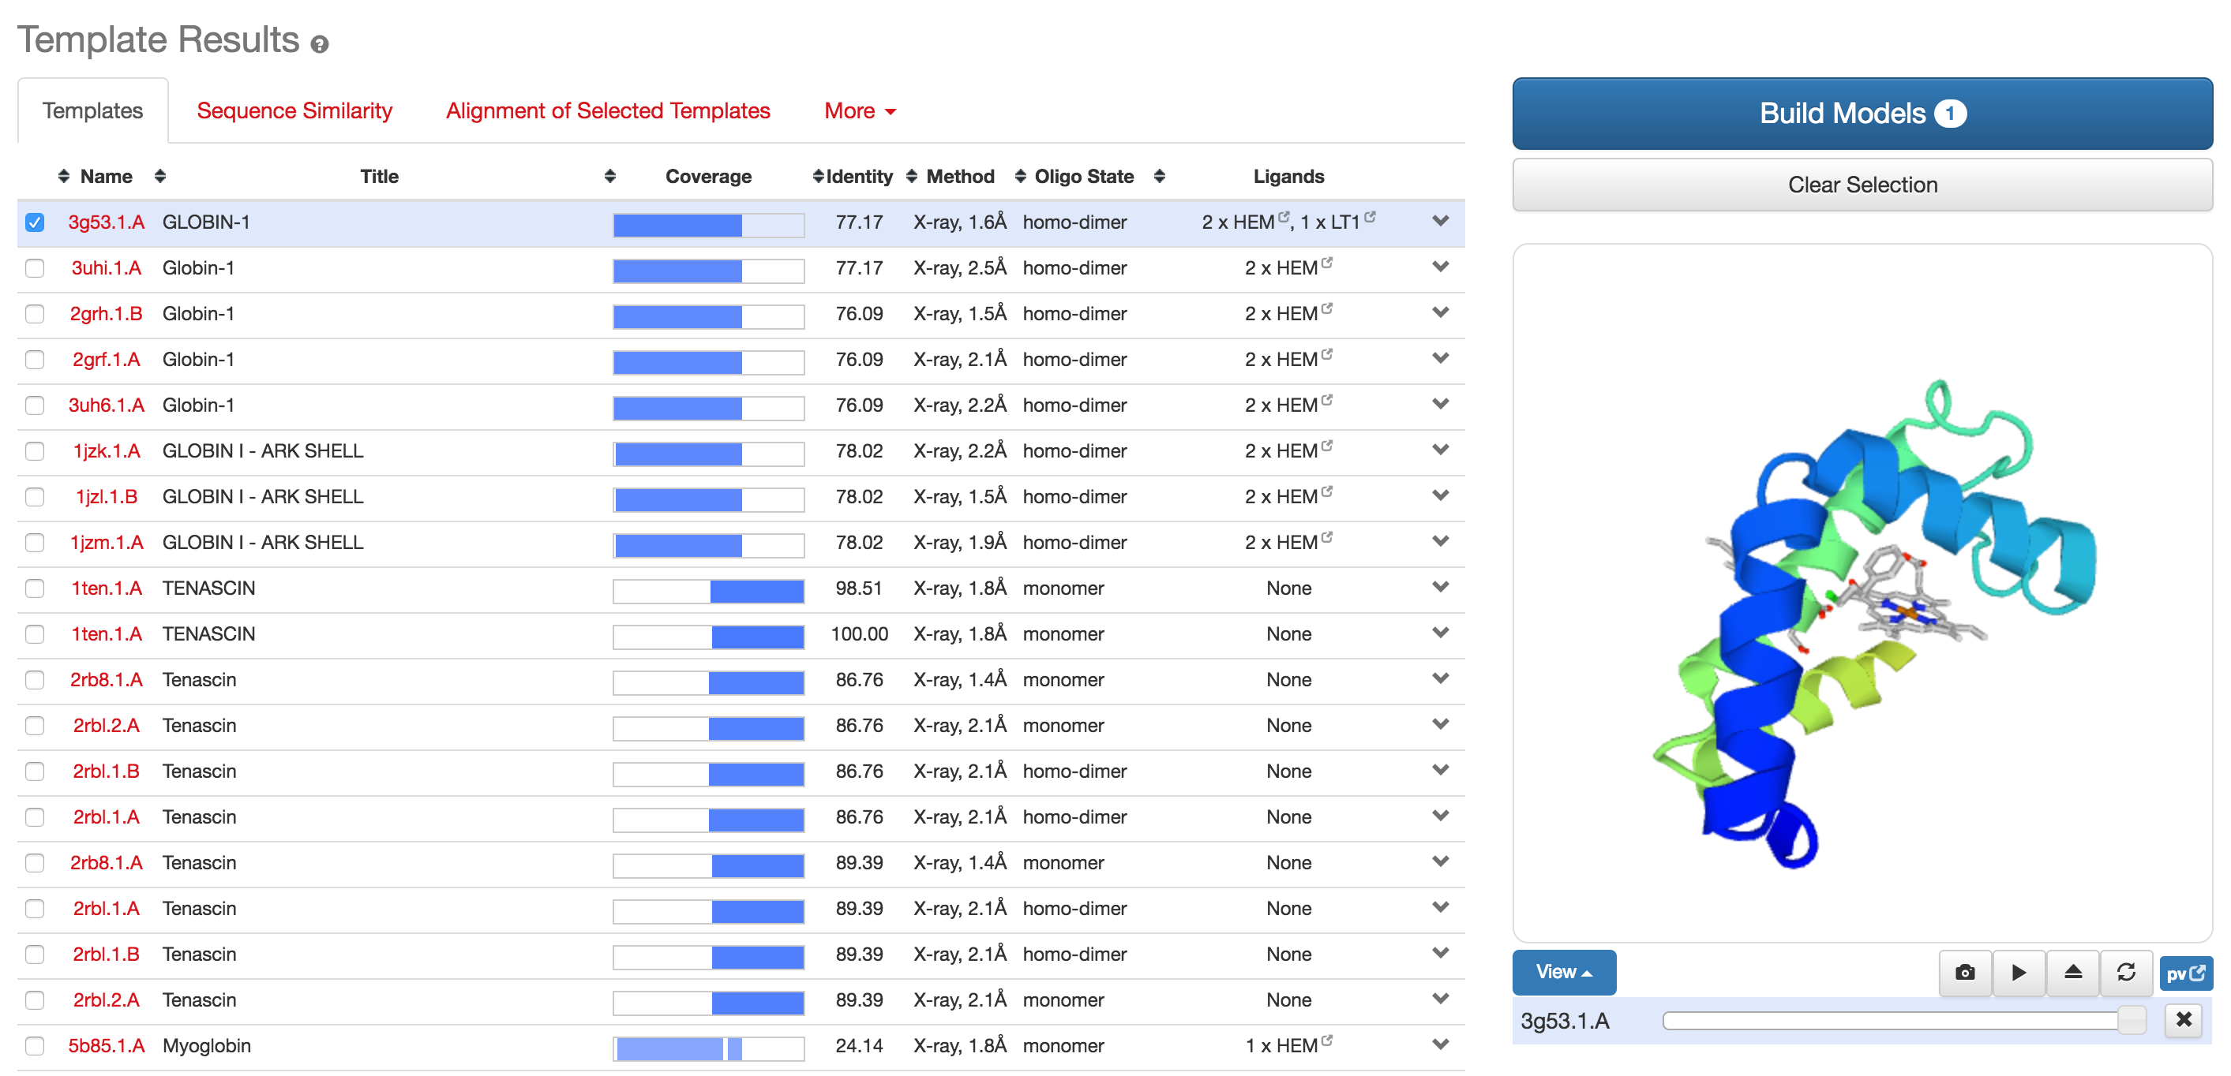
SwissModel

Slide 111
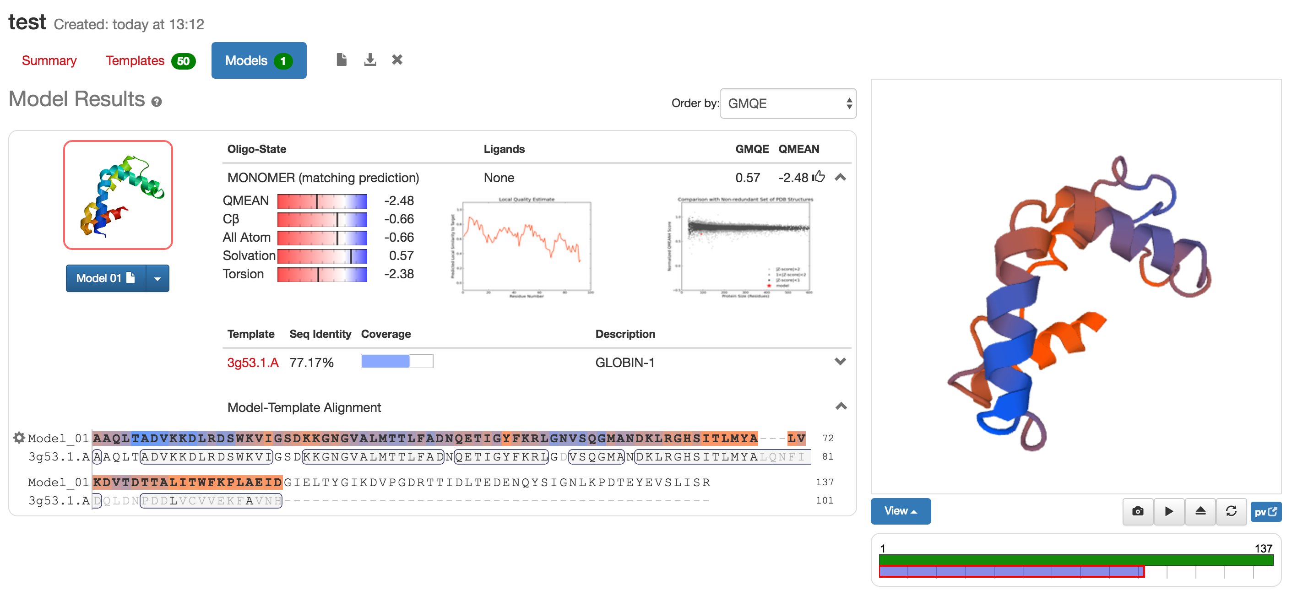
SwissModel

Slide 112
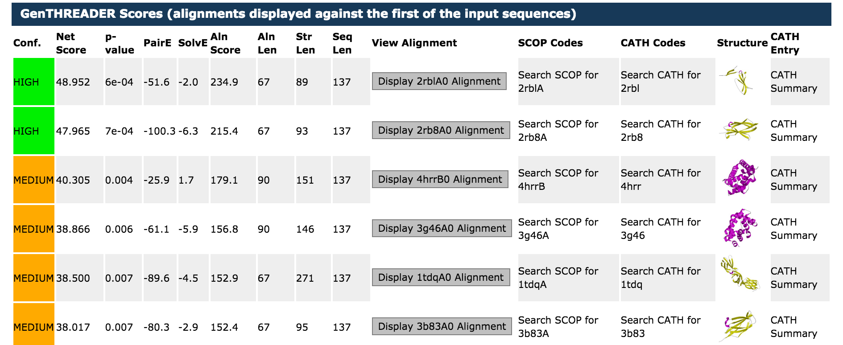
GenThreader

Slide 113
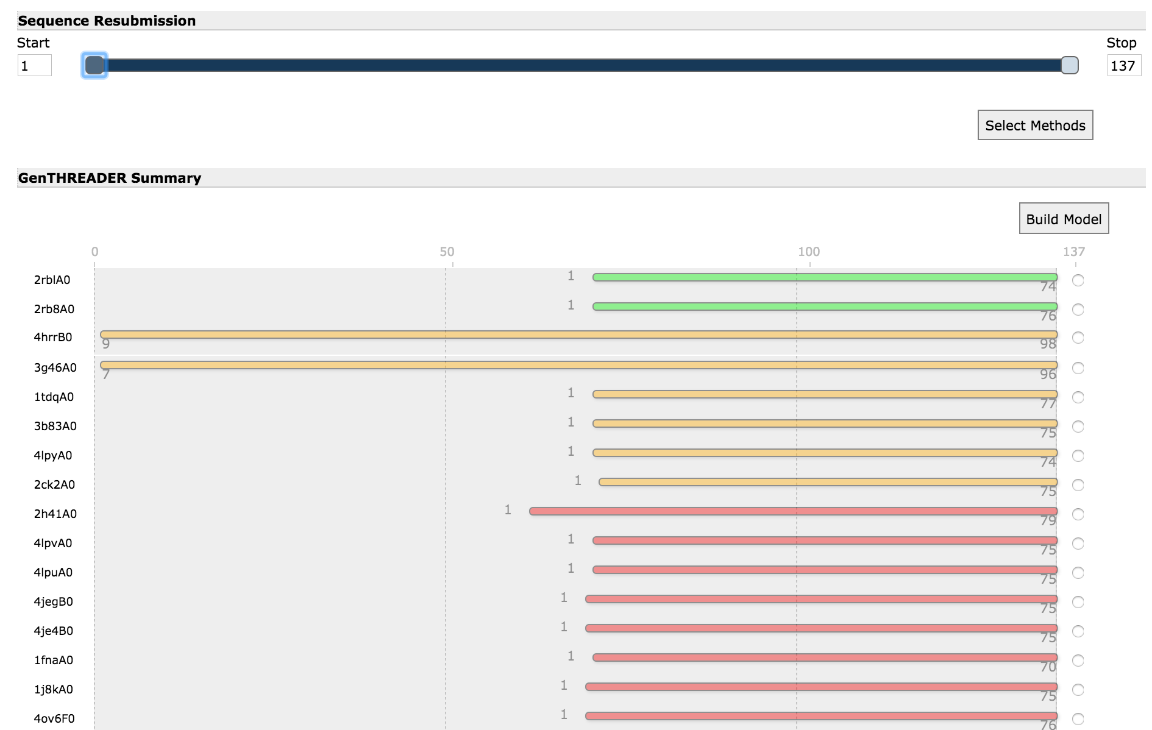
GenThreader

Slide 114
Hybrid alternatives
Robetta, i-TASSER

Slide 115
Alternative Resources
Robetta and i-Tasser: Consensus and Fragments
  Multiple independent HMM/profile-based systems to generate starting models. Wisdom of crowds approach.
  Model short (9 residues, Robetta) or longer (20 residues, i-TASSER) fragments of your protein
  Stitch together in millions of combinations and select using pseudo-energy functions
  Lots of clustering (thousands or 10’s of thousands of models produced)

Slide 116
Alternative Resources
Hybrid methods
 | Registration required? | Speed | Multiple jobs? | Multi- template? | Template-free modelling?
i-TASSER | Yes | SLOW | No | Yes | Yes
Robetta | Yes | SLOW | No | Yes | Yes
Phyre2 | No | Fast | Yes | Yes | Yes
SLOW = days to weeks (my recent test i-Tasser 2 days , Robetta 6 days)
Fast = minutes to hours

Slide 117
Alternative Resources
Large complex systems
Too much for this introductory talk
To get a feel for them….

Slide 118
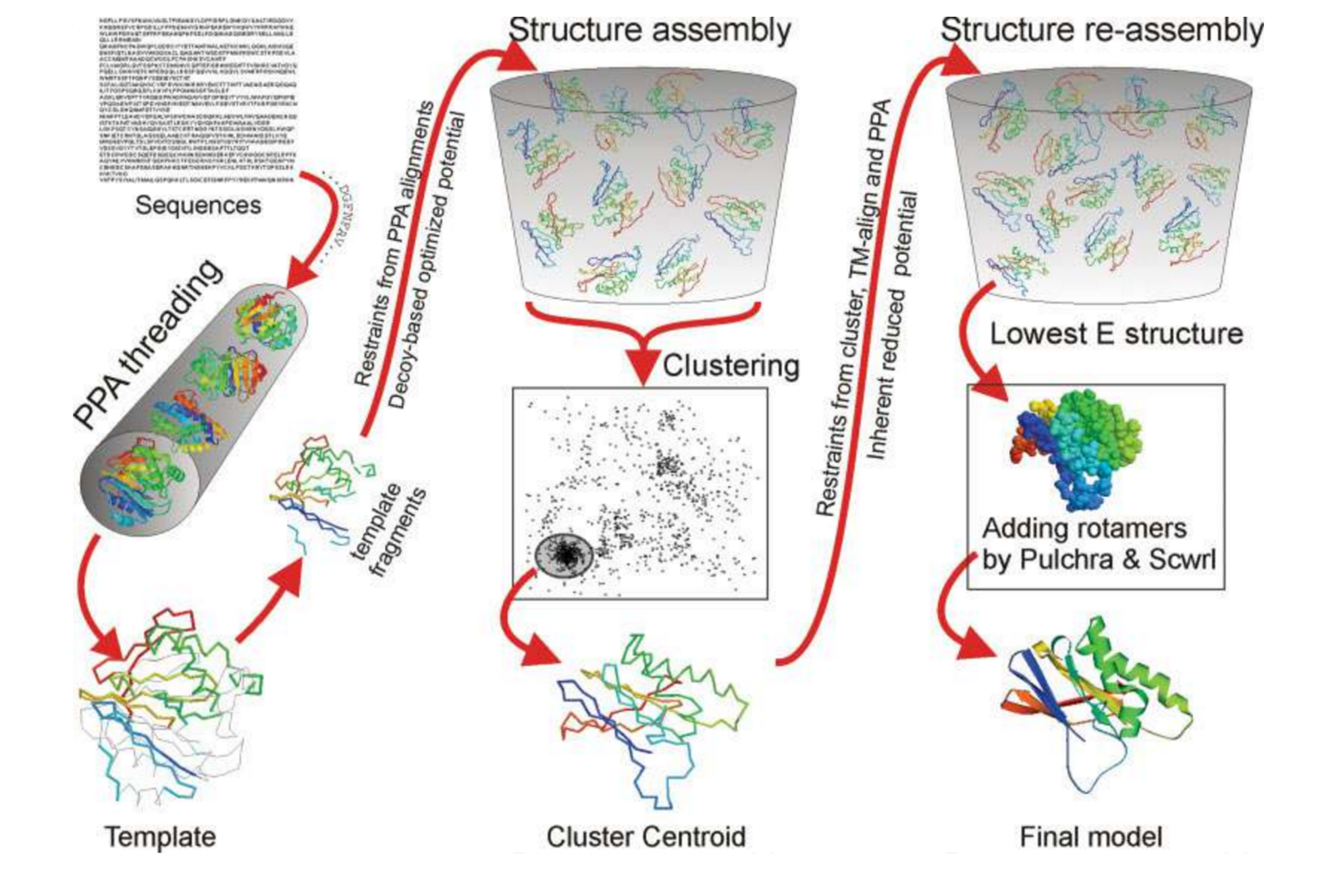
i-TASSER
This step alone uses 15 independent HMM/profile threading systems

Slide 119
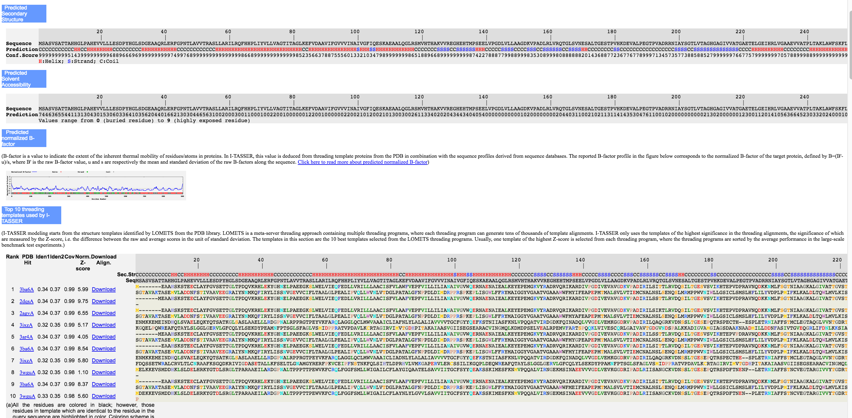
i-TASSER

Slide 120
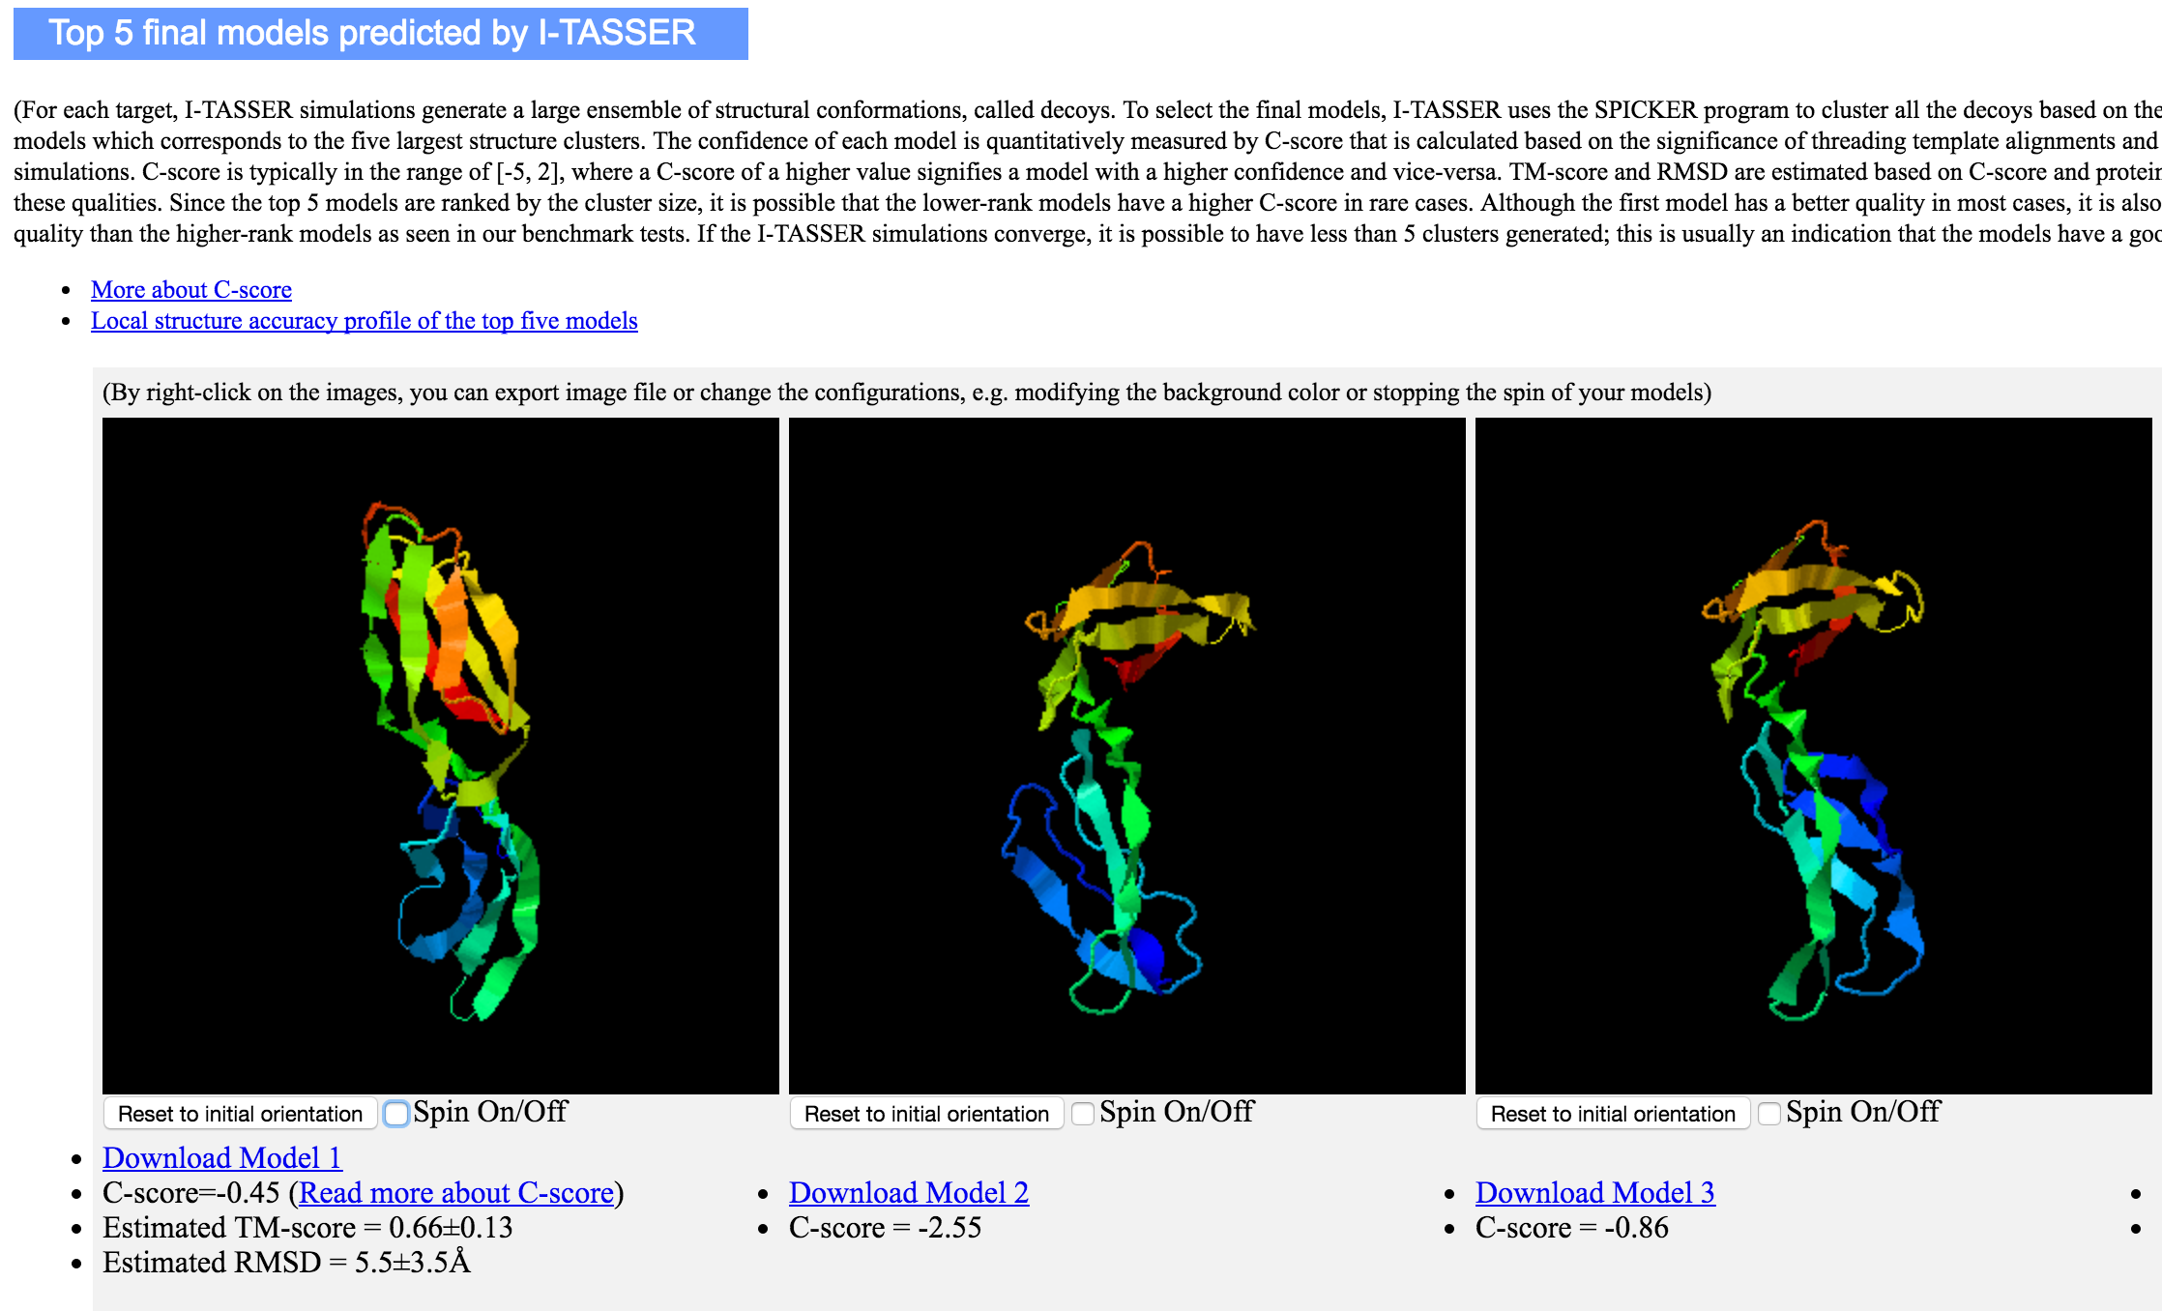
i-TASSER

Slide 121
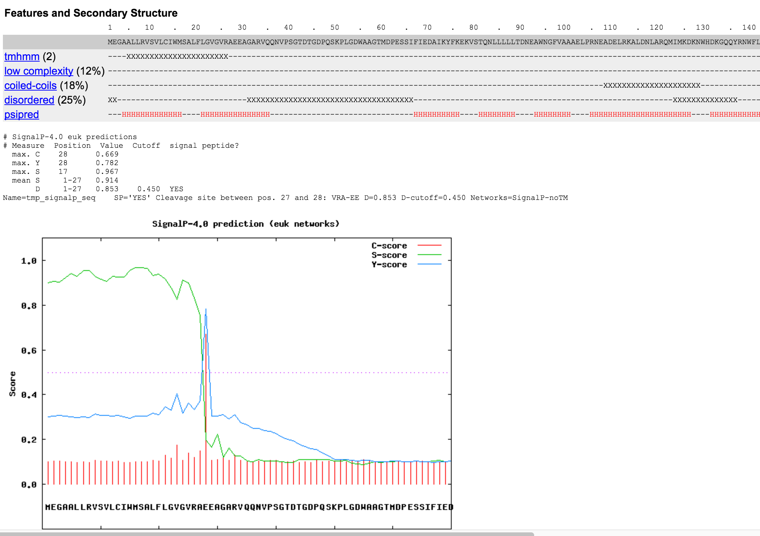
Robetta

Slide 122
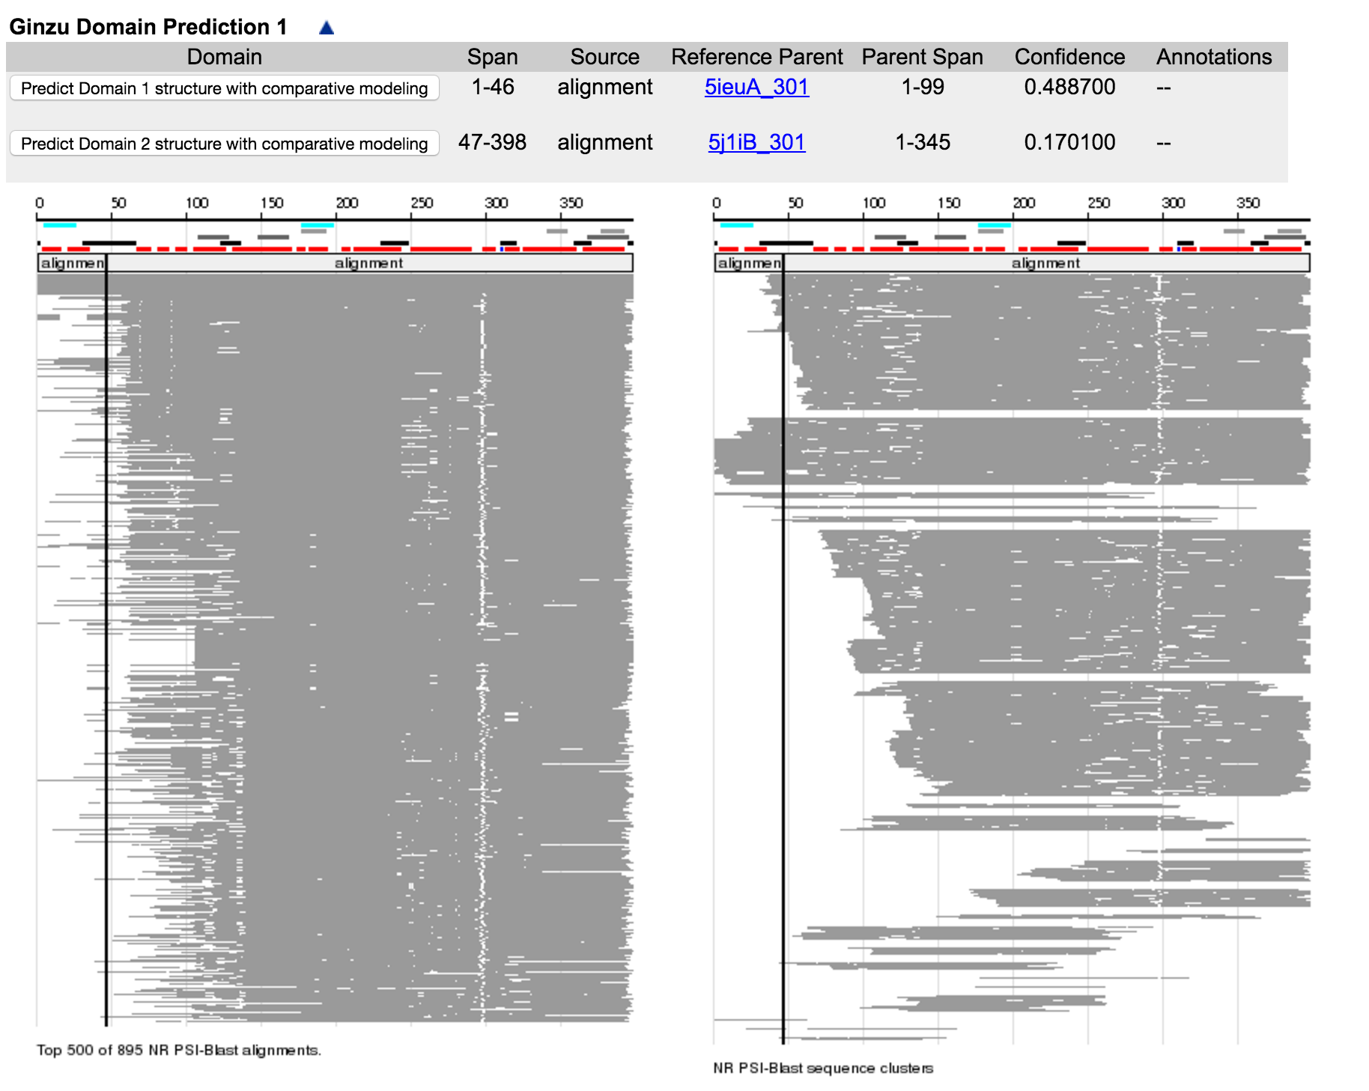
Robetta

Slide 123
Alternative Resources
SUMMARY
Always wise to try multiple resources
i-TASSER the regular ‘winner’ at CASP
For most modelling tasks, very little difference in quality between methods. Try the fast ones first.
For particularly hard problems, worth the wait for i-TASSER or Robetta, but still very difficult to know when to trust result.

Slide 124
Feedback welcome
Ease of use – what’s clear/unclear on the site?
Functionality – is there something you wish it could do that it doesn’t?
Contact:
  Twitter (@phyre2server)
  Google Groups (groups.google.com/group/phyre)
  Email (l.a.kelley@imperial.ac.uk)

Slide 125
Further information
The Phyre2 web portal for protein modelling, prediction
and analysis
Kelley et al., Nature Protocols 10, 845-858 (2015)
Detailed step by step tutorial and overview of the methods

