Slide 1
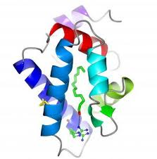
Phyre2: One to one threading
User structure
Extract sequence and
secondary structure information
PSI-Blast vs sequence database
HMM of
User structure
SVYDAAAQLTADVKKDLRDSWDLVCS…….
hmm-hmm matching
PSI-Blast vs sequence database
User sequence
HMM of
user
sequence
KLRGHSITLMYALQN
NPDSLDLVCS…….
Final model

